Slide 1

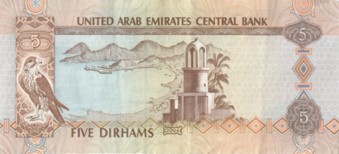
Task: You must create a mind map to answer the question
‘Is China’s one child policy fair?’
(Use success criteria to help you structure it)
Think Tax
Source of information | Cost
Your brain | 0 AED
Your classmate | 5 AED (per question)
Learning stations | 5 AED (per visit)
Miss Rachael | 25 AED (per question)
You have been given 50 Dirhams, you may use any of the above sources of information to help you with the mind map, however its going to cost you!
The objective is that you don’t get charged any think tax, so try and use your brain!
You can earn extra money by answering other people’s questions or expanding on their points.

