Slide 1




Tomorrow’s Teachers!
Student Planning Toolkit

Slide 2


Contents
Introduction p-g 3
How to question effectively p-g 4-5
Planning higher order thinking questions p-g 6
Starter/ Plenary ideas p-g 7-16
Observation Feedback Form p-g 17

Slide 3
Introduction-
Student Led learning
Congratulations you have been chosen to take part in a project in which students lead their own learning and you get to teach your class mates! We also want to challenge you in your learning.
You are going to be trained in using strategies that teachers use to assess what progress students are making in lessons.
You will also be taught how to question other people effectively. This will also improve your own higher order thinking skills.
Those who can…….TEACH!

Slide 4

Questioning strategies
Strategy/approach | Gains and benefits
Thinking Time: Consciously waiting for a pupil or class to think through an answer (before you break the silence) e.g 15-30secs | Ensures all pupils have a view or opinion to share
No Hands Questioning: Using the ‘no hands up’ rule | Improves engagement and challenges all pupils to think.
Basketball questioning: Move questions and discussions between pupils | Engages more pupils. Stops teacher being focus for all questioning.
Conscripts and Volunteers: Using a planned mix of ‘conscripts’ and ‘volunteers’ | Enhances engagement and challenge for all.
Phone a friend: Removes stress to enable those who cannot answer to participate | Encourages whole-class listening and participation

Slide 5
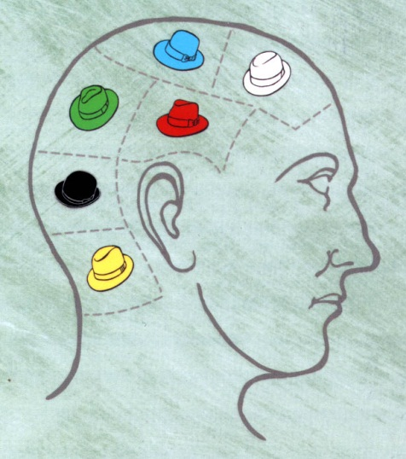
Hot-seating: | Encourages listening for detail and provides challenge
Preview: Previewing questions in advance | Signals the big concepts and learning of the lesson
Pair rehearsal: of an answer or a question | Encourages interaction, engagement and depth
5Ws: Modeling simple exploratory questions to gather information | Creates a thinking/self reflective approach to learning.

Slide 6

BLOOMS TAXONOMY
Competence | Skills Demonstrated | Question Cues:
Knowledge | observation and recall of information knowledge of dates, events, places knowledge of major ideas mastery of subject matter | list, define, tell, describe, identify, show, label, collect, examine, tabulate, quote, name, who, when, where, etc.
Comprehension (understanding) | understanding information grasp meaning translate knowledge into new context interpret facts, compare, contrast order, group, infer causes predict consequences | summarize, describe, interpret, contrast, predict, associate, distinguish, estimate, differentiate, discuss, extend
Application | use information use methods, concepts, theories in new situations solve problems using required skills or knowledge: | apply, demonstrate, calculate, complete, illustrate, show, solve, examine, modify, relate, change, classify, experiment, discover
Analysis | seeing patterns organization of parts recognition of hidden meanings identification of components | analyze, separate, order, explain, connect, classify, arrange, divide, compare, select, explain, infer
Synthesis | use old ideas to create new ones generalize from given facts relate knowledge from several areas predict, draw conclusions | combine, integrate, modify, rearrange, substitute, plan, create, design, invent, what if?, compose, formulate, prepare, generalize, rewrite
Evaluation | compare and discriminate between ideas assess value of theories, presentations make choices based on reasoned argument verify value of evidence recognize subjectivity | assess, decide, rank, grade, test, measure, recommend, convince, select, judge, explain, discriminate, support, conclude, compare, summarize

Slide 7
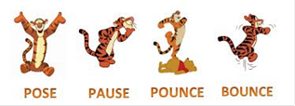
PPPB
Question the other students using the technique: Pose, Pause, Pounce, Bounce
Pose: Ask a challenging question
Pause: Give the students some thinking time (around 10 seconds)
Pounce: Target a student with the question
Bounce: Bounce the question to other students
Some good bouncing phrases:
_________would you agree with _______ answer?
Can you explain __________ answer further?
What is your opinion __________?

Slide 8
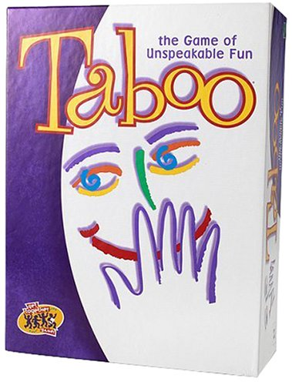
Taboo
Students have to describe a key word without using that word (it is taboo!).
(could do it in teams, pairs, whole-class)

Slide 9
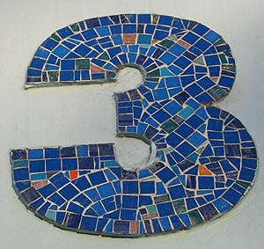
Tell me three things...
you have learnt today
you have done well
the group has done well
you would like to find out more about
you know now that you didn’t know 50 minutes ago

Slide 10



5 – 5 – 1
Summarise today’s topic in 5 sentences.
Reduce to 5 words.
Now to 1 word.
(with as many variations as there are numbers!)

Slide 11
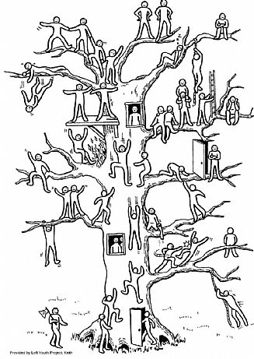
Evaluation
Tree
Ask students where they feel they are on the tree in relation to the lesson or topic.
Can be used repeatedly to articulate progress/problems.
Could print out on A3/A2 and get students to put post-it notes on with their name. Could then pair up strong and weaker students etc.

Slide 12

Beat the Teacher
Your task is to try and beat the teacher!
Come up with questions based around your learning today and see if the teacher can answer them.
Develop by: - snowballing
- writing questions on pieces of paper and placing in a box.
One student (sensible) then sits opposite the teacher at the front of the class and pulls out questions to ask a la Mastermind.

Slide 13


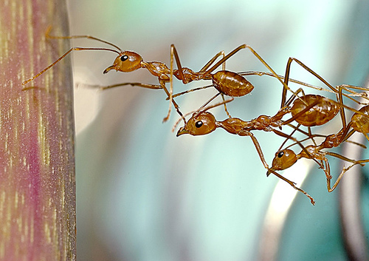


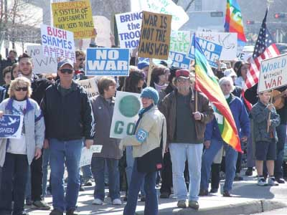
PLTS
Pick one of the skills and explain how you have used it today…
Pick one of the skills and explain how you have improved it today…
3) Pick one of the skills and explain how you will aim to use it or improve it next time…
Independent Enquirer
Creative Thinker
Team Worker
Reflective Learner
Self Manager
Effective Participator

Slide 14

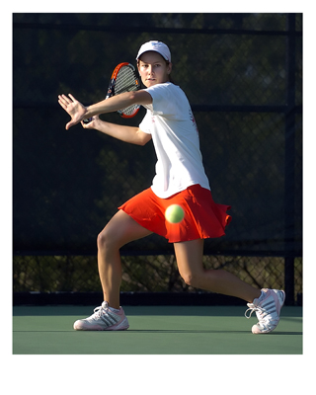
Question Tennis
Arrange the class in two rows facing each other. The first student asks the student opposite a question about the lesson. If they get it right the person sat next to them gets to ask a question of the student opposite. If they get it wrong, the first team continue asking the questions.
A1 asks B1.
If B1 gets it right, then B2 asks A2.
If B1 gets it wrong, then A2 asks B2.
Etc.

Slide 15
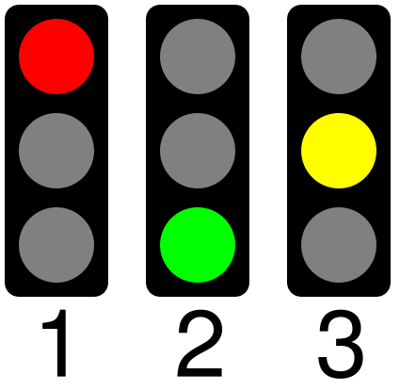
Objective Traffic Lights
How do you feel about the lesson objectives?
Red = don’t think I have grasped this
Amber = feeling OK about this, have just about got there
Green = Confident I have achieved this
Develop through AfL tools i.e. hand out traffic light cards that students show visibly, use coloured pens for students to indicate on their work how they have assessed themselves, have a class count of red/amber/green and then pair up greens with reds and ambers to try and improve the spread

Slide 16
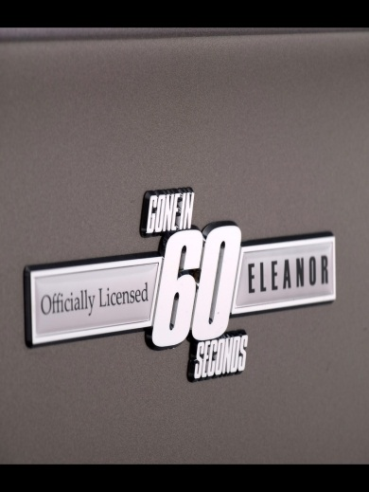
60 Seconds
Timer on board –
http://classtools.net/main_area/template_loader.php/?timer
Set students the challenge of summing up the lesson in sixty seconds.
Students then read out their summations until a really full picture is presented to the class.

Slide 17
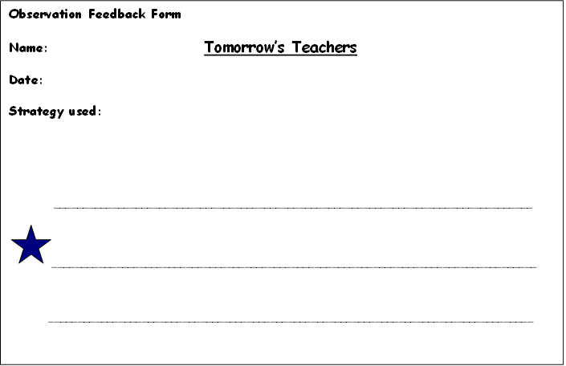

Your teacher will regularly give you feedback, so you can see what you are doing well and what you need to do to improve next time
Observation Feedback Form
Name: Tomorrow’s Teachers
Date:
Strategy used:
__________________________________________________________________________________
___________________________________________________________________________________
___________________________________________________________________________________

