Slide 1

twitter
@Dubai_Teachmeet

Slide 2



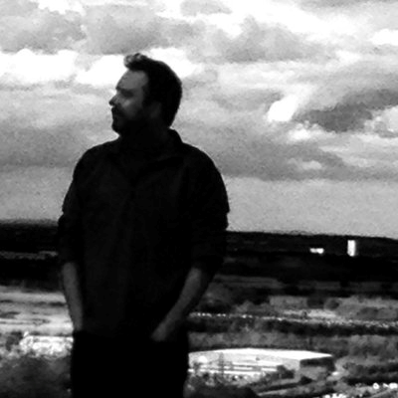
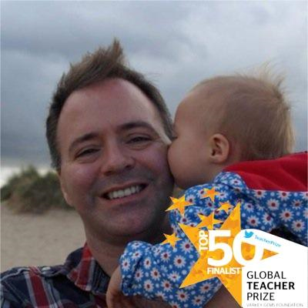
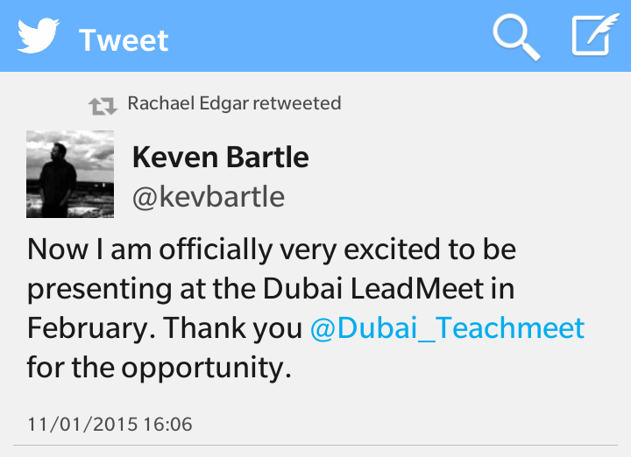

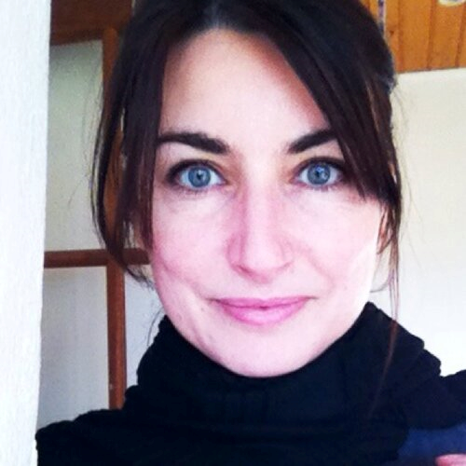



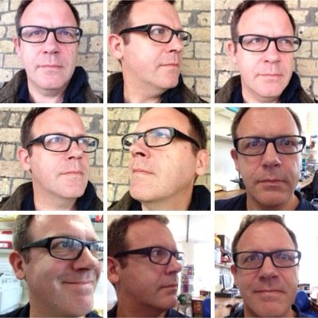
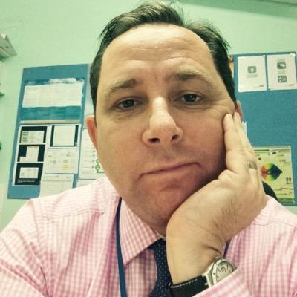

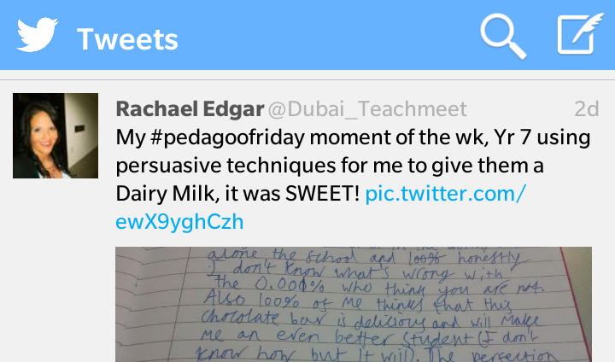
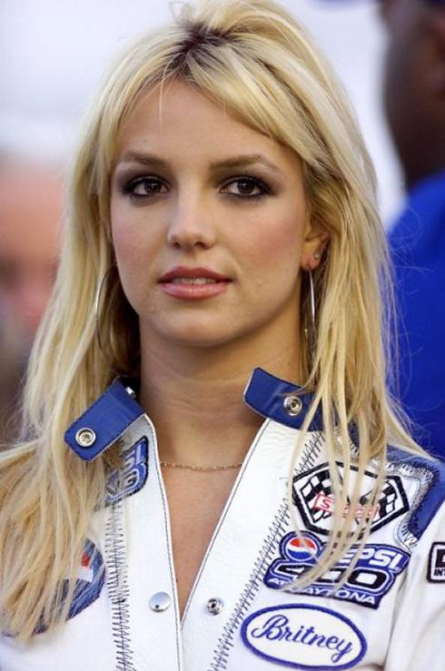
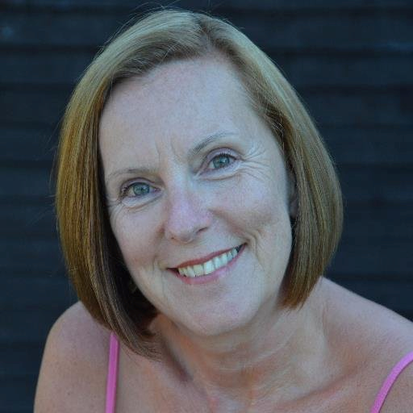


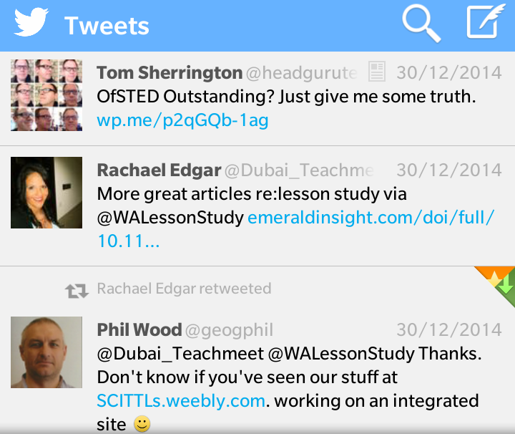
@Dubai_Teachmeet

Slide 3
Personal
CPD
Learning
Network
Resources
Ideas
Inspiration
Engage
Help
@Dubai_Teachmeet

Slide 4
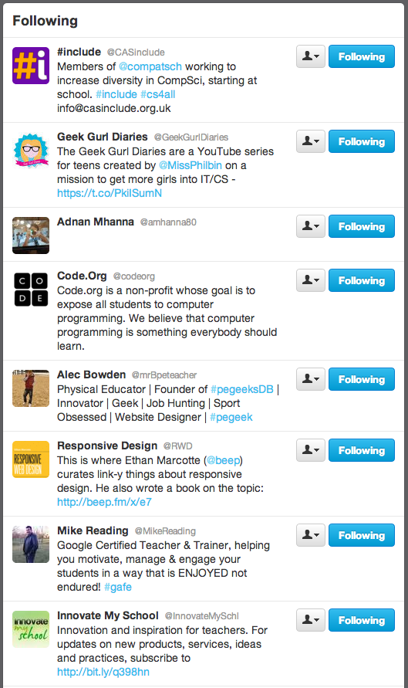
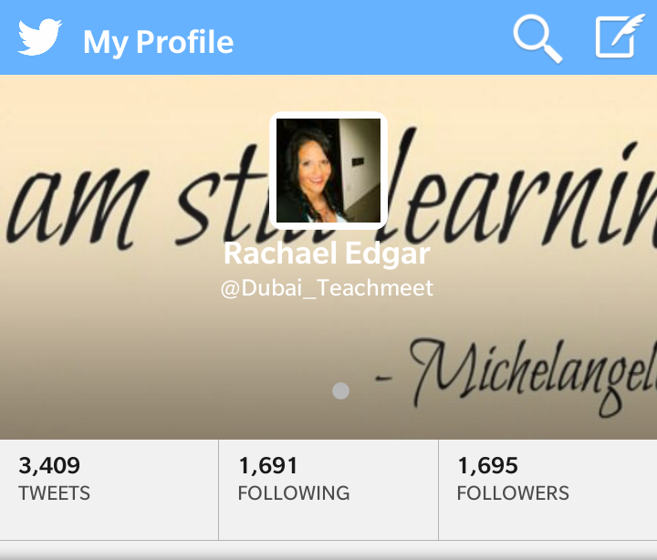
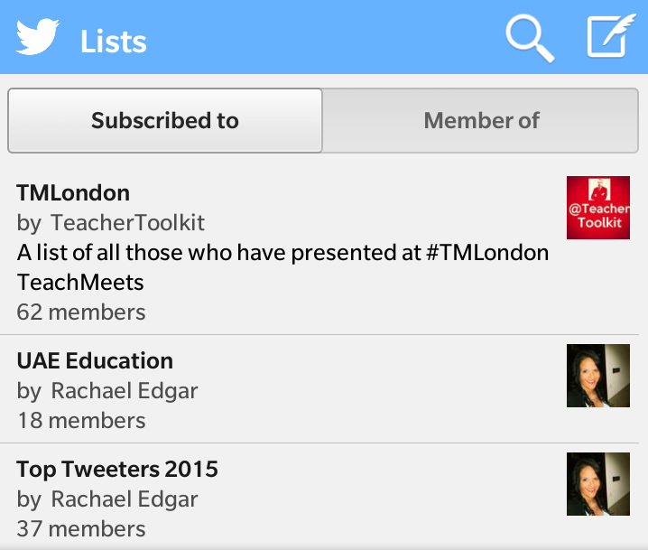
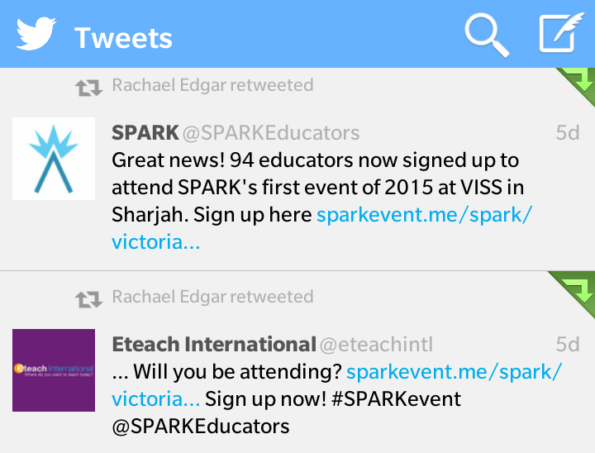
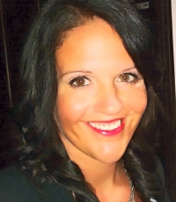



Where to start...
Sign Up - www.twitter.com
Get your Twitter Handle (username e.g. @Dubai_Teachmeet)
Follow me @SPARKEducators or @Dubai_Teachmeet
#
@
See who we follow
Follow them
See what's trending (follow the #hashtags #SPARKevent #UKedchat)
Write some interesting or useful tweets
Get followed by others
Build up a PLN
Get free CPD
@Dubai_Teachmeet

Slide 5
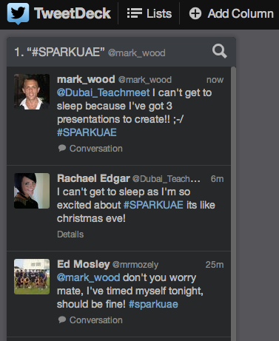




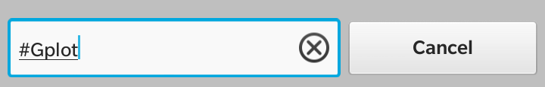

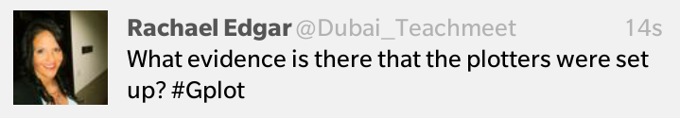
Twitter in the classroom
Use it for: Q&A
Use it for: Back-Channelling
Access: Tweetdeck (www.tweetdeck.twitter.com)
Add a column
Search for a Hashtag
Verbally/written share a hashtag with students e.g. #Gplot
Ask your questions / Present your content
Make sure that in each of their tweets students use the hashtag
Tweetdeck will do the rest
@Dubai_Teachmeet

Slide 6
twitter
#SPARKevent
@Dubai_Teachmeet

