Slide 1
LOL 2
Community leaders

Slide 2
New structure
WOW within your department
HOY/HOD to pair people up.
Can be X groups

Slide 3

Feedback
Rally coach
Rally Robin
Timed pair share
Round robin

Slide 4
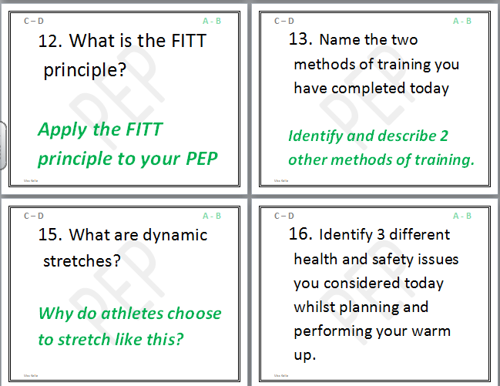
G&T Q&A

Slide 5
Student roles Secondary
Everyone is in charge of something. It
Encourages independence
Group work
Communication
Differentiation by task/outcome
Independent learning
Pupils initiate discussions
Independently reflect on learning …….

Slide 6


OFFICIAL
Emotion
Feeler
OFFICIAL
“Why?”
Questioner
OFFICIAL
Chief
Umpire
OFFICIAL
Match
Referee
OFFICIAL
Devil’s
Advocate
OFFICIAL
Information Seeker

Slide 7





JOB DESCRIPTION Your role involves: Listening to information. Asking “Why?” to seek more. For example: Why are we learning this? Why is this important? |  | JOB DESCRIPTION Your role involves: Having a reaction! Giving an opinion based on your feelings. For example: I like it because… I don’t like it because…
JOB DESCRIPTION Your role involves: Reminding everyone of his/her role. Encouraging harmony during group work. For example: Can we check your job description, please! |  | JOB DESCRIPTION Your role involves: Alerting everyone to reasoning behind the task/activity. Getting discussions back on track if necessary. For example: What have you decided to do and why?
JOB DESCRIPTION Your role involves: Seeking information from additional resources. Ensuring that FACTS are correct through evidence. For example: Make notes, look in books, search on the Internet, ask! |  | JOB DESCRIPTION Your role involves: Critical (although NOT negative) voice. Spotting possible pitfalls or problems. For example: How do we know that this is the best way? Is there another?

Slide 8
OFFICIAL
Creativity
Sparkler
OFFICIAL
“What if?”
Inquisitor
OFFICIAL
Spelling
Checker
OFFICIAL
“YES!”
Campaigner
OFFICIAL
Grammar
Police
OFFICIAL
Numeracy
Spotter

Slide 9



JOB DESCRIPTION Your role involves: Practising your creativity. Coming up with alternative solutions. For example: Make and KEEP quick sketches of at least 3 different ideas before choosing a final outcome. |  | JOB DESCRIPTION Your role involves: Encouraging creativity in others by supporting them in coming up with alternatives. Leading whole-class discussions. For example: Volunteer your ideas!
JOB DESCRIPTION Your role involves: Always taking a POSITIVE view. Encouraging others to forge ahead with their work. For example: This looks really good because…This is really interesting because…I am pleased with… |  | JOB DESCRIPTION Your role involves: Checking all spelling on the board. Supporting students with spellings. For example: Using your skills/ knowledge to help others. Using a Dictionary. Using ICT spelling support. LAST RESORT: Asking a TA/Teacher.
JOB DESCRIPTION Your role involves: Pointing out when MATHS is used. Supporting students with MATHS. For example: For example: Using your skills/ knowledge to help others. Using ICT numeracy support. LAST RESORT: Asking a Teaching Assistant/Teacher. |  | JOB DESCRIPTION Your role involves: Checking grammar on the board. Supporting students with grammar. For example: Using your skills/ knowledge to help others. Using ICT grammar support. LAST RESORT: Asking a TA/Teacher.

Slide 10


OFFICIAL
Quality
Assurance
OFFICIAL
Cheer
Leader
OFFICIAL
Quality
Control
OFFICIAL
ICT
Monitor
OFFICIAL
“How?”
Examiner
OFFICIAL
Skills
Tracker

Slide 11
JOB DESCRIPTION Your role involves: Supporting individuals and groups of students with encouraging words. For example: Are you pleased with what you are doing? I think you are working really well BECAUSE… |  | JOB DESCRIPTION Your role involves: Reminding students to refer to their individual targets. Asking what has to be done for succeeding at each level. For example: Point out the success criteria for each different level.
JOB DESCRIPTION Your role involves: Finding out how ICT is to be used. Supporting students with use of ICT. For example: Using your skills/ knowledge to help others. LAST RESORT: Asking a TA/Teacher. |  | JOB DESCRIPTION Your role involves: Checking students’ work/methods against their individual targets. Providing critical feedback. For example: Use the success criteria for the different levels to support student progress.
JOB DESCRIPTION Your role involves: Recording the skills being used – new and old. Reporting on student progress. For example: Drawing attention to individuals who have made progress with their skills. |  | JOB DESCRIPTION Your role involves: Asking questions about the methods used/to be used. Sharing information from students showing particular prowess. For example: How did you do that? How do I do that?

Slide 12
OFFICIAL
Positive
Thinker
OFFICIAL
Progress
Checker
OFFICIAL
Kit
Manager
OFFICIAL
Resource
Manager
OFFICIAL
Critical
Challenger
OFFICIAL
Knowledge
Hunter

Slide 13

JOB DESCRIPTION Your role involves: Monitoring the progress of groups. Sharing this information with the class. For example: X number of boys/girls on Level 2/3/4 etc. have made progress with their Drawing skills today. |  | JOB DESCRIPTION Your role involves: Working out the benefits of the work being undertaken. Pointing out the value of the lesson content. For example: This is really useful because…
JOB DESCRIPTION Your role involves: Checking that students are taking responsibility for class resources. Showing others where things belong. For example: Letting the Teacher know if something is/is not done. |  | JOB DESCRIPTION Your role involves: Reminding students that they are responsible for their table kits. Checking the content of the kits for missing/broken items. For example: Reporting missing/broken items to the Teacher.
JOB DESCRIPTION Your role involves: Adding extra USEFUL facts to those provided by the teacher Finding out answers to students’ questions For example: Going on the Internet to find out more about skills/knowledge. |  | JOB DESCRIPTION Your role involves: Taking a CRITICAL view of the lesson content. Encouraging others to think about the consequences of their actions. For example: What is the value in this?

Slide 14
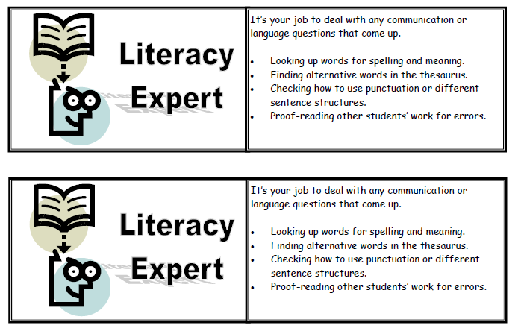
Student roles: primary

Slide 15
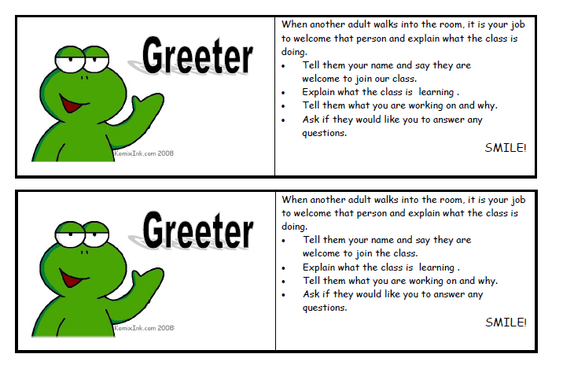

Slide 16
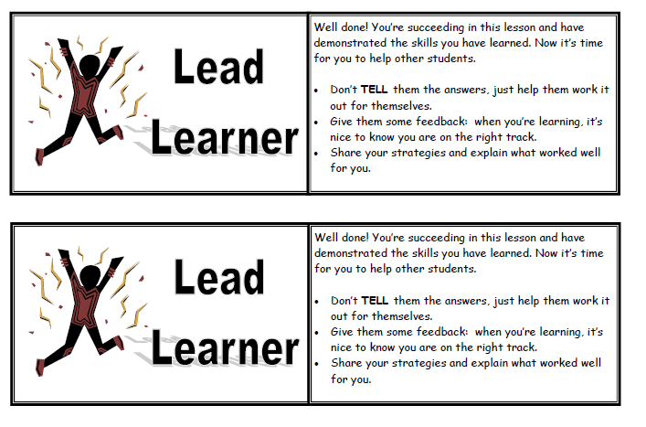

Slide 17
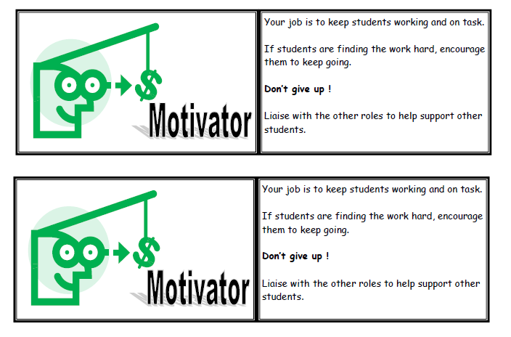

Slide 18


Another example for primary….
Top teachers
Teacher of the Day
Students getting involved in Student Council

Slide 19

Power Teaching –develops leadership skills in students by training them to lead class discussions.

Slide 20
Idea 3: Lesson STUDY
Get into groups of 3 (in your department)
Plan a lesson to address an area of need
1 teacher delivers the lesson the other 2 observe
Particular attention on 3 students progress and attainment in the lesson
All 3 discuss what went well (WWW) and Even better if (EBI)
Re-plan lesson and all observe again

