Slide 1


Leaders of Learning (LoL)
Teaching and Learning Hubs 2013-2014
Monday 16th September 2013

Slide 2
T&L Hubs- The set up
There are 5 calendared Teaching and Learning meetings this academic year. These involve all staff, grouped into hubs, cross curricular and cross phase who meet regarding a specific area of pedagogy.
The idea behind this is that CPD is more valuable if concentrated on one area of specific practice that is revisited over a longer period of time.
There is also the opportunity for staff to engage in action based research with their colleagues at SRS and also across partnership schools.
This work will be disseminated through department meetings and spotlight briefing sessions throughout the year.

Slide 3
Dates
Hub Meeting One | Monday 16th September | 3.15pm-4.15pm | WOW wk 22/9- 3/10
Hub Meeting Two | Monday 11th November | 3.15pm-4.15pm | WOW wk 17/11- 28/11
Hub Meeting Three | Monday 10th February | 3.15pm-4.15pm | WOW wk 16/2- 27/2
Hub Meeting Four | Monday 21st April | 3.15pm-4.15pm | WOW wk 27/4- 8/5
Hub Meeting Five | Monday 26th May | 3.15pm-4.15pm | WOW wk 1/5- 12/5

Slide 4
1st WoW week: 22nd September – 3rd October
Everyone to buddy up with someone else by the end of the meeting. Please make sure you buddy up with someone from a different department/phase.
During WoW weeks you are required to carry out a peer observation which demonstrates a strategy that we have suggested you trial (see SRS Peer Observation proforma).

Slide 5
Strategy………..John
One minute – in your groups, define: ‘Enquiry Based Learning’

Slide 6
‘Enquiry Based Learning’: Investigating questions, scenarios or problems. It is open-ended, student-centred, hands on.

Slide 7
Inquiry places students' questions and ideas, rather than solely those of the teacher, at the centre of the learning experience.

Slide 8

WARNING
Enquiry based learning is not the same as Problem solving.

Slide 9
What is Enquiry based learning?
The steps for EBL are as follows:
Ask questions
Explore by observing and investigating
Analyse and describe findings
Communicate and share by writing and discussing
Reflect on what has been learned

Slide 10

Why…..

Slide 11
…. should we incorporate enquiry based learning?
Children develop research skills
It is a more self directed learning path
Pupils work on their presentation skills
Working in teams
Encourages curiosity in a topic
As a teacher you can grab the children’s interest / the children are guided by their own interests.

Slide 12
Enquiry based learning strategies
There are various strategies for enquiry based learning, for example:
The 5 E’s
  Engagement
  Exploration
  Explanation
  Elaboration
  Evaluation
Guided discovery
Set your LO/WALT as a question
7 monkeys of independent learning
Pupils creating their own success criteria based on their findings/investigation

Slide 13
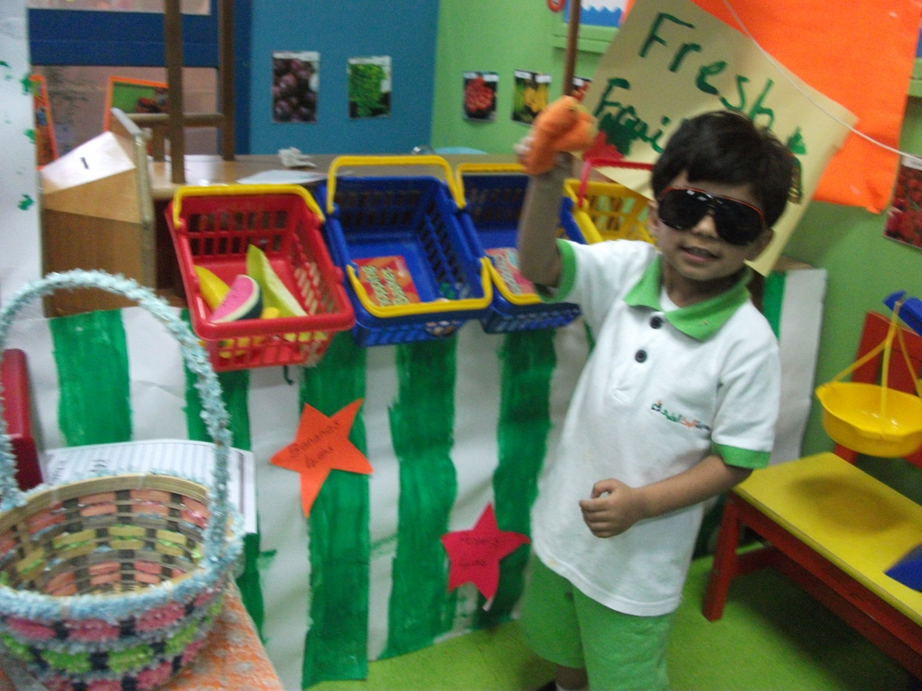
Strategy………..Joy
In the Early Years we focus our day on a strategy on PDR!
This is where children plan, do and review what they have been doing during the day.

Slide 14
Strategy………..Jo
Guided discovery in PE/pupils success criteria
Athletics: Sprinting lesson KS2/KS3
Intro: Lesson objection question set (WALT), no success criteria outlined, pupils to investigate this during the lesson/question in their sock task
Starter: Sprint using own technique for 3 sec, mark where they stop
Main: Pupils given various drills for each element to carryout and to identify the best technique to use. Pupils to discuss in their groups and provide detailed answers and examples.
Peer assess throughout
Plenary: Sprint using improved technique for sec, mark where they stop again.
Reasons for improvements
Pupils discuss and inform teacher of the success criteria
Level their performance/evaluate
Q&A
Cool down

Slide 15
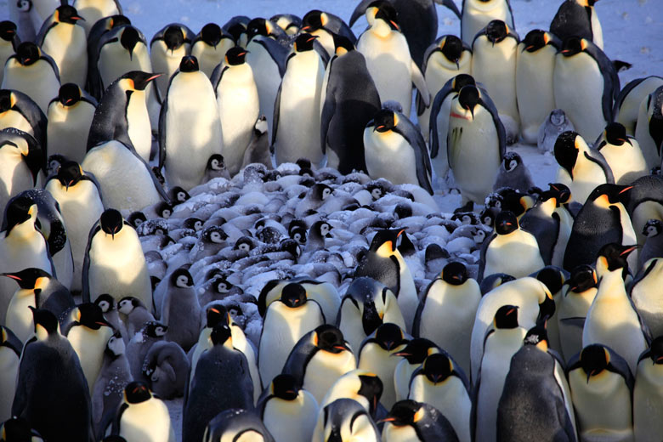
Strategy………..John
Guided discovery in Science/pupils success criteria
Yr 7: Science: Investigating why penguins huddle?
Intro: Lesson objection question set. No success criteria outlined, pupils to investigate this during the lesson.

Slide 16

Strategy………..John
Students shown equipment. In groups they come up with ways to investigate question:
Why do penguins huddle?

Slide 17
Strategy………..John
Success Criteria (e.g.):
Relate experiment to penguins huddling
Identify equipment needed
Explain why the selected equipment has been chosen

Slide 18
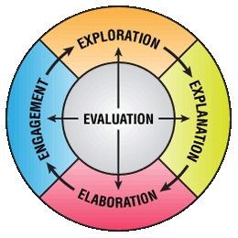
The 5 E Learning Cycle Model (Bobbie)
The 5 E’s represent five stages of a sequence of teaching and learning.
An enquiry based approach to learning.

Slide 19
Engagement
Mentally engage the students with an event or question. Engagement activities help students to make connections with what they know and can do.
What the Teacher Does
Creates interest
Generates curiosity
Raises questions
Elicits responses that uncover what the students know or think about the concept/topic
What the Student Does
Asks questions, such as Why did this happen? What do I already know about this? What can I find out about this?
Shows interest in the topic

Slide 20
Exploration (Investigation)
Students work with one another to explore ideas through hands-on activities. Under the guidance of the teacher, students clarify their own understanding of major concepts and skills.
What the Teacher Does
Encourages the students to work together without direct instruction from the teacher
Observes and listens to the students as they interact
Asks probing questions to redirect the students’ investigation when necessary
Provides time for students to puzzle through problems
What the Student Does
Tests predictions and hypothesis
Forms new predictions and hypotheses
Tries alternatives and discusses them with others
Records observations and ideas

Slide 21
Explanation
Students explain their understanding of the concepts and processes they are learning. Teachers clarify students’ understanding and introduce new concepts and skills.
What the Teacher Does
Encourages the students to explain concepts and definitions in their own words
Asks for justification (evidence) and clarification from students
Uses students’ previous experiences as the basis for explaining concepts
What the Student Does
Explains possible solutions or answers to others
Questions one another’s explanations
Listens to and tries to comprehend explanations the teacher offers
Uses recorded observation in explanations

Slide 22
Elaboration
These lessons challenge students to apply what they have learned and build on the students’ understanding of concepts to extend their knowledge and skills.
What the Teacher Does
Encourages the students to apply or extend the concepts and skills in new situations
Reminds the students of alternative explanations
Refers the students to existing data and evidence and asks: What do you already know? Why do you think…?
What the Student Does
Uses previous information to ask questions, propose solutions, make decisions, design experiments
Draws reasonable conclusions from evidence
Records observations and explanations
Checks for understanding among peers

Slide 23
Evaluation
Students assess their own knowledge, skills, and abilities. These lessons allow teachers to evaluate students’ progress.
What the Teacher Does
Accesses students’ knowledge and/or skills
Looks for evidence that the students have changed their thinking or behaviors
Asks open-minded questions, such as Why do you think…? What evidence do you have? What do you know about it? How would you explain it?
What the Student Does
Answers open-ended questions by using observations, evidence, and previously accepted explanations
Demonstrates an understanding or knowledge of the concept or skill
Evaluates his or her own progress and knowledge
Asks related questions that would encourage future investigations

Slide 24
Task: In a group come up with your own strategies/ideas
(10 min)

Slide 25
Reminder
1st WoW week 22nd September – 3rd October
QUESTIONS???

Slide 26
Enquiry based leaders
The challenges and realities of enquiry based learning
mantle of the expert (mantleoftheexpert.com Dorothey Heathcote)
Independence v independent learning (David Didau)
Promoting independence (Newlands T&L this is fab!)
Great teaching happens in cycles (David Didau)
Stage 1: Explaining (David Didau)
Stage 2: Model (David Didau)
Stage 3: Scaffold (David Didau)
Stage 4: Practice (David Didau)
20 ways to promote independence (From good to outstanding.com)
Developing independent learners: The 7 monkeys (Shaun Allison)
Independence strategies/ ideas (Amjad Ali)
The school promotes itself as one which fosters enquiry based learning. So this group will focus on strategies developing our students as independent learners.

