Slide 1
An example of an ‘outstanding’ Maths lesson at SRS
Used during Inspection week 2013

Slide 2
Background: Challenge activities in Maths- progress?
“Outstanding progress leads to outstanding lessons.”
Have all the children made progress in your lesson? Have you pushed them enough?
An outstanding lesson is not achieved the children ‘fly through’ the work without mistakes or challenge.
During Maths in year 1 we made challenge boxes so that the children could choose from more than 1 activity.

Slide 3
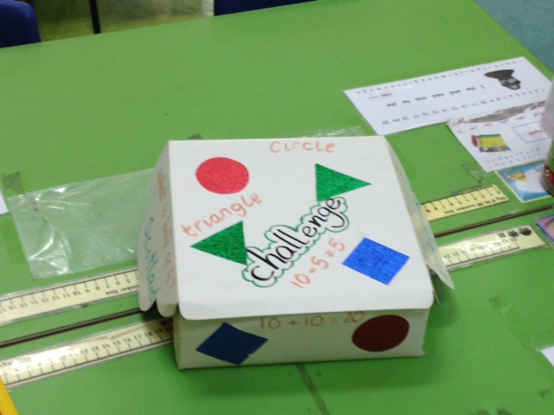
The challenge box goes on each group table.

Slide 4
The positives are:
1: children feel empowered as they think they are getting a choice in their own learning.
2. All activities are challenging enough to push for outstanding progress.

Slide 5
Things to ensure:
1. children will almost always choose the challenge and the teacher should subtly push them in this direction. (Feel free to hint.)
2. In the event that they don’t choose the challenge then the alternative work should be challenging enough so as not to infringe on the child’s progress.

Slide 6
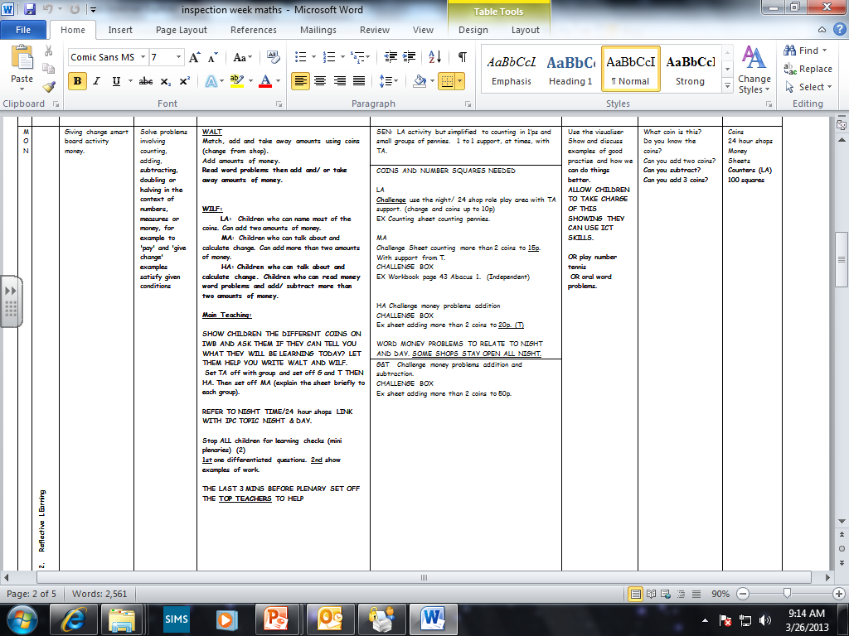

Slide 7
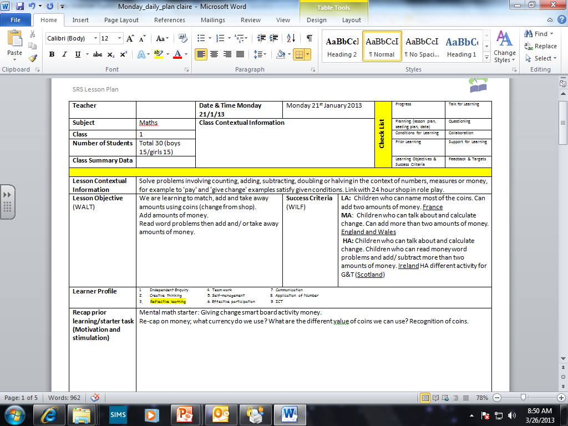
The Individual lesson plan

Slide 8
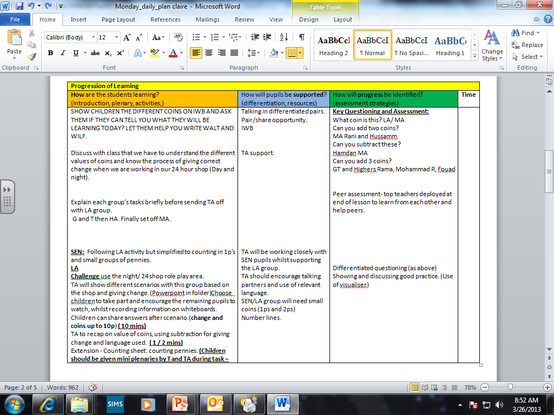

Slide 9
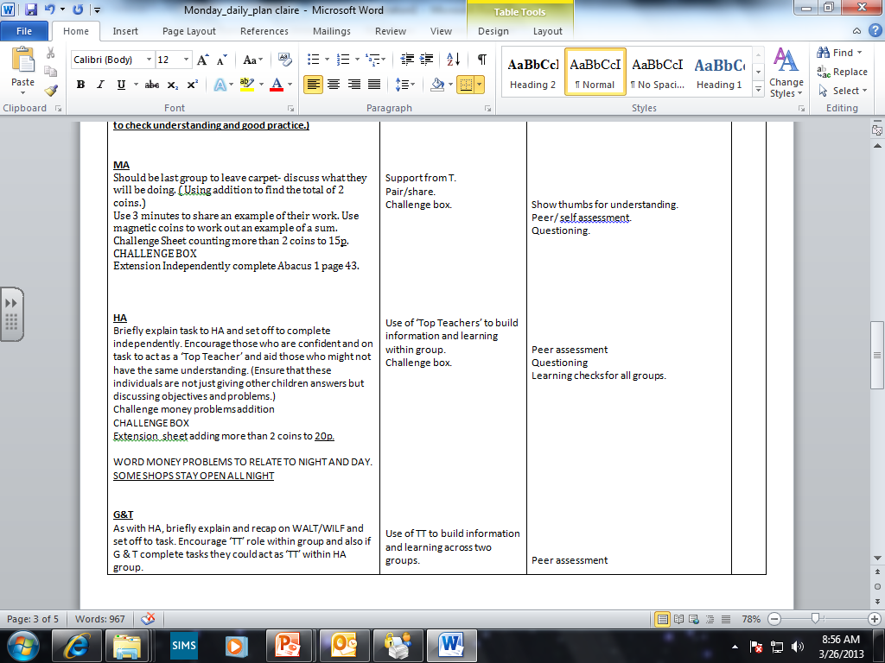

Slide 10
