Slide 1


Leaders of Learning (LoL)
Teaching and Learning Hubs 2013-2014
Kellie.H & Andrew.P

Slide 2
T&L Hubs- The set up
There are 5 calendared Teaching and Learning meetings this academic year. These involve all staff, grouped into hubs, cross curricular and cross phase who meet regarding a specific area of pedagogy.
Community leaders- This group will focus on student leadership and developing student autonomy within the school community, e.g. students controlling peer mentoring groups, setting up anti bullying committees, students identifying prefects etc. Also looking at student led learning within a classroom setting.

Slide 3
When?
Hub Meeting One | Monday 16th September | 3.15pm-4.15pm | WOW wk 22/9- 3/10
Hub Meeting Two | Monday 11th November | 3.15pm-4.15pm | WOW wk 17/11- 28/11
Hub Meeting Three | Monday 10th February | 3.15pm-4.15pm | WOW wk 16/2- 27/2
Hub Meeting Four | Monday 21st April | 3.15pm-4.15pm | WOW wk 27/4- 8/5
Hub Meeting Five | Monday 26th May | 3.15pm-4.15pm | WOW wk 1/5- 12/5

Slide 4
Why?
The idea behind this is that CPD is more valuable if concentrated on one area of specific practice that is revisited over a longer period of time.
There is also the opportunity for staff to engage in action based research with their colleagues at SRS and also across partnership schools.
This work will be disseminated through department meetings and spotlight briefing sessions throughout the year.

Slide 5
Community leaders
Top ways to reduce Teacher Talk (Ross McGill)
Letting students lead the learning (Sarah Findlater)
Student led CPD (Shaun Allison)
Students as 'Leaders of talk' Talk Toolkit (Newlands T&L)
Student leadership materials from TMLondon (Rachael Edgar)

Slide 6
General knowledge quiz
Capital cities

Slide 7

Community Leaders:
Cooperative Learning through
Kagan Structures

Slide 8
What are Kagan Structures?
Structures are simple, step-by-step instructional strategies. Most Kagan Structures are designed to increase student engagement and cooperation.

Slide 9
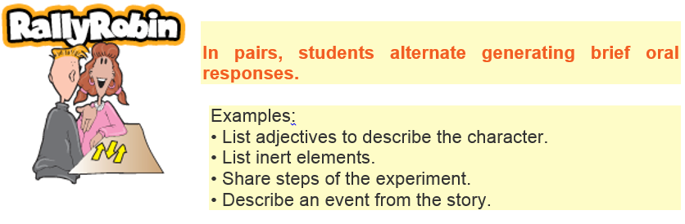
Let’s try capital cities again!

Slide 10
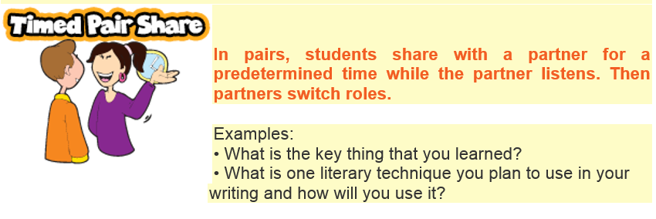
Let’s try Shakespeare or Charles Dickens

Slide 11
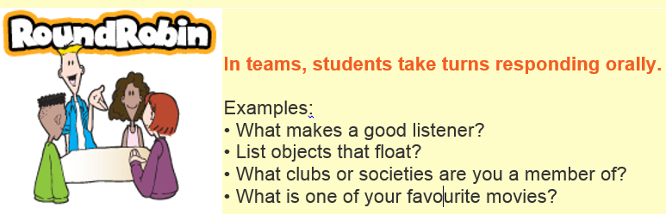
Let’s try enterprise

Slide 12

Let’s try economics
Apple increased the price of the Ipad from £480 to £520 and demand fell from 300 to 280 units sold per major store per week. Was this a good decision? Yes or No?

Slide 13
What are the basic principles of Kagan Cooperative Learning?
1) The learning task promotes teamwork and students experience themselves as being on the same side;
2) Each student is held accountable for their individual contribution;
3) Students participate about equally; and
4) Many students are engaged at once.

Slide 14
With a partner, discuss how you could use some of the Kagan Structures in your subject/year group and be prepared to feedback.

