Slide 1
LOL 2
Community leaders

Slide 2

Feedback
Rally coach
Rally Robin
Timed pair share
Round robin

Slide 3
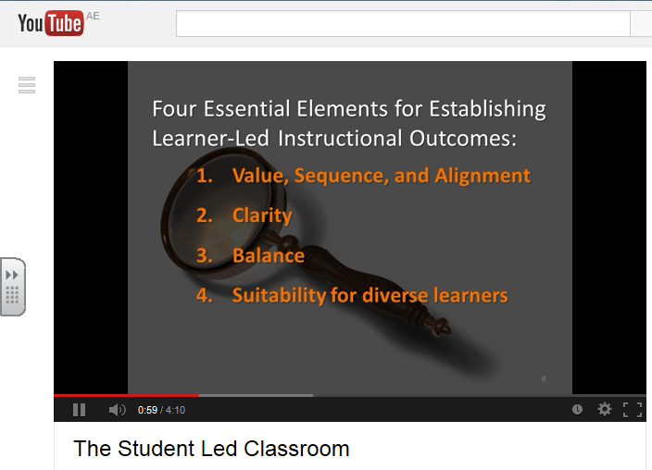
http://www.youtube.com/watch?v=flnO-u2cSZM

Slide 4
New structure
WOW within your department
HOY/HOD to pair people up.
Can be X groups

Slide 5
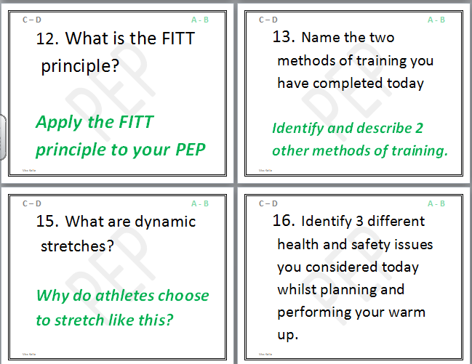
G&T Q&A

Slide 6
Student roles Secondary
Everyone is in charge of something. It
Encourages independence
Group work
Communication
Differentiation by task/outcome
Independent learning
Pupils initiate discussions
Independently reflect on learning …….

Slide 7


OFFICIAL
Emotion
Feeler
OFFICIAL
“Why?”
Questioner
OFFICIAL
Chief
Umpire
OFFICIAL
Match
Referee
OFFICIAL
Devil’s
Advocate
OFFICIAL
Information Seeker

Slide 8





JOB DESCRIPTION Your role involves: Listening to information. Asking “Why?” to seek more. For example: Why are we learning this? Why is this important? |  | JOB DESCRIPTION Your role involves: Having a reaction! Giving an opinion based on your feelings. For example: I like it because… I don’t like it because…
JOB DESCRIPTION Your role involves: Reminding everyone of his/her role. Encouraging harmony during group work. For example: Can we check your job description, please! |  | JOB DESCRIPTION Your role involves: Alerting everyone to reasoning behind the task/activity. Getting discussions back on track if necessary. For example: What have you decided to do and why?
JOB DESCRIPTION Your role involves: Seeking information from additional resources. Ensuring that FACTS are correct through evidence. For example: Make notes, look in books, search on the Internet, ask! |  | JOB DESCRIPTION Your role involves: Critical (although NOT negative) voice. Spotting possible pitfalls or problems. For example: How do we know that this is the best way? Is there another?

Slide 9
OFFICIAL
Creativity
Sparkler
OFFICIAL
“What if?”
Inquisitor
OFFICIAL
Spelling
Checker
OFFICIAL
“YES!”
Campaigner
OFFICIAL
Grammar
Police
OFFICIAL
Numeracy
Spotter

Slide 10



JOB DESCRIPTION Your role involves: Practising your creativity. Coming up with alternative solutions. For example: Make and KEEP quick sketches of at least 3 different ideas before choosing a final outcome. |  | JOB DESCRIPTION Your role involves: Encouraging creativity in others by supporting them in coming up with alternatives. Leading whole-class discussions. For example: Volunteer your ideas!
JOB DESCRIPTION Your role involves: Always taking a POSITIVE view. Encouraging others to forge ahead with their work. For example: This looks really good because…This is really interesting because…I am pleased with… |  | JOB DESCRIPTION Your role involves: Checking all spelling on the board. Supporting students with spellings. For example: Using your skills/ knowledge to help others. Using a Dictionary. Using ICT spelling support. LAST RESORT: Asking a TA/Teacher.
JOB DESCRIPTION Your role involves: Pointing out when MATHS is used. Supporting students with MATHS. For example: For example: Using your skills/ knowledge to help others. Using ICT numeracy support. LAST RESORT: Asking a Teaching Assistant/Teacher. |  | JOB DESCRIPTION Your role involves: Checking grammar on the board. Supporting students with grammar. For example: Using your skills/ knowledge to help others. Using ICT grammar support. LAST RESORT: Asking a TA/Teacher.

Slide 11


OFFICIAL
Quality
Assurance
OFFICIAL
Cheer
Leader
OFFICIAL
Quality
Control
OFFICIAL
ICT
Monitor
OFFICIAL
“How?”
Examiner
OFFICIAL
Skills
Tracker

Slide 12
JOB DESCRIPTION Your role involves: Supporting individuals and groups of students with encouraging words. For example: Are you pleased with what you are doing? I think you are working really well BECAUSE… |  | JOB DESCRIPTION Your role involves: Reminding students to refer to their individual targets. Asking what has to be done for succeeding at each level. For example: Point out the success criteria for each different level.
JOB DESCRIPTION Your role involves: Finding out how ICT is to be used. Supporting students with use of ICT. For example: Using your skills/ knowledge to help others. LAST RESORT: Asking a TA/Teacher. |  | JOB DESCRIPTION Your role involves: Checking students’ work/methods against their individual targets. Providing critical feedback. For example: Use the success criteria for the different levels to support student progress.
JOB DESCRIPTION Your role involves: Recording the skills being used – new and old. Reporting on student progress. For example: Drawing attention to individuals who have made progress with their skills. |  | JOB DESCRIPTION Your role involves: Asking questions about the methods used/to be used. Sharing information from students showing particular prowess. For example: How did you do that? How do I do that?

Slide 13
OFFICIAL
Positive
Thinker
OFFICIAL
Progress
Checker
OFFICIAL
Kit
Manager
OFFICIAL
Resource
Manager
OFFICIAL
Critical
Challenger
OFFICIAL
Knowledge
Hunter

Slide 14

JOB DESCRIPTION Your role involves: Monitoring the progress of groups. Sharing this information with the class. For example: X number of boys/girls on Level 2/3/4 etc. have made progress with their Drawing skills today. |  | JOB DESCRIPTION Your role involves: Working out the benefits of the work being undertaken. Pointing out the value of the lesson content. For example: This is really useful because…
JOB DESCRIPTION Your role involves: Checking that students are taking responsibility for class resources. Showing others where things belong. For example: Letting the Teacher know if something is/is not done. |  | JOB DESCRIPTION Your role involves: Reminding students that they are responsible for their table kits. Checking the content of the kits for missing/broken items. For example: Reporting missing/broken items to the Teacher.
JOB DESCRIPTION Your role involves: Adding extra USEFUL facts to those provided by the teacher Finding out answers to students’ questions For example: Going on the Internet to find out more about skills/knowledge. |  | JOB DESCRIPTION Your role involves: Taking a CRITICAL view of the lesson content. Encouraging others to think about the consequences of their actions. For example: What is the value in this?

Slide 15
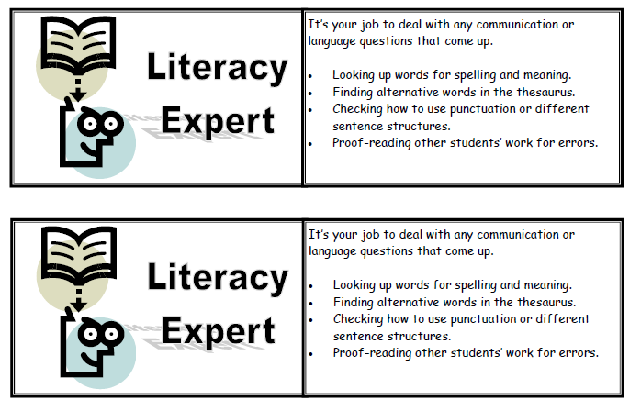
Student roles: primary

Slide 16
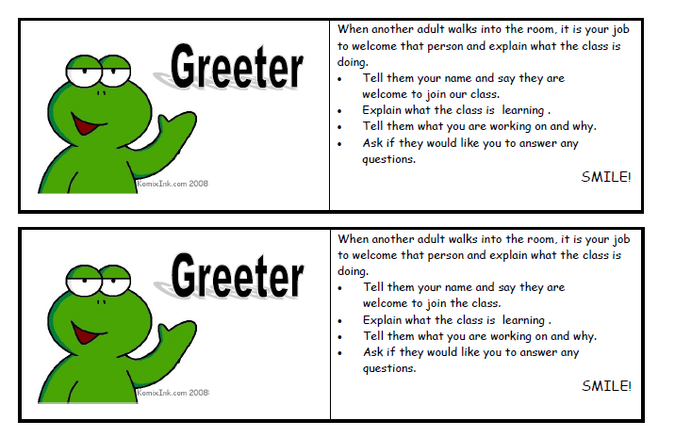

Slide 17
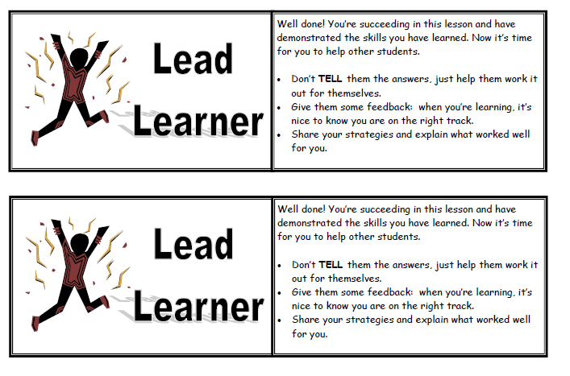

Slide 18
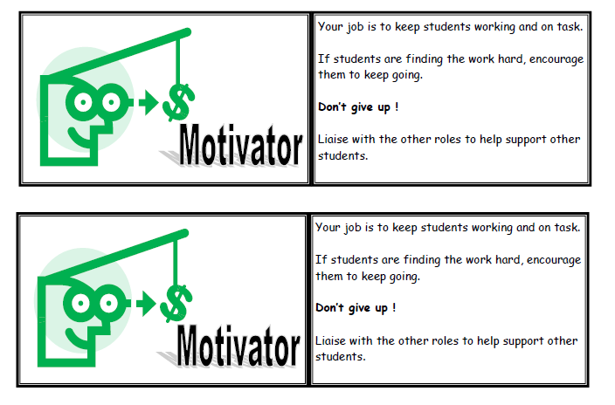

Slide 19
Another example for primary….

Slide 20
Idea 3: Lesson STUDY
Get into groups of 3 (in your department)
Plan a lesson to address an area of need
1 teacher delivers the lesson the other 2 observe
Particular attention on 3 students progress and attainment in the lesson
All 3 discuss what went well (WWW) and Even better if (EBI)
Re-plan lesson and all observe again

