Slide 1


Leaders of Learning (LoL)
Teaching and Learning Hubs 2013-2014
Monday 16th September 2013
Community Leaders
Paula O’Hare, Lee Felton, Tina Malone

Slide 2
T&L Hubs- The set up Tina
There are 5 calendared Teaching and Learning meetings this academic year. These involve all staff, grouped into hubs, cross curricular and cross phase who meet regarding a specific area of pedagogy.
The idea behind this is that CPD is more valuable if concentrated on one area of specific practice that is revisited over a longer period of time.
There is also the opportunity for staff to engage in action based research with their colleagues at SRS and also across partnership schools.
This work will be distributed through department meetings and spotlight briefing sessions throughout the year.

Slide 3
Dates
Hub Meeting One | Monday 16th September | 3.15pm-4.15pm | WOW wk 22/9- 3/10
Hub Meeting Two | Monday 11th November | 3.15pm-4.15pm | WOW wk 17/11- 28/11
Hub Meeting Three | Monday 10th February | 3.15pm-4.15pm | WOW wk 16/2- 27/2
Hub Meeting Four | Monday 21st April | 3.15pm-4.15pm | WOW wk 27/4- 8/5
Hub Meeting Five | Monday 26th May | 3.15pm-4.15pm | WOW wk 1/5- 12/5

Slide 4
Peer Observation
By the end of this meeting everyone will have to find a buddy within the Hub.
With your buddy you will carry out a peer observation focusing mainly on the strategies that will be discussed today.
Peer observations will take place in WoW week 22nd September – 3rd October.

Slide 5

Community Leaders Lee
This group will focus on student leadership and developing student autonomy within the school community, e.g. students controlling peer mentoring groups, setting up anti bullying committees, students identifying prefects etc. Also looking at student led learning within a classroom setting.

Slide 6
Starter Activity
You will be given a pair of scissors, 1 A4 piece of paper.
Your task is to work in groups to find a way to fit your whole group through the piece of paper without it breaking.
You have 2 minutes to plan and 3 minutes to complete the task.

Slide 7
Key Aspects
Work in a team
Pupil voice and communication
Discovery
Getting to know each other
Different stages/subjects

Slide 8
Importance of The Hub
Many successful leaders started without confidence or skills. Leadership skills are built step-by-step. No matter what your skills are right now, you can become a better leader if you work at it. You may find yourself doing things you never imagined you would!

Slide 9
New Learning Paula
You now have 2 minutes to think, pair, share your ideas for pupil led opportunities.
What did you do?
Were they effective?

Slide 10
The Essential 5
A Starting Point for Kagan Cooperative Learning.
www.kaganonline.com
http://www.youtube.com/watch?v=S0s_qxJDuas

Slide 11
The Essential 5
Cooperative Learning promotes the idea that students work together to learn and are responsible for one another's learning as well as their own. (Slavin, 1991)

Slide 12
The Essential 5
Rally Robin
Timed Pair Share
Round Robin
Rally Coach
Stand up, Hand up, Pair up

Slide 13
Next Steps: Action Plan
We have created a pro-forma for your action plan.
We would like you to trial an idea from today with your class. Use the pro-forma to collate your ideas.

Slide 14
Next Meeting:
For the next meeting on 11th November 2013;
You should have trialled an idea from today.
Taken part in a peer observation focusing on that strategy.
You buddy should give you effective feedback – POSITIVE FEEDBACK ONLY ☺

Slide 15

“Make it a better place for YOU and for ME”

Slide 16


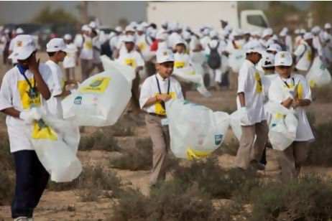


Our Vision:

