Slide 1
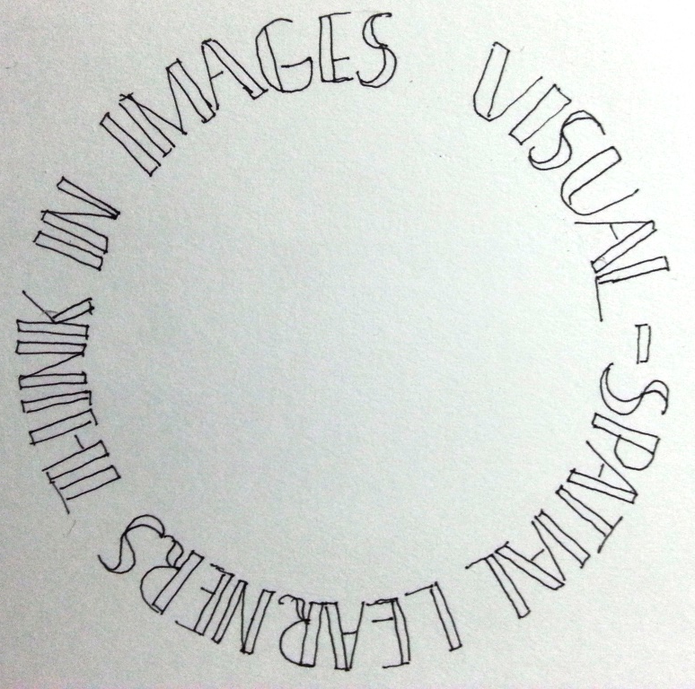
Can a picture paint a 1000 numbers?
Ania Sikora

Slide 2
Starter
When I show you the next slide…
To set up a ‘before’ and ‘after’ and determine the quality of learning
To engage students immediately
To provide a challenge
To initiate an inductive dialogue with the student
…I would like you to stand up if you think you can work out the answer to the given question…
You have 10 seconds…
PS. you will not have to give the answer

Slide 3
Starter
Given the formula below convert the
binary number given into decimal:-
Formula:
(2^0 x 1) + (2^1 x 0)+(2^2 x 0) + (2 ^ 3 x 0) +(2 ^ 4 x 0) + (2 ^ 5 x 0) + (2 ^ 6 x 0) + (2 ^ 7 x 1)
10000001
BinaryNumber:
Decimal Number:

Slide 4
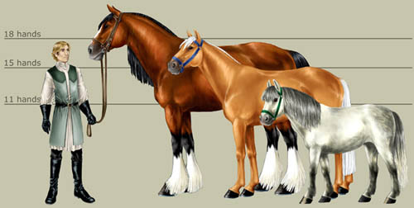
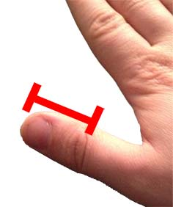
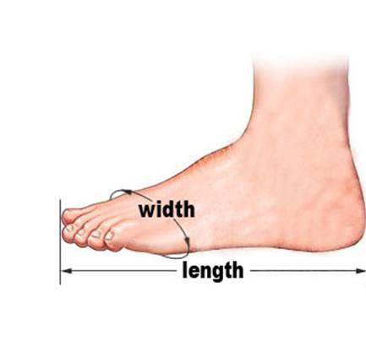
Activity 1 - Systems
Measured in hands
To take the learner from the familiar to the unknown
The Imperial System –
Inch and Foot
Type of thinking / learning –
Experiential / concrete / visual / spatial

Slide 5
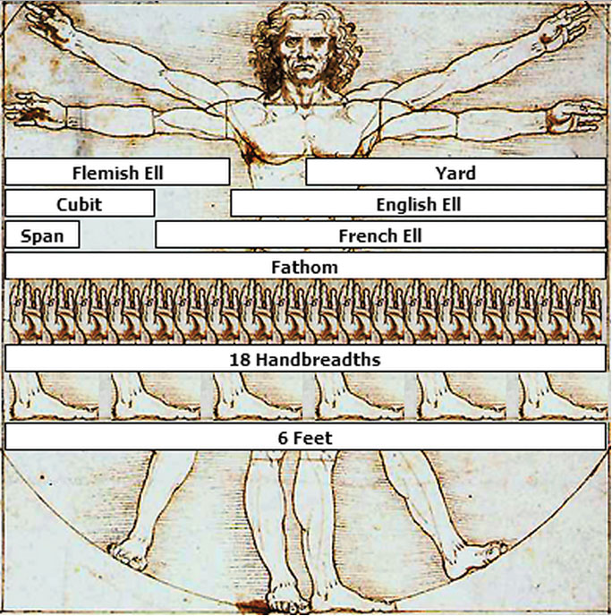
Activity 1 – The Decimal System
How do you think the decimal system came about?

Slide 6




Activity 1 – The Binary System
To explain that electrical currents flow through circuit boards. There are 2 states.
Off represented by 0
On represented by 1.
(Deductive instruction)

Slide 7
Activity 2 – The Decimal System
Visual – Spatial Learning
3 volunteers needed at the front of the room.
1. Hand out denary cards – one per person.
To use the physical space around the individual to experience and model the abstraction.
Type of thinking / learning –
visual/spatial / kinaesthetic / experiential / familiar
Type of learning – Inductive – students noticing
2. Position yourselves to make the number 134.
3. Which digit is the most significant? Why?
4. Which digit is the least significant? Why?
5. But the least significant digit plays a very important role. What is it?
6. What do you notice about the pattern in the numbers? How do they increment?

Slide 8
Activity 2 – The Binary System
Visual – Spatial Learning
Ask 5 volunteers to the front of the room.
1. Hand out binary cards – one per person.
To use the physical space around the individual to experience and model the abstraction.
Type of thinking / learning –
visual/spatial / kinaesthetic / emotional / deep and permanent learning / challenge / known to unknown
Type of learning – Inductive – students noticing and forming own rules and reasoning
2. Position yourselves to order the cards.
3. Which digit is the most significant? Why?
4. Which digit is the least significant? Why?
5. But the least significant digit plays a very important role. What is it?
6. What do you notice about the pattern in the numbers? How do they increment?
7. What is the next highest number? How do the numbers increment?

Slide 9
Activity 2 – Visual – Spatial Learning
8. How can we show the number 1?
9. How can we show the number 6?
To use the physical space around the individual to experience and model the abstraction.
Type of thinking / learning –
visual/spatial / kinaesthetic / emotional / deep and permanent learning / challenge
Type of teaching – Inductive – students noticing and forming own reasoning
10. 15? 21? 3? 12? 19? 9? 17? 31?
11. Count up from 0 to the highest number you can get.
12. What pattern do you see?

Slide 10
Plenary
When I show you the next slide…
To set up the ‘after’ and determine the quality of learning
To create the ‘aha’ moment
To provide a challenge
To facilitate the working memory
To see if students have been able to create their own formula / mental arithmetic and apply their own rules and reasoning
…I would like you to stand up if you think you can work out the answer to the given question…
You have 10 seconds…
PS. This time I want the answer

Slide 11
Plenary
Convert the binary number given into decimal:-
10000001
Base 2 Number:
Decimal Number:

Slide 12
Visual-spatial strategies – getting deeper learning results faster & providing challenge!
All subjects:-
Find out what they have already mastered before teaching them.
Use visual aids, such as overhead projectors, and visual imagery either via computer or displays.
Allow hands-on experience.
Avoid rote memorisation. Use more conceptual or inductive approaches.
Avoid drill and repetition. Instead, have them perform the hardest tasks in the unit.
Emphasise creativity, imagination, new insights, new approaches rather than acquisition of knowledge. Creativity should be encouraged in all subject areas.
Group gifted visual-spatial learners together for instruction.
Engage students in independent studies or group projects which involve problem finding as well as problem-solving.
Allow them to construct, draw, or otherwise create visual representations of concepts.
Have the students discuss the ethical, moral and global implications of their learning and involve them in service-oriented projects.
Literacy
Use a sight approach to reading rather than phonics.
Use a visualisation approach to spelling: show the word; have them close their eyes and visualise it; then have them spell it backwards (this demonstrates visualisation); then spell it forwards; then write it once.
Visual-spatial Learners understand big picture information first, not the smallest details! Can one
create a mental picture of syllables?
The more difficult the words, the better. There is a distinction in the shape of the letters that form
“xylophone” or “Disneyland,” that the visual-spatial won’t find when reading the word, “an”.
Skip over little words to get to big picture meaning quickly
Keep notes as actual drawings

Slide 13
Application to other subjects
Numeracy
Have them discover their own methods of problem solving (e.g., instead of teaching division step-by-step, give them a simple division problem, with a divisor, dividend and quotient. Have them figure out how to get that answer in their own way. When they succeed, give them a harder problem with the solution already worked out and see if their system works).
Mastery and Challenge
Give them advanced, abstract, complex material at a faster pace.
Allow them to accelerate in school.
Emphasise mastery of higher level concepts rather than perfection of simpler concepts in competition with other students.

Slide 14
Who? How?
65% of the population are considered to be visual – spatial thinkers.
If you are musically, artistically or engineering-inclined you are likely to be a visual-spatial thinker.
Visual-spatial learn better visually than auditorally. They learn all-at-once, and when the light bulb goes on, the learning is permanent. They do not learn from repetition and drill.

Slide 15
Visual-spatial strategies
Visual-spatial learners are more attentive if they understand the goals of instruction.
They are more cooperative at home and at school if they are allowed some input into decision-making process and some legitimate choices.
Discipline must be private, as these children are highly sensitive and easily humiliated. If they are respected, they will learn to treat others with respect.
When they are placed in the right learning environment, where there is a good match between their learning style and the way they are taught, visual-spatial learners can actualise their potential to become innovative leaders.
They see the big picture first before they learn the details. They are non-sequential, which means that they do not learn in the step-by-step manner in which most teachers teach.
They tend to be organisationally impaired and unconscious about time.
They are often gifted creatively, technologically, mathematically or emotionally.

Slide 16
Research Findings
Nearly 75% of the neurons in our brains that process sensory information—smell, taste, touch, hearing, sight—are dedicated to vision. (Dan Roam; Unfolding the Napkin; 2009)
In Silverman’s research, 1/3 of the school population emerged as strongly visual-spatial. An additional 30% showed a slight preference for the visual-spatial learning style. Only 23% were strongly auditory-sequential.

Slide 17
Objectives
To consider visual thinking as another tool in helping students to conceptualise abstract ideas and dig into deeper levels of learning
To help individual students develop their spatial thinking - find a solution, a formulae or a method that suits their learning style and works for them
To help students with a predisposition to right brain learning, the part of the brain that is emotional and creative, to organise information in an intuitive way and concepts in a simultaneous way (rather than sequential).
To allow the learner to experience a concept in order to ‘get’ it.
To see patterns, interrelationships and the big picture.

Slide 18
Further reading
Bolen, J. S. (1979). The tao of psychology. New York: Harper & Row.
Buzan, T. (2001). The power of creative intelligence. London. Thorsons.
Cottrell, S (1999) The Study Skills Handbook Basingstoke: Macmillan
DeBello T C (1990) Comparison of eleven major learning models: variable, appropriate populations, validity of instrumentation and the research behind them Journal of Reading, Writing and Learning Disabilities
Dixon, J. P. (1983). The spatial child. Springfield, IL: Charles C. Thomas.
Dunn R and Dunn K (1999) The Complete Guide to the Learning Styles Inservice System Boston, MA: Allyn and Bacon
Eastaway, R (2007) Out of the Box.
Gardner H (1993) 10th edition Frames of Mind: The Theory of Multiple Intelligences New York: Basic Books
Gazzaniga, M. (1992). Nature's mind: The biological roots of thinking, emotions, sexuality, language, and intelligence. New York: Basic Books.
Gregorc A R (1982) Style Delineator Maynard MA: Gabriel Systems
Kolb D A (1984) Experiential Learning: experience as the source of learning and development Upper Saddle River, NJ: Prentice Hall
Pask, G (1988) Learning Strategies and Conceptual or Learning Style, in R Schmeck (ed) (1988) Perspectives on Individual Differences, Learning Strategies and Learning Styles New York and London: Plenum Press 83-100
Riding R, Rayner S (1998) Cognitive styles and learning strategies: Understanding style differences in learning and behaviour London: David Fulton.
Sikora. A. (2000) Construction or Deconstruction: The transference of meaning in a digital environment. ECU, Australia
Sikora A. (2003) Visualisation Technology: the tranference of meaning ECU, Australia
Silverman, L. K. The visual-spatial learner. Preventing School Failure, 34(1), 15-20.
Silverman, L.K. (2002) Upside-Down Brilliance: The Visual-Spatial Learner (Denver: DeLeon)
Springer, S. P., & Deutsch, G. (1989). Left brain, right brain (3rd ed.). New York: W. H. Freeman.

