Slide 1



Slide 2

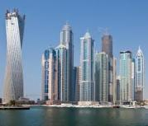
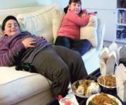


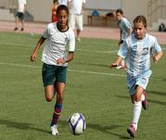
MIDDLE EAST
RICHEST ECONOMIES
OBESITY ENDEMIC
LOW SPORT PARTICIPATION
GOVERNMENT FOCUS OF ATTENTION
POSITIVE DTM TRENDS
GROWING GDP PER CAPITA
LET THEM PLAY
REALIZING THE URGENCY
‘DESIGNED TO MOVE’
WEIGHTY ISSUE
UAE to rise by 22% to $75,000 by 2015
QATAR largest growth
rate in the world, $100,000 a year.
KSA $24,000 a year.
SPONSORSHIPS 4 airlines hold more than 100 sponsorship deals with some of the most visible and prominent sports teams, events, stadiums, and cultural festivals in the world.
UAE 30% children between 6 and 16 years are overweight. 20% population suffer from diabetes. 89.3% girls aged 4-18 were overweight in 2003.
QATAR 73% men and 70% woman are overweight. 16% of the population suffers from diabetes.
KSA 30% children are overweight.. 54% adults and 63% children are obese.
KSA 57% of boys aged 7–12 years old do not participate in even moderate levels of physical activity.
UAE Princess Haya intervention for Physical Education improvement within government schools.
UAE only 19% of Dubai's population gets sufficient amount of exercise which is required to stay healthy.
UAE 13 – 40% of the health budget spent on diabetes. 1 in 5 deaths are attributed to cardiovascular diseases.
KSA adopted a National School Sport Development Strategy.
QATAR Hosts 1st Conference on Women and Sport in 2013.
KSA Previously illegal Women’s Sports Clubs to be licensed in 2013.
UAE Dubai Healthcare Authority launching a standard PE guideline in all schools of Dubai.
DTM Champions operate in the region (GIZ, ICSSPE).
QATAR Aspire Academy
Active PE teachers community across the region.
Prepared to work together (Aspire Academy, Princess Haya/Dubai Education Zone and Saudi School Sports, Tatweer).
QATAR Doha Goals Initiative established in 2012 to unify sport and culture.

Slide 3

ACHIEVEMENT, BEHAVIOUR, ATTAINMENT
This generation’s youngsters expend an estimated 600 calories per day less than their contemporaries 50 years ago.
Physical inactivity could pose problems for them in the classroom, as a study conducted by The University of Illinois revealed a strong correlation between physical fitness levels and academic performance in children. Could all work and no play be counterproductive in the classroom?
The study, carried out on 48 kids aged 9 and 10 years, tested their physical fitness levels and divided them into two groups - most fit and least fit. The children who were the most physically fit scored significantly higher academically than the less fit group reinforcing that the fitness of a child's body and mind are tightly linked - the more difficult something is to learn, the more physical fitness may aid children in learning it.
A number of research studies substantiate that children need sufficient amounts of physical activity a day not only to prevent obesity and its related issues, but to improve their performance academically and socially as well. We've all experienced how a brisk walk or quick workout can help clear a cluttered mind or awaken your senses when having a mid-afternoon slump - this is certainly true for students too!
In addition to the proven positive physical and mental health impact of being active, there is a strong belief that regular participation in physical activity is linked to greater brain function and cognition. A 2012 study that conducted a systematic review of literature on the subject, found that across all the work reviewed there was a positive relationship between physical activity and academic performance in kids3. A message so loud and clear, even the school bell can't drown it out!

Slide 4

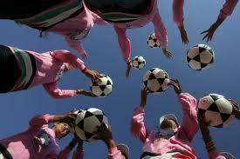

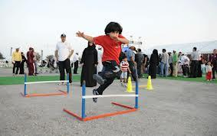
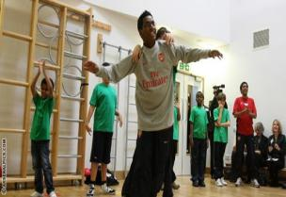
OPPORTUNITY
Increase Young People’s Participation
Making Healthy Choices
ENGAGE
ENERGIZE
INCREASE & IMPROVE
Alternative choices/activities to engage ALL students.
Staff as role models
Engage with professionals
Create positive physical activity experience to ALL students
Promote inclusive sport and highlight girl’s activity
How any students have access to 5 hours activity within school hours?
What is the enjoyment factor?

Slide 5

ROAD MAP
CATALYZE & MOBILIZE
INVESTIGATING
What is within your school strategy?
Identify current participation rates (5 hours)
Setting up Activity Advisory Board
Advocacy/Research
Engage ‘army’
Identify issues and potential pilot project(s)
Issue
Map existing initiatives
Create Advisory Board
Partners
Funding
Roles/Responsibilities
Engage/Pilots
Identify activities
Age range specific
List of competencies
Identify weaknesses
Investigate Cross Curricular Possibilities
Objectives
Potential activities
Common Core Specific
PHASE 3
PHASE 1
PHASE 2
PHASE 4
Jan to Feb 2013 March to June 2013 Starting Sept 2014

Slide 6
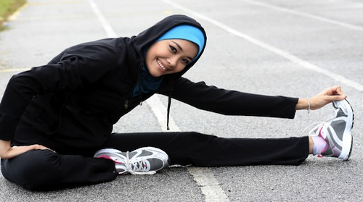






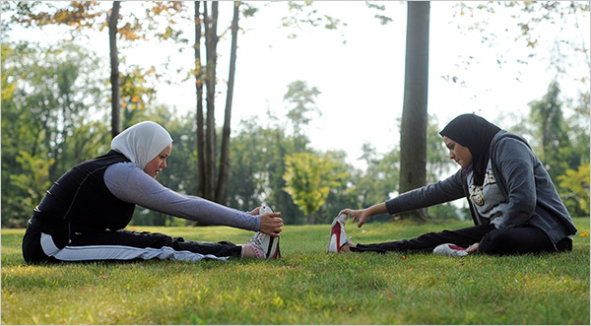
TAKE ACTION FOR A HEALTHY SCHOOL
CONTACT US
InnerG Solutions®FZE - 3785/2013 FLC, DUBAI
Contact : (+971) 55 – 1044615
Email: contact@innergsolutions.com
Website : www.innergsolutions.com

