Slide 1
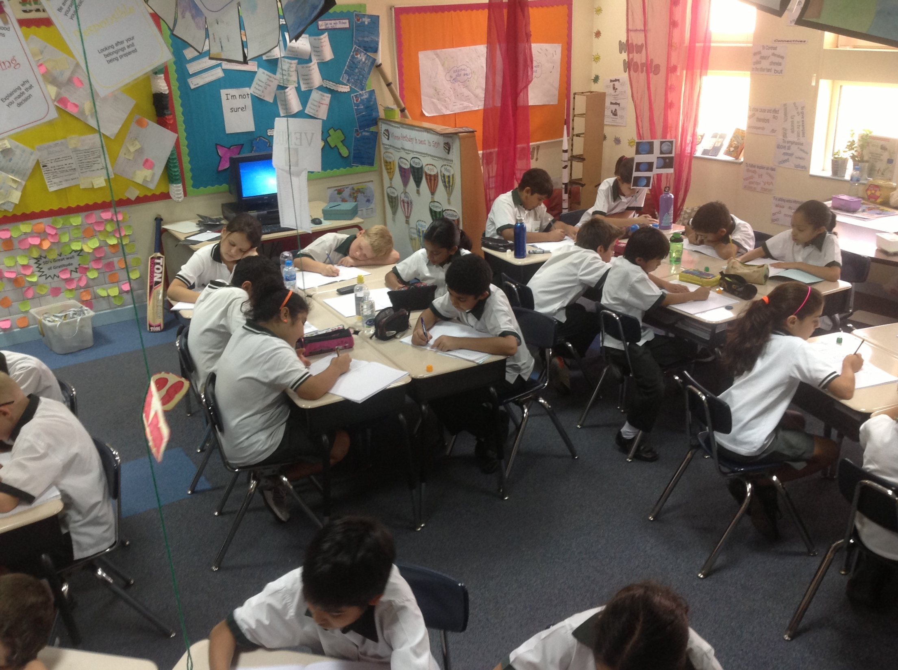
Lend Me Your Literacy
Jenny Murray - Deira International School
@MissJGM

Slide 2

‘Schools should redefine their conception of literacy and associated pedagogies to connect to the lives that children are living and offer authentic and realistic opportunities for young people to remain engaged...’. (Thomson, 2009)

Slide 3
Create
Collaborate
Celebrate
Motivate

Slide 4
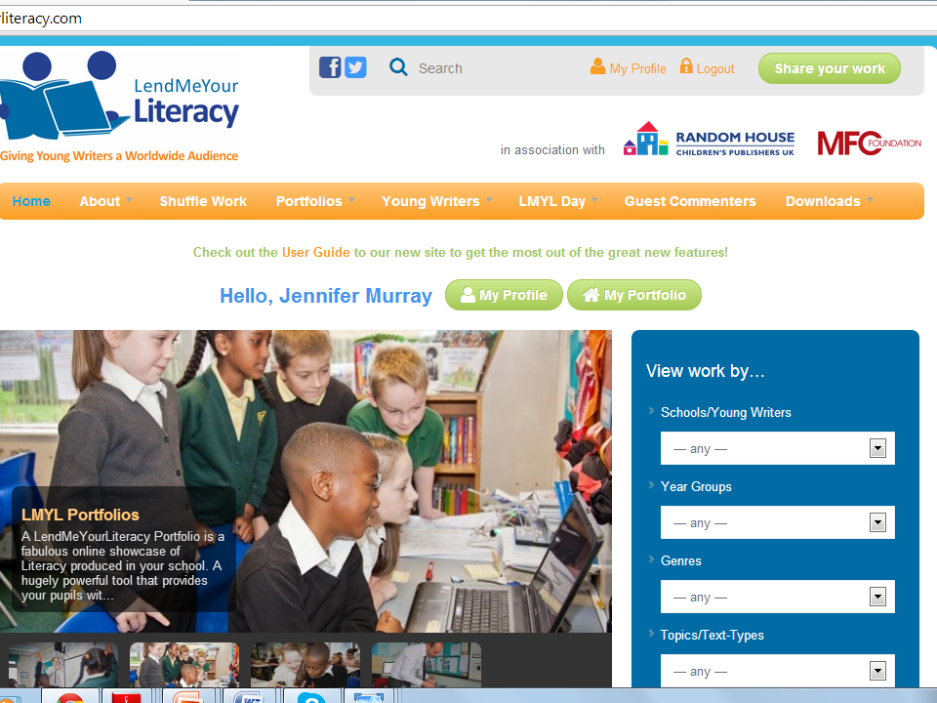

Slide 5
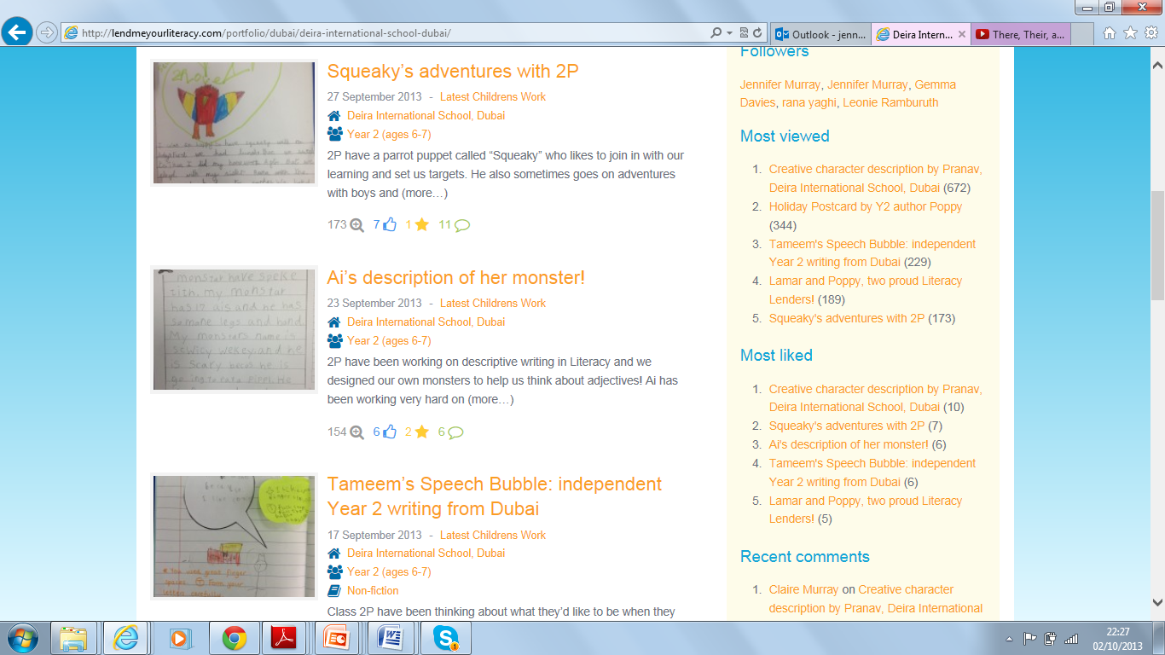

Slide 6
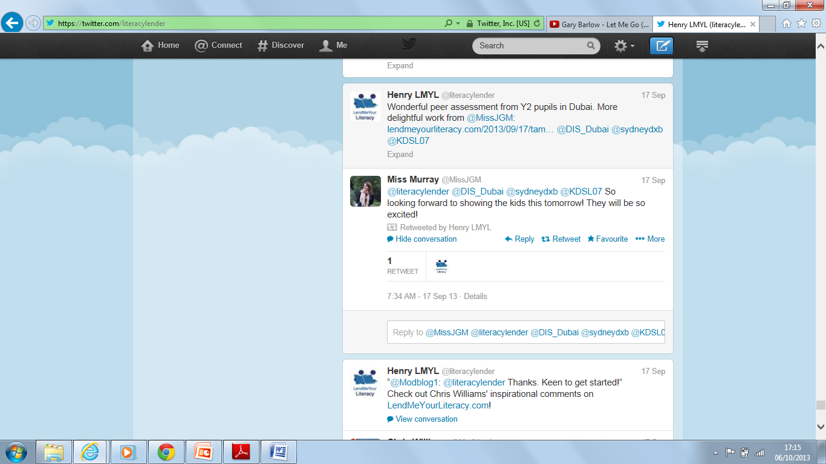
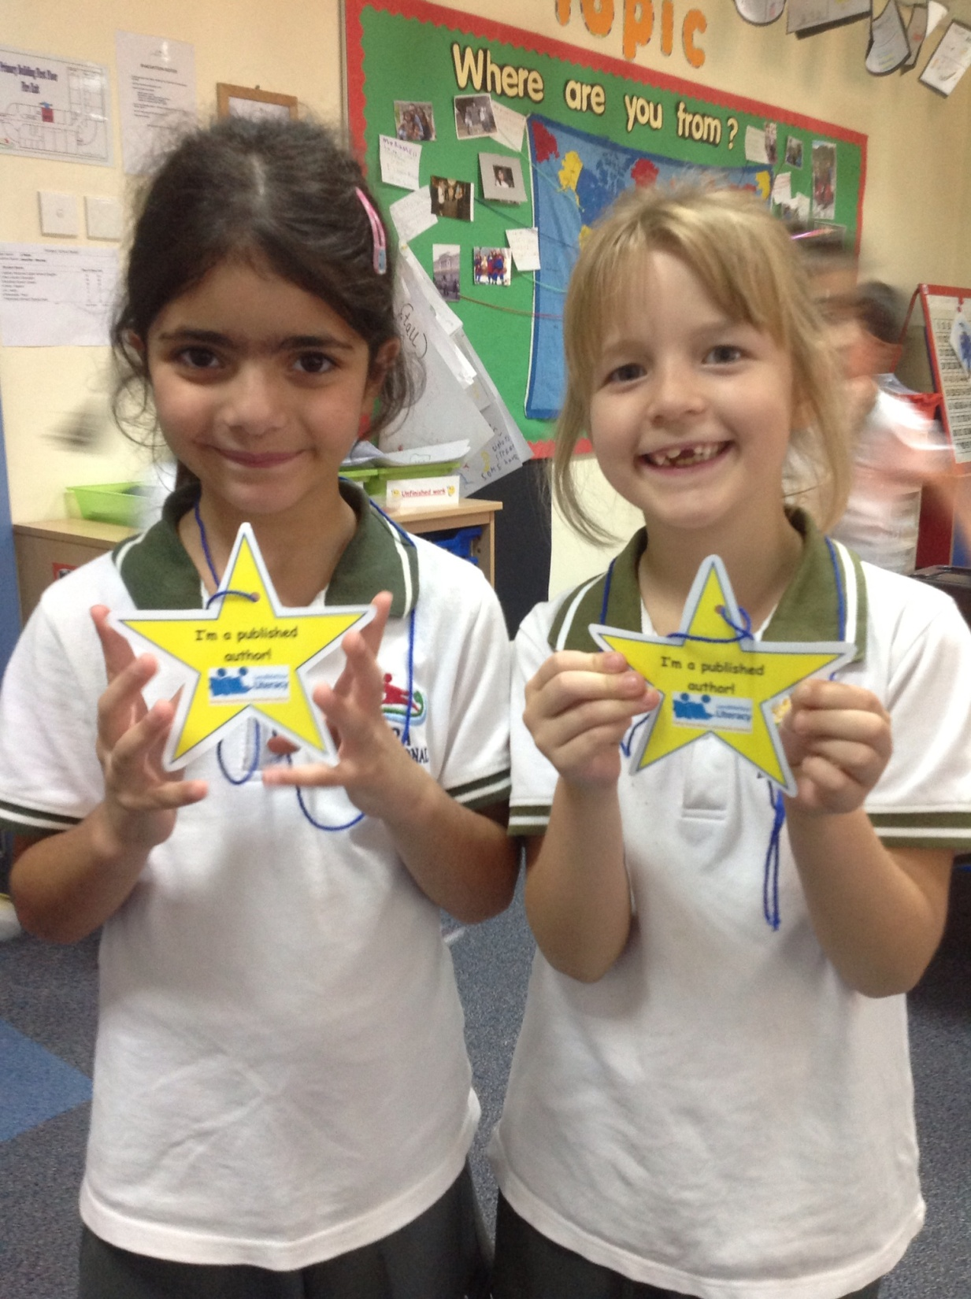
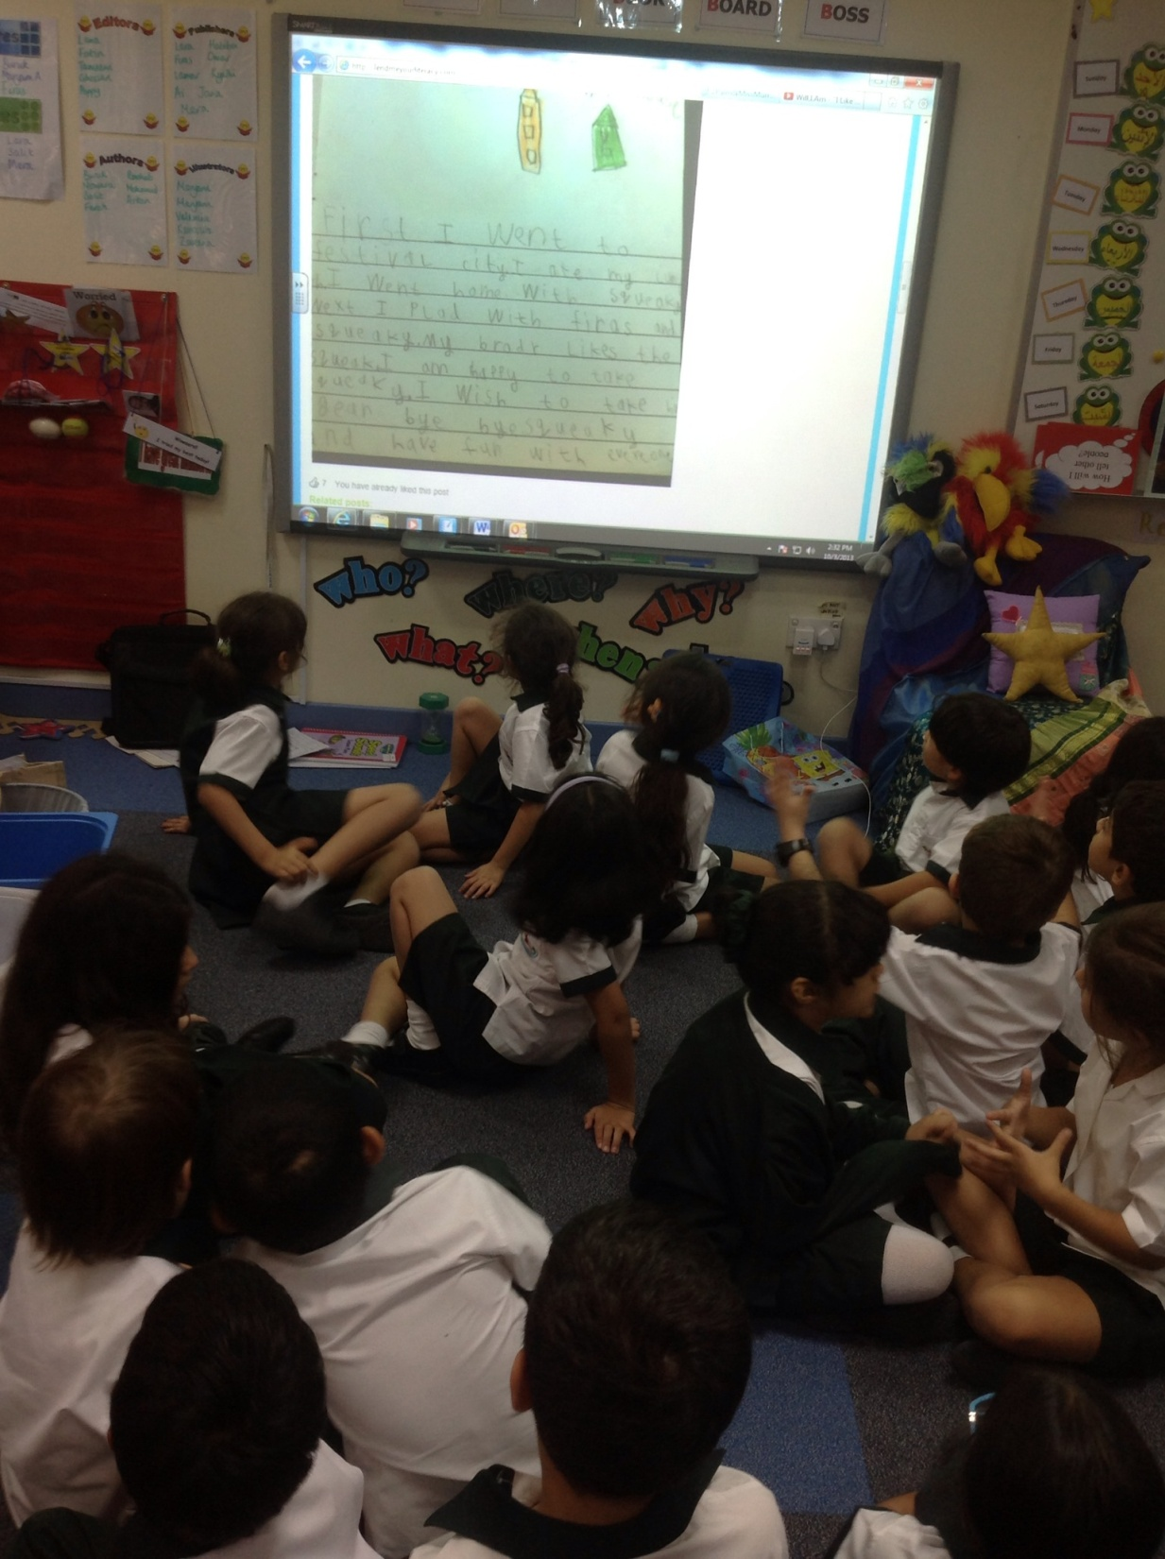
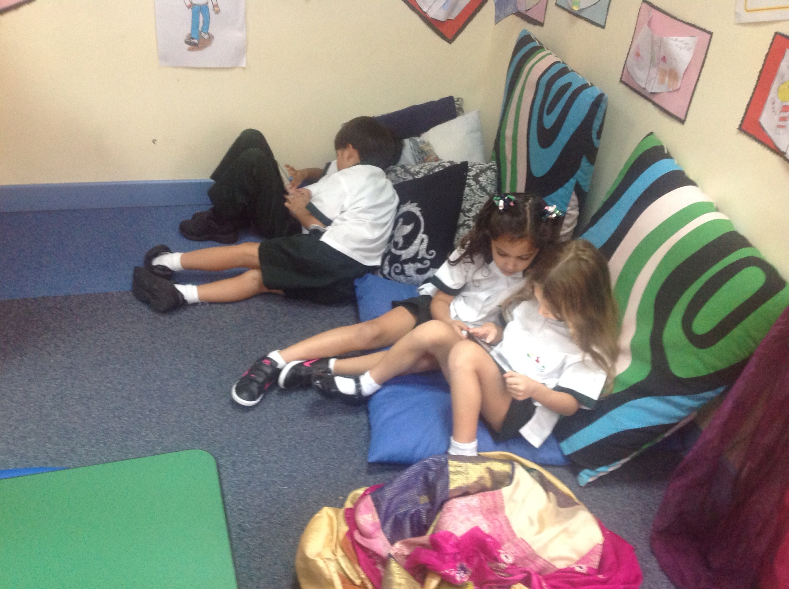


Slide 7
Watch the views and comments appear –
SHARE, TRACK, CELEBRATE
Literacy Learning
Send a photograph – LMYL team publish
Engage your whole school community by participating in the LMYL community
Motivation, engagement and attainment all increase

Slide 8

Students in class/at home/in free time
Independent /Peer writing
All genre, all abilities, all standards
Create
Collaborate
Celebrate
Motivate
Buddy assessing of LMYL samples
Audience
Purpose
School links
Immersion in real
Writing
Community collaboration on comments
Twitter/website/
assemblies
Teacher moderation tool
Stars/certificates/wall of fame
IB CAS credits

Slide 9
References
What now?
www.lendmeyourliteracy.com – sign up for free, trial it and see the impact
Follow Deira International School – comments welcome! ☺
@MissJGM for what’s going on at DIS
@literacylender for lots more information
Thomson, J. (2009). Literacy and inclusion in the 21st Century. A Journal of Youth Work(3), 43-58.

