Slide 1
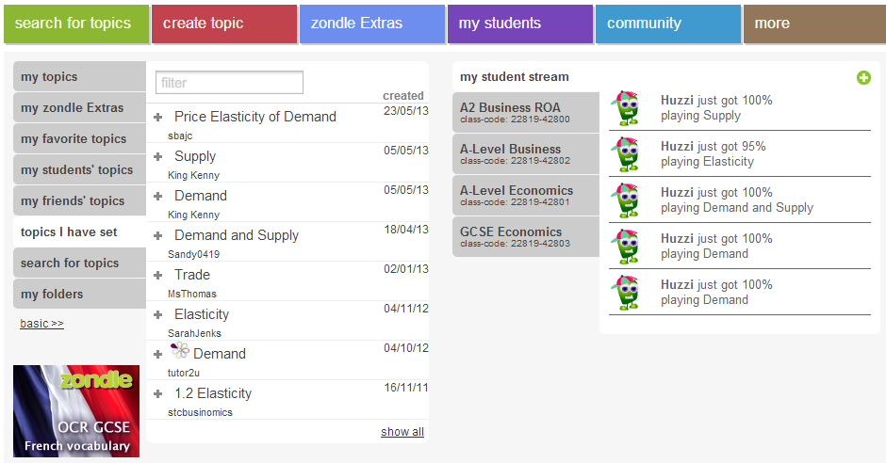
Zondle: Learning & Assessment through Gaming

