Slide 1

Creative Classrooms!
Planning for 70 mins
Rachael Edgar & John Harris
Wednesday 27th November 2013

Slide 2
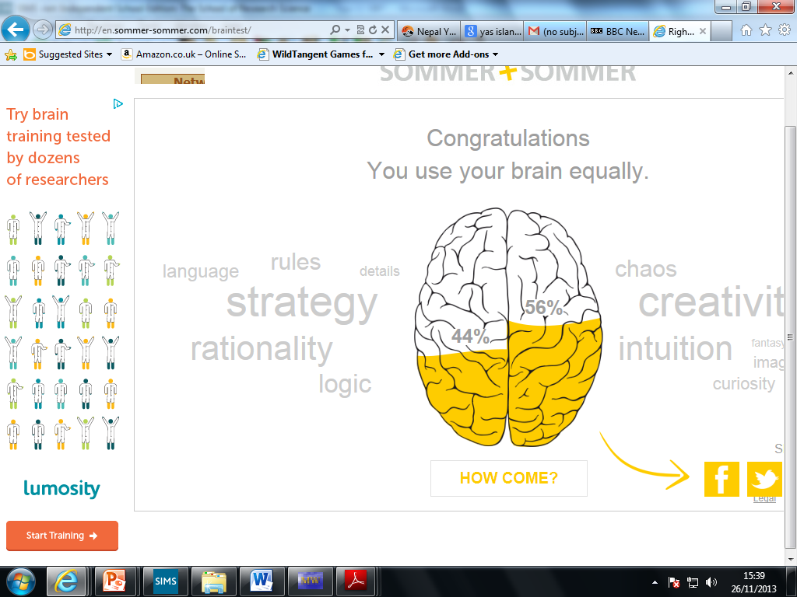
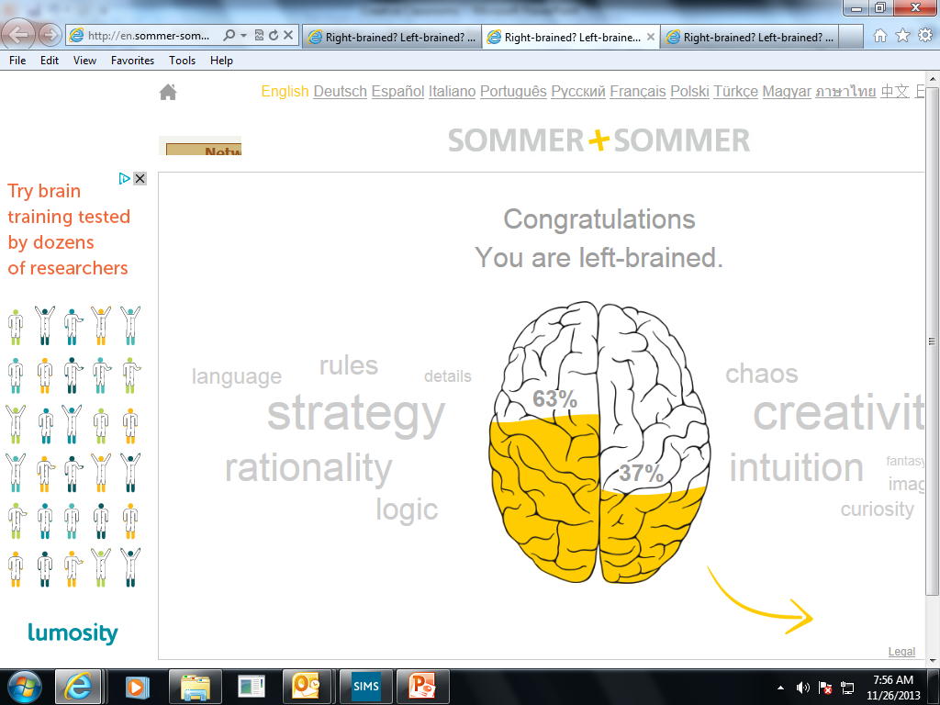
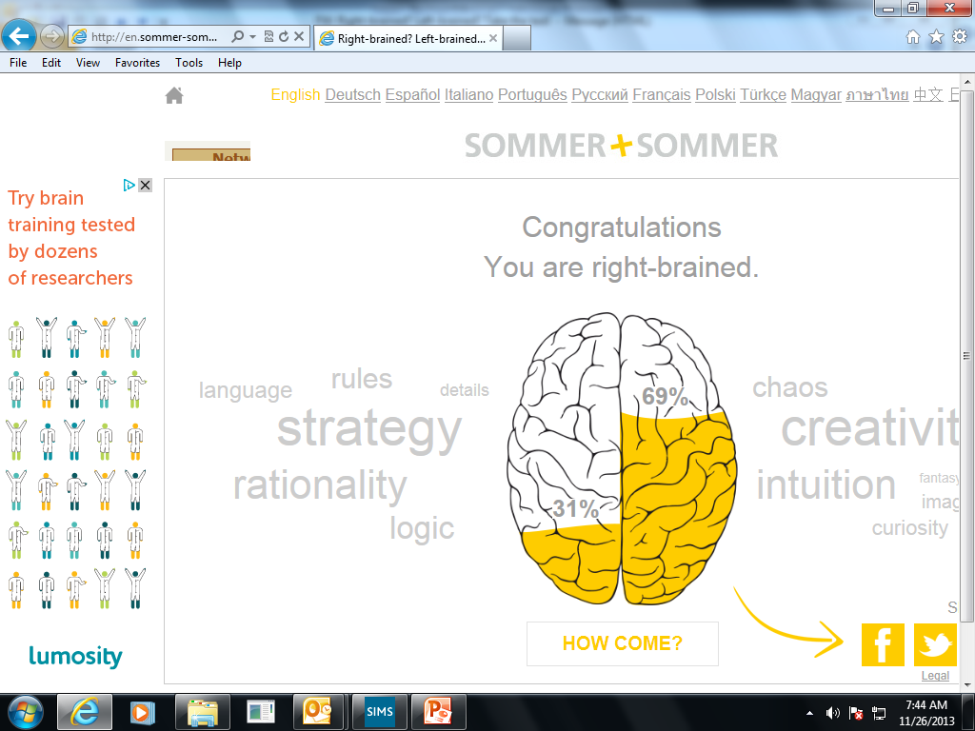
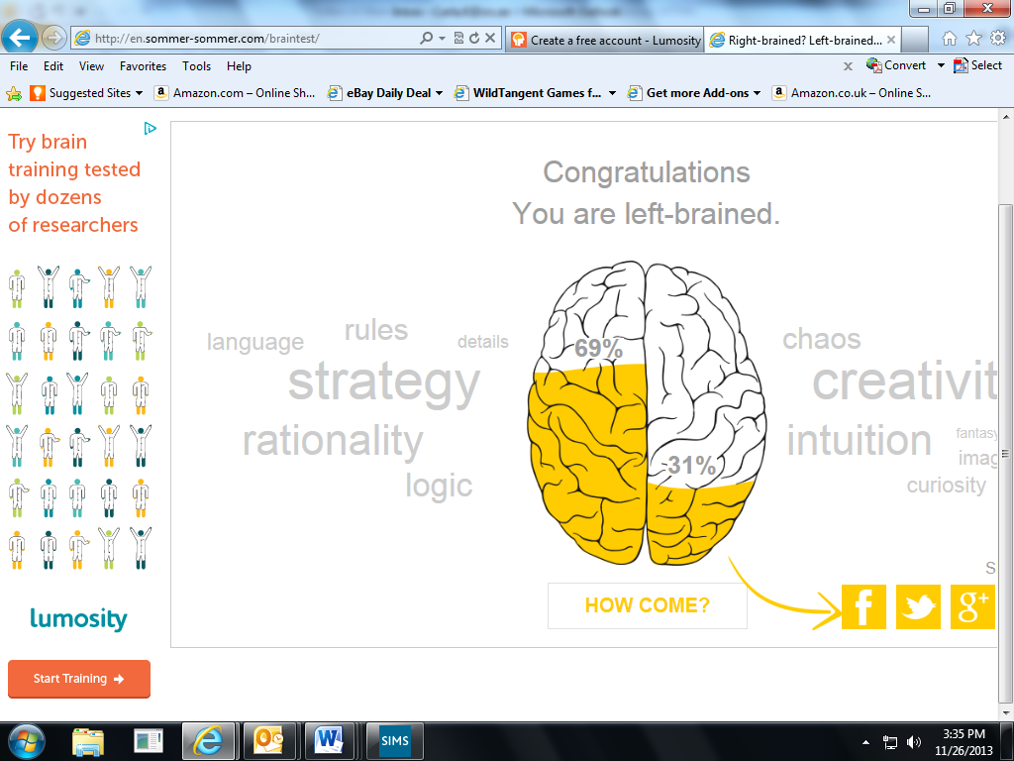
A
B
The ‘brains’ of your Senior Team….(Rachael E, Juliet, Carla K, Carla S)
C
D

Slide 3
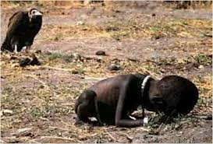
Hook

Slide 4
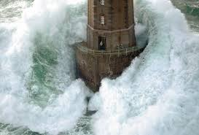

Slide 5
Google image search
Google image search
Unusual pictures
Laughing animals
Metaphor photography
Optical illusions
Fabulous landscapes
Album covers
Space
Amazing buildings

Slide 6
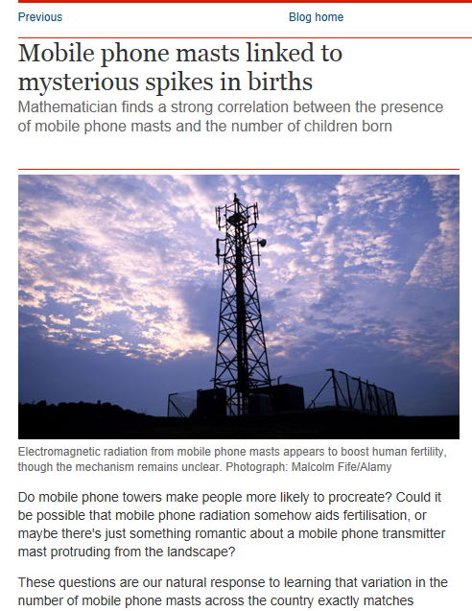
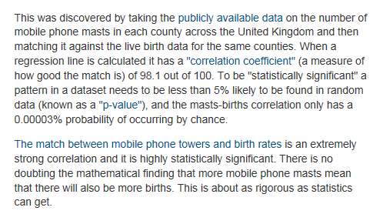
Relevance
Relevance

Slide 7
How likely is this?
How likely is this?
I think that SRS is the best school in Dubai. I employ the highest quality teachers, have the highest quality resources available for staff and students and am currently overseeing a massive building project which will see the facilities improve greatly. SRS is wonderful.
Miss Nan, 2013

Slide 8
How about this?
How about this?
I hate school. My life is horrible. I don’t like this place, think Maths, English and Humanities are boring and do not know why I have to do it. School is boring and a waste of every ones time. We should only have to go to school 3 times a week and get a 4 day weekend!
Miss Karen, 1995

Slide 9
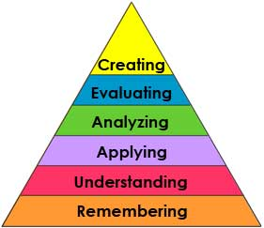
Depth
Depth

Slide 10
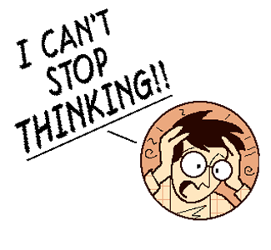



Lets get THINKING!
PICTURE
What’s the…………………….
PICTURE
Task: In your groups unscramble the Dingbats in the boxes below
Ag Ag Ag Ag Ag
Ag Ag Ag Ag Ag
Ag Ag Ag Ag Ag
Ag Ag Ag Ag Ag
Ag Ag Ag Ag Ag
Ag Ag Ag Ag Ag
World
World
World
1, 3, 5, 7, 9, 11
Coming
What’s the link??

Slide 11
There are two identical twins born 10 minutes apart. Sara is older than Maryam.
Once Maryam celebrated her day of birth on a Tuesday, Sara celebrated hers a day later on Wednesday, HOW?
Lets get THINKING!

Slide 12




Use DeBono Thinking Hats..
White Hat
The facts
what is it basically about.
where is it set?
Who is in it?
Who is it about?
Black Hat
The negatives- What does the snitterjipe look like?
Are there any negative points in the poem?
Yellow Hat
The positives- consider the place and what really happens to the boys
- Are there any positive points in the poem?
Red Hat
Feelings
What feelings are in the poem? Anger? Joy? Love? Hate? Sorrow? Etc.
What is the atmosphere/ mood?

Slide 13
Learning map – The big picture
Step one:
What is global warming and the Greenhouse effect?
Step two:
Discovery – become experts on an aspect of global warming
Step four:
Use your new knowledge and.
Show that you now have a deeper understanding of…
Step three:
Share your new knowledge

Slide 14
Becoming an expert
In groups of 4:
Look at the resources and discuss which you think you would like to do. Each resource has a challenge task should you wish to have a go at something a little more difficult.
Read through your resource thoroughly. You can label things and make annotations should you wish.
Undertake the task you have selected.
If you need help:
1st step – Go to another person who is doing the same colour task as you and ask them to explain to you their answer.
2nd step – If you are still unsure, stick your hand up and I will help you.

Slide 15
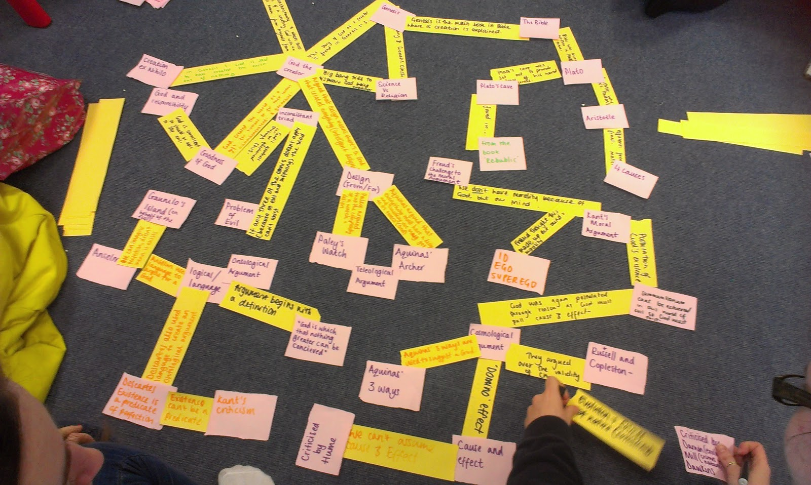
Big mind map!
Big Mind Map
Write down as many things about the topic you have studied so far onto the square pieces of paper (one word per square), this can be key words, quotes, and key people, etc.

Slide 16
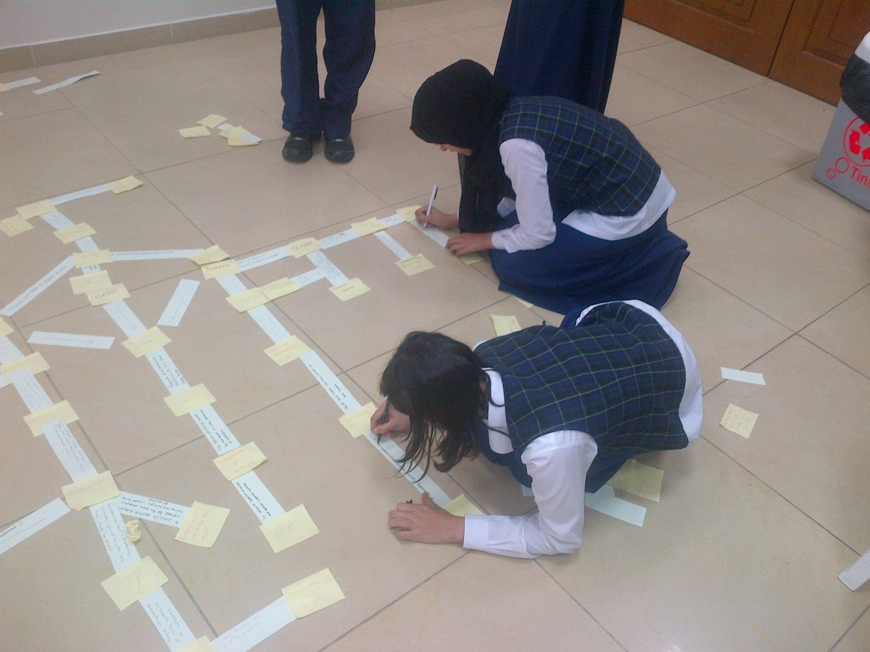

Slide 17
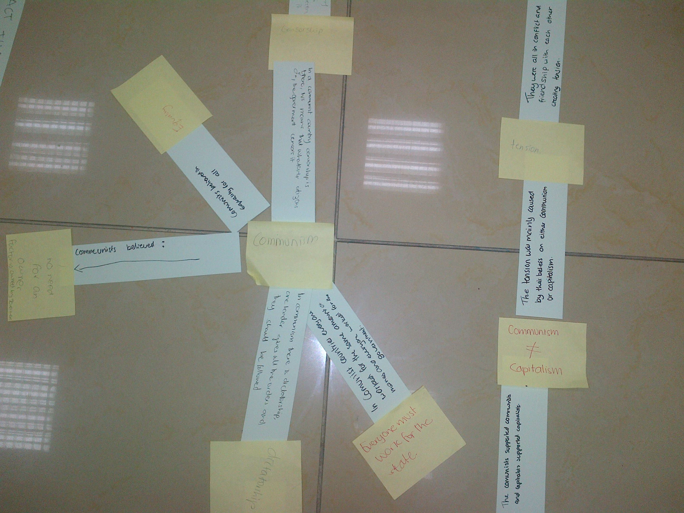

Slide 18
Visit this website!
Visit this website!
http://cheneyagilitytoolkit.blogspot.ae/

