Slide 1
Demonstrating Progress In The Classroom
Wednesday 12th December 2012
Today’s Session Objective:
To add to my teaching toolkit so that I know many approaches that demonstrate progress.
I set this session up to show that immediate progress could be made by my early pupils. Do you do this?
Those that get in early, should be rewarded with the ability to succeed – no matter how small that success is!
However, you also need to ensure that those that are late, do not miss out!
Starter 1
Write your name in the crystal ball and then predict how many techniques I will show you today.
Starter 2:
Read the story of the Hare and The Tortoise
Extension:
Read the Progress Indicators – then can you answer the questions?

Slide 2






Session Objective:
To add to my teaching toolkit so that I know many approaches that demonstrate progress.
At the end of this session, I will ask you to list all of the progress techniques that I will demonstrate / discuss / talk about for the next 20 minutes.
Could you do this now?
Where would you place yourself on my confidence line?
This is your end goal; to succeed you will need to keep track throughout the session.

Slide 3
The Confidence Line
Many variations on a theme:
Physically line up;
Place a sticker / post it on a location and move it up;
Draw a line in the book and revisit the line at key points in the lesson.
Use the confidence line proforma

Slide 4
Progress Descriptors:
Progress | All students have made exceptional progress by the end of the lesson. Their learning is profound. Students demonstrate that they can use and apply the knowledge and skills that they have gained in future learning, with confidence. Students are consistently supported on improving their work. Understanding is checked throughout the lesson allowing for striking, high –impact intervention. | Most students have made good progress by the end of the lesson and, in some cases, will have exceeded their expected capabilities. They have deep understanding of their work and will be able to build upon this in future learning. Students know how well they have done and can articulate how to sustain good progress. Teachers listen to and observe students in order to reshape tasks and explanations to improve learning. | The majority of students have made the progress that is in line with their capabilities by the end of the lesson. Their outcomes are secure and will be helpful for future learning. Students are informed of their progress and how to improve. Teachers monitor students work during lessons. | Too few students are engaged by the lesson; achievement is superficial and / or insecure given their starting points. Students are unclear about progress and / or how to improve. Activities take too little account of students’ understanding and do not help students to improve.

Slide 5
The Hare and The Tortoise
How much progress did each party make and how do you know?
How much is this anecdote like the classroom?
Who won the race then?
The problem with this race is that we do not know:
how fast the tortoise,
or the hare, were capable of running;
or how often they’d done it;
or how many times they had done it before;
or what their focus was whilst they were doing it;
or whether or not this win for the tortoise was his best time…….
and therefore, even though the tortoise may have beat the hare, Ofsted have checked out all of this information and they know that he:
dawdled all of the way…
and he should have finished the race hours ago…
his best result was 3 hours quicker and he was supposed to be running to aim for 4 hours quicker….
and they also know that you didn’t manage the Hare very well…
so both of them made superficial progress when they finished the race!

Slide 6
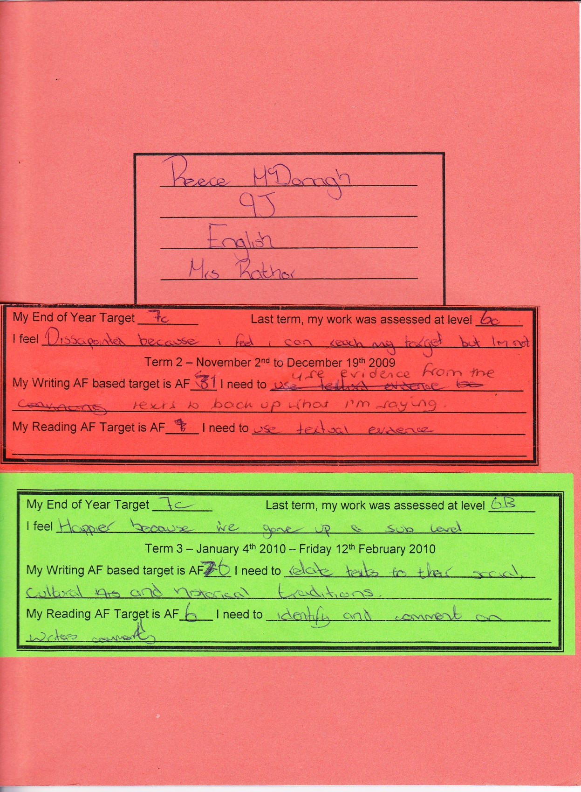
To Measure Progress:
You must know the class’s starting points.
You need to know the class.
You need to know what each child’s target is.
Equally important – so do they!

Slide 7
Your Marking
Make it skills based!
Praise what the pupil did well
Well done, you did really well with your use of capital letters.
Let them know the approximate grade or level
This would be level 5 if…
Tell them what they need to do better:
You managed to get full stops correct all the way through!

Slide 8
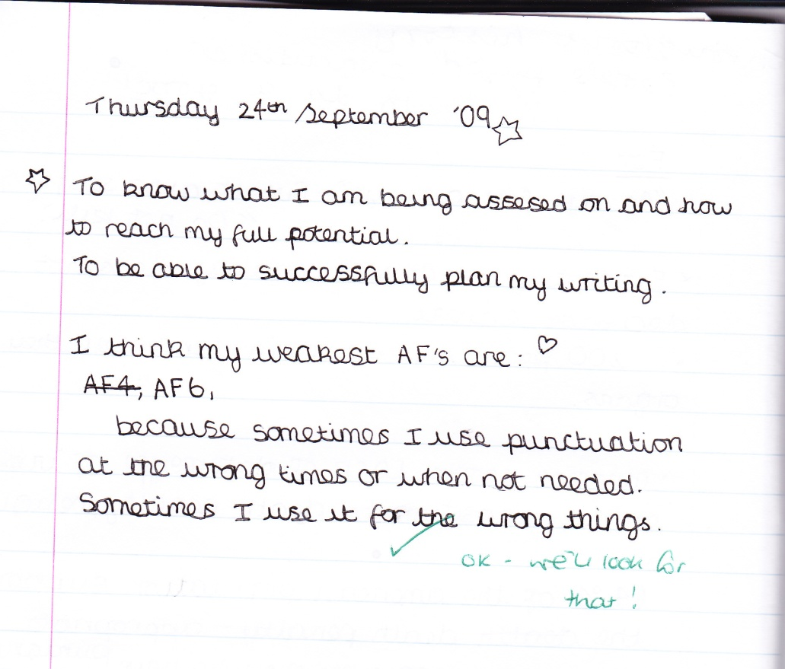
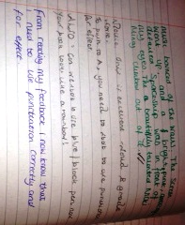
Engaging With Marking
Pupils need to engage with the marking that you have completed.
Set this up as starters in the lesson after you have marked to demonstrate progress; and to make pupils aware that you EXPECT them to engage with your marking!

Slide 9
Progress – Every 15 minute Rule
Start with how the pupils will show progress
Build in two mid points – that relate to the learning objectives
End with a review of progress.

Slide 10
Session Objective:
To add to my teaching toolkit so that I know many approaches that demonstrate progress.
I really know how to show progress now and I have over 20 ideas to take away!
I’m pretty sure that you’ve given me more than 8 ideas and I can see how they can be used
I’m pretty sure that you’ve given me more than 4 ideas
I am quietly confident that I know at least 3
I can still only tell you 1 thing
I couldn’t tell you one thing

Slide 11

The Crystal Ball
Show pupils the LO
Predict how they will show that they have met the lesson objective.
At key points, update their premonition
Go back and test the premonition

Slide 12
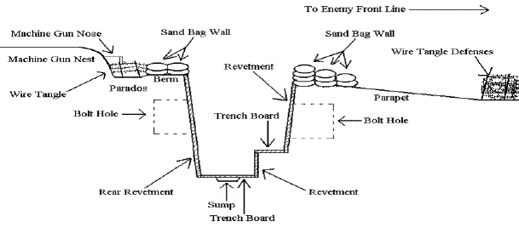
Draw what you think the end result is:
And then draw it again and compare.
i.e What were the trenches like in WW1
Draw before you’ve taught the lesson
Add to the drawing at key points
Compare the drawing to the end result

Slide 13
Unpicking the LO
Pupils read the LO carefully and write a question that relates to the LO on a post it note.
Pupils stick the post it note to an enquiry board.
At 2 points, you allow pupils to get a question and see if they can answer it.
At the end of the lesson, they see if they can answer it – and maybe some more of them to show exceptional progress?

Slide 14
Corners
I know nothing
I know a little
I have no opinion
I disagree with the idea
Ask pupils where they stand on an issue; what they know about an issue etc.
Teach them all about the issue, where do they stand at key points during the lesson.
I think that the issue is too complicated to go either way!
I know everything that you taught us today!
I agree with the idea
I know quite a lot

Slide 15
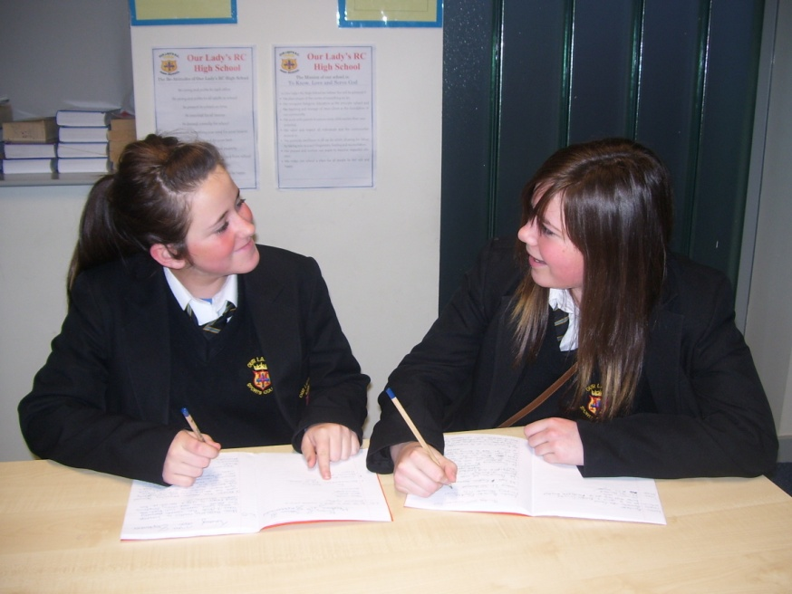
SELF / PEER EVALUATION
Hugely underestimated as a tool.
Pupils define their own success criteria, with your guidance and then use each other/ themselves to asses their progress.
Has to be structured!

Slide 16
Random AFL
Check’s that everyone is listening and, as long as they can answer the question, they are!

Slide 17
Whiteboards
It’s a whole class AFL tool, but it is great for showing progress for every individual in the lesson!
What’s even better is the ability to pai up those who may have misconceptions!

Slide 18
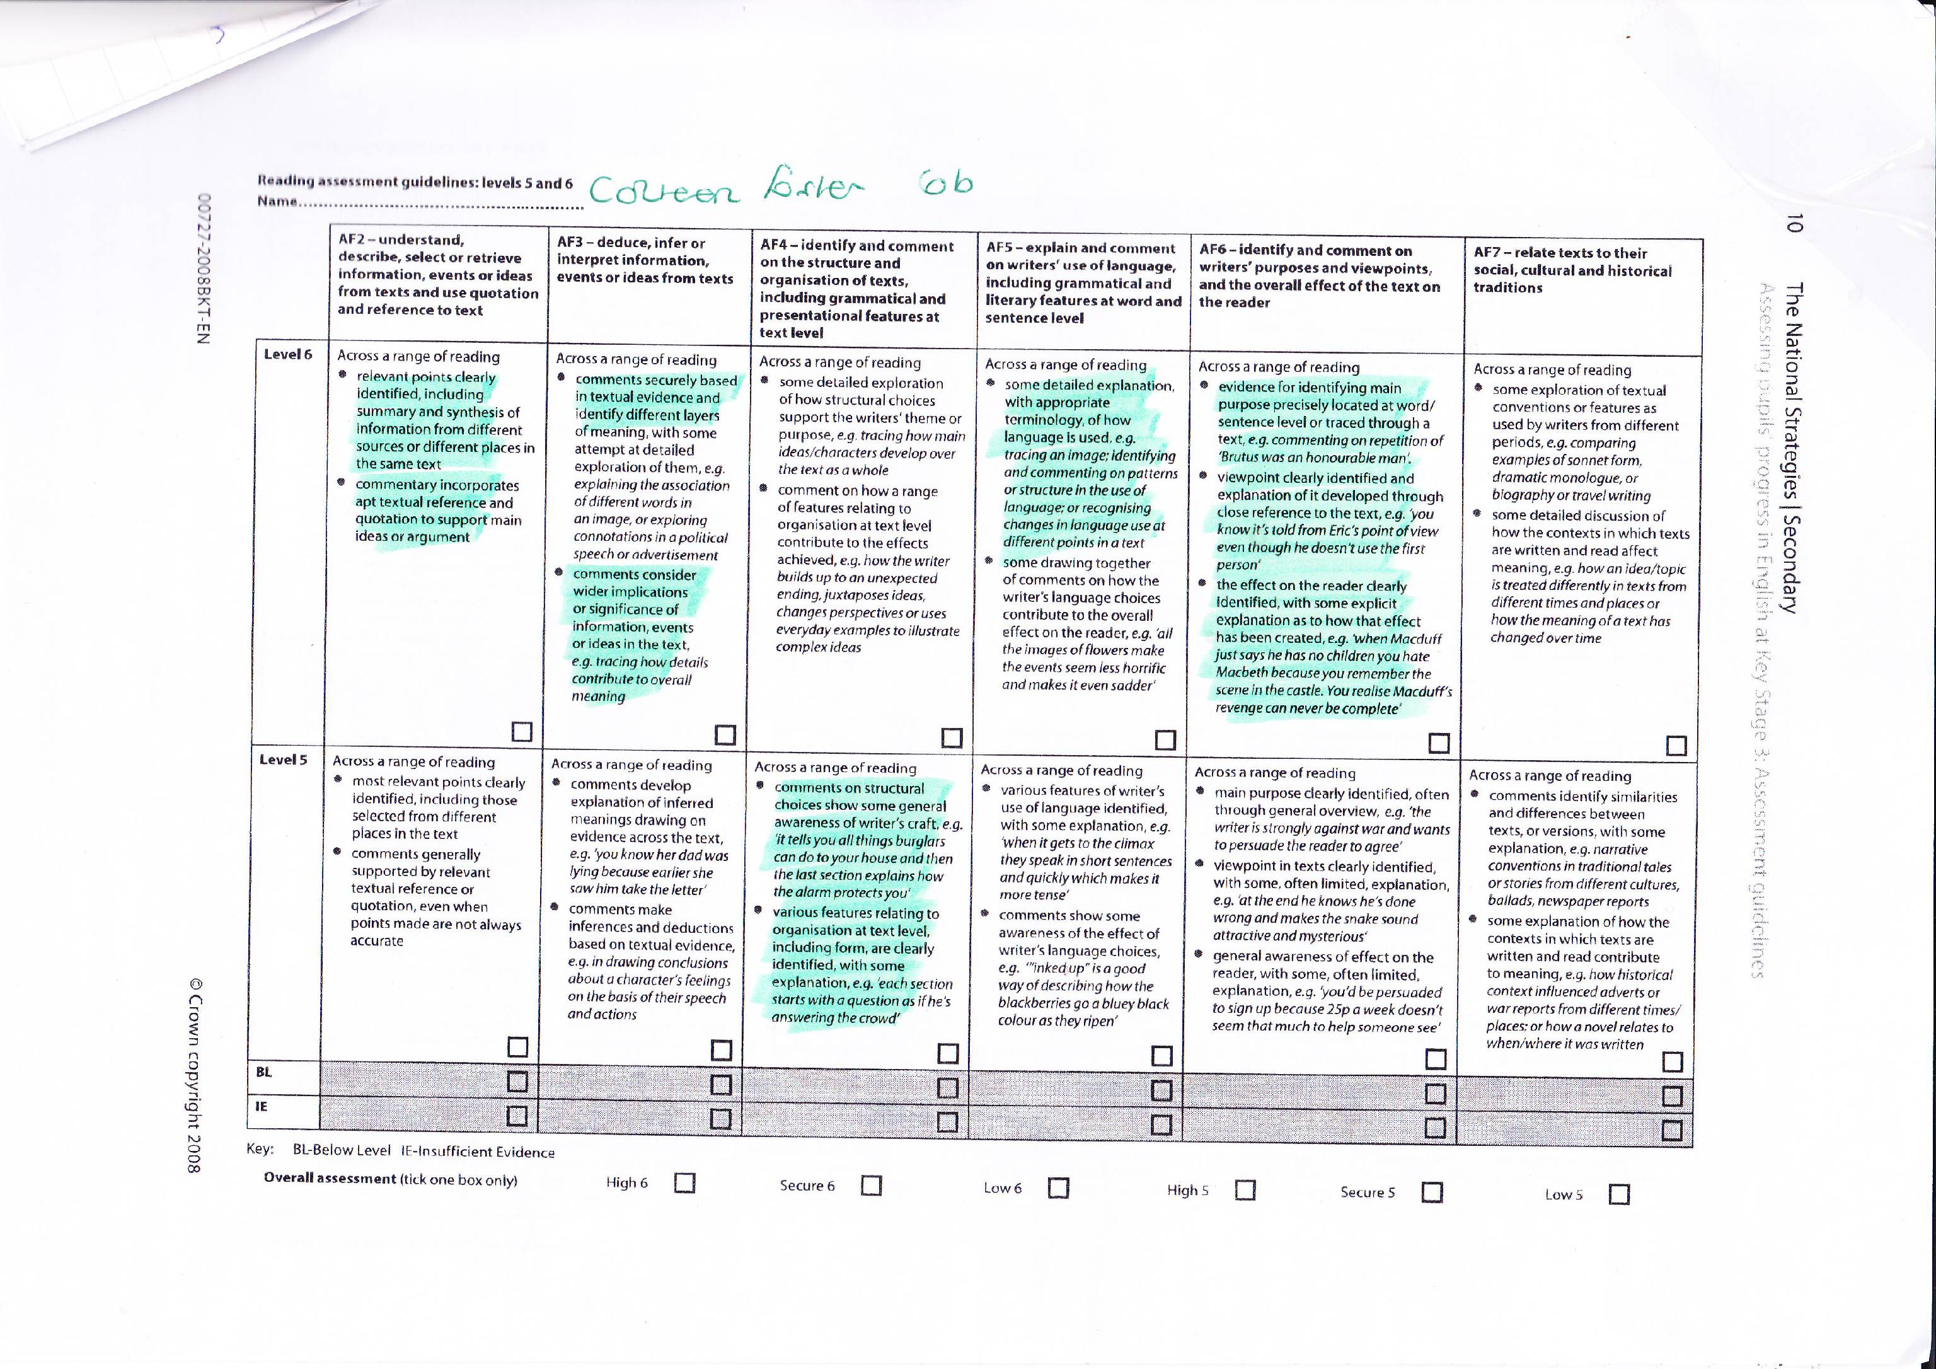
Summative Assessment
Progress cards on the front of books; keep pupils on track!
Regular assessment with feedback that pupils work with!
Pupils set their own targets to take ownership of them!

Slide 19
Evidence on Display
In books
In folders
On walls
Make sure that observers see the long term progress!

Slide 20
End the Lesson with evaluation - How many did you get?
1 - The lesson Objectives have to be engaged with in some form:
2 - Confidence line; 3 – line on the board, 4 physical, 5 in book, 6 on pro-forma
7 Targets on the front of books
8 Specific marking that it skills based and tells pupils what level they are working at and what they have to do to improve.
9 skills based marking that offers formative and summative assessment.
10 Pupils must engage with marking and comment back!
11 – 15 minute rule
12 – success criteria detailed on confidence lines
13 – The Crystal Ball
14 Draw Something
15 Questioning the LO
16 Corners
17 – Peer Evaluation
18 – Self evaluation
19 – Random AFL
20 – Use of whiteboards
21 – summative assessment
22 – pupils set their own targets from summative so that they can track progress

Slide 21
Session Objective:
To add to my teaching toolkit so that I know many approaches that demonstrate progress.
I really know how to show progress now and I have over 20 ideas to take away!
I’m pretty sure that you’ve given me more than 8 ideas and I can see how they can be used
I’m pretty sure that you’ve given me more than 4 ideas
I am quietly confident that I know at least 3
I can still only tell you 1 thing
I couldn’t tell you one thing

Slide 22
The Crystal Ball
Do I have any psychics in the room?

Slide 23
Where will you apply this learning today?

Slide 24
Resources

