Slide 1

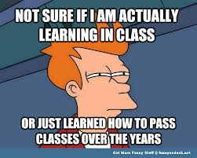
What kind of learning skills do we want our students to develop?

Slide 2
What kind of learning skills do we want our students to develop?
Students who take responsibility for their own learning?
Students who can reflect on their own learning? Aware of own strengths and weaknesses
Students who can collaborate in a wide range of learning situations
Students who are Independent learners
Students who can contribute their own ideas, ask questions and listen to each other
Students who can think and problem solve

Slide 3

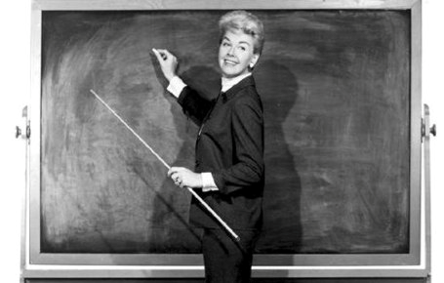

What some teachers do
Clear learning intentions
Challenging success criteria
Range of learning strategies
Know when students are not progressing
Provide feedback and give opportunities for reflection
Visibly learn themselves
Such that students……
Understand learning intentions
Are challenged by success criteria
Develop a range of learning strategies
Know when they are not progressing
Seek feedback for themselves
Visibly teach themselves

Slide 4



Developing our students as learners
Using IT to support learning (Edmodo/Zondle/Blendspace)
Collaboration/Student talk activities
Rachael Edgar Monday 12th January 2013

Slide 5


Benefits?
Safe, free, teachers can give feedback and post grades and parents can view child’s work and grades.
On the staff page, library for resources and notifications when students comment or produce work.
Good for communication with parents
Summative/formative feedback- set assignments and link to resources and comment on submitted work.

Slide 6
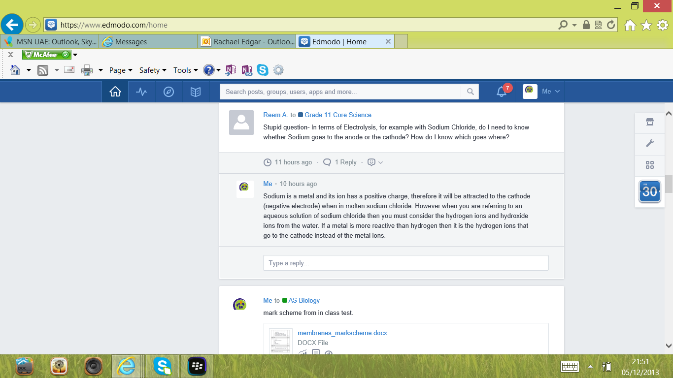

Slide 7
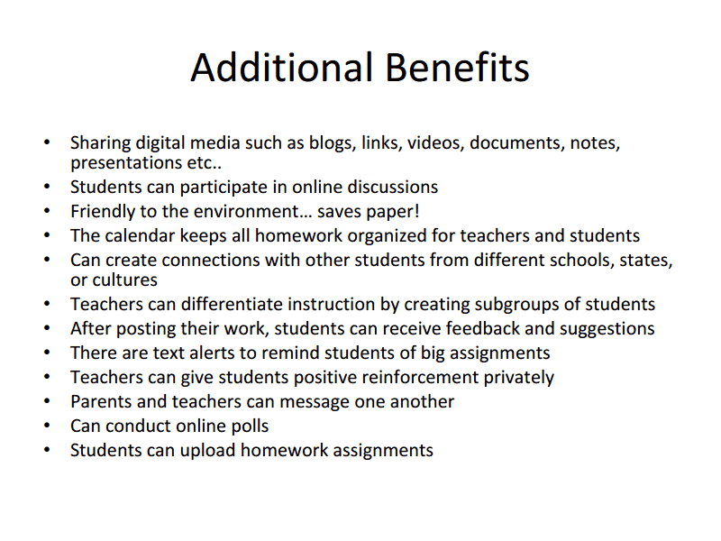

Slide 8
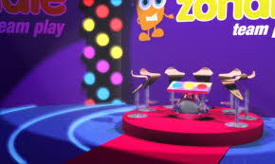
Rehearsing knowledge and understanding
Practice is essential for consolidating learning and understanding
Collaborative learning
Collaboration can help deep learning
Engagement
Uncertain rewards enhance engagement and promote learning
Learning processes
Stimulation of the brain's reward system supports learning
Competition
Brains respond to our own successes and to the failures of our competitors
Classroom practice
The importance of pedagogy in game-based teaching and learning

Slide 9
Benefits?
Flip the classroom- Find, add, share online content, vids, images, PDFs, Google Docs.
Students can comment/take notes alongside content.
Track student progress
Personalise student learning with different online materials and built in assessment
All you digital content in one place!
Blendspace- How to get started?
http://www.youtube.com/watch?v=aQ_Mg3lSoew
Blendspace- Student tracking
http://www.youtube.com/watch?annotation_id=annotation_1963439531&feature=iv&src_vid=aQ_Mg3lSoew&v=I1zID7fcqcM

Slide 10

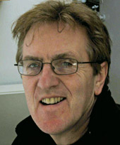
Really?
“Teachers are USELESS at ________________”
Professor Neil Mercer 2010

Slide 11


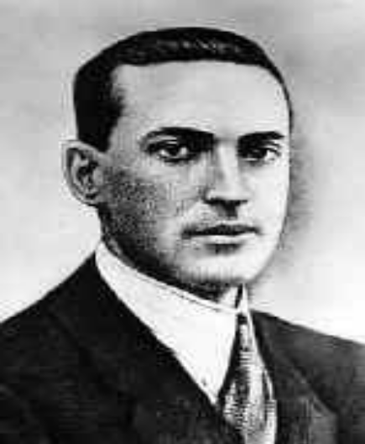
Effective collaboration
“What the child learns to do in cooperation with others, he will learn to do alone.”
Lev Vygotsky, Mind and Society, 1978

Slide 12

“Talk is the sea upon which all else floats”
James Britton, Language and Learning, 1970

Slide 13

Why is student’s talk in groups often not creative or productive?
1. Many students may not know how to talk and think together effectively
2. Their teachers assume they do
Notes:
13

Slide 14
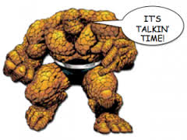
Student Oracy-what is key?
Encouraging/ modelling the use of exploratory/high quality talk
Strategies for getting them talking

Slide 15
Structuring/modelling exploratory talk
Teacher: With your partner, discuss what you know about Oxygen. (suitable pause) Sara, what do you know about Oxygen?
Sara: O is the chemical symbol for Oxygen.
Teacher: Alia is she right?
Alia: Er… yes?
Teacher: What else do you know about Oxygen?
Alia: You breathe it.
Teacher: Mariam , which of those answers do you think is the most interesting?
Teacher: What is the chemical symbol for Oxygen?
Student: O
Teacher: Well done.

Slide 16
Exploratory Talk….
…in which partners engage critically but constructively with each other's ideas;
everyone participates;
tentative ideas are treated with respect;
ideas may be challenged;
challenges are justified, reasons are given and alternative ideas or understandings are offered;
opinions are considered before decisions are made and agreement is sought.
Knowledge is made publicly accountable and so reasoning is visible in the talk.
Notes:
16

Slide 17
Exploratory Talk:
When group work goes right
Talk is really important for learning!!!!
Sharing your ideas with somebody else is learning
Everyone offers relevant information
Everyone's ideas are treated as worthwhile
People ask each other what they think
People ask for reasons and give them
People try to reach agreement
      People don’t just interact - they interthink!
Notes:
*

Slide 18
Exploratory Talk- How to do it!
What do you think?
What are your reasons?
Is there another way of looking at this?
Have we considered all of the factors?
I agree with you because…
I disagree with you because…
What have we agreed?
What if?
The opposite view would be...
Another reason is…

Slide 19

Group Activity One- Icebreaker
In pairs:
Think of a famous person and write their name down on a post it, don’t tell your partner who it is
Stick the post it note to your partners forehead
The task is for the person with the post it on their head to try and guess who it is, the other person can only answer yes or no
You have 2 minutes

Slide 20

Group Activity Two- Debate
In groups of 3:
Take a card from the brown envelope, in your group you have 2 minutes to debate the issue on the card
Remember the rules for great group work and talk:
Everyone offers relevant information
Everyone's ideas are treated as worthwhile– but are critically evaluated
People ask each other what they think
People ask for reasons and give them
People try to reach agreement
Use the prompt phrases on your table to help you!

Slide 21

Group Activity Three- Design a Mammal
In groups of 3:
You have to design a mammal to live in the Canadian Arctic
(very low temperatures and constant darkness in the winter, and temperatures above freezing and constant daylight in the summer)
Choose SIX characteristics from the cards in the white envelope and these must make a sensible animal
Use the exploratory talk prompts on your table to help structure your groups conversation about which characteristics to choose
Using the A3 paper draw your animal and give him/her a name
You have 10 minutes!

Slide 22
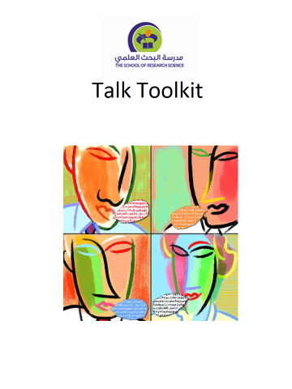
SRS Talk Toolkit….Strategies to facilitate talk
(Courtesy of M.Gershon!)
Circle Time Philosophy for Children
Rainbow Groups Snowballing
Pair Talk Listening Triad
Envoys Jigsawing
Value Continuum Hot Seating
Distancing Goldfish Bowl
Freeze Frame Six Thinking Hats
Free Discussion Radio Phone-In
TV Chat Show Circle of Voices
Post-It Dialogues Rotating Stations
Think-Pair-Share 3-Step Interview

Slide 23
Value Continuum….
Purpose:
To express opinions, show values, discuss differences of opinion, engage in public discussion.
Set Up:
Use a piece of rope or string for the continuum; have arrows pointing on the board; place the two extremes of opinion on opposite walls.
How it works:
In this format students or groups of students have to respond to a thought provoking statement by saying to what degree they agree with it. There are a number of ways this can to used: the students could be asked to come and stand at the point on a line that represents their individual opinion, alternatively, first they could be asked to discuss a statement in groups and then for one of the group to come up to the front and place their groups card/token somewhere along the line, explaining the position their group have taken as they do so. This is an excellent format for comparing responses to different questions and finding out contradictions in their thinking

Slide 24

Rainbow Groups….
Purpose:
Encourages every student to listen (to their home group) and talk (to their colour group)
Set Up:
Standard group work set up with space to move and discuss.
How it works:
Place students in groups with a topic (the same for all, or different topics) to discuss (this is their ‘home’ group). After discussion students are given a colour and regroup accordingly. The new groups should have a member from each of the ‘home’ groups. The students then take it in turns to report back what their groups discussed. This can then lead into further discussion.

Slide 25

Learning Triads….
Purpose:
Structured means of eliciting information, developing concepts and understanding and processing what is said. Also promotes self-awareness through role of observer.
Set Up:
Students in threes, two sat facing, one slightly offset – not engaged but observing.
How it works:
Pupils work in groups of three. Each pupil takes on the role of talker, questioner, recorder. The talker explains something, or comments on an issue, or expresses an opinion. The questioner prompts and seeks clarification The recorder makes notes and gives a report at the end of the conversation. Next time, roles are changed.

Slide 26
Using the Talk Toolkit plan an activity you can do to get your students talking

Slide 27


Further reading:
Daniel Willingham
Mike Gershon
40 strategies for encouraging discussion

