Slide 1
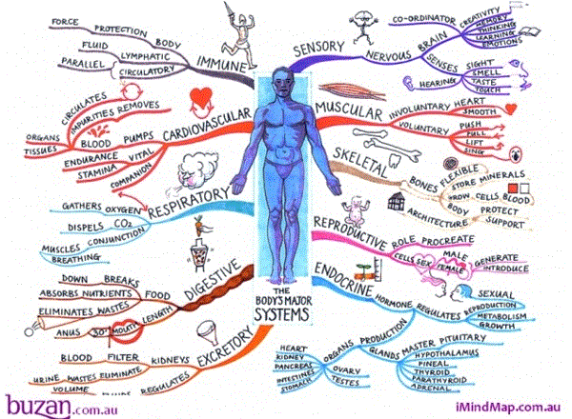
The Power of mind-mapping!

Slide 2
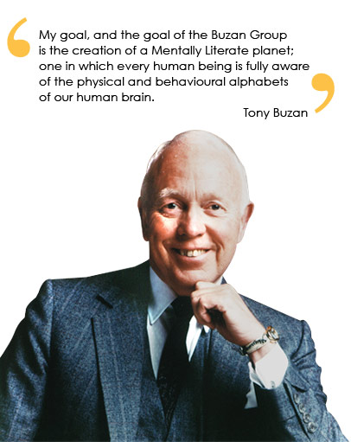
Tony Buzan (the originator of ‘mind maps’)
President of ‘Brain foundation’
Founder of ‘Brain trust’ and ‘The Brains club’
Born London 1942 – Double honours in Psychology
World’s leading author on ‘The power of the brain’ & ‘Creativity and learning’

Slide 4
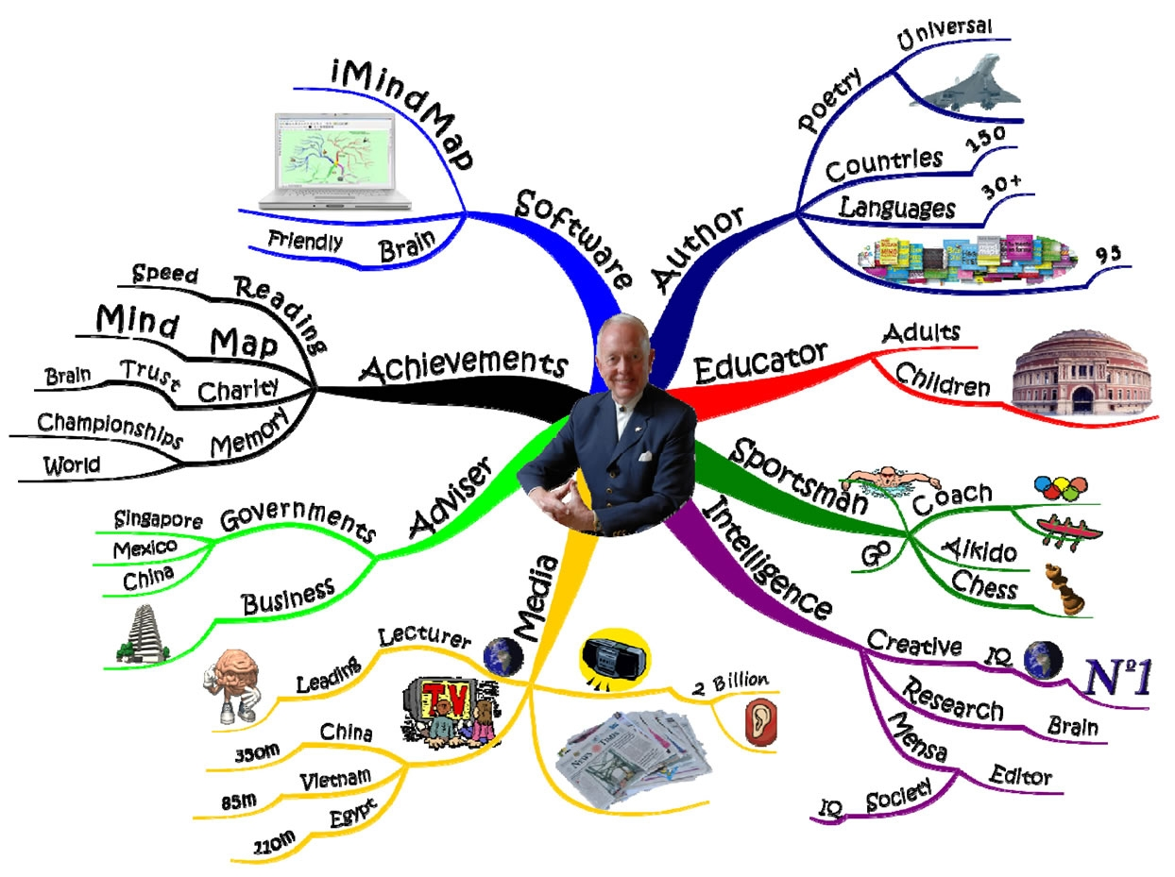
A Mind map of Tony Buzan!

Slide 5
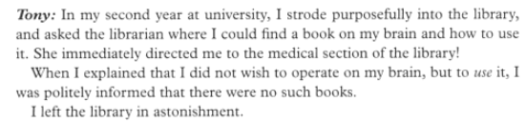



Where it all began…

Slide 6
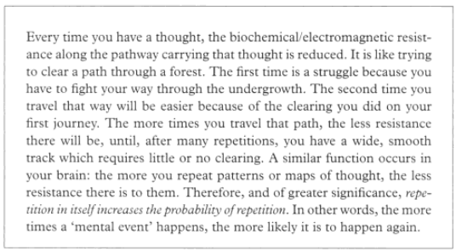
Modern brain research suggests:

Slide 7
So what’s the point of mind mapping?..
Trains your brain to think in an organised, systematic manner to map out information and see how it fits together
Answers some fundamental questions students have:
What do I need to know?
  With so many facts and figures flying around, it’s hard to condense an outline as to exactly what you need to know
What’s the big picture? : How is this all connected?
  Without purpose / relevance/ context it is unlikely this information will stick!
  If it does…it will most likely be rote learnt and not learnt, understood, appreciated and enjoyed!

Slide 8

Trains your mind to be organised & systematic in all disciplines

Slide 9
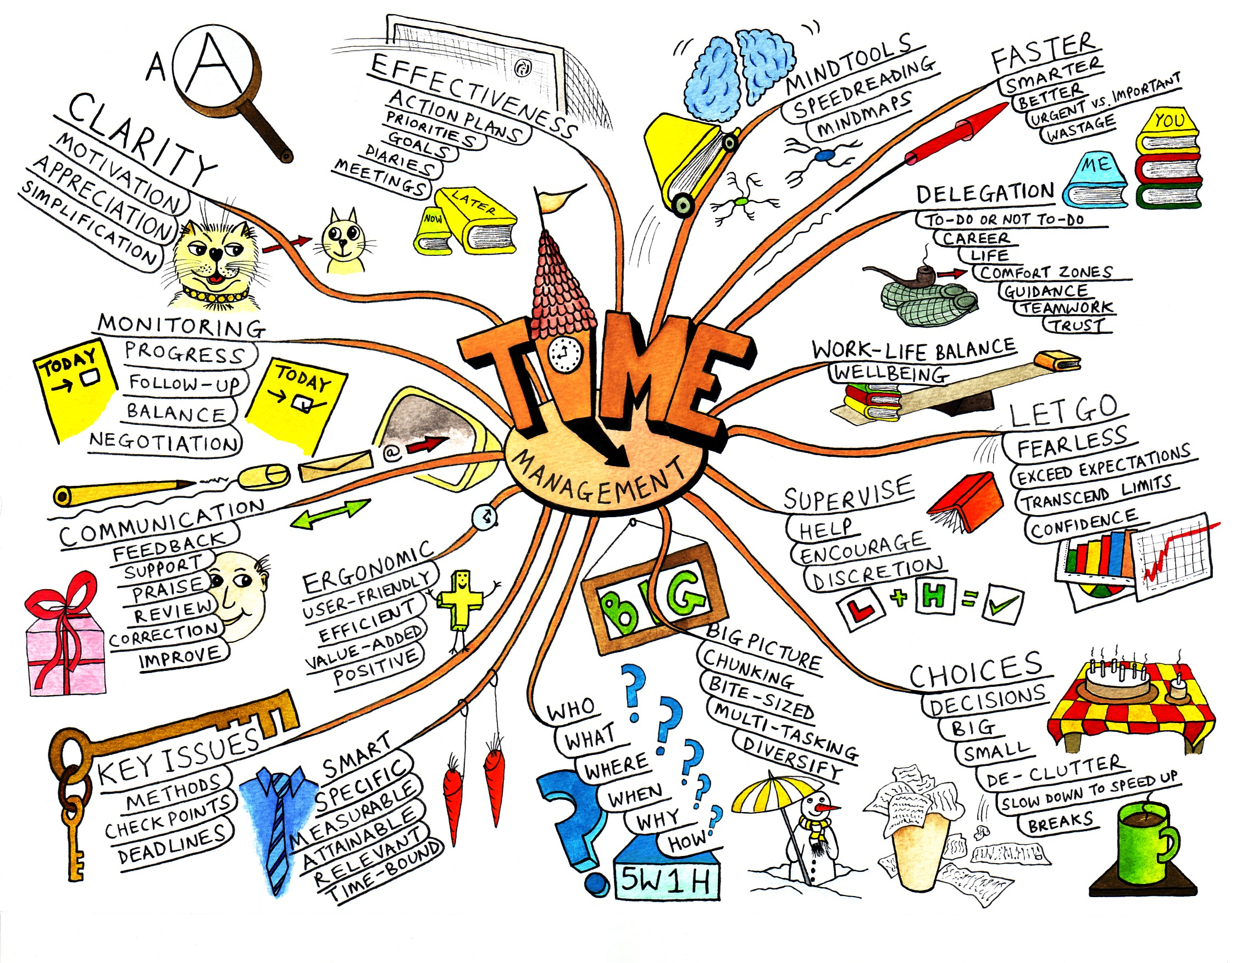
Trains your mind to be organised & systematic in all disciplines

Slide 10
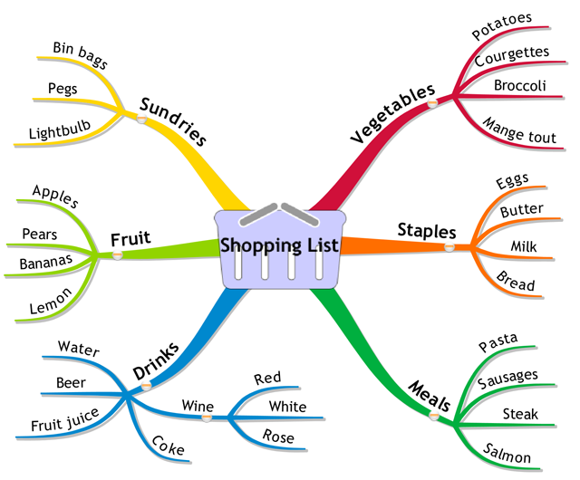
Trains your mind to be organised & systematic in all disciplines

Slide 11
Trains your mind to be organised & systematic in all disciplines- School… Science!

Slide 12
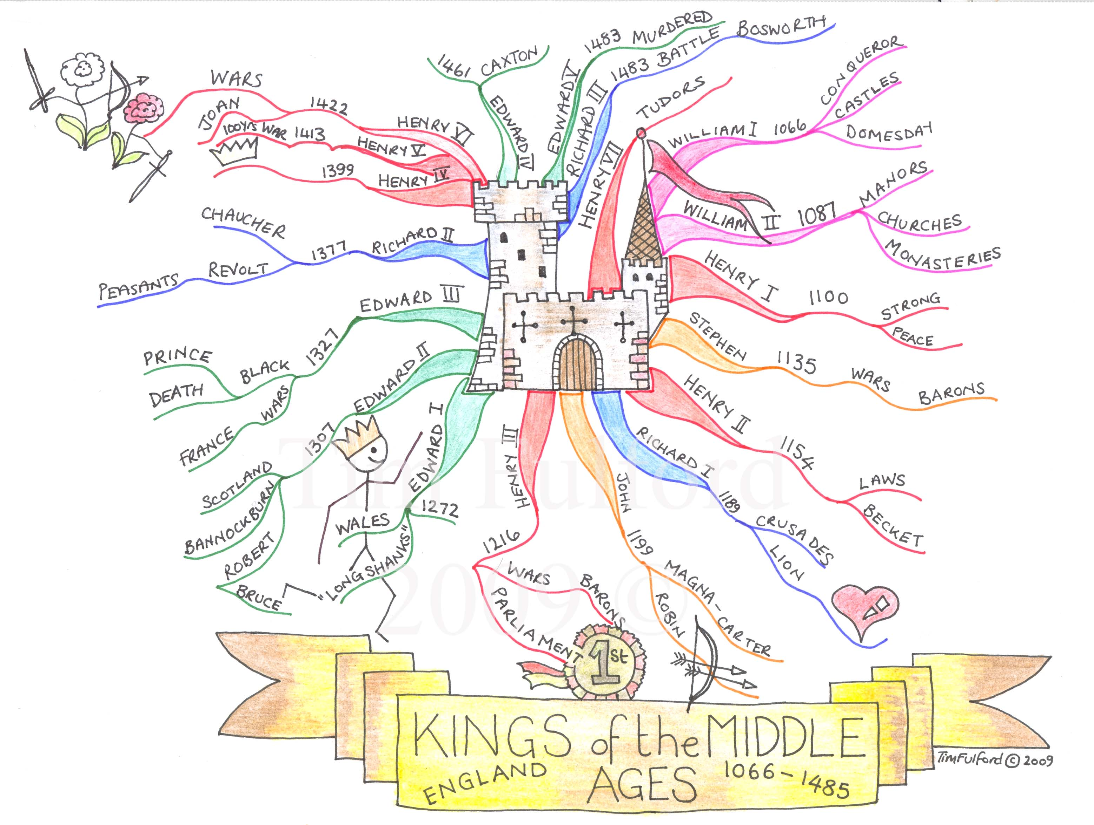
www.wordpress.com
Trains your mind to be organised & systematic in all disciplines- School… History!

Slide 13
How can mind mapping be used in school?
Provide students with a complete mind map for a topic (or just a template)...

Slide 14
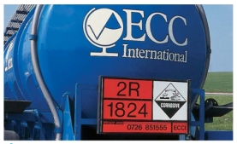
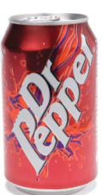
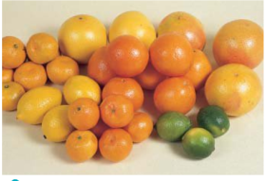

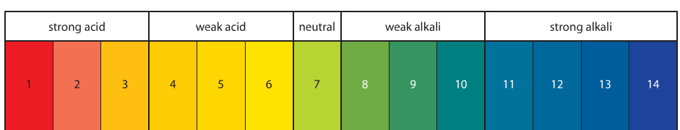
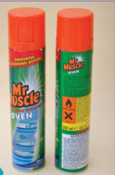
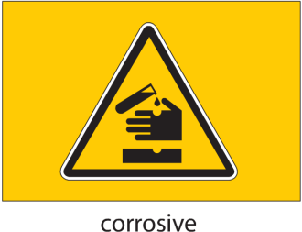
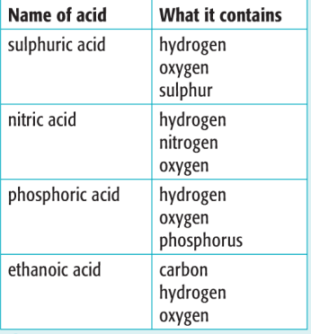
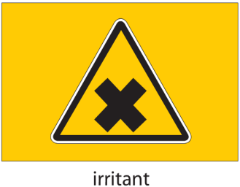
How can mind mapping be used in school?
Get students to create a mind map for a particular lesson
Dangers Acids
Uses Acids
Acids and Alkalis
Acids in every day life
Alkalis in everyday life
Hazard symbols
pH Scale
What does an acid contain?
Uses Alkalis
Dangers Alkalis

Slide 15
How can mind mapping be used in school?
Mind map next steps: Form a basis for discussion
Mind map next steps: Lead into an assessment (oral / written)
Mind map next steps: Starter to lesson / topic
Mind map next steps: Plenary to lesson / topic
Mind map next steps: Differentiated activities in lesson
Acids and Alkalis
Acids in every day life
Alkalis in everyday life
Hazard symbols
What does an acid contain?
pH Scale

Slide 16
How can mind mapping be used in school?
Mind map next steps: Form a basis for discussion:
  On your tables…. In pairs…
  One-to-one (SEN / G&T)
Acids and Alkalis
Acids in every day life
Alkalis in everyday life
Hazard symbols
What does an acid contain?
pH Scale

Slide 17
How can mind mapping be used in school?
Mind map next steps: Lead into an assessment (oral / written)
  IWB / Quiz / fill in blanks / correct statements
  Individually assess: Create from scratch
  Paired: half a map
Acids and Alkalis
Acids in every day life
Alkalis in everyday life
Hazard symbols
What does an acid contain?
pH Scale

Slide 18
How can mind mapping be used in school?
Mind map next steps: Starter to lesson / topic
Mind map next steps: Plenary to lesson / topic
Acids and Alkalis
Acids in every day life
Alkalis in everyday life
Hazard symbols
What does an acid contain?
pH Scale

Slide 19
How can mind mapping be used in school?
Mind map next steps: Differentiated activities in lesson
  Group work (HA/MA/LA)
  Different mind map template for different levels L4, L5, L6
Acids and Alkalis
Acids in every day life
Alkalis in everyday life
Hazard symbols
What does an acid contain?
pH Scale

Slide 20
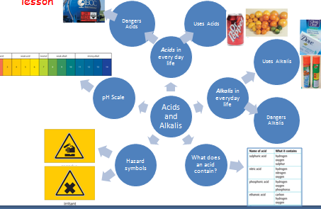
The Power of mind-mapping!
Thanks for listening...
science1@sheffield-school.com

