Slide 1
PERSONALISING FOR TODAY
Mike Wernham
JESS Ranches

Slide 2

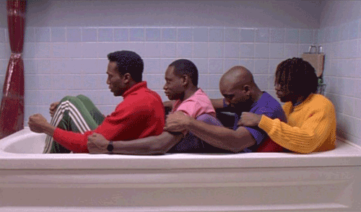


Slide 3


Slide 4
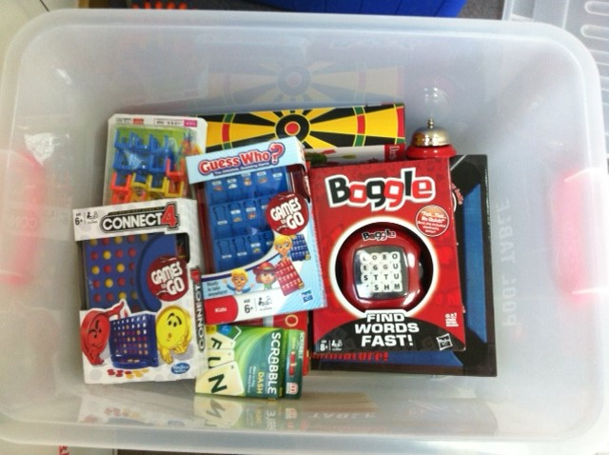

Slide 5


TEACHER TAKEAWAY

Slide 6
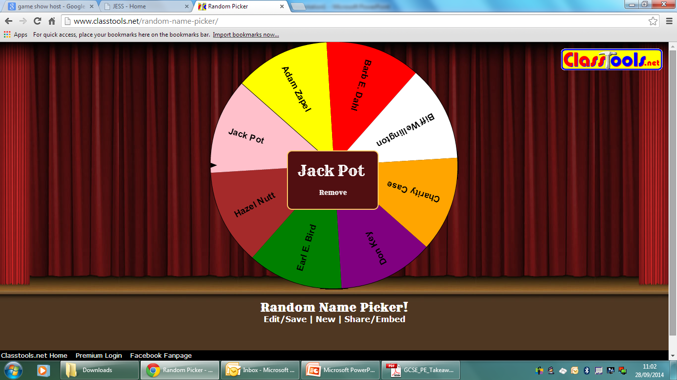

Slide 7
