Slide 1
Using MOOCs to enhance learning for teachers and students
Hamish Farquharson

Slide 2
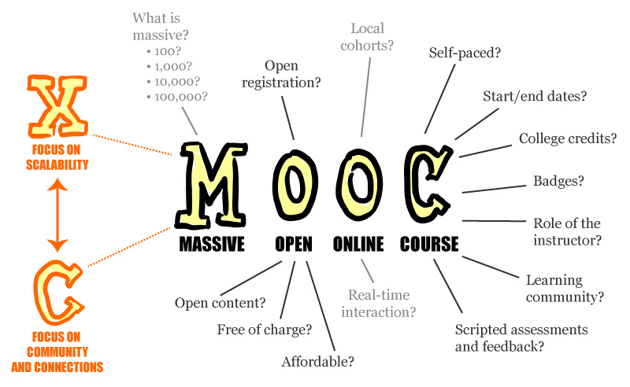

Slide 3
Provider | Example institutional participants
UPEx | USC, UCLA, Khan Academy, NPTEL
Stanford Online | Stanford University
Coursera | University of Maryland, Wharton School, University of Virginia, Stanford University, University of Houston System, University of Tokyo
iversity | Universidad Autonoma de Madrid, University of Florence, University of Hamburg
edX | MIT, Harvard University, UC Berkeley, Kyoto University, Australian National University, University of Queensland, IIT Bombay, Dartmouth College
Eliademy | Aalto University Executive Education,
Canvas Network | Santa Clara University, University of Utah, Université Lille 1
One Month | School of Visual Arts
OpenLearning | University of New South Wales, Taylor's University, University of Canberra
Udacity | Georgia Institute of Technology, San Jose State University, Google, Salesforce, Facebook, Cloudera, Nvidia, Autodesk, Cadence
Academic Earth | UC Berkeley, UCLA, University of Michigan, Oxford University
FutureLearn | University of Birmingham, University of Reading, Open University, Monash University, Trinity College Dublin, Warwick University, University of Bath, University of Southampton
Peer to Peer University | n/a
Khan Academy | n/a
Acade.me | Universidad Latina
Saylor.org | n/a
Udemy | n/a
MOOEC | University of Queensland, Griffith University, University of Technology^{[clarification needed]}
NovoEd | Stanford University, Carnegie Foundation, Universidad Católica de Chile
WizIQ | IIT Delhi, Des Moines Area Community College
France Université Numérique | Conservatoire National des Arts et Métiers, École normale supérieure de Cachan, University of Paris-Sud

Slide 4
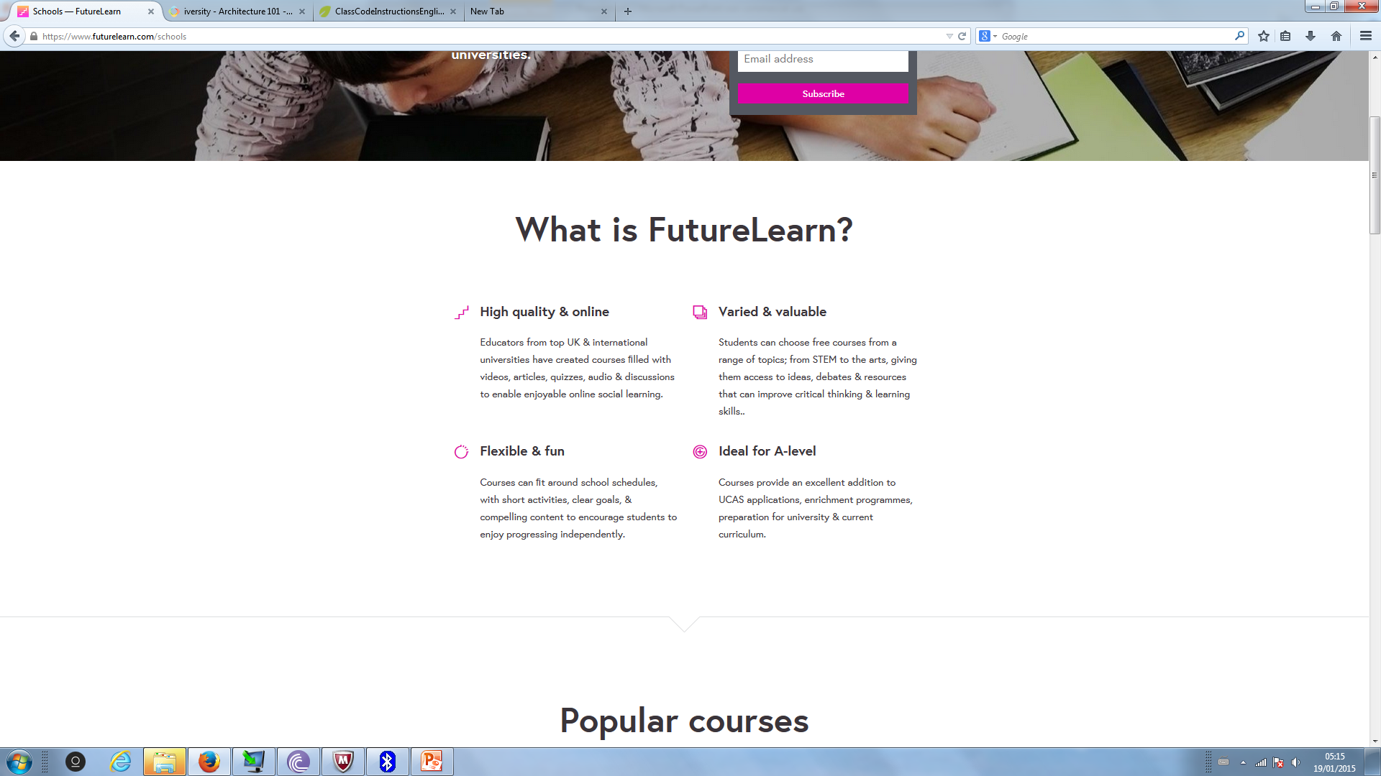
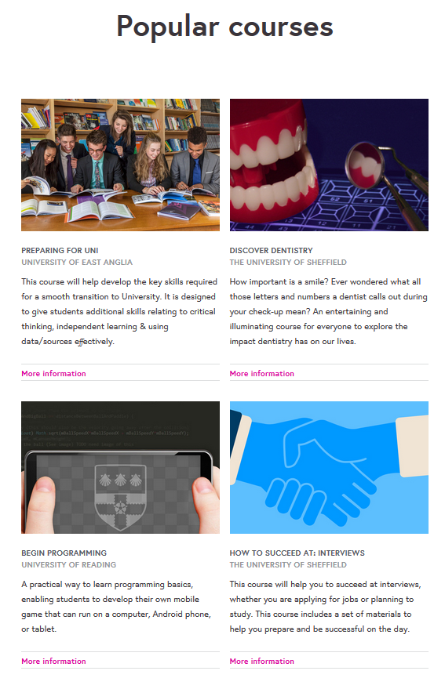

Slide 5
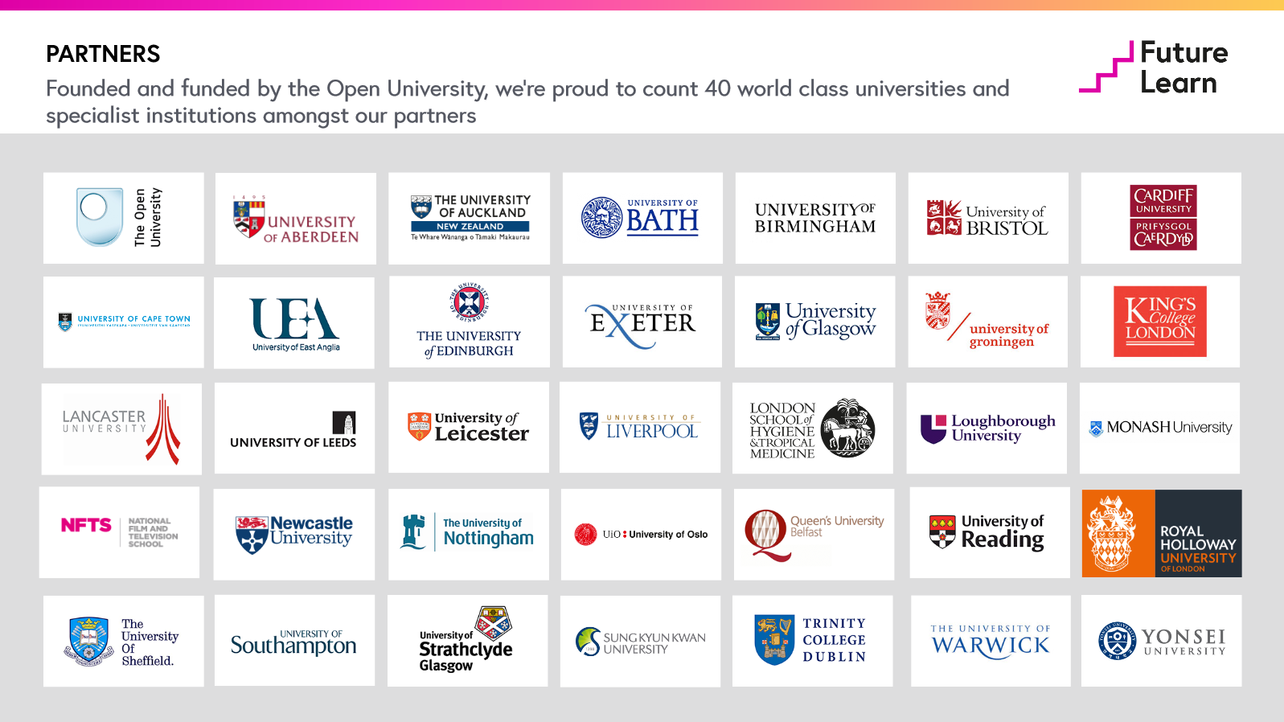

Slide 6
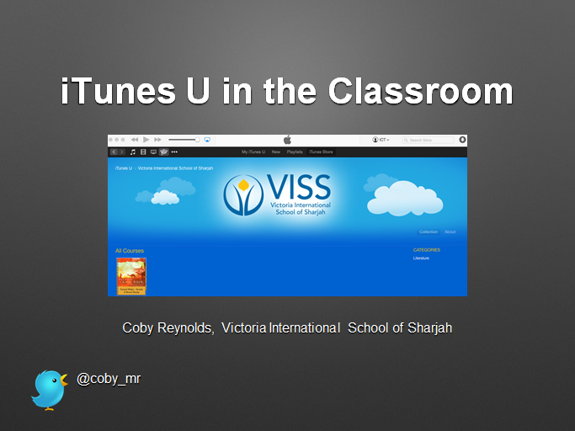

Slide 7
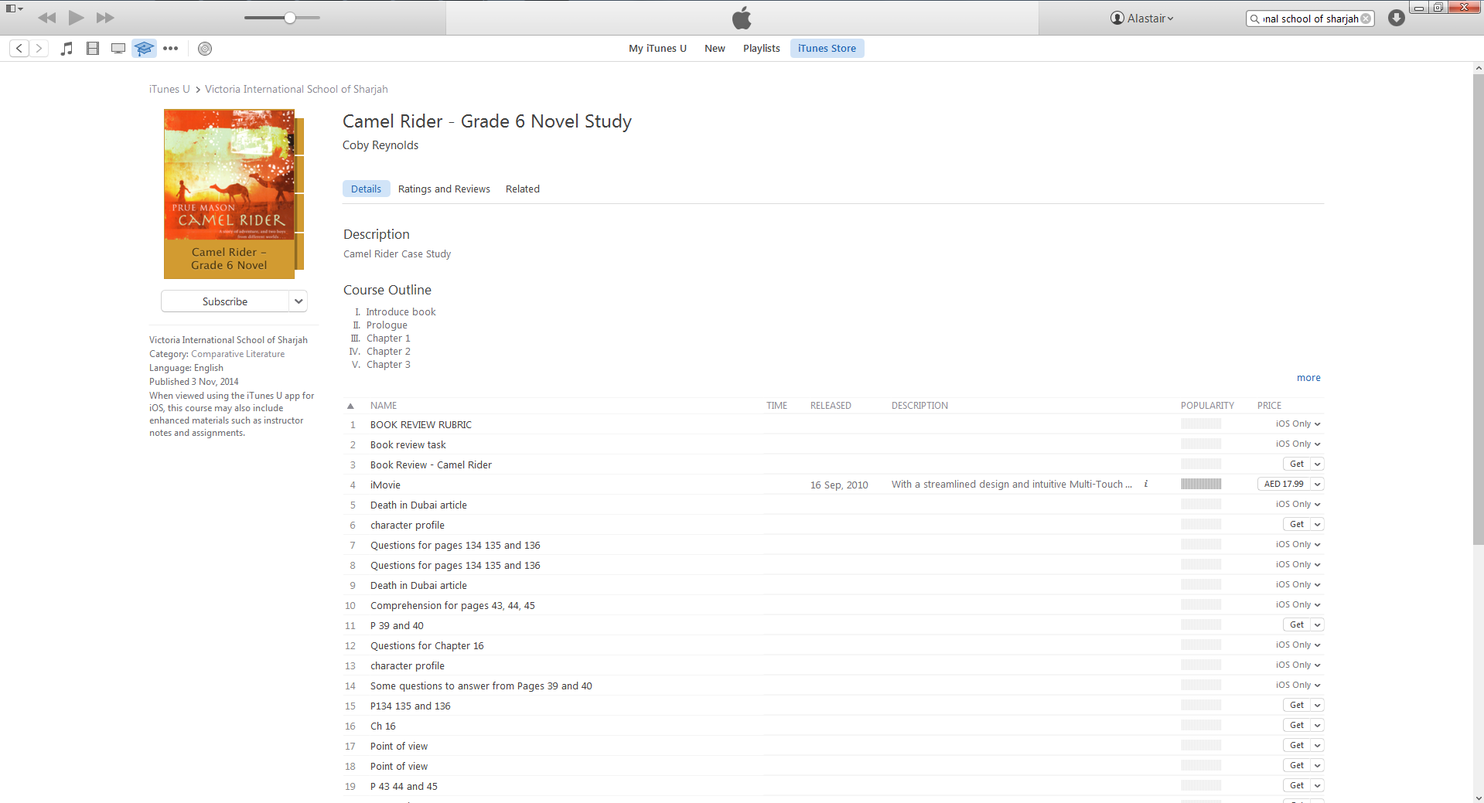

Slide 8
Twitter Links
@af_pedagogy
@coby_mr
@futurelearn
@sparkeducators

