Slide 1




Professional Development
Through Collaboration
Ed Mosley
Secondary School Teacher
Physical Education and Geography
Whole School Professional Development
@mrmozely

Slide 2
The history of CPD at SES
Three years ago - very traditional - external courses
Two years ago - time dedicated in briefing to share good practice.
Last year - Development meetings every 6 weeks - more formalised.
Today - multiple facilities to access professional development through collaboration, independently and external courses. Accountability introduced.

Slide 3
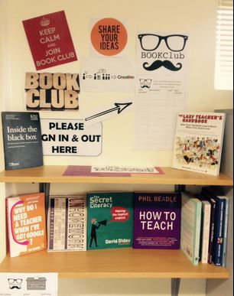
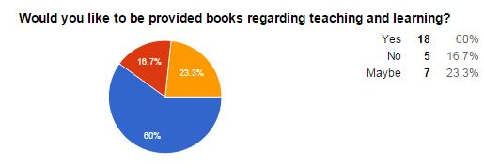
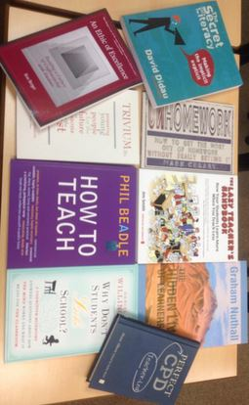
Book Club

Slide 4
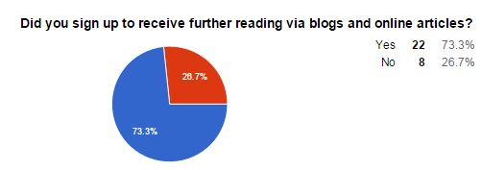

Blog subscription...
Staff sign up to a mailing list through CPD coordinator:
Teaching and Learning
Leadership
A Teacher’s Life
UK Education Policy and Ofsted

Slide 5

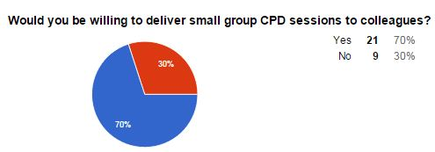



Pop Up PD...

Slide 6

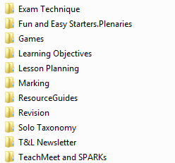
The Teacher’s Toolbox...
A organised folder of resources
Put together by contributing staff
Maintained and updated by staff
Referred to at key points throughout the year.

Slide 7
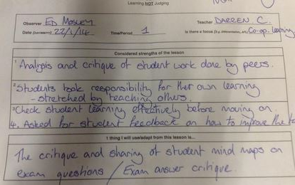
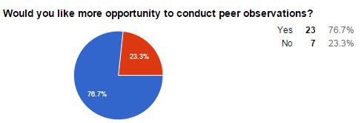
Peer Observations....Learning NOT Judging
Arranged between teachers
Covered by SLT.
20 minutes.
Three strengths.
One thing you have taken from the lesson.
Carbon copy in staff room.
Copy to the teacher.

Slide 8

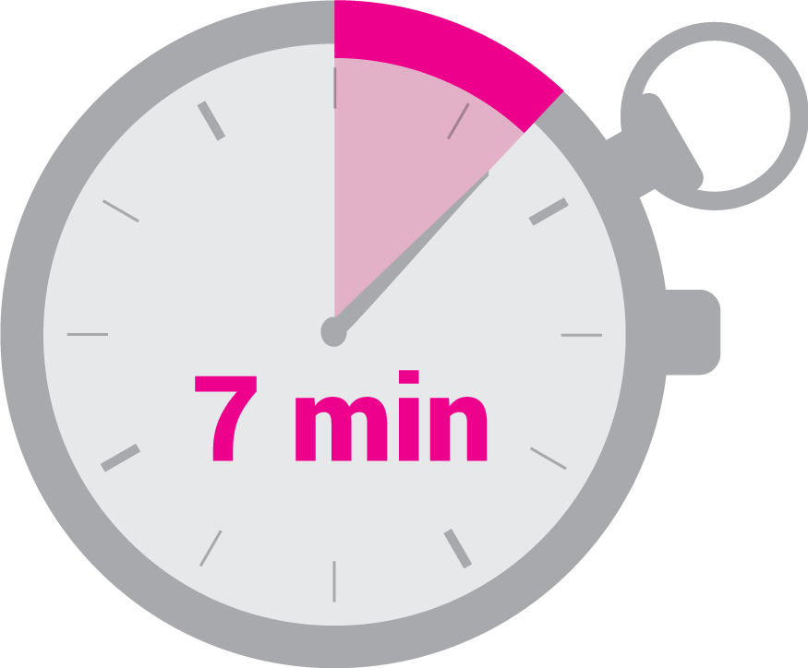
CPD
Tuesday’s
Staff briefing
An opportunity to share good practice
Celebrate good teaching.

Slide 9
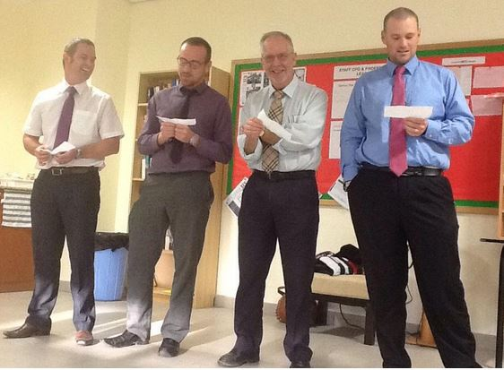
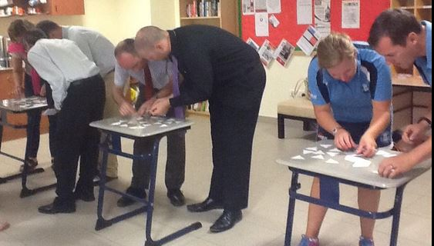
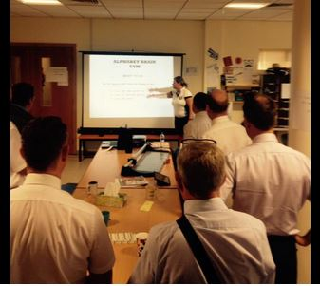
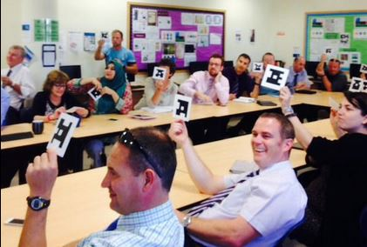
Lots of enjoyment
Creates a culture of sharing good practice
Opportunity to collaborate

Slide 10
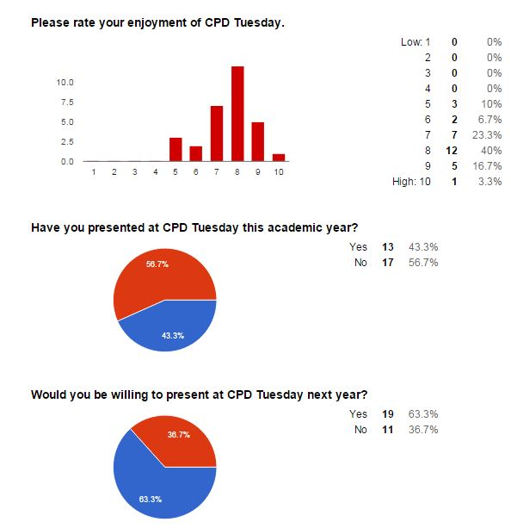
CPD Tuesday’s...
43% presented
63% want to present

Slide 11
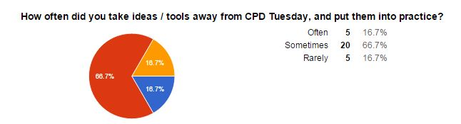
CPD Tuesday’s...

Slide 12
CPD Tuesday’s...

Slide 13



@mrmozely
Ed Mosley
emosley@sharjahenglishschool.org

