Slide 1

Lazy Teaching: Ideas for work life balance
Neal Oates
Dubai British School
Head of Primary Computing
@mroatessosimple
noates@dubaibritishschool.ae

Slide 2


Some stuff to read

Slide 3
The Lazy Teacher Philosophy
An effective teacher is not overworked and stressed.
There is no need to do everything for your students… They learn better by doing it themselves anyway.
Be secure in the fact that an independent enquirer/learner does not need to depend upon you.
Talk less and students will learn more!

Slide 4
Tip 1 - Before planning any lesson activity think...
What will the students have to do?
What will I have to do in response to this?
How can I make the students do as much of the work as possible?
How do I keep myself free to engage with students who need my support?
Who am I going to assess and give meaningful feedback to?

Slide 5


Tip 2 - Make them work for answers...

Slide 6
Tip 3 - Stop marking everything a student writes in a book...
Student feedback is the single most powerful learning tool we use. But it doesn't have to be a chore! And it doesn't all take place in a student's book.
Do you have to mark everything?
Could the student self/peer assess the work first?
Feel free to refuse work before it has been self assessed properly!
Could you give them some formative feedback and tips instead of a mark/grade?
Do we have to write down all our feedback?
Are we marking the book for the students sake or because of an upcoming book scrutiny?

Slide 7
Tip 4 - Technology is your friend
Use Google Drive to share work and continuously improve resources across a department. Reinvent the wheel together!
Google Forms/Edmodo/Flubaroo/Zondle and many others allow instant assessment. Less time marking more time on feedback/teaching!
Use Blendspace/Edmodo/GDrive to share resources.
Flip your classroom with pre recorded lessons. Get students to create the resources for you? Could they plan the lessons for you?
Use online documents to give live feedback during your lessons. Get students commenting on each other's work! Live assessment sessions.
Force students to be collaborative/Independent enquirers and use technology effectively.

Slide 8










Some tools a lazy teacher might use

Slide 9

All About Google Drive/Docs

Slide 10
Links to todays sites
https://www.blendspace.com/
http://www.qrstuff.com/
http://www.nearpod.com/
https://www.edmodo.com
https://getkahoot.com/
https://www.zondle.com/

Slide 11
Lazy Teaching: Ideas for work life balance
Neal Oates
Dubai British School
Head of Primary Computing
@mroatessosimple
noates@dubaibritishschool.ae

Slide 12
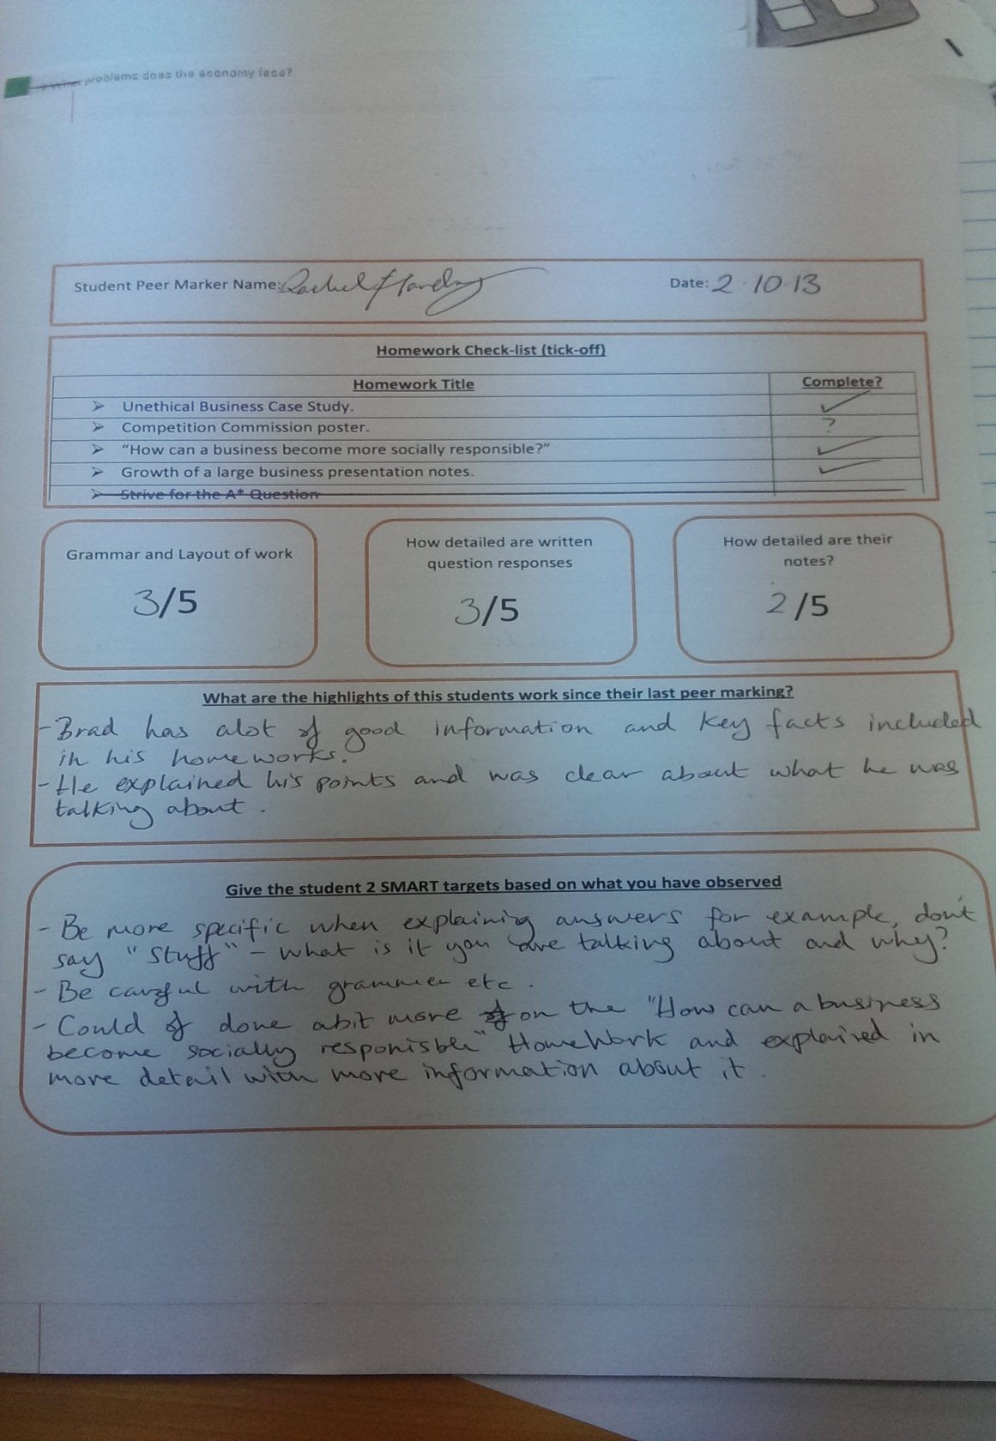
Get students to spend time finding grammatical errors and checking for homework.
Peer assessment of the quality of work on offer
Finally the most important part where the student says what is good and gives their peer smart targets for improvements

