Slide 1
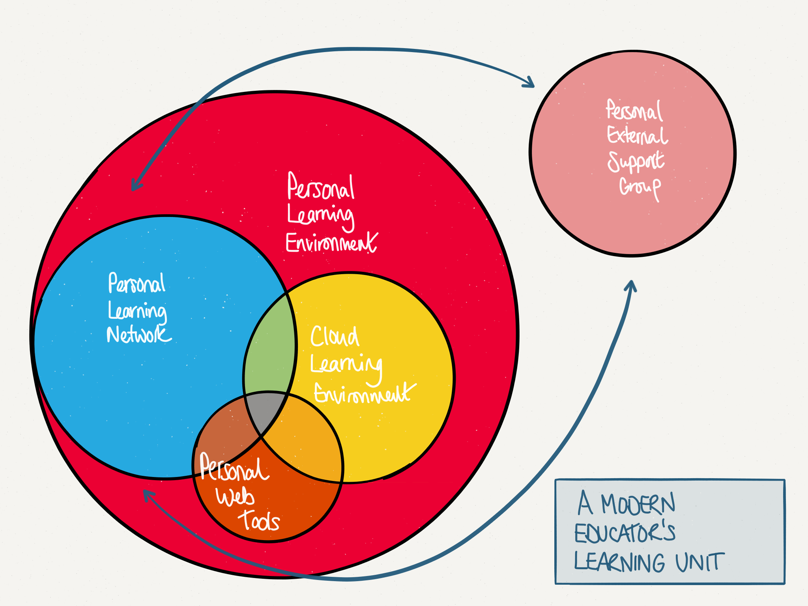

Slide 2

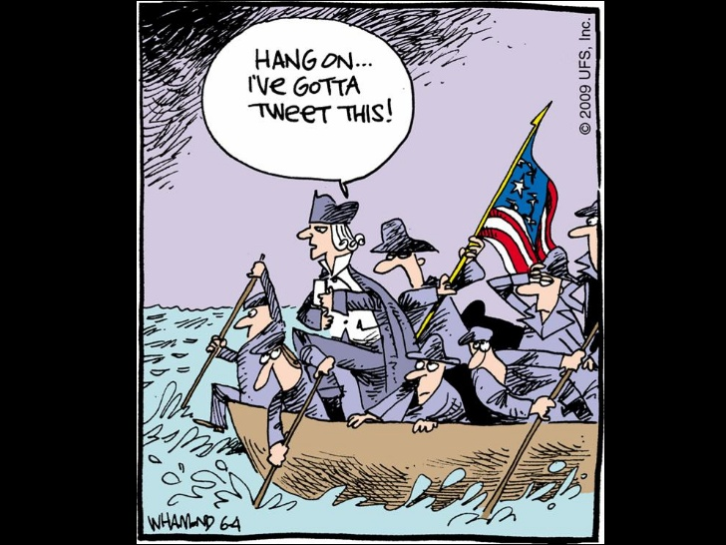


Learning
Inspiration
Collaboration
Reflection
#DESClearn
“It’s time to realise that teachers who leverage social media for learning are at a greater advantage than those who don’t” (@gcouros)

