Slide 1


Slide 2
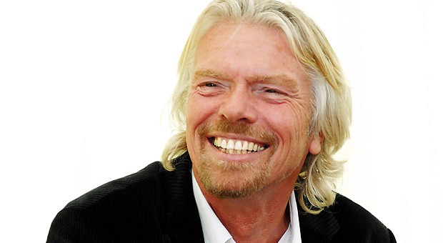
Sir Richard Branson

Slide 3
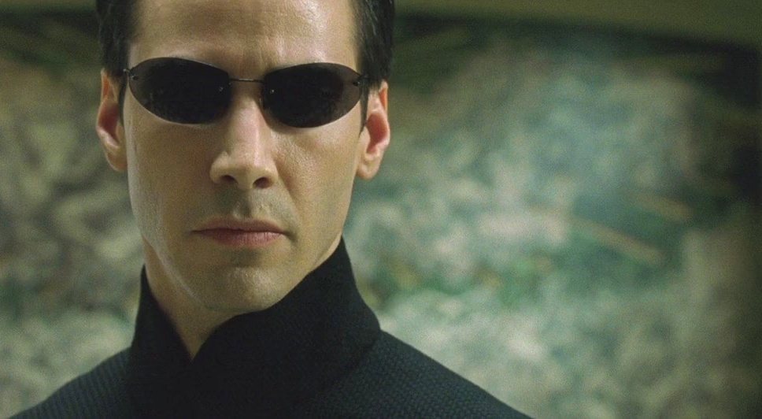
Neo from Matrix

Slide 4
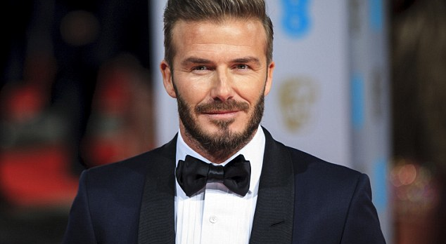
David Beckham

Slide 5
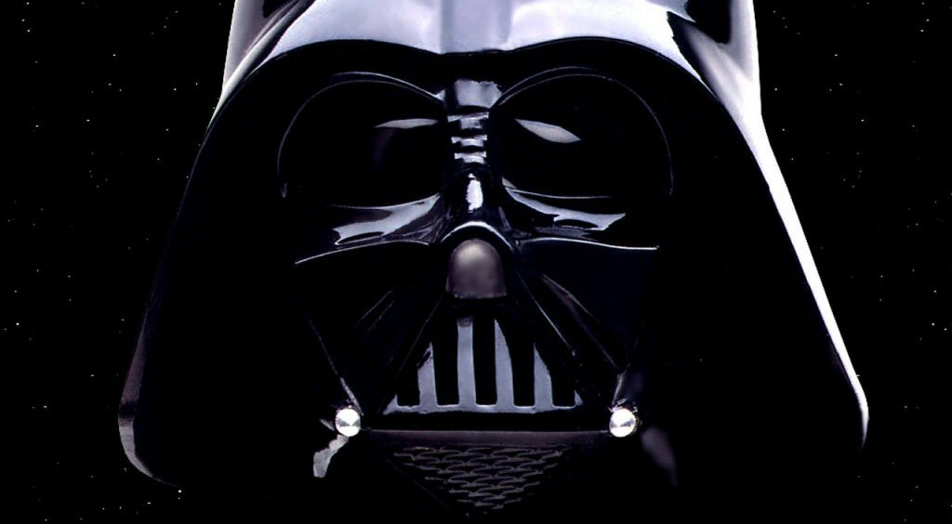
Darth Vader

Slide 6
What do they have in common?

Slide 7
They all had a mentor

Slide 8
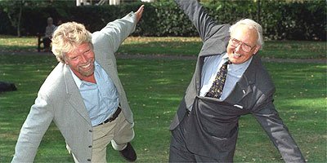
Sir Freddy Laker

Slide 9
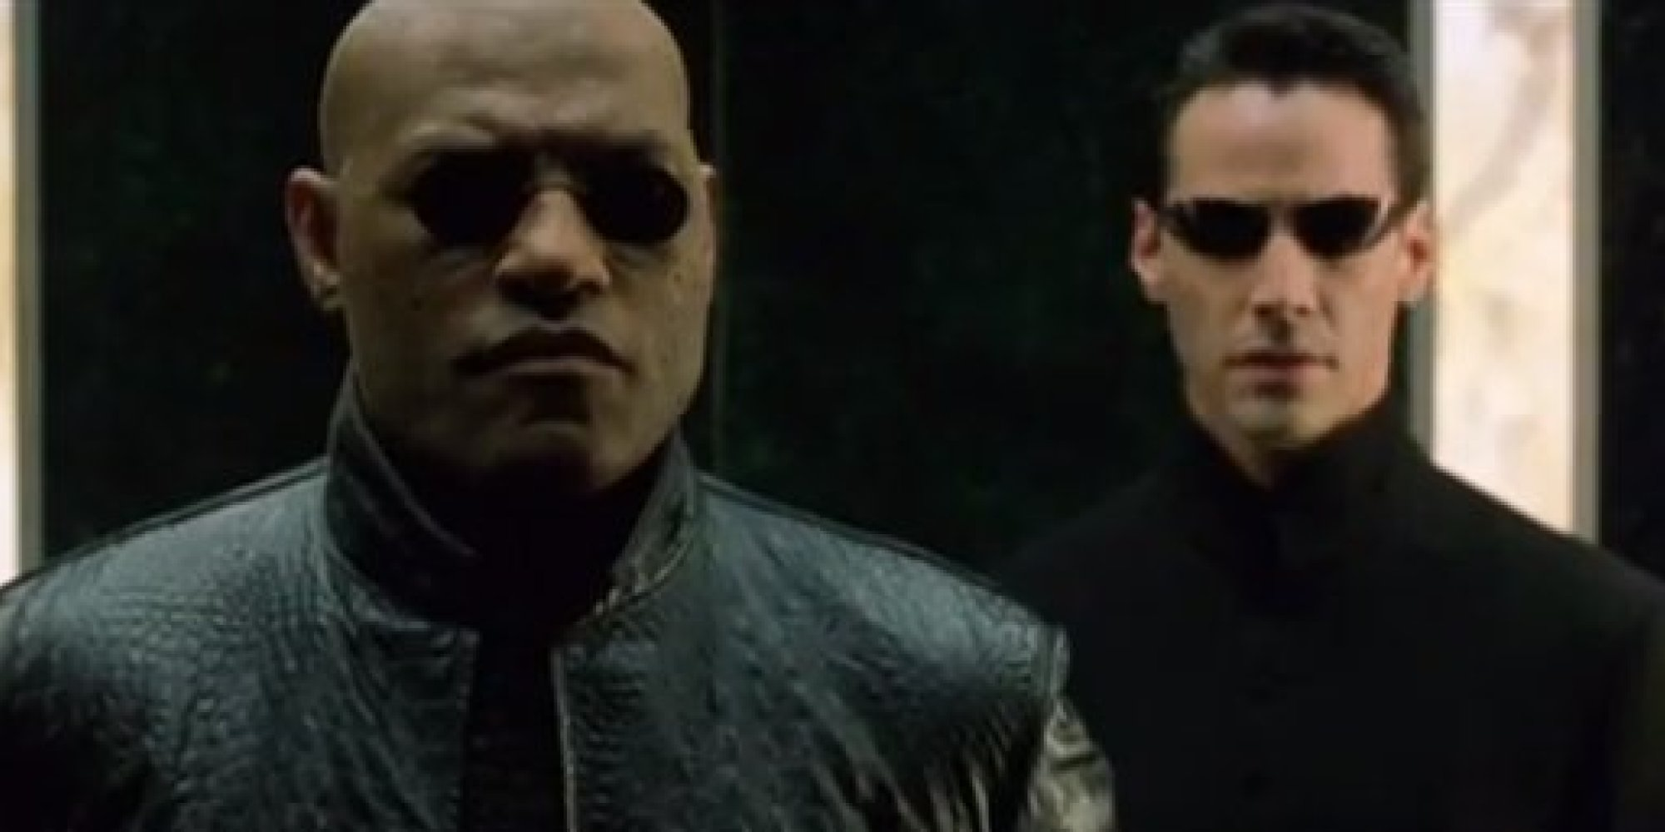
Morpheus

Slide 10
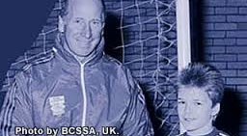
Sir Bobby Charlton

Slide 11
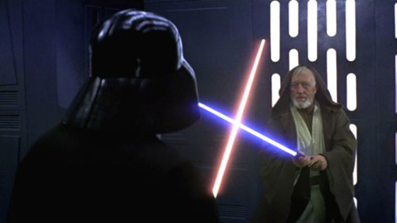
Obi-Wan Kenobi

Slide 12


Slide 13
https://vimeo.com/144399545

Slide 14
If mentoring works for the successful, imagine if every child had a mentor?

Slide 15
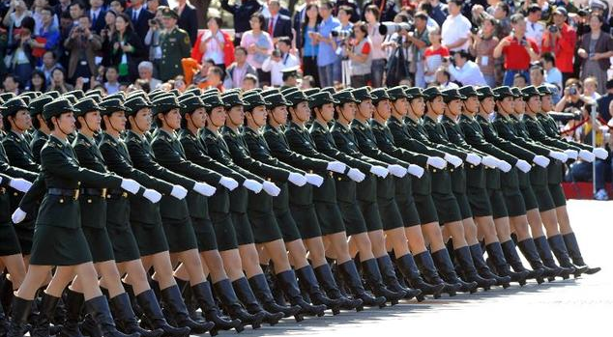
Mass mentoring

Slide 16
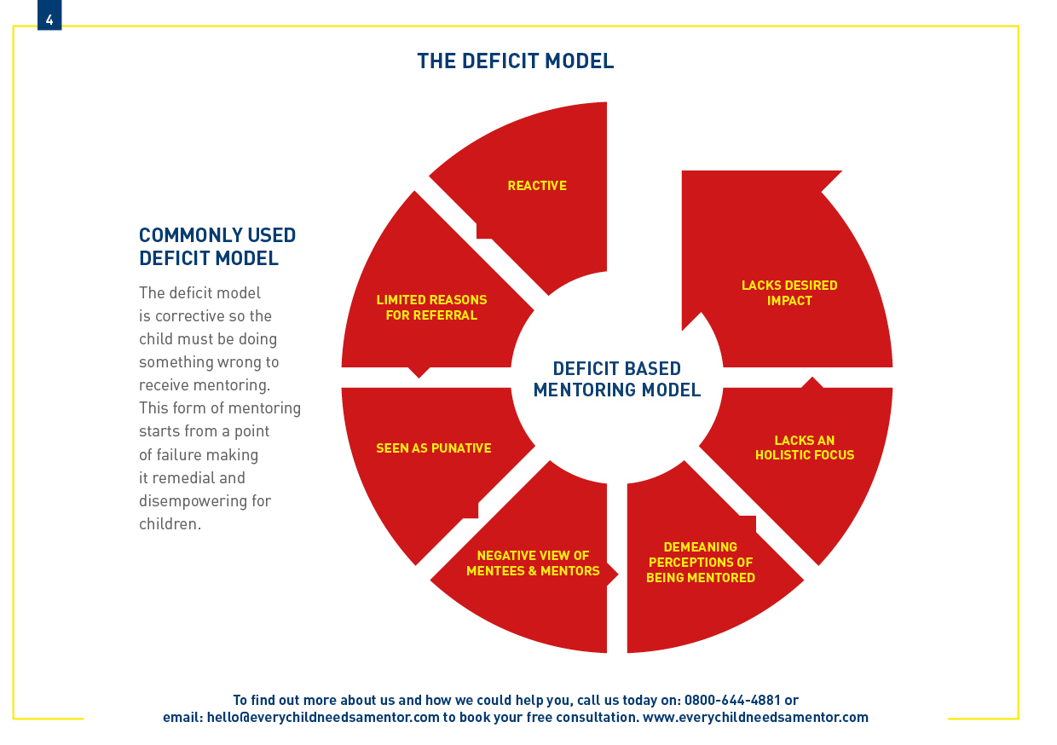
Mass mentoring

Slide 17
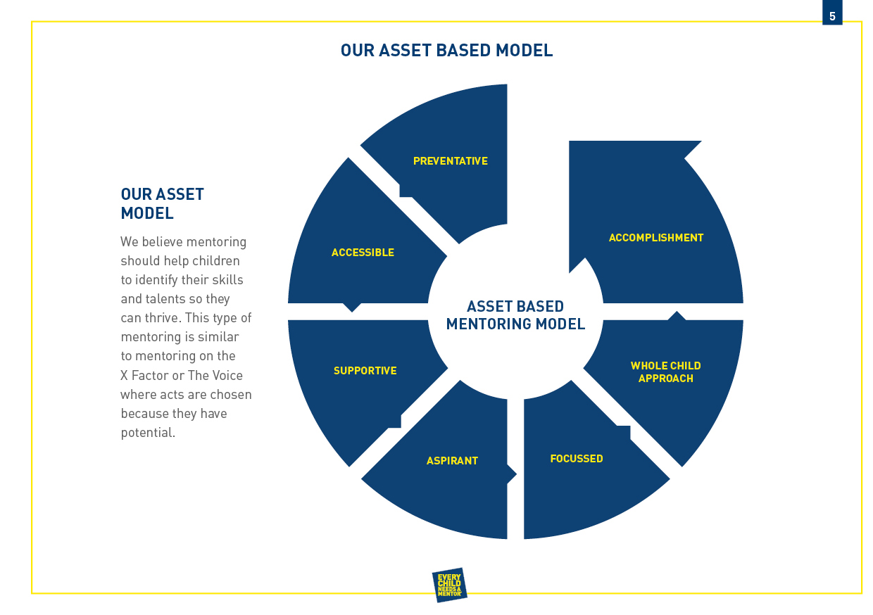
Mass mentoring

Slide 18


Slide 19
Head teacher Feedback
“The students outstripped the outcomes in their previous grade predictions. This was my vision for them as the Head teacher.
I cannot recommend Every Child Needs a Mentor highly enough; in fact we have engaged their services again".
Heather Phillips - Head teacher

Slide 20
Improvement of grades
^{53% improvement GCSE Maths}
^{50% improvement GCSE English}
“Last year our school achieved our best ever exam results in the schools history. The work that Herman did has helped us to achieve this.” Dean Blake – The International School, UK

Slide 21
Student Voice
68 out of 68 students found being on the Every Child Needs a Mentor programme to be good to very good.

Slide 22
Parent Voice
27 out of 28 parents said their child’s progress was good to very good whilst being on the Every Child Needs a Mentor programme

Slide 23
Staff Voice
9 out of 10 staff members who became mentors on the Every Child Needs a Mentor programme found their experience good to very good

Slide 24

Herman Stewart
Founder & CEO
Contact details
herman@everychildneedsamentor.com

