Slide 1
Courses and Qualifications for Secondary SEND Students
Louise Dawson

Slide 2
British System
Qualifications and Credit Framework
Qualifications and Credit Framework (QCF)
Allows individual pace
Regulated by Ofqual, Wales’ DCELLS and Northern Ireland’s CCEA.

Slide 3
British System
Qualifications and Credit Framework
Levels of difficulty
Entry Level to Level 8
GCSE is currently the first recognised level of qualification across the UAE
Students can still achieve qualification below GCSE

Slide 4
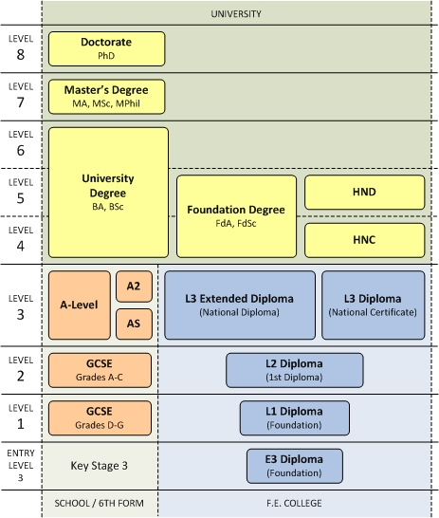
QCF Framework

Slide 5
Entry Level 1 – English
Three elements: reading, speaking/listening, writing
Reader and scribe allowed without access arrangement application
Context is changeable without informing the exam board

Slide 6
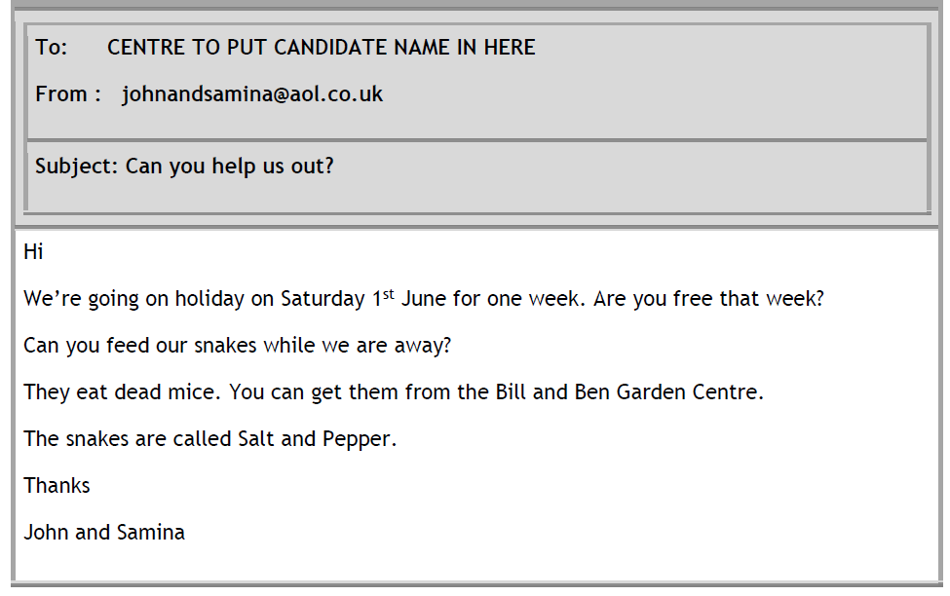
Entry Level 1 – English - Reading

Slide 7
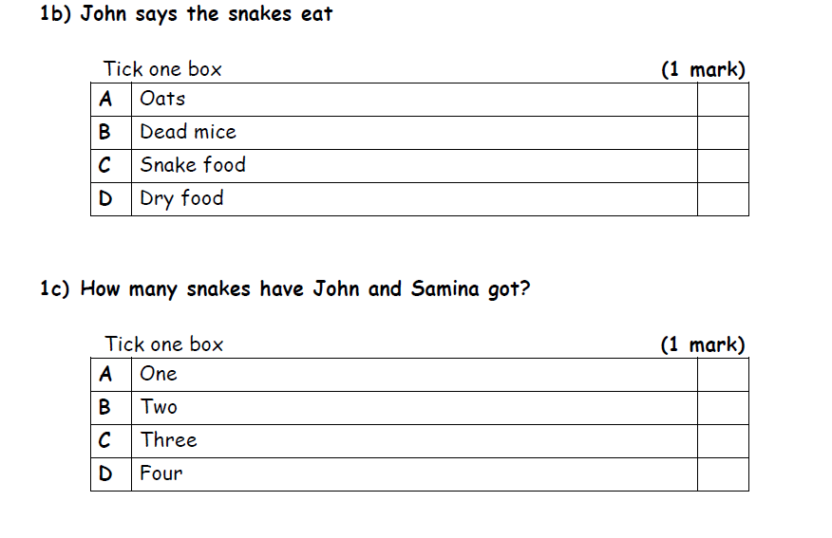
Entry Level 1 – English - Reading

Slide 8
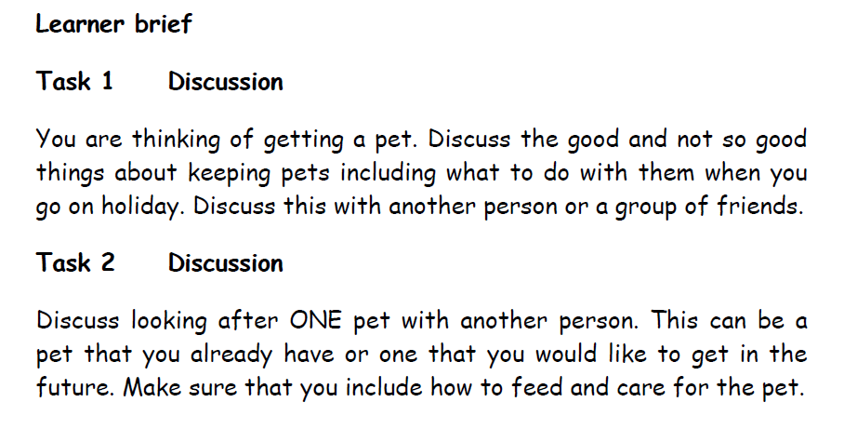
Entry Level 1 – English – S&L

Slide 9
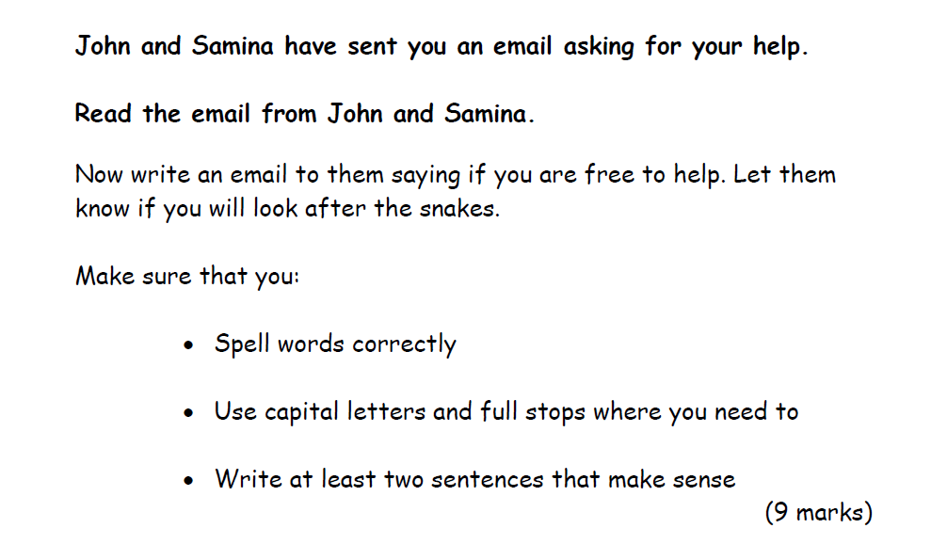
Entry Level 1 – English - Writing

Slide 10
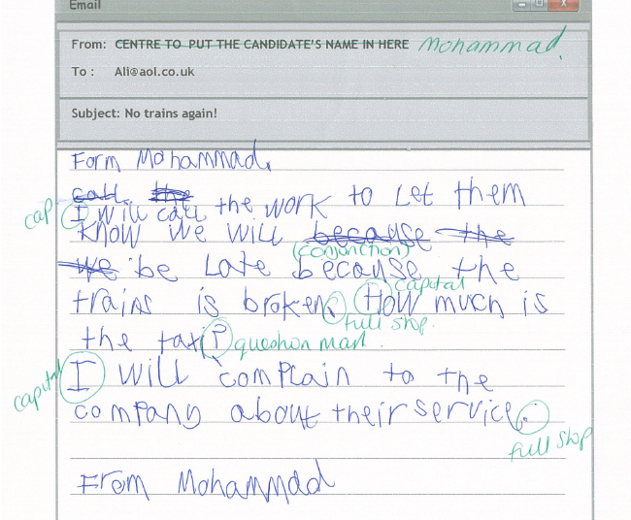
Entry Level 2 – English - Writing

Slide 11
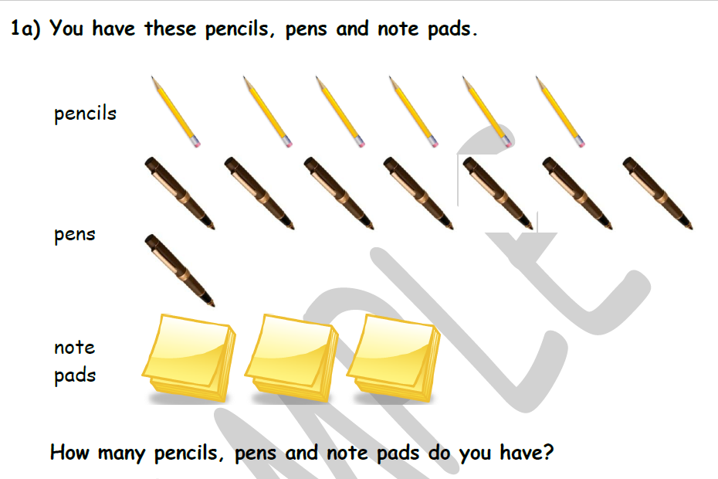
Entry Level 1 – Maths

Slide 12
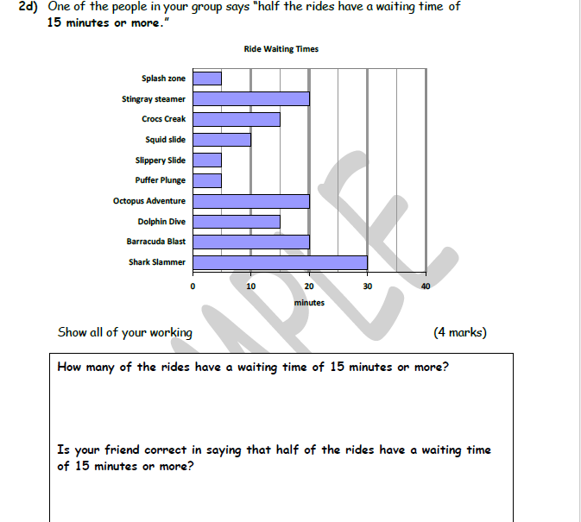
Entry Level 3 – Maths

Slide 13
ASDAN
http://www.asdaninternational.com/
Managed from the UK
Courses not regulated by Ofqual and so no training required for delivery
http://www.asdan.org.uk/
Managed from the UK
Regulated by Ofqual and so training is mandatory
Modules are between 10 hours and 150 hours of learning time

Slide 14
ASDAN
ASDAN courses fall into three categories:
Curriculum programmes:
Structured, ‘light-touch’ resources that promote active learning and progression and reward achievement
Development courses: A low-cost programme with a certificate at the end, for individuals or small numbers of learners​.
ASDAN can also offer bespoke accreditation for your existing programme through our Customised Programmes option.

Slide 15
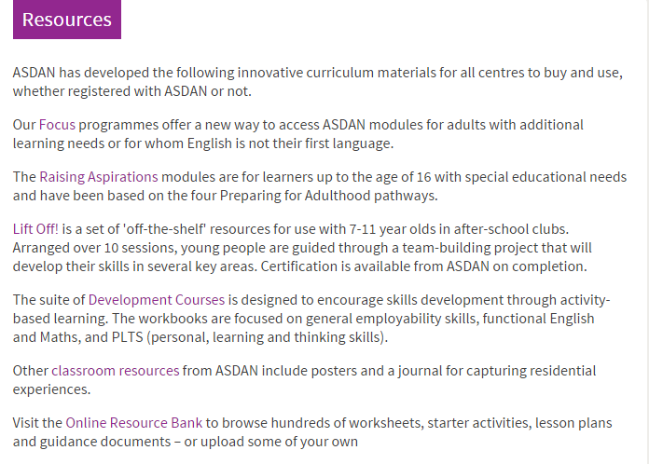
ASDAN
ASDAN courses fall into three categories:
Resources:

Slide 16
ASDAN
ASDAN courses fall into three categories:
Topics:
English / Maths / Computing
Animal Care / Hair and Beauty
Personal Finance
Roadwise
History
Hospitality
Rugby
Volunteering
Sport and Fitness
Leadership
Islam and citizenship
Find out more with a non commital expression of interest

Slide 17
Contact
ASDAN courses fall into three categories:
Louise Dawson
L-dawson@kingsalbarsha.com
UK Distance Learning
shaun@ukdlp.com
http://www.ukdlp-distance-learning.com/
ASDAN International
http://www.asdaninternational.com/
ASDN UK
http://www.asdan.org.uk/

