Slide 1
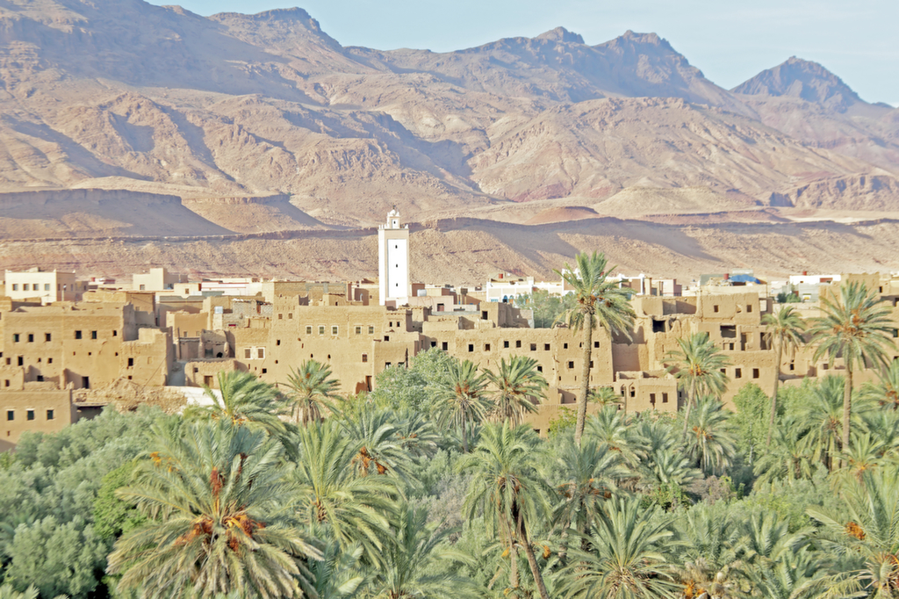
Raising the standard of Arabic, Islamic and Social Studies
Notes:
1
1
1
1

Slide 2
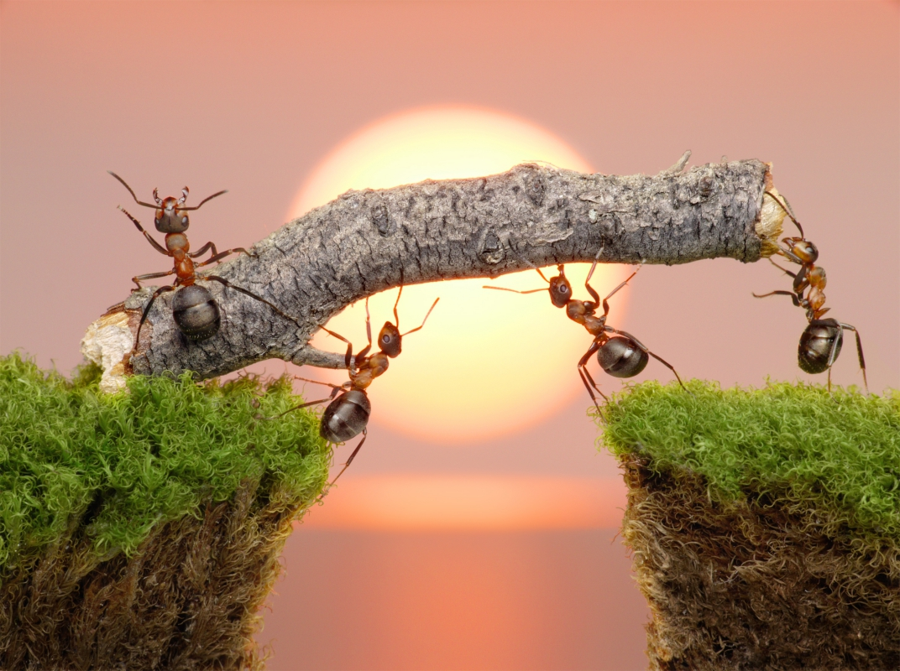
Strategies
Team/moral
Notes:
2
2
2
2

Slide 3
Raising standards in pedagogy.
Evaluation of current position and provision
Action plan
Measurable, timed
Review, reflect, react
New curriculum
Meaningful, fun and allows progression
Up-to-date with teaching and learning strategies.
CPD
Monitoring and evaluating the work in the department
Book scrutiny/SEN/
Resources and resourcing.
Active-learning and learner-centred teaching and learning
AFL at the heart of the teaching practice.
Feedback
High expectations.
Raising the bar
Review of current summative/diagnostic tests
Validity and reliability
Effective measure of teaching and learning.

Slide 4
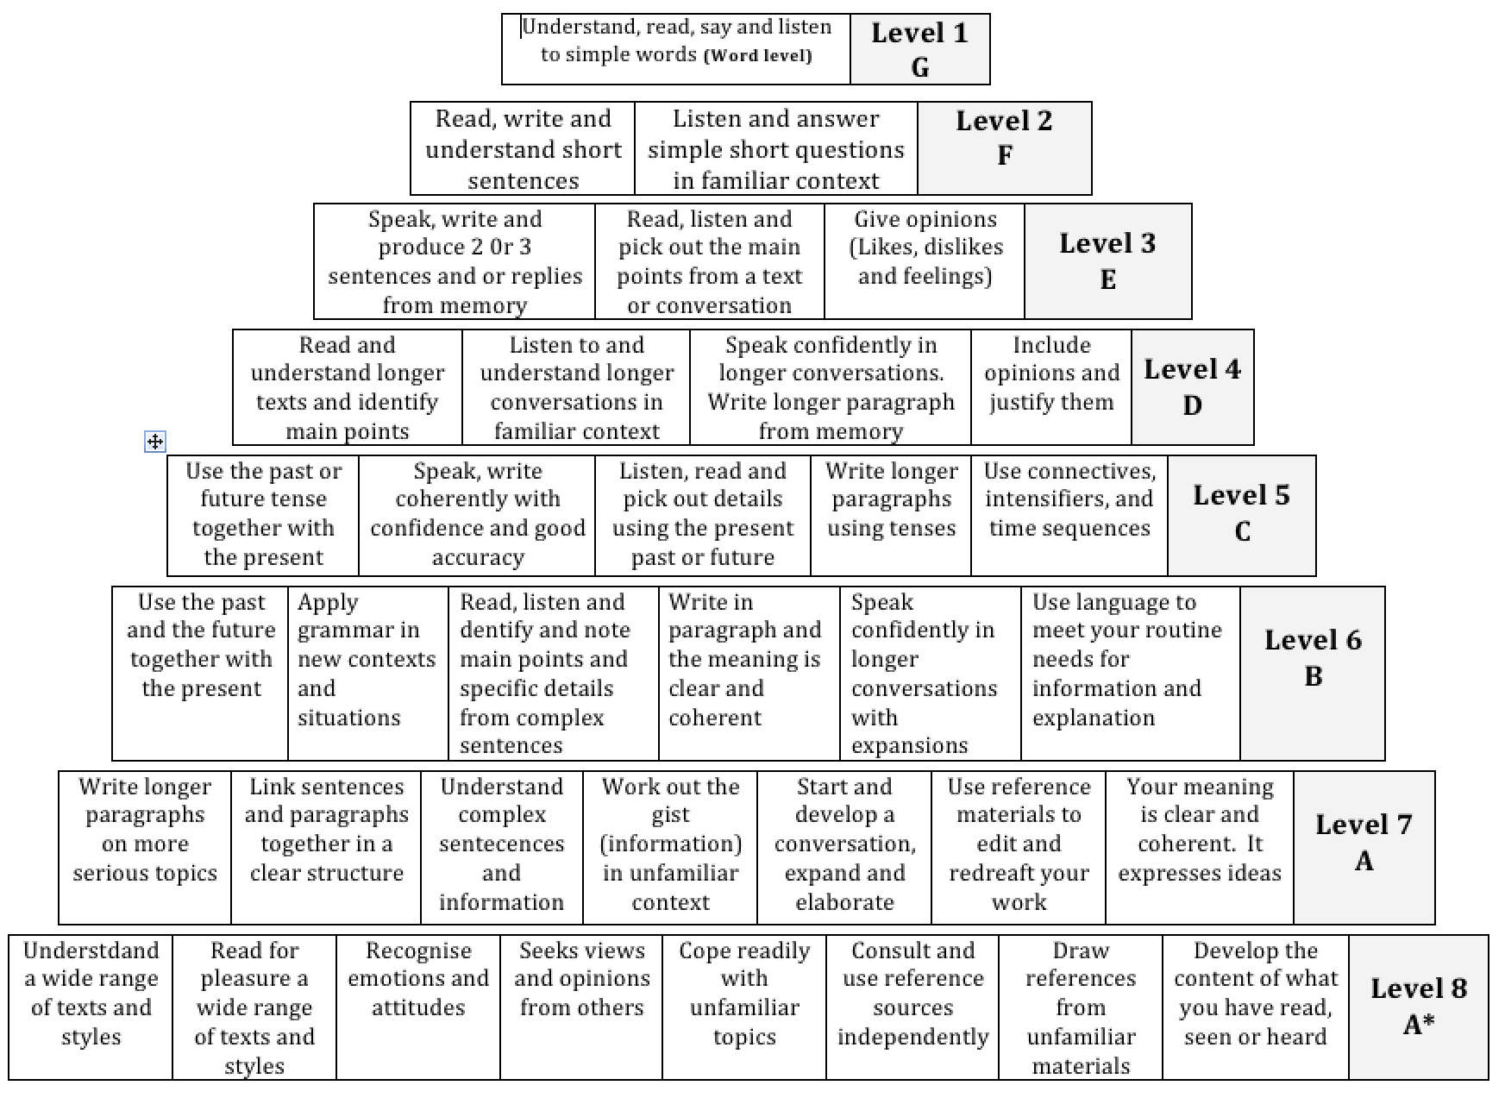
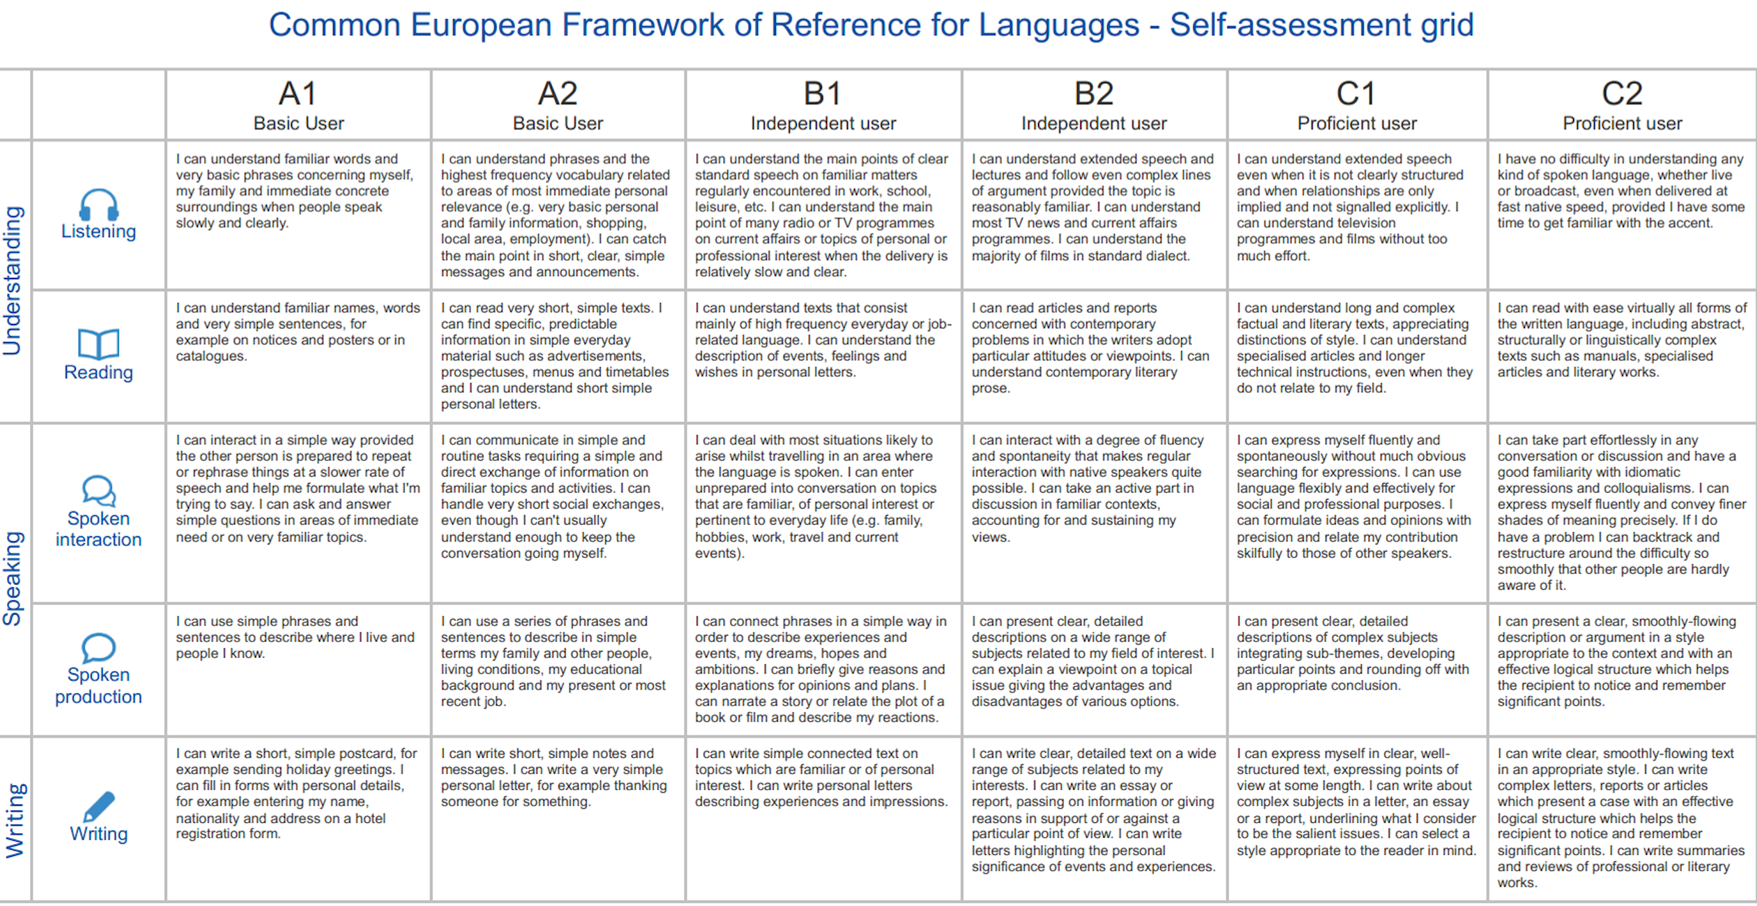
Effective measure of teaching and learning
Data collection
Effective measure of teaching and learning.

Slide 5
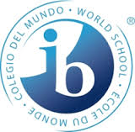



Qualifications
GCSE
IGCSE
AS
A2
GCSE RS
IB

Slide 6
The presence of the faculty in the school.
Assemblies
Displays
Promote Arabic language and culture
Events
Trips
Cross-curricular events
House system

Slide 7
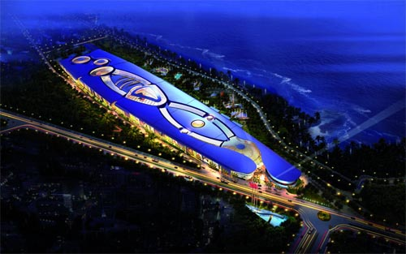




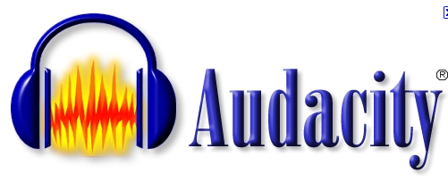


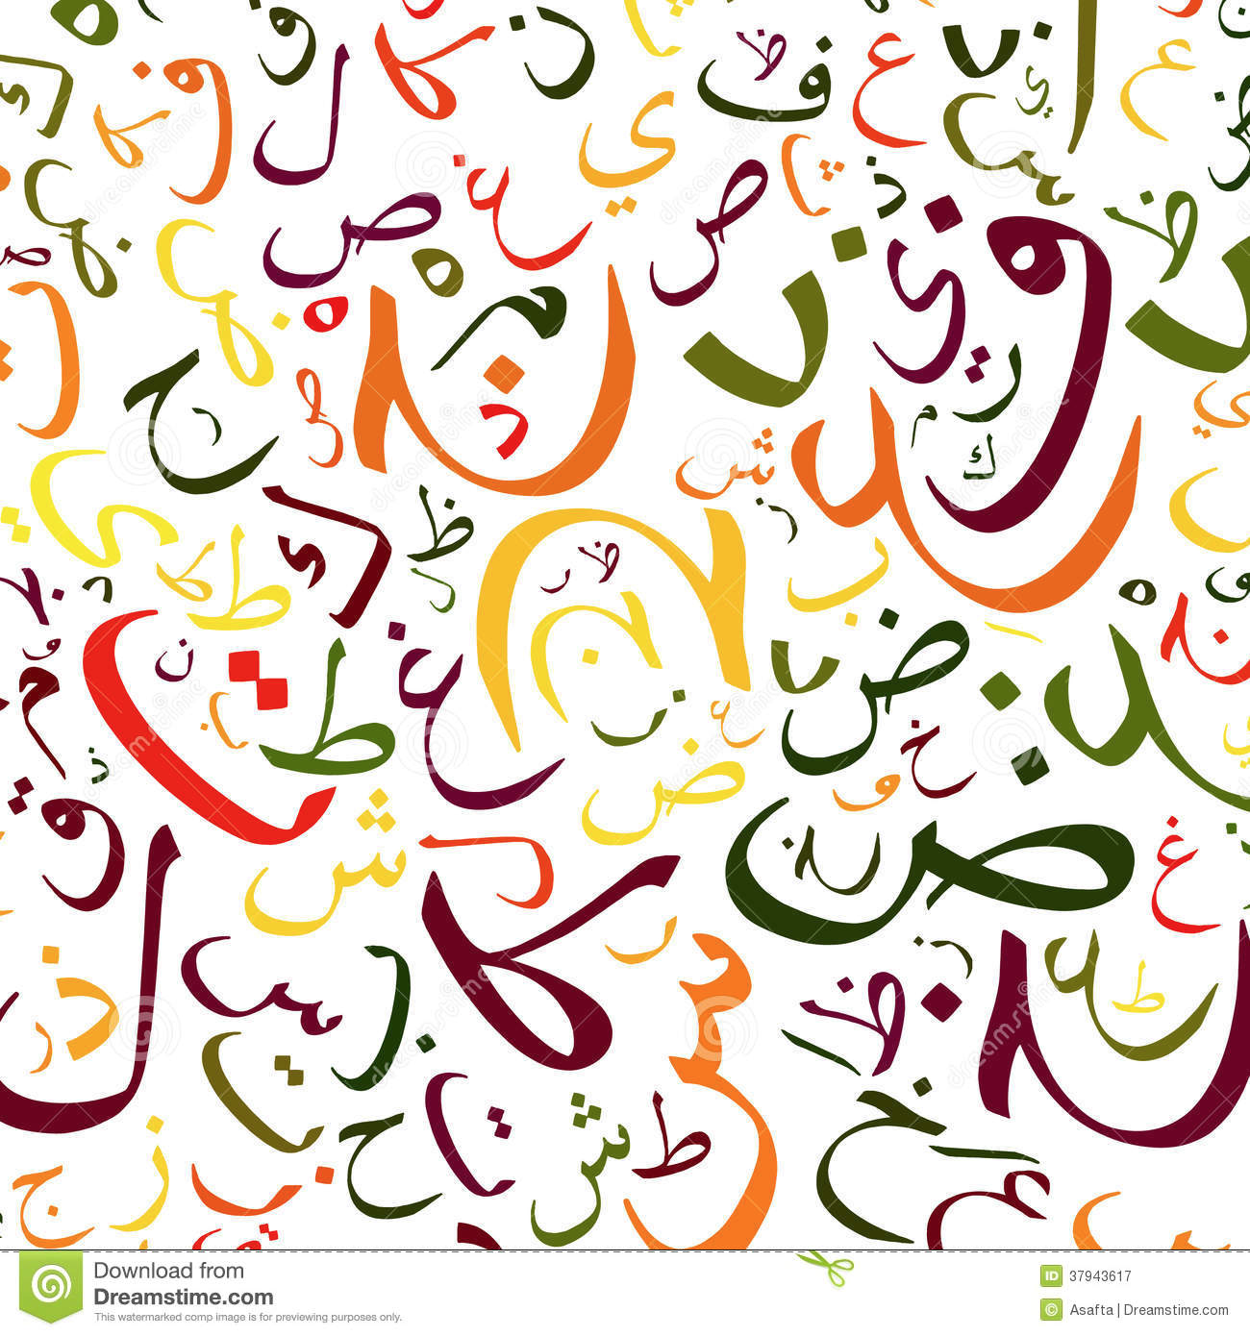






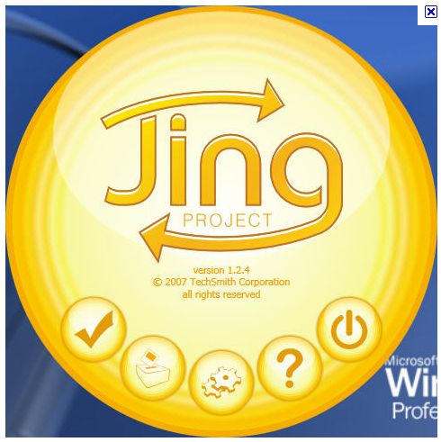




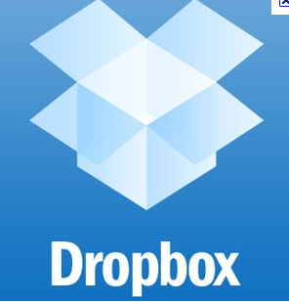

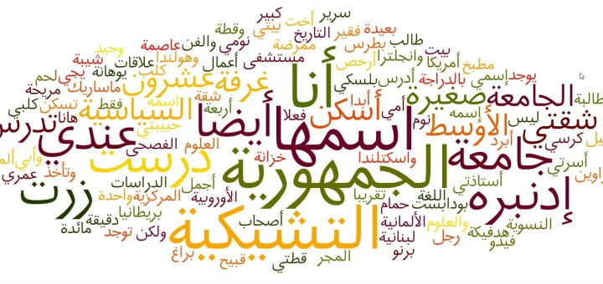


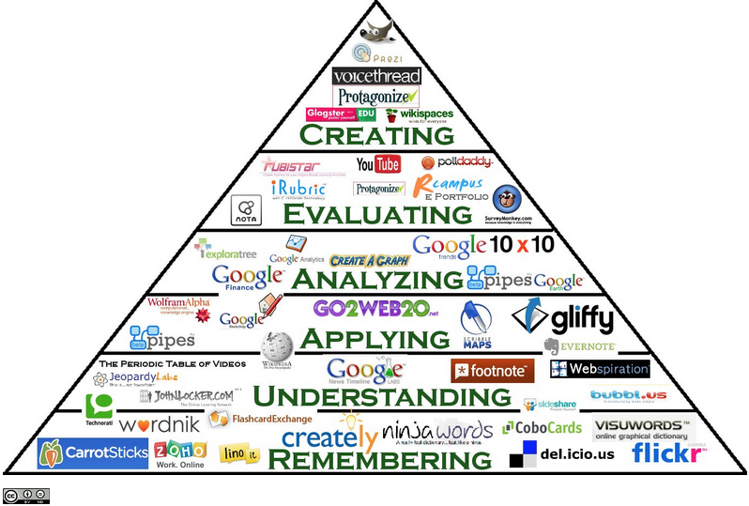
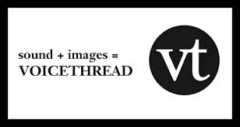

Technology
Casablanca Mall

Slide 8
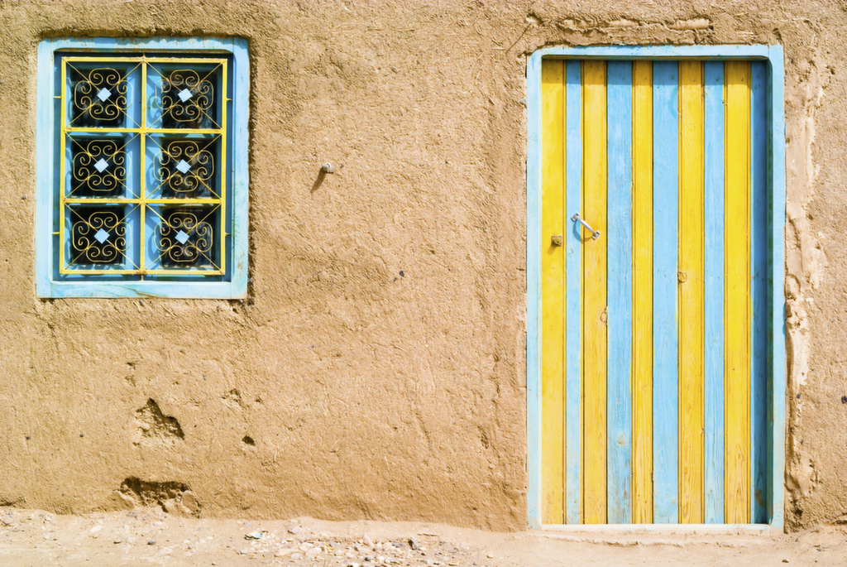
Misconceptions
What is the first thing you think about
when you hear the word Arab?
Notes:
8
8
8
8

Slide 9
caabu
Cultural capital at the heard of the curriculum

Slide 10
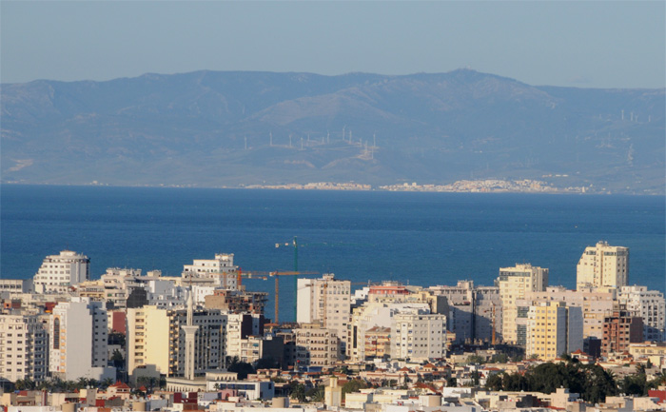
Tangier, Morocco
Tangier, Morocco
Tangier, Morocco
Notes:
10
10

Slide 11
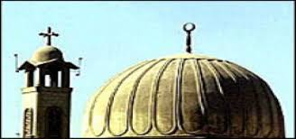

The multi-faith nature of the Arab World

Slide 12
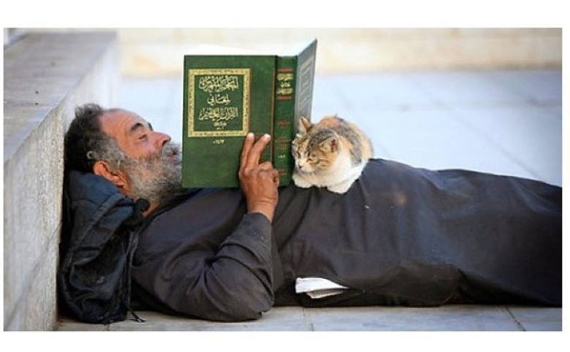
The first word revealed in the Quran was "Iqra" READ! Seek knowledge! Educate yourselves! Be educated.

Slide 13
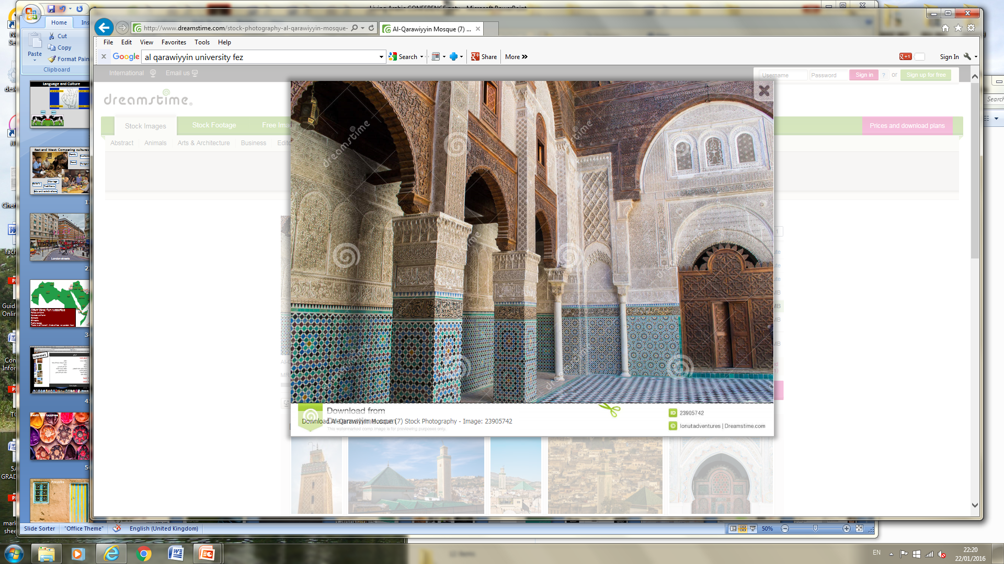
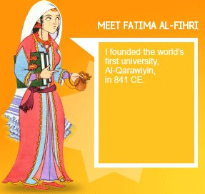
Muslim culture illustrated in a few lines by the historian James Burke about Córdoba in the 9th Century – ‘At a time when London was a tiny mud-hut village that could not boast of a single street lamp, in Córdoba there were half a million inhabitants, living in 113,000 houses. There were 700 mosques and 300 public baths spread throughout the city. The streets were paved and lit. The houses had marble balconies for summer and hot-air ducts under the mosaic floors for winter. They were adorned with gardens with artificial fountains and orchards. Paper, a material still unknown to the west, was everywhere. There were bookshops and more than seventy libraries.’
Opportunity

Slide 14
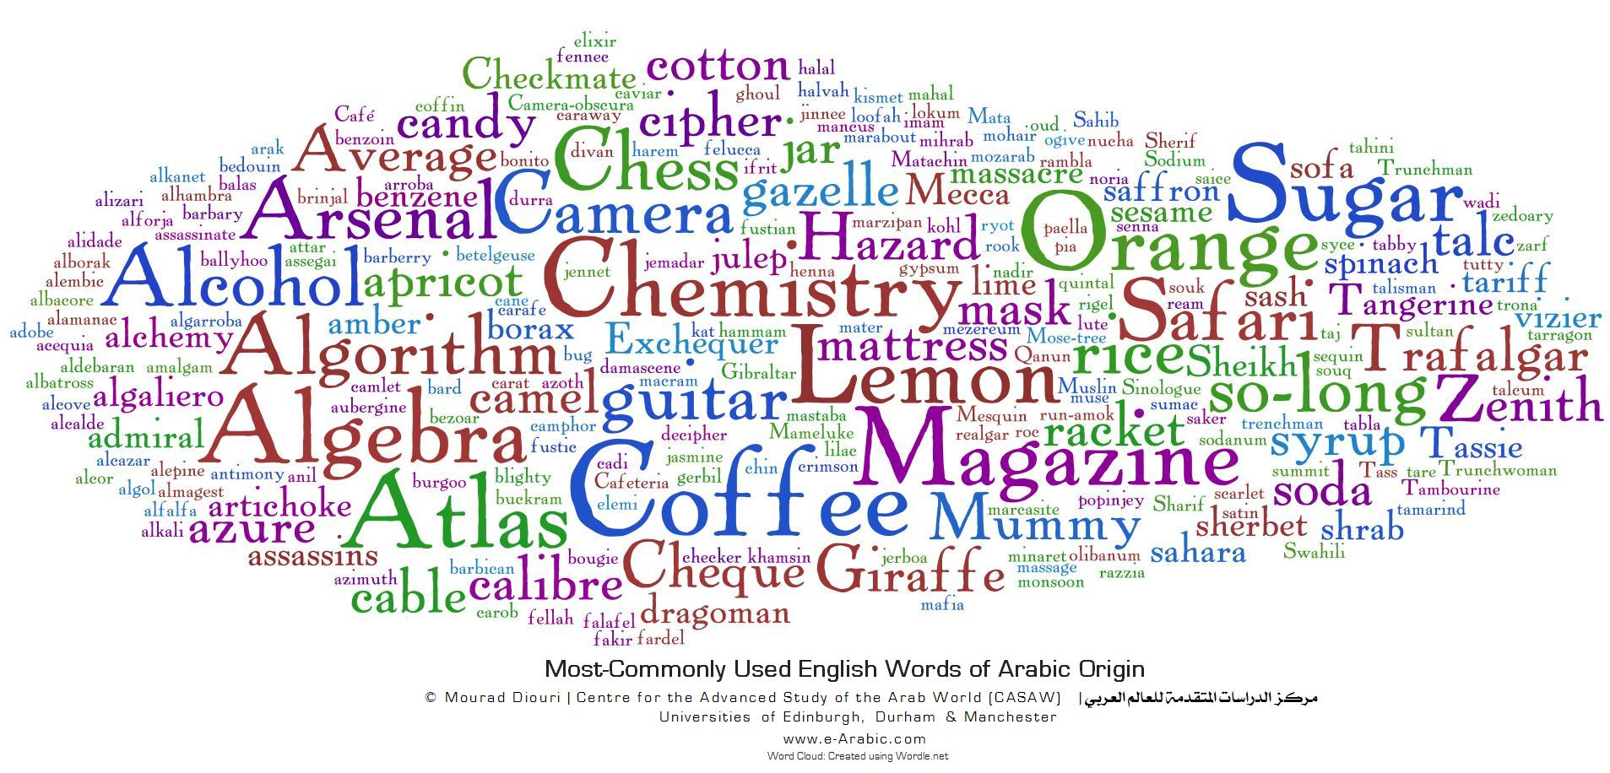
Opportunity

Slide 15
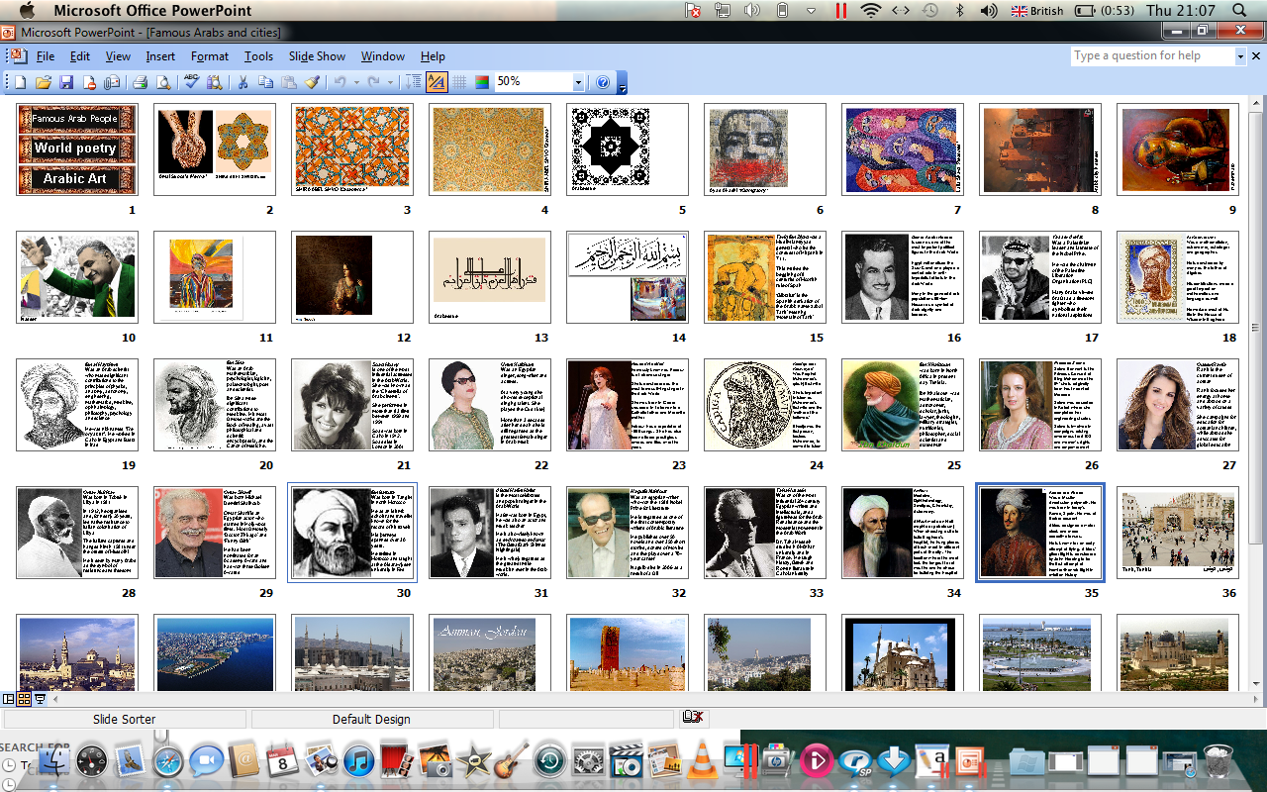
Notes:
15
15
15
15

Slide 16
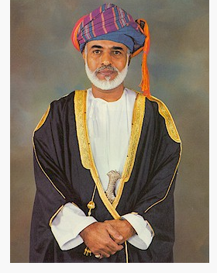
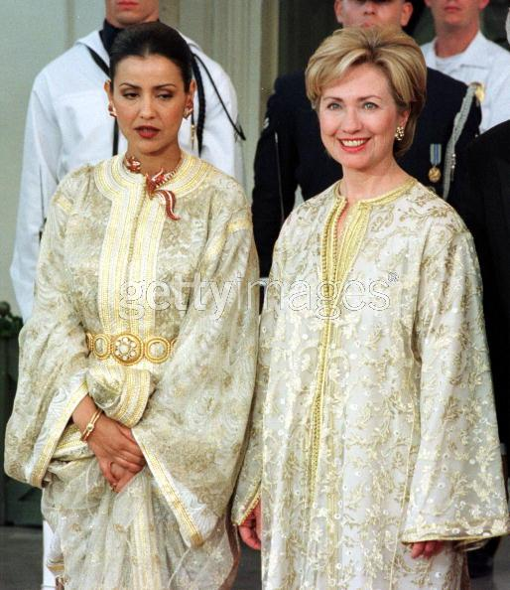
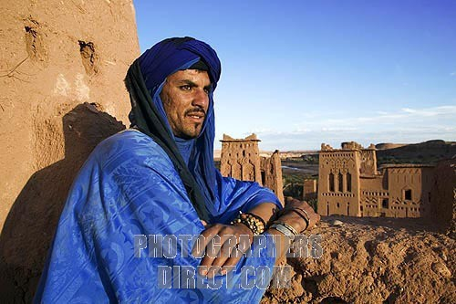
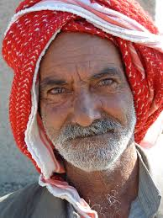
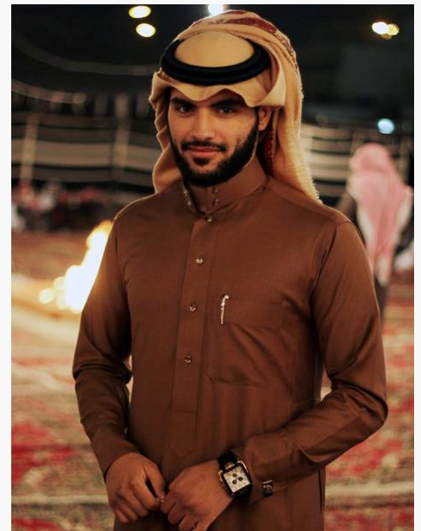
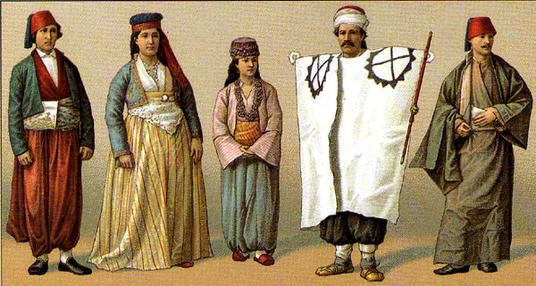
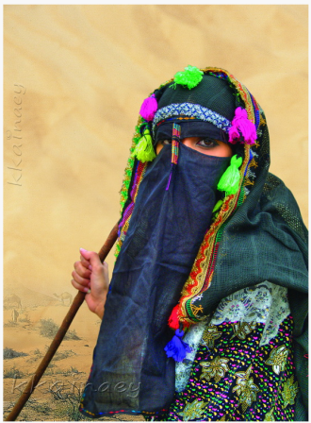
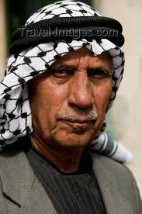
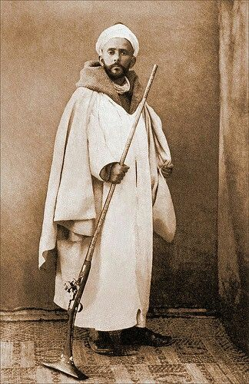
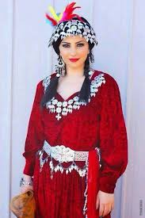
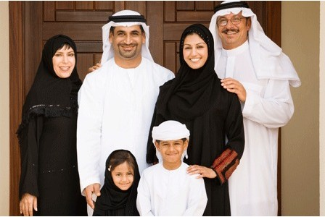
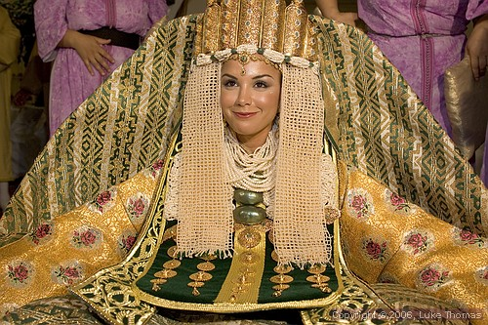

Slide 17
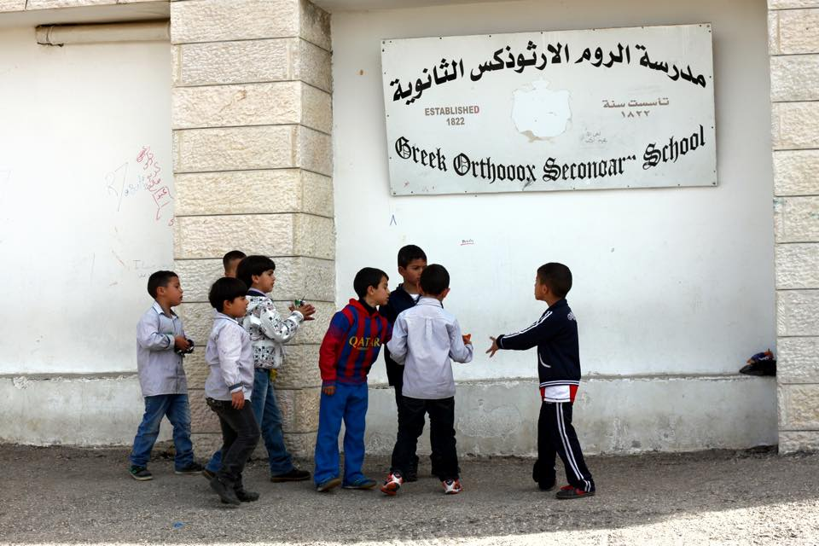
Using pictures
Pictures differentiate very well and enable all students, regardless of ability, to
Participate and contribute in activities.
What are their names?
How old are they?
What are they discussing/planning?
Where are they from? Why?
What are their hobbies/interests?
What time of year is it? Summer/winter/spring/ autumn? Where are they from?
Notes:
17

Slide 18
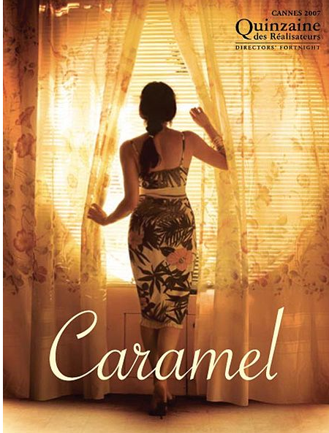
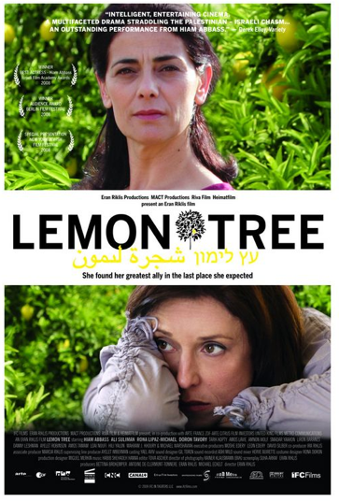
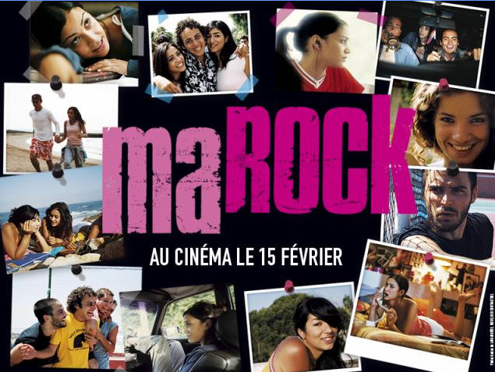
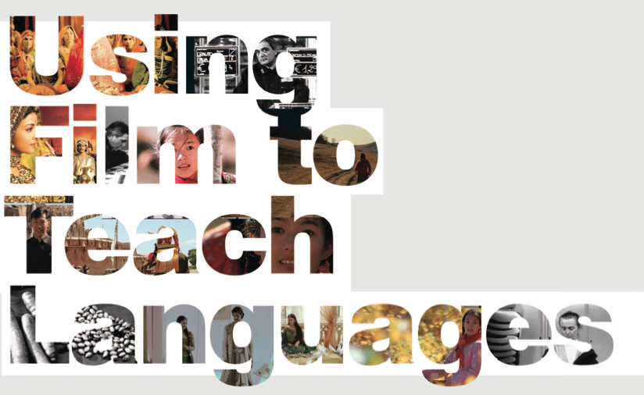
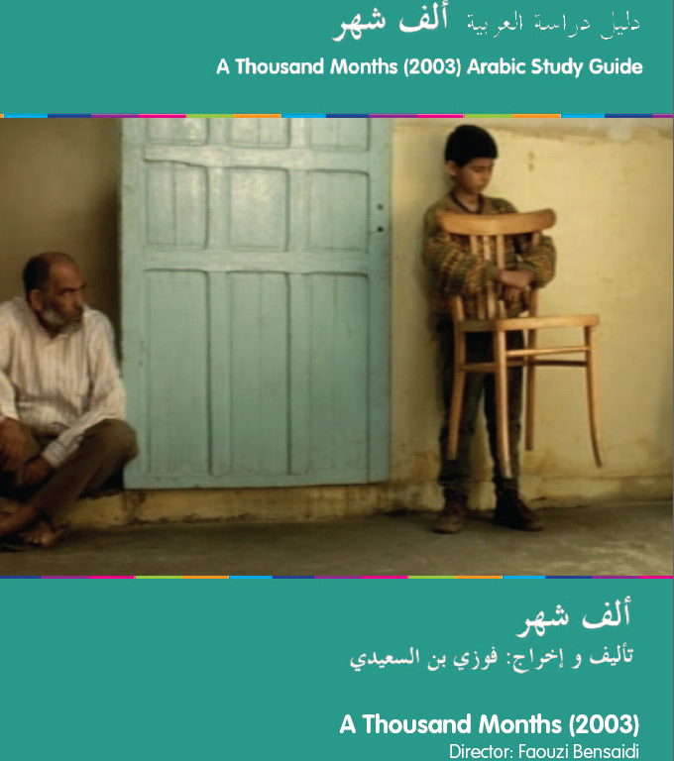
Notes:
18
18

Slide 19
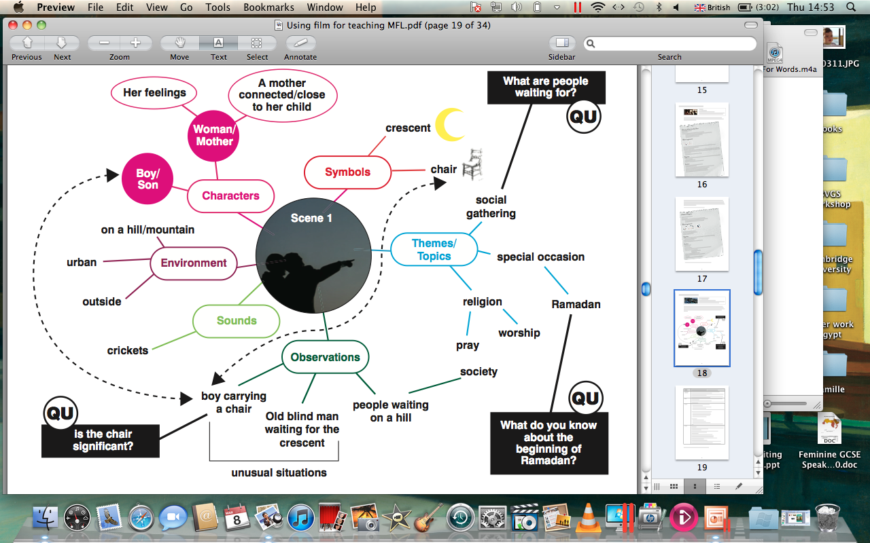
Notes:
19
19

Slide 20
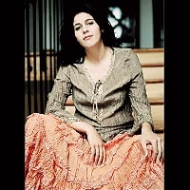
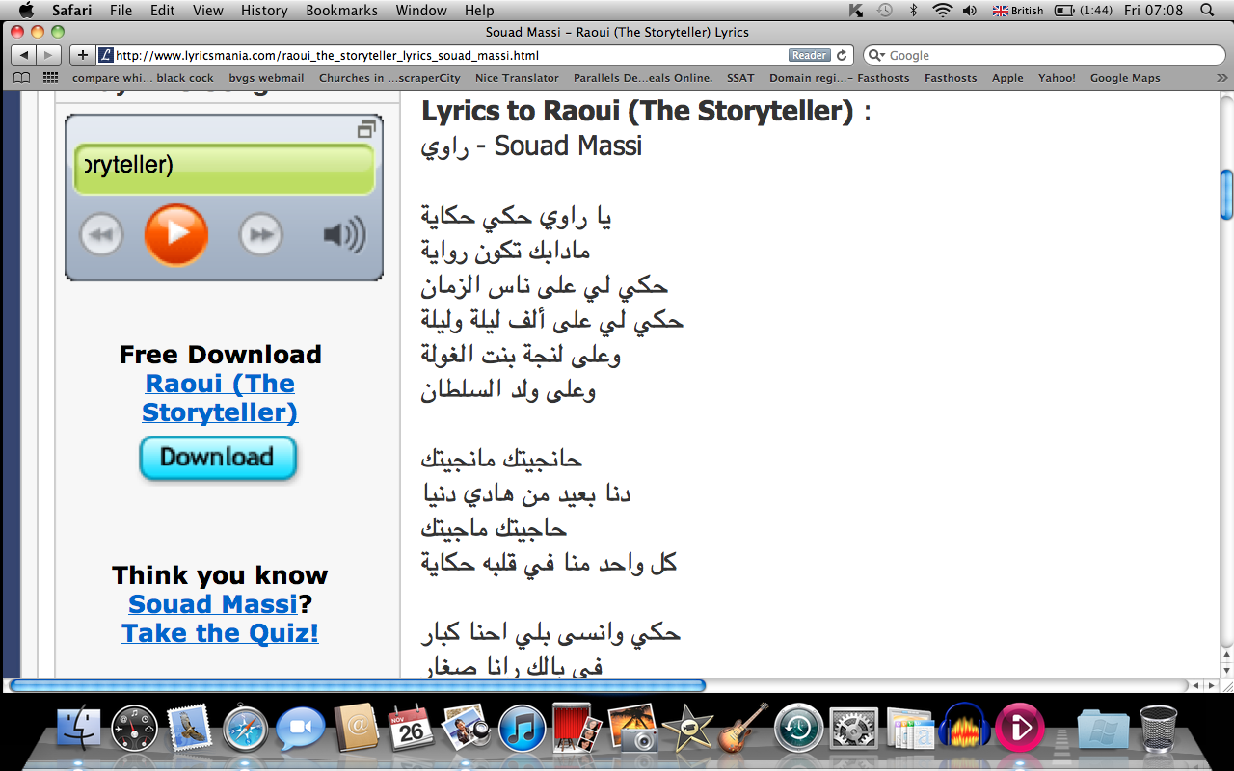
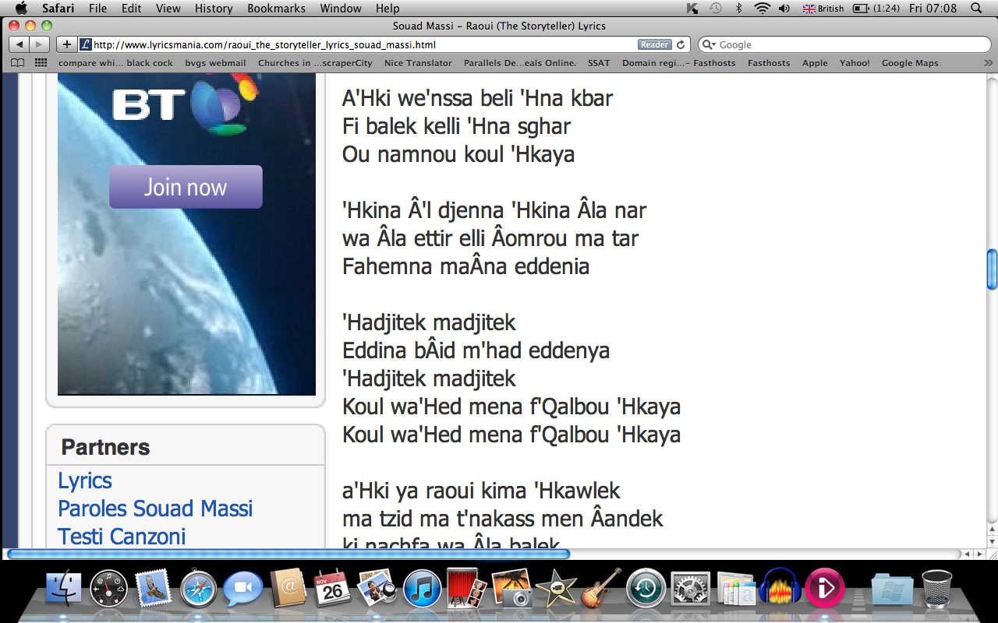
Souad Massi
Verbs
Prepositions
Verbs
Connectives
Time sequences
Adjectives
Intensifiers

Slide 21
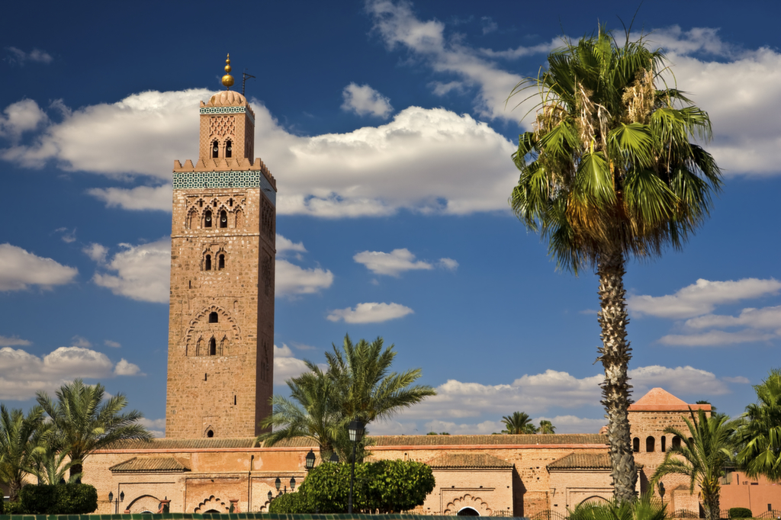
Why invest in Arabic?

Slide 22
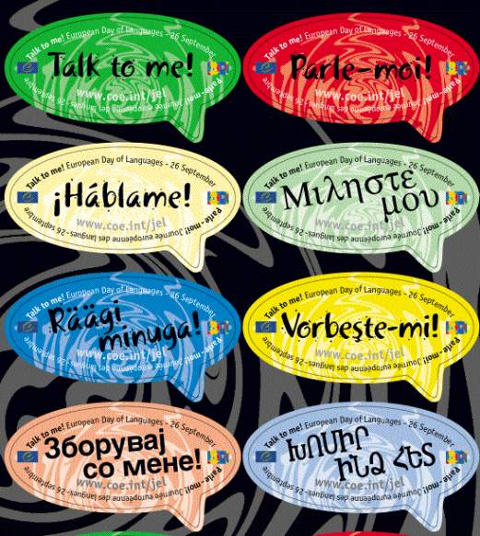

Native speakers
CIA World Fact Book
Mandarin 12.65%
Spanish 4.93%
English 4.91%
Arabic 3.31%
Hindi 2.73%
Bengali 2.71% Portuguese 2.67% Russian 2.16%
Japanese 1.83% German 1.35%

Slide 23
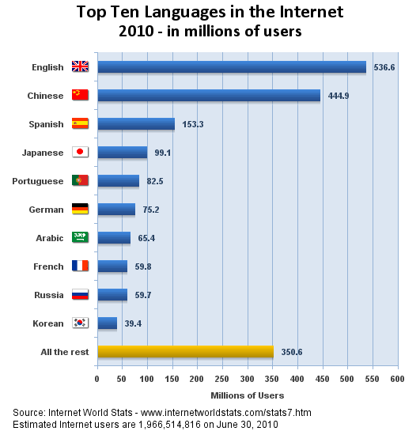

Slide 24
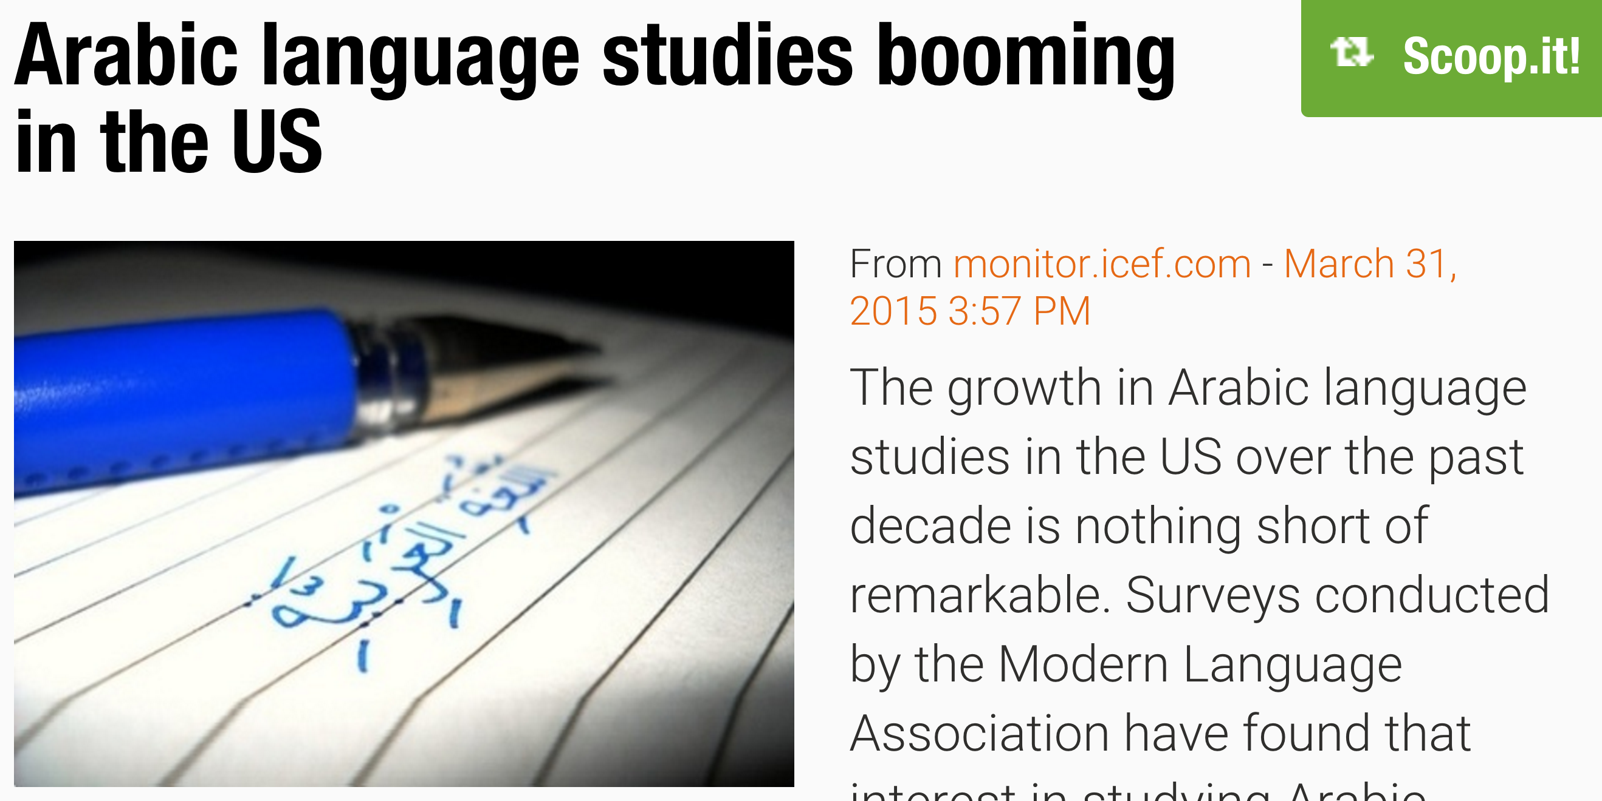
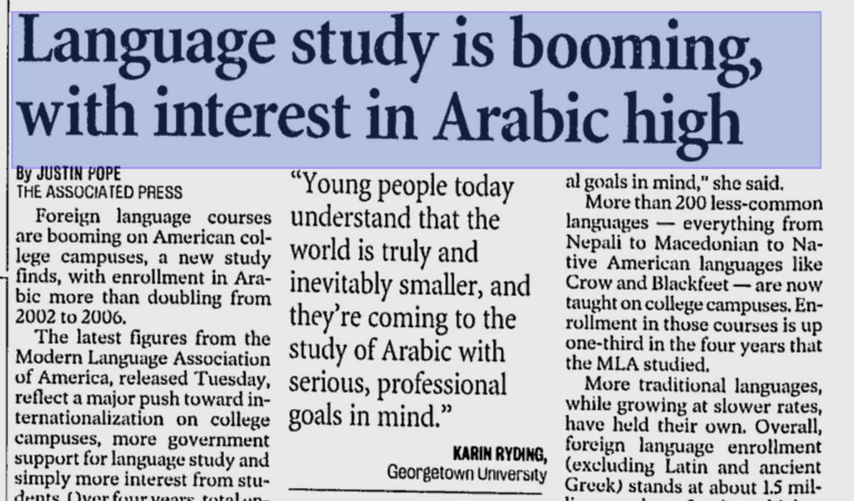
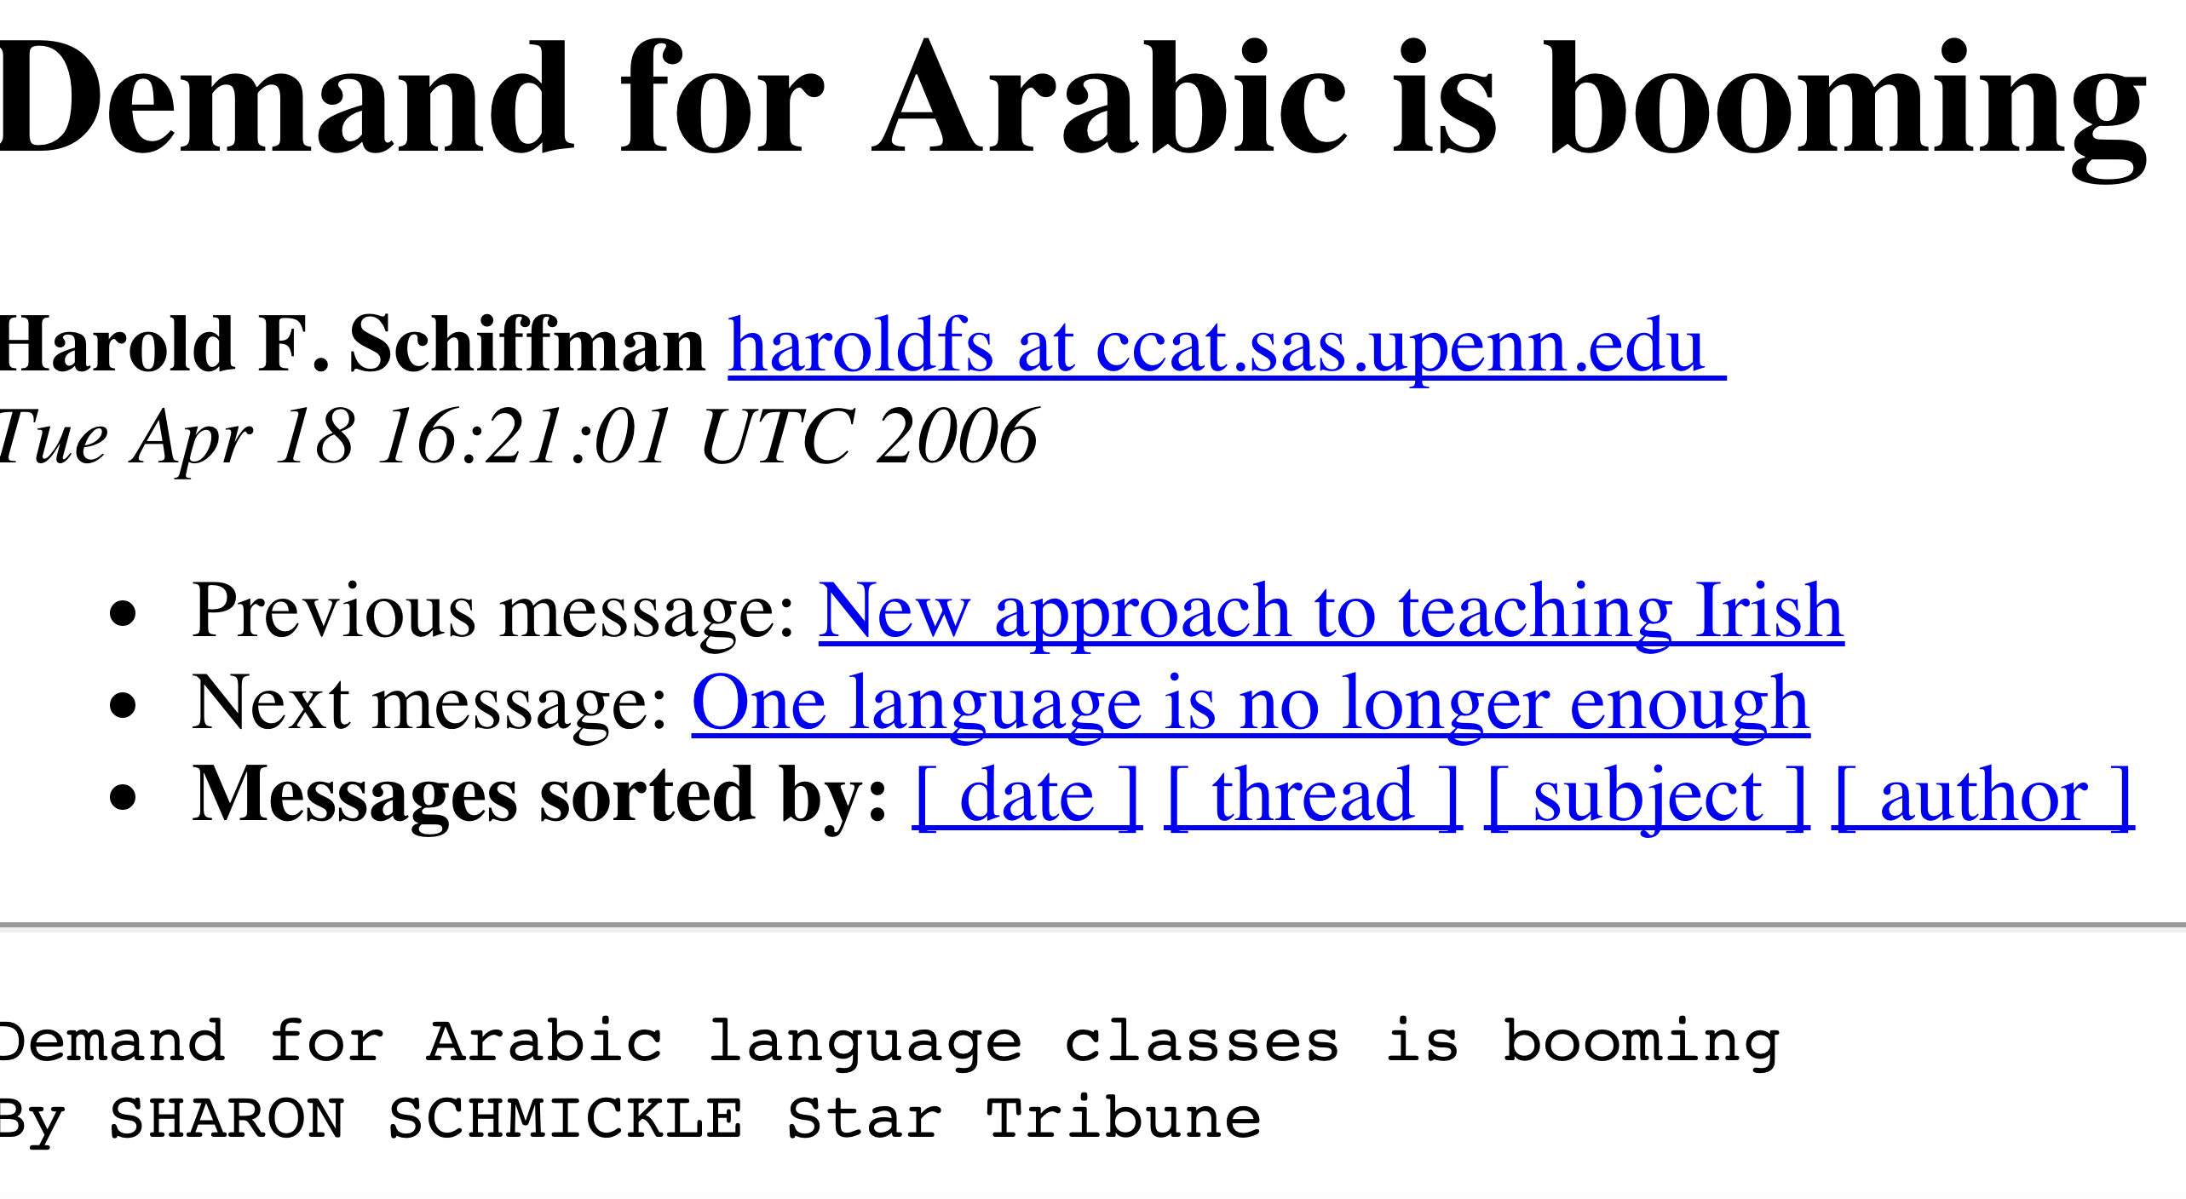
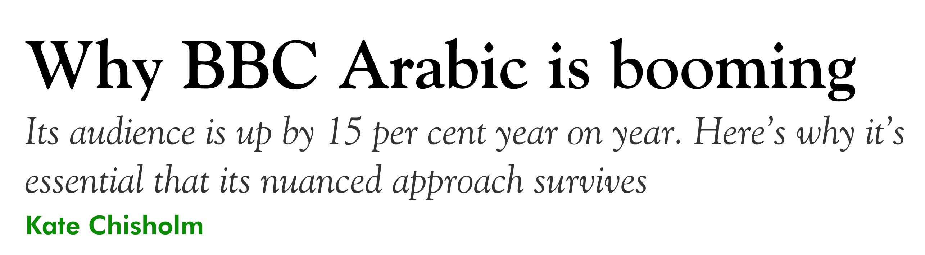
Why invest in Arabic

Slide 25




www.arabalicious.com

