Slide 1
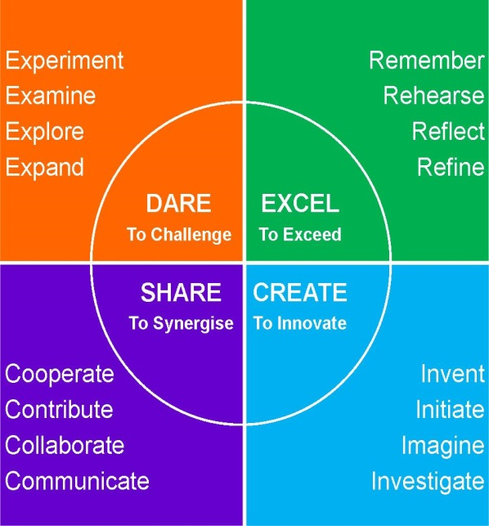
Feedback!
ABC
During classroom discussion, what to do if you are asked to give some “ABC feedback”
A= AGREE WITH- CO-OPERATE Explain how you agree with your peer’s answer.
B= BUILD UPON- EXPAND Try and build upon your peer’s answer.
C= CHALLENGE- EXAMINE/REFINE Try and disagree with your peer’s answer, offer an alternative point of view.

