Slide 1
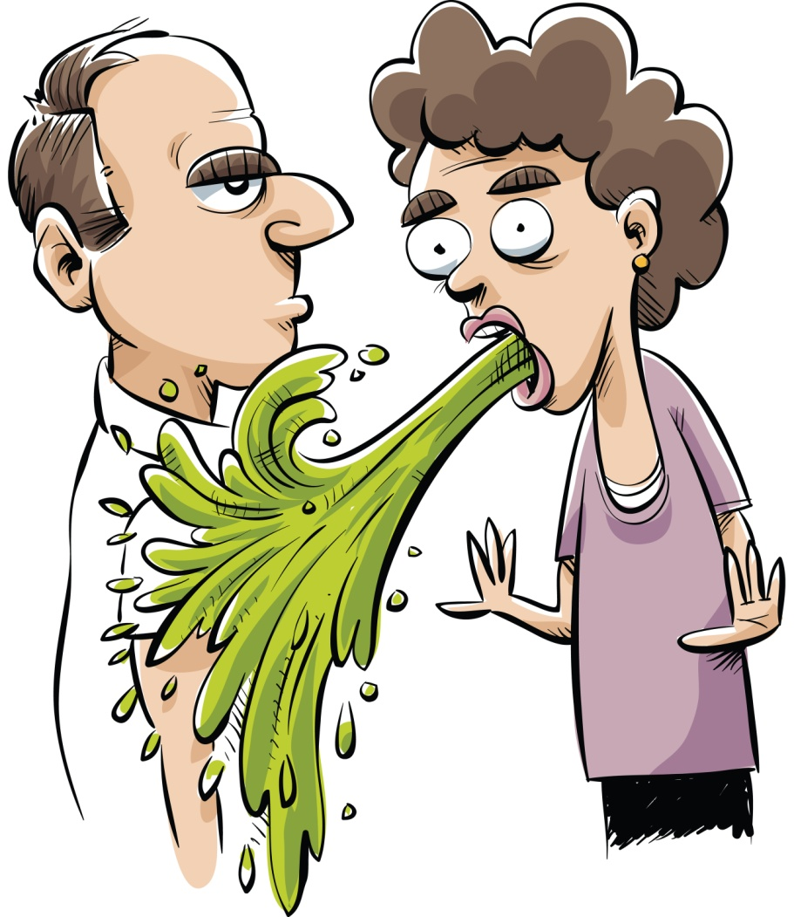
Help! I’m going to do a
KNOWLEDGE VOMIT!
You have 10 minutes to empty your guts of everything you have learned so far about …
Spew your ideas onto the paper in big chunky piles.

