Slide 1
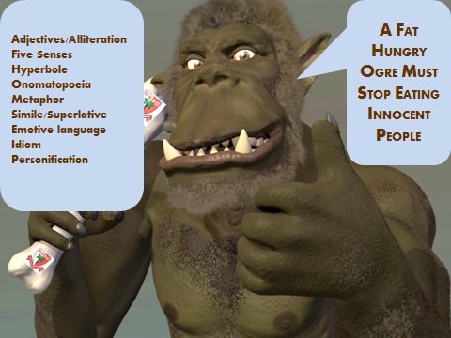
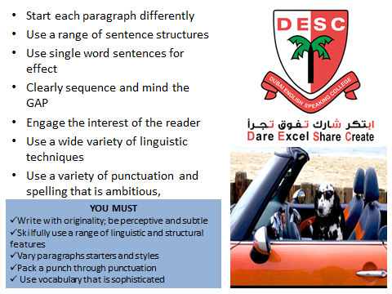
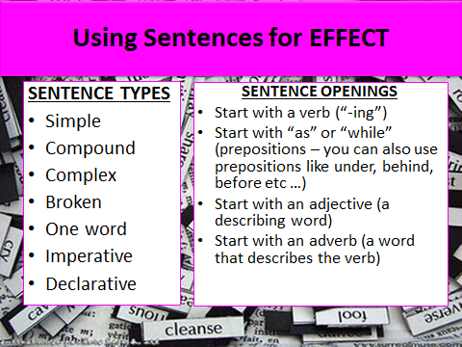
Creative writing
Toolkit
4 to Grow Skills
Imagine
Initiate
Refine
OGRE Techniques
Ambitious Vocabulary
Sentence structure
Sentence starters
Connectives
SPaG

