Slide 1
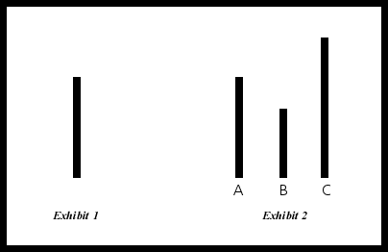
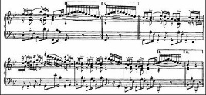
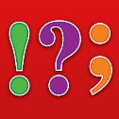
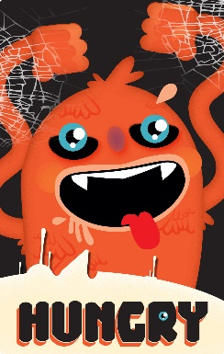
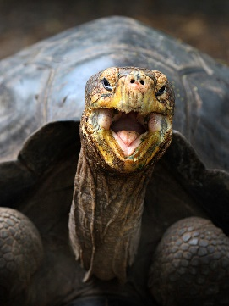

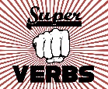

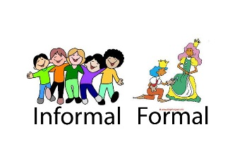
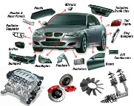



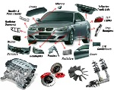



Writing or Creating Language
A grammatical sentence needs a verb and a thing doing the verb (subject).
Every idea that you write needs an active verb – this forms a clause.
Every clause must be connected with a connective/conjunctive.
Identify these connectives to see if your clauses are connected.
Example Connective Words
because, and, so
after, before, while, since, as, until, when, if, after
although, despite, but
Writing to Describe
A Fat Hungry Ogre Must Stop Eating innocent People.
Adjctives/Alliiteration
Five senses
Hyperbole
Onomatopoeia
Metaphor
Simile/Superlative
Emotive Language
Idiom
Personification
Writing to Persuade
A Slow Fat Tortoise Overtakes Every Racing Hare In Style!
Adjectives/Alliteration
Statistics/Superlatives
Facts
Tripartite List
Opinions/Oxymoron
Emotive Language
Rhetoric/Repetition
Hyperbole
Imagery
Second Guessing
Writing Techniques
Short sentence for emphasis
Paragraph length
Advanced punctuation
Starting with different word types (verb, adjective, connective)
Verbs for connotation
Formality adjusted for effect
Connections between paragraphs
Use of connectives
Use of signposts
Use of phrase words
Embedded subordinate clause
Use of language techniques specialised to writing type
Starting sentences
1) Nouns or determiners (most common, neutral emphasis)
The man walked down the street
2) Verb -ing or –ed (emphasising action)
Fleeing from the man, he tripped.
Worried about tripping, he bumped into his wife.
3) Adjective (emphasising description)
Unwashed pavements stretched ahead on the street.
4) Adverb -ly word (emphasising action)
Joyfully skipping up the street.
5) Connective or signpost (emphasising relationships)
As he walked, he whistled.
Example Phrase Words
that, which, with, from, who, of, for, the
-ing words, e.g. running across the road
-ed words, e.g. covered in snow
-ly words, e..g cautiously inching forward
Advanced Punctuation
; semi-colon
connects two ideas of equal importance
: colon
connects two ideas, the second one is more important
() brackets
attaches detail to an idea in a sentence – emphasises connotation
! exclamation mark
emphasises the connotations of a word over other words
? Question mark
requires the reader to interact (agree or disagree) with your idea
- hyphen
Attaches an idea to end of a sentence
Paragraph Length and organisation
Short Paragraph 1-3 sentences (used to emphasise an idea)
Common Paragraph 3-5 sentences (balance between pace and description)
Long Paragraph 5-8+ sentences (used to develop description or narrative)
The less sentences in a paragraph, the more emphasis is given to each individual sentence.
© 2014 TQG

