Slide 1
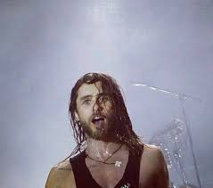
WOW MRS FORD I NEVER KNEW BEING SWEATY COULD BE SO GOOD!
https://www.youtube.com/watch?v=uc2UEfWjvo8

Slide 2
SW“E ”A Y
T
SWAG

Slide 3
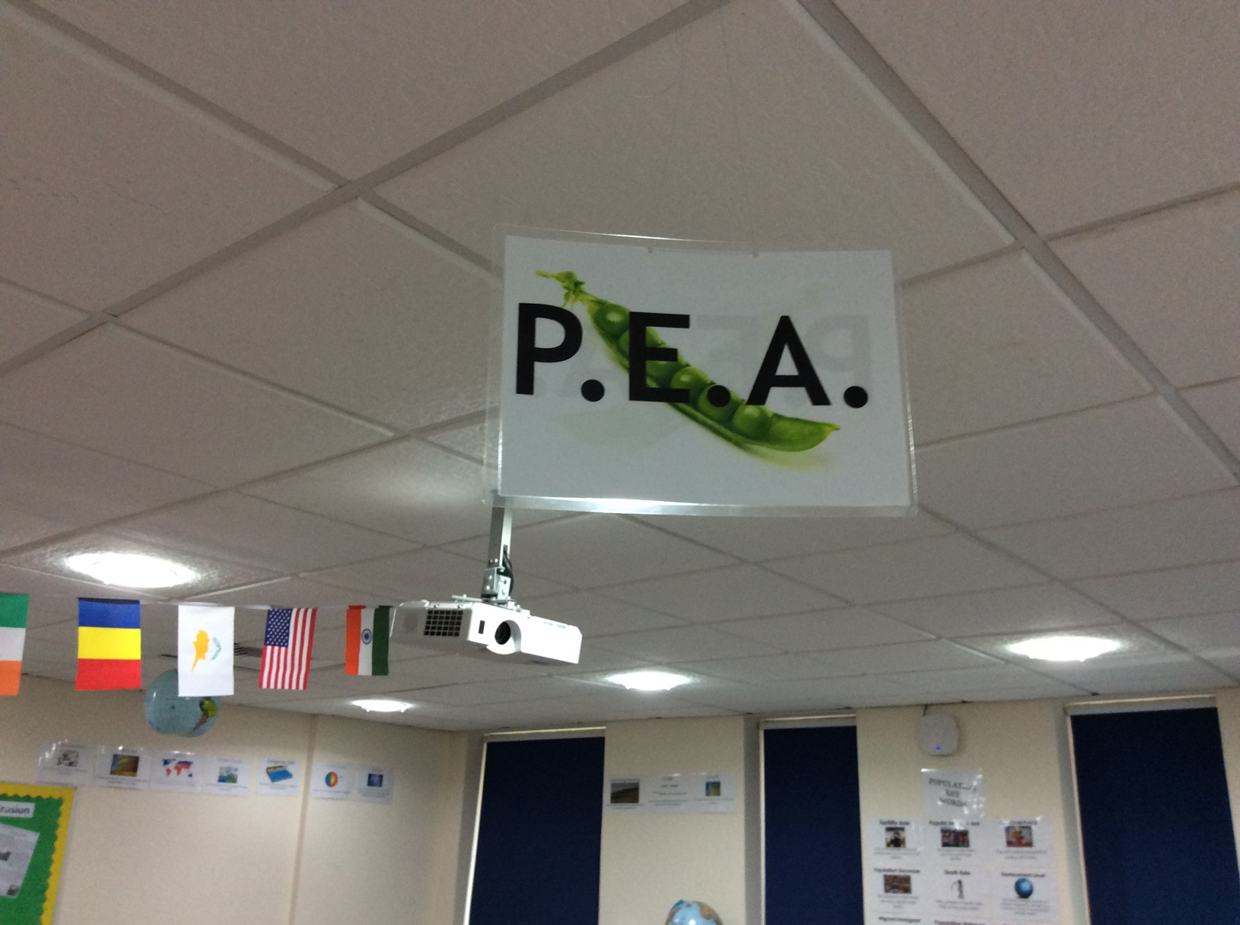
SURELY POINT IS THE SAME AS STATEMENT? JUST WITH MORE DELIBERATE CONNONTATIONS….
WE BOTH AGREE ON EVIDENCE!
AND ANALYSIS!

Slide 4
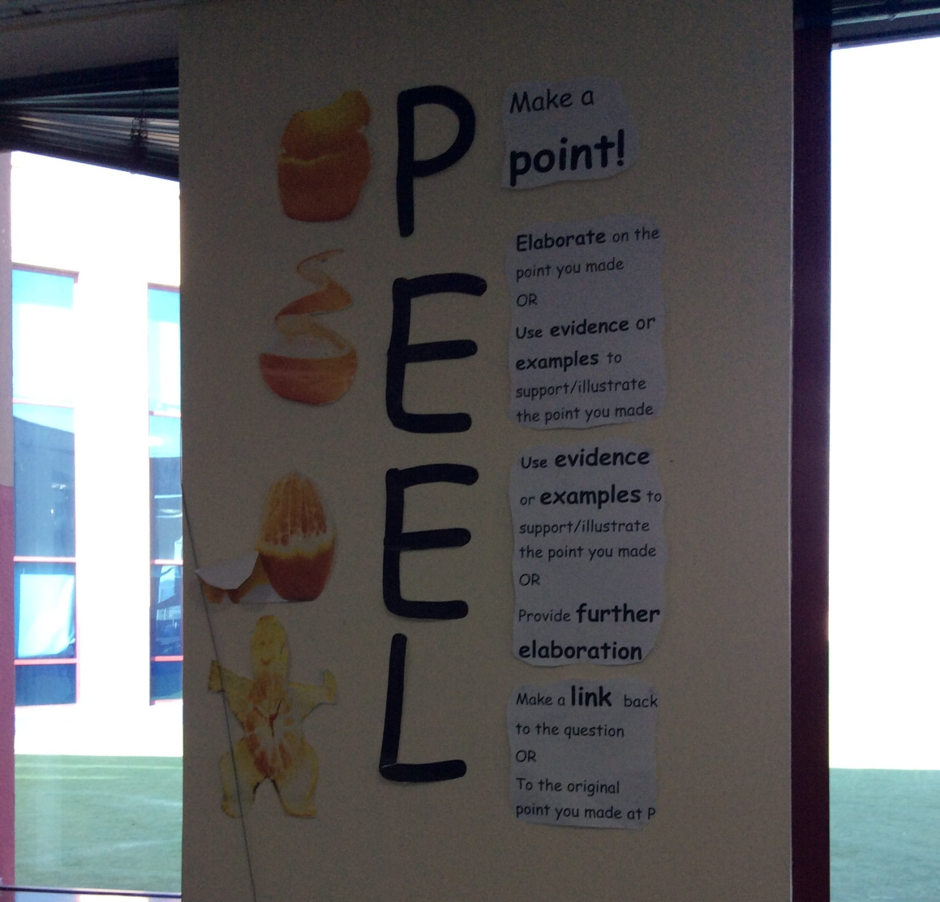
I LIKE THE ADDITION OF THE L FOR LINK
BUT SURELY Y FOR YES I HAVE ANSWERED THE QUESTION IS MORE ACTIVE – LESS PASSIVE

Slide 5
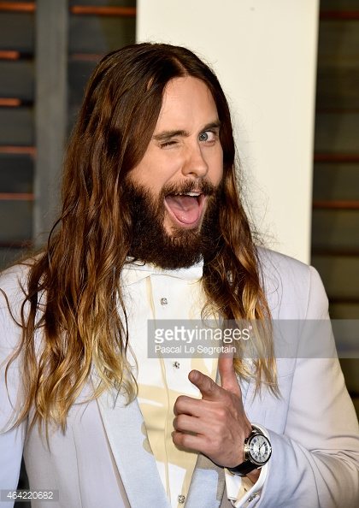

WHY?
So that everyone approaches the same thing in the same way
Why waste time teaching the same thing 10 different ways?
Every subject (almost) has an element of writing
All of us want students to get into good habits early on
Teach them it once well and they can transfer it from subject to subject
Y waste time breaking bad habits later on?

Slide 6
PEE ON A GOOD DAY…
Question – How is the mouse presented in the Gruffalo?
Fine this answers the question
POINT
The mouse is brave and tricks the Gruffalo
EVIDENCE
A quote that shows this is, “Just follow behind me and soon you’ll see everyone is afraid of me”
EXPLANATION
Being able to trick a Gruffalo is brave.
Yes this is evidence but the style is awful and is breeding bad habits for later on. The use of “quote” will never be suitable beyond year 9
Nothing about this is analytical. It really just repeats the point and adds little to the paragraph

Slide 7
SWEATY ON A GOOD DAY…
Question – How is the mouse presented in the Gruffalo?
STATEMENT
The mouse is brave and tricks the Gruffalo,
WEAVE
instructing him to
EVIDENCE
“just follow behind me and soon you’ll see everyone is afraid of me”
ANALYSIS plus T
The image of a tiny mouse being followed by a huge Gruffalo is not only humorous but also metaphorical in terms of role reversal and the mouse's ability to be canny and quick witted.
The use of “afraid” being spoken in first person by the mouse also gives strength to his character and …….
YES I HAVE ANSWERED THE QUESTION!

Slide 8
WHAT?
STATEMENT
WEAVE
EVIDENCE
ANALYSIS
TECHNIQUE
YES

Slide 9

TOP TIPS
KEEP THIS SHORT
MAKE SURE IT ANSWERS THE QUESTION
USE THE WORDS OF THE QUESTION
Statement
THE THING YOU KNOW/BELIEVE. THE ANSWER TO THE QUESTION.
CONNOTATIONS: FACTUAL, TRUTHFUL, CONCISE, CLEAR

Slide 10
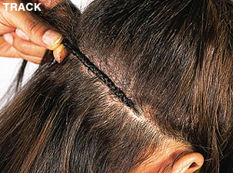
TOP TIPS
MAKE THIS THE EASIEST ROUTE POSSIBLE
USE THE CONTEXT TO HELP YOU
RE-READ FOR SENSE
RE-JIG THE EVIDENCE AS NECESSARY
Weave
A WAY TO GET FROM YOUR STATEMENT TO YOUR EVIDENCE.
CONNOTATIONS: SMOOTH, CONTEXTUALISED

Slide 11
WEAVE IT TO WIN IT!
NO WEAVE
Typical paragraph
Forster uses a metaphor to show the excitement of the two friends running for the bus “we chased Olympic Gold.”
THIS IS BAD – IT DOESN’T MAKE SENSE
Or even worse
Forster uses a metaphor to show the excitement of the two friends running for the bus and I quote “we chased Olympic Gold.”
THIS IS YUCK – TERRIBLE STYLE
WEAVE
Forster uses a metaphor to show the excitement of the two friends running for the bus as they “chased Olympic Gold.”
THIS IS GREAT THE EVIDENCE COULD ACTUALLY BE YOUR OWN WORDS

Slide 12

TOP TIPS
KEEP THIS SHORT
COPY IT OUT EXACTLY
DON’T FORGET “….”
Evidence
THE WORDS FROM THE TEXT IN “XXX”.
CONNOTATIONS: BORROWED, ACCURATE, PROOF

Slide 13

TOP TIPS
MAKE THIS THE LONGEST PART OF YOUR PARAGRAPH
SQUEEZE EVERY LAST BIT OUT OF YOUR EVIDENCE
CONSIDER OTHER INTERPRETATIONS
ADD SOME S.W.A.G
Analysis
THE LONGEST PART OF THE PARAGRAPH. HIGHER ORDER SKILL
CONNOTATIONS: DETAILED, BALANCED, INSIGHTFUL

Slide 14

SINGLE
WORD
ANALYSIS
GLORY

Slide 15

TOP TIPS
MAKE SURE THIS IS ACCURATE
USE THE 3 X RULE
ADD THIS IN ANWHERE YOU LIKE
Technique
THE TECHNICAL HOW. THE IDENTIFICATION OF THE ‘WAY’
CONNOTATIONS: SPECIFIC, ACCURATE, NAMED

Slide 16
HOW?
Staff taught SWEATY in a PD session or such like
Worked examples provided for reference
Each department assigned a SWEATY English Expert
All classrooms provided with a visual reference for consistency Teachers feed back on their SWEATY success
Yes we all write so much better!

Slide 17
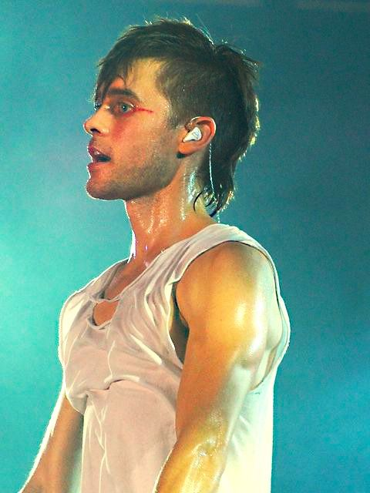
S.W.E.A.T.Y
I DONT CARE IF I AM SWEATY AS I KNOW IT REALLY WORKS!
THANKS MRS FORD!
S= STATEMENT. Your answer
W = WEAVE. The build up to your
quote/evidence
E= EVIDENCE. Your short “quote”
A = ANALYSIS. The language analysis
of your quote. Longest Part
T = TECHNICAL TERM. The key term
that describes the language –
THIS CAN MOVE AROUND.
Y = YES IT ANSWERS THE QUESTION

Slide 18
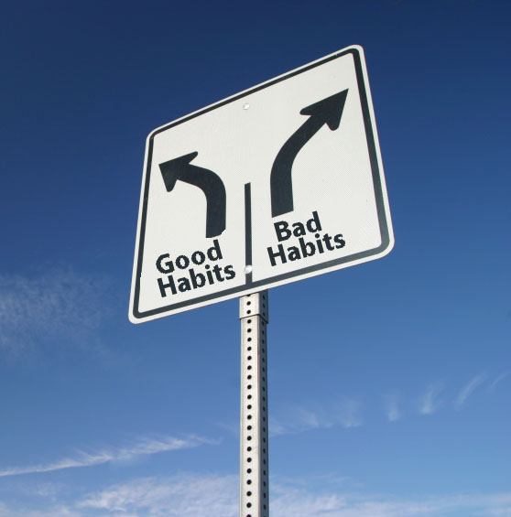

Slide 19
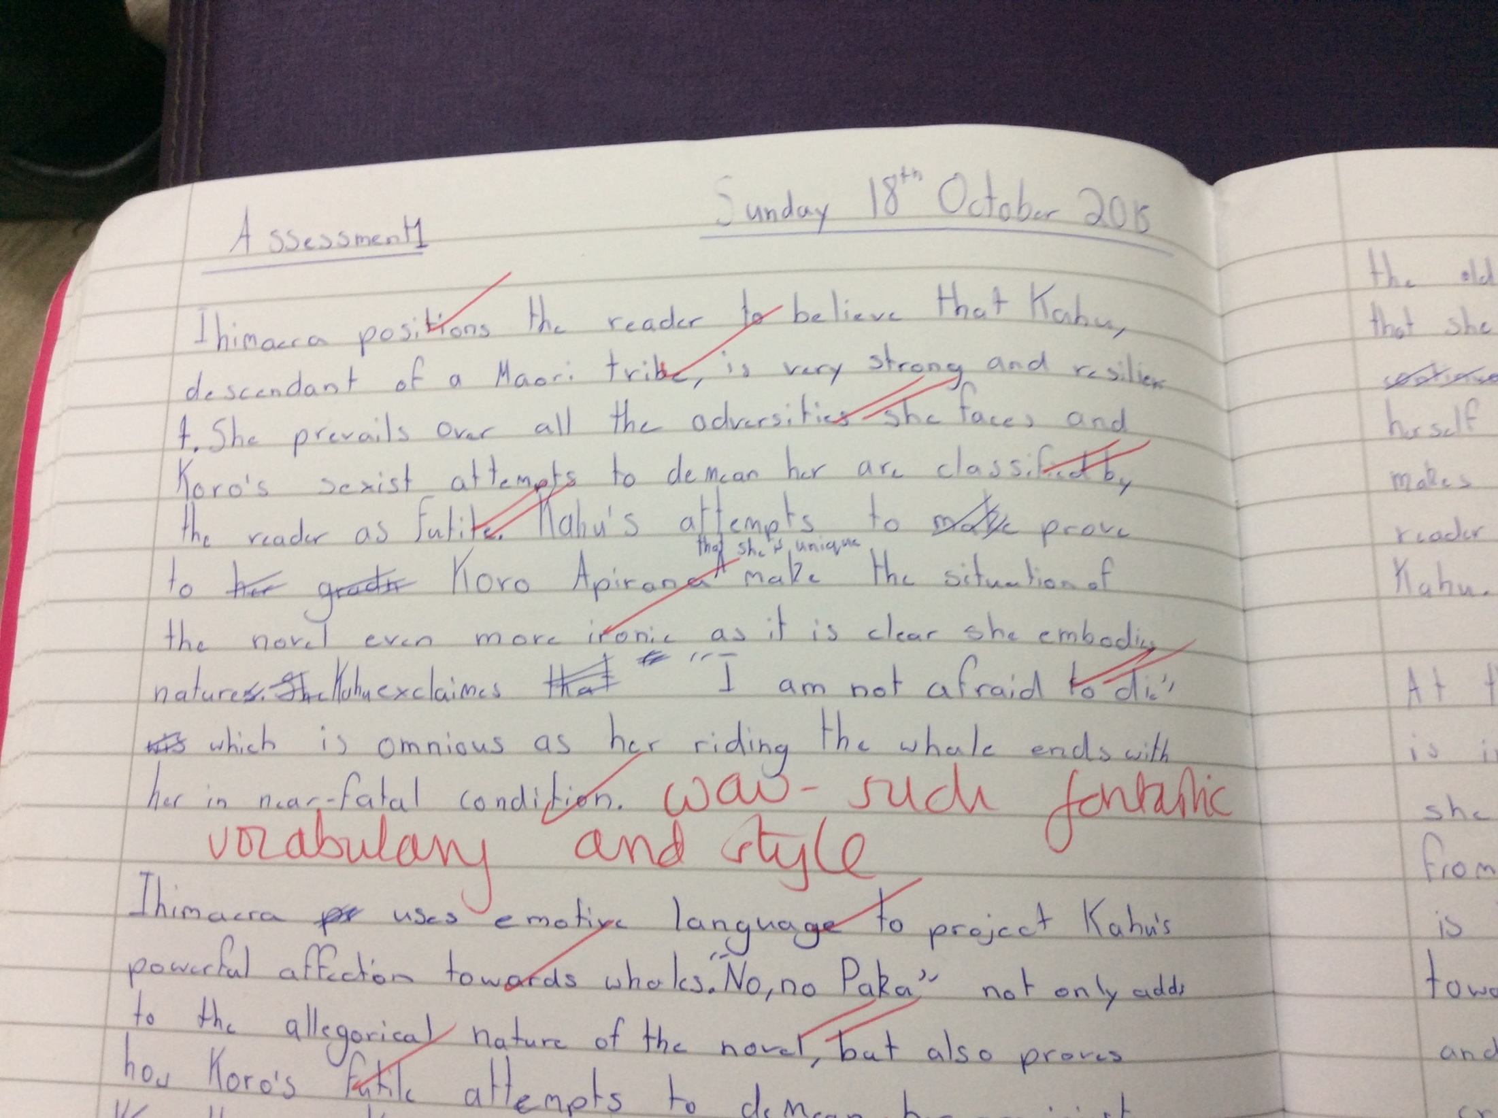
YEAR 7
Yes really!

Slide 20
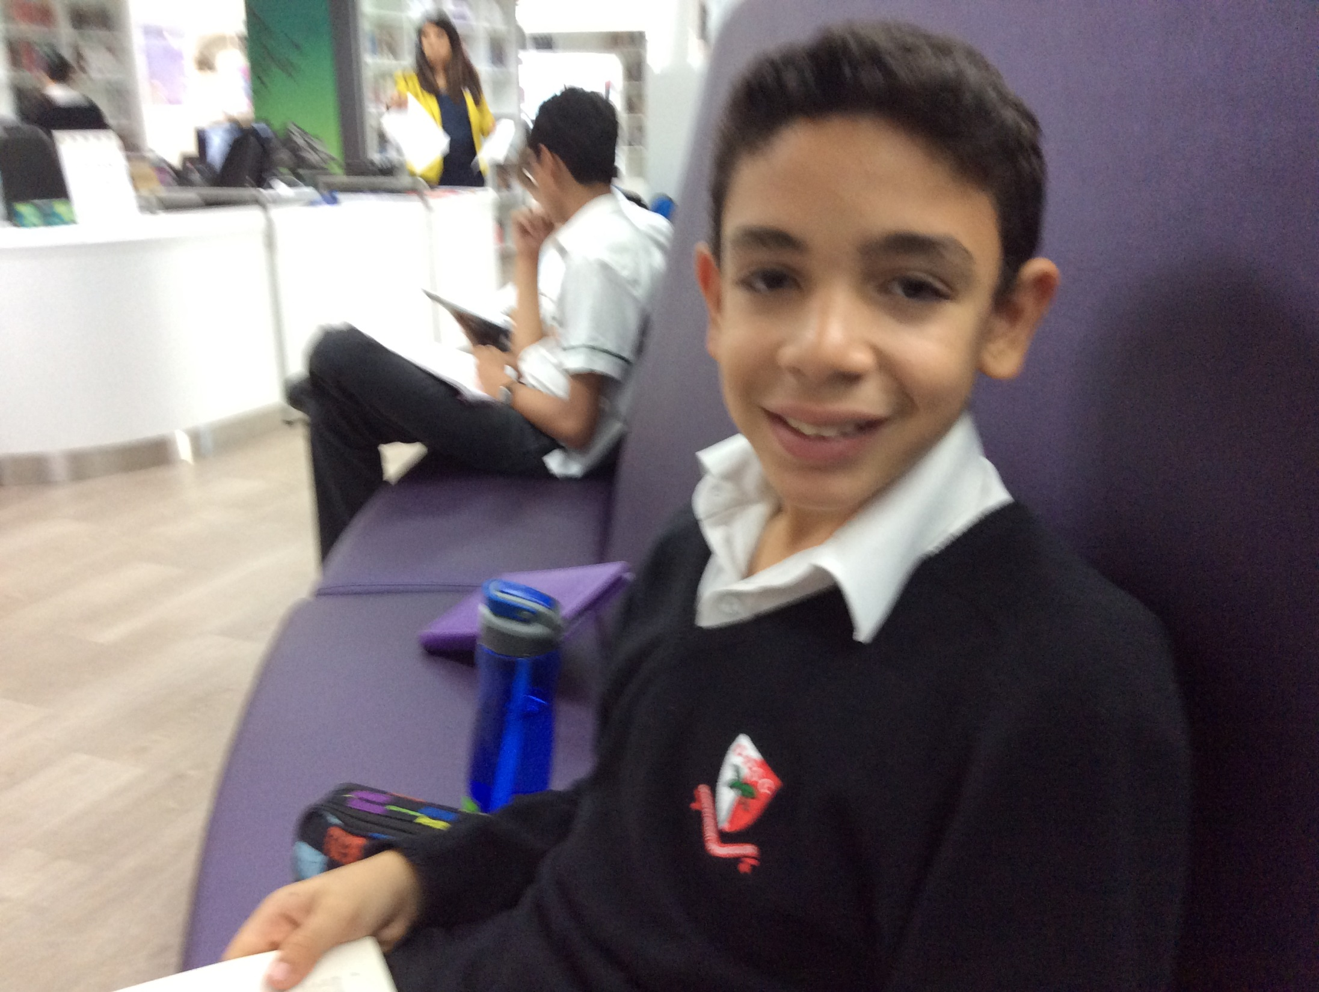
Hello, yep I wrote it. SWEATY is such an easy system for formulating analytical paragraphs.

Slide 21
949 TIPS FOR SWEATY SUCCESS
My STATEMENT is short
My STATEMENT answers the question (ATQ)
I have WOVEN in a piece of EVIDENCE
My EVIDENCE is concise and accurate
I have included a TECHNICAL TERM
My TECHNICAL TERM is accurate and spelt correctly
My ANALYSIS doesn’t repeat my statement
My ANALYSIS is the longest part of my paragraph
YES I have answered the question!

Slide 22
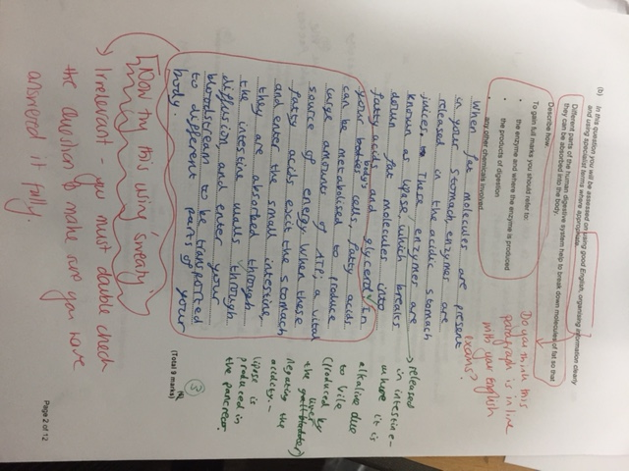

Slide 23
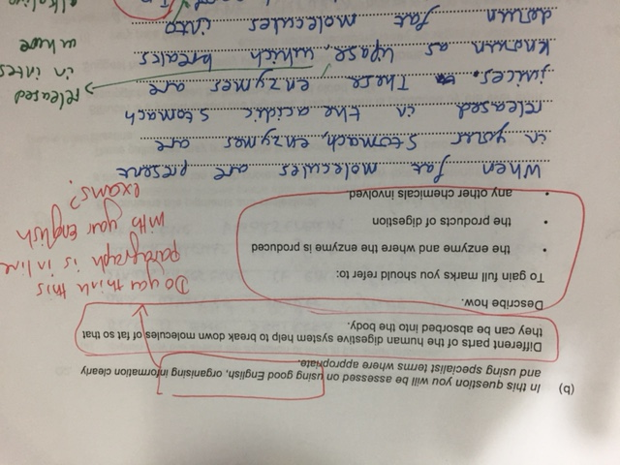

Slide 24
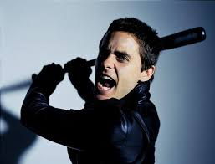
What do we want –
death to PEE
When do we want it – NOW!

Slide 25

