Slide 1


@vhpsinnovation
Ben Rothwell, Head of Technology and Innovation
Victory Heights Primary School

Slide 2
@vhpsinnovation
Where we were at
CPD held at strategic times throughout the year
Tuesday 3.00-4.30 - sporadic whole-school CPD, admin time, meetings etc
Difficult to align CPD with the requirements of the whole school body
Staff felt that CPD opportunities did not meet their needs - potential issue for recruitment and retainment
@vhpsinnovation
Ben Rothwell, Head of Technology and Innovation
Victory Heights Primary School

Slide 3
@vhpsinnovation
What we did to change it
Gave ownership of CPD back to teachers and leaders
Encouraged teachers to participate in wider learning opportunities (PLNs, teachmeets etc)
Reduced ‘directed’ CPD dramatically
Encouraged participation in action research/RCTs to ensure that VHPS became an evidence informed school
Changed our observation protocols
@vhpsinnovation
Ben Rothwell, Head of Technology and Innovation
Victory Heights Primary School

Slide 4
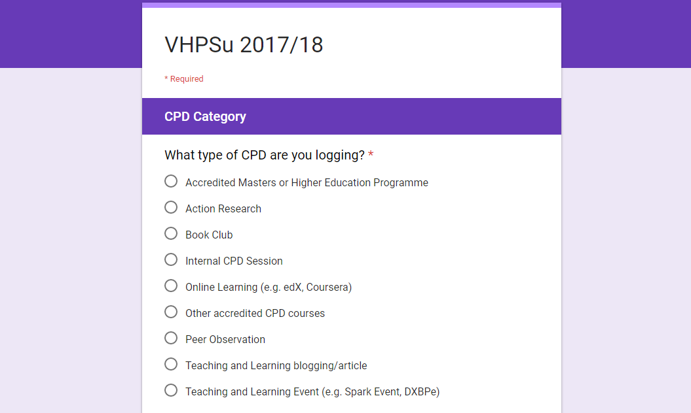

Slide 5
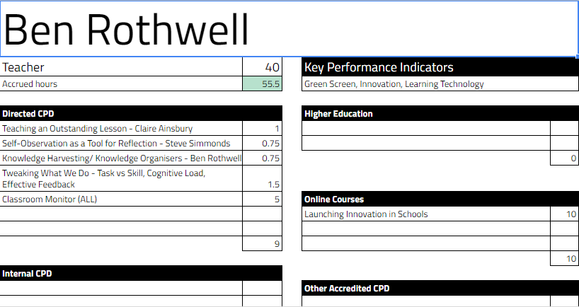

Slide 6
@vhpsinnovation
What comes next?
Step up our focus on evidence informed school through;
  Research lead within school
  Additional credit hours for involvement in research
  Work towards some form of accreditation scheme
Work in collaboration with Southview School (sister school) to extend range of opportunities
Develop in-house LMS for online-content
@vhpsinnovation
Ben Rothwell, Head of Technology and Innovation
Victory Heights Primary School

