Slide 1

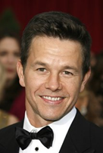
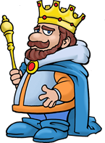
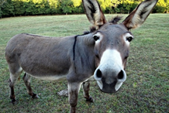


1 word,
2 syllables
1 word,
3 syllables

Slide 2
Mark King (Marking)
Ass S Mint (Assessment)

Slide 3

Technologies and Education
Using a variety of digital tools to reduce teacher workload and improve impact on student learning.
Baldish Nijjar
Innovation Leader @ Jumeirah College
GEMS Tellal: ICT, Computing & Digital Network Leader

Slide 5

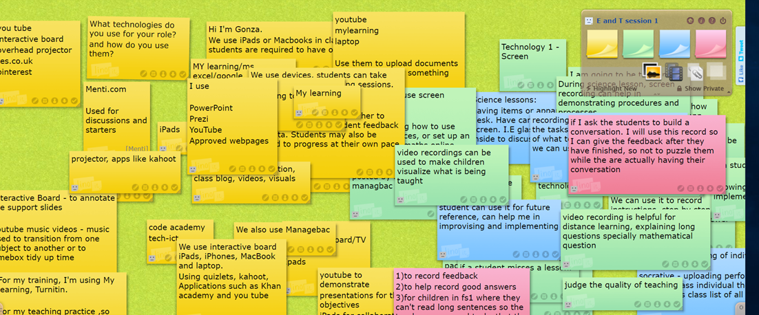
Previous responses
Digital tools used, what for, and how they were used

Slide 6

By using technology
Can you reduce workload?
Can you reduce repetitive feedback?
Can you make feedback/lessons more effective?
Can you reduce the need to repeat lessons topics?
Can you use the students to build resources?
Can you use flipped learning to improve lesson preparation?

Slide 7

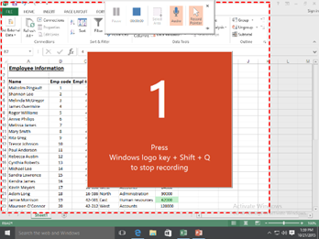
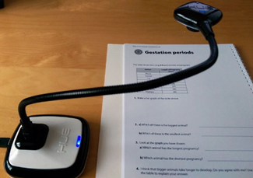


Screen/Paper recording

Slide 8
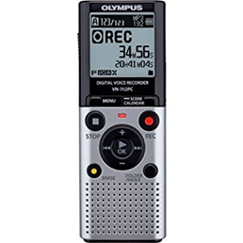

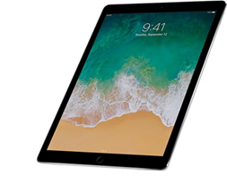
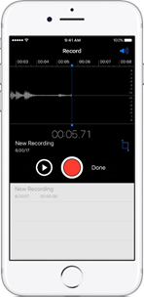
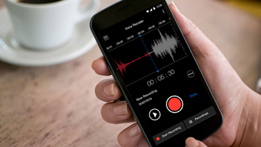
Voice recording

Slide 9

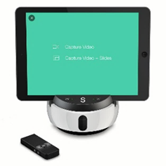
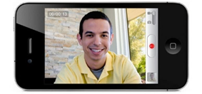

Video recording

Slide 10

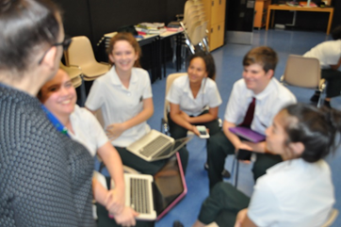
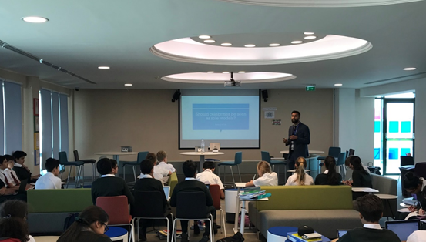
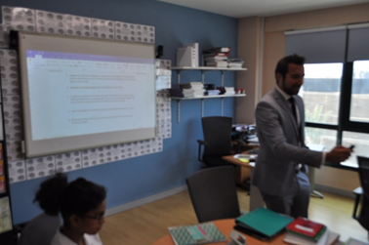
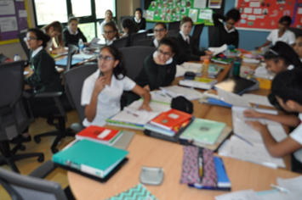
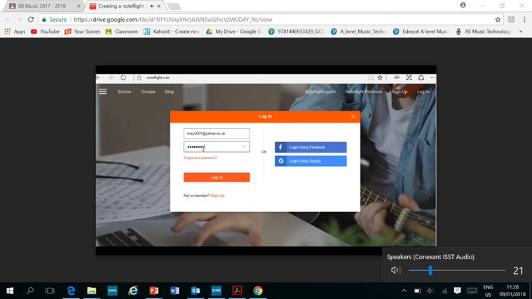
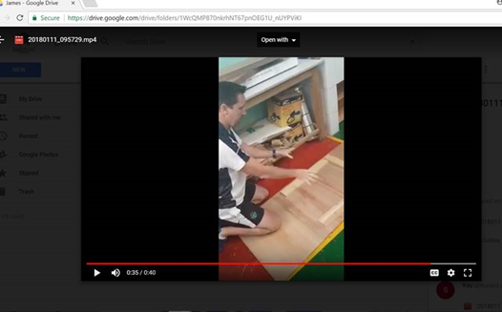
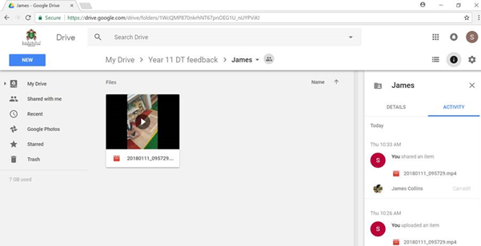
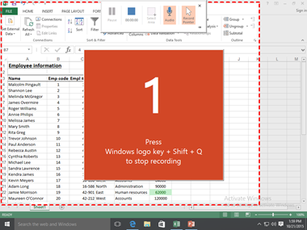
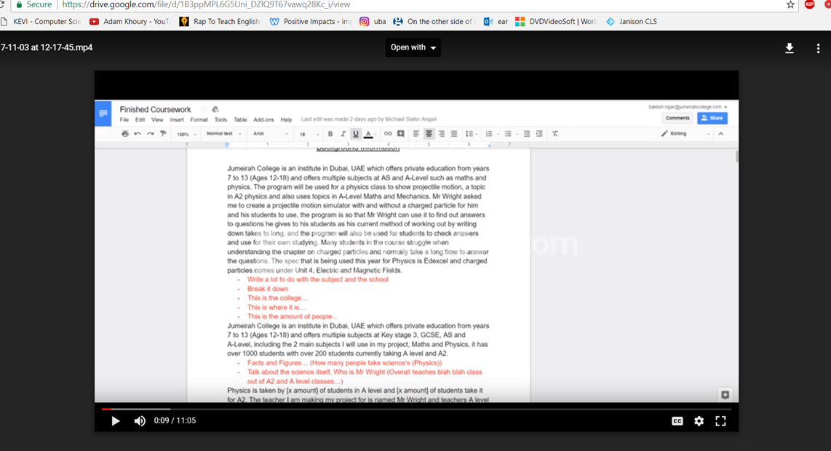
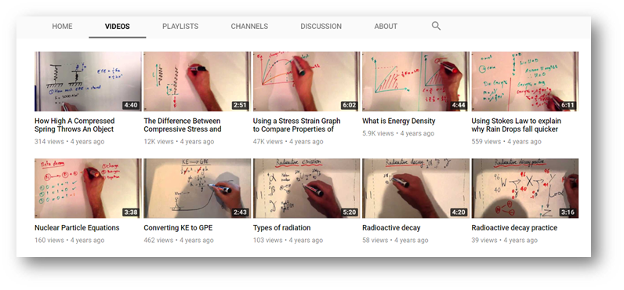


Slide 11
Evidence of feedback
Feedback from: | Type of feedback: | Date: | Location: | Example of feedback: | Action taken:
Teacher/Self/Peer | Verbal/Audio/Video | 20/01/2018 | Google drive personal folder | Mr Nijjar stated that I should explain why I used the editing tools, why did I select them, and not just state that I had used them. More feedback was given on the audio note. | I added more explanations to my answer, and included why I used the marquee, selection and eraser tools to edit the picture.
Teacher/Self/Peer | Verbal/Audio/Video
Teacher/Self/Peer | Verbal/Audio/Video

Slide 12

Teachers are reluctant
Technophobia!
Comfort zone
Closed minded
Training/Initial setup
Don’t see the bigger picture
Genuinely prefer their current methods

Slide 13
Students can be involved too!
Revision
Specific exam questions/topics/tasks
Peer feedback
Self improvement
Reflection
Etc.

Slide 14
It may already exist!
There may be videos out there that you can just use;
Create your lessons around them, and if they link well to a specification then keep them, create a sheet linking to the videos/websites/pages in the book which can be accessed easily for different lessons/students.
There may be resources out there that you can easily adapt, rather than having to start from scratch.
Share with each other! Collaboration is key!

Slide 15

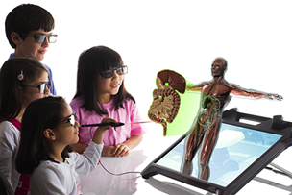


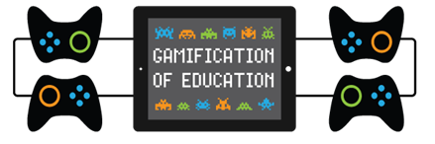
The current
future

Slide 16

Thanks!
Any questions?
You can find me at:
@MrNijjar_
MrNijjarICT@gmail.com

