Slide 1

Dubai GESS Conference, Education Leadmeet
Tuesday 27th February 2018
Dr Carol Webb (Twitter @DrCWebbBAPhD), Middlesex University Dubai
“From Theory to Practice – Focus on Distributed Leadership”

Slide 2
Distributed?
Why?
What?
How?
Who?
When?

Slide 3
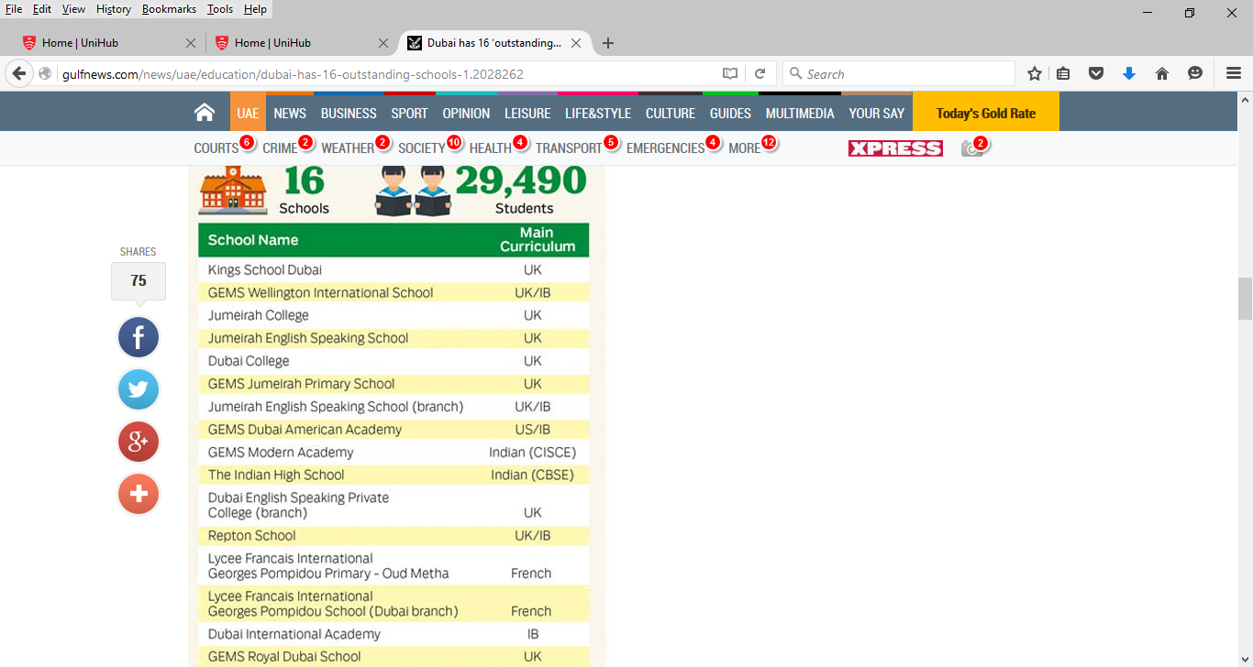
Kings: “Leadership was distributed very productively across the school”
Outstanding Dubai Schools 2017
Dubai College: “Leadership responsibilities were widely shared”
DESC: “headteacher provided inspirational
Leadership – determination shared by leadership team and all staff”
Dubai International Academy: shared and delegated leadership, school community based vision
GEMS Dubai American Academy: “A very effective system of delegated leadership was in operation. It was facilitated by unambiguous job descriptions that detailed lines of accountability and individualized, core responsibilities. The values of the school mission were embedded in these
Descriptions.”
GEMS Jumeirah Primary School: “A strong collegiate approach achieved through effective communication channels enabled the leaders to build capacity and create an ethos of collective responsibility”
The Indian High School: “The CEO was very well supported by his senior and middle leadership team” – “a collegiate approach to school improvement” – “Leaders had a clear and ambitious vision”.

Slide 4
GEMS Modern Academy: inclusive school vision by principal, supported by highly committed SMT – ‘leaders presented a united and dedicated team’
GEMS Royal Dubai School: “they had built a very strong, inclusive and collegiate ethos among staff, students and parents. […] The principal had delegated responsibilities to a wide range of staff, and teamwork was a notable feature
of the school's work. […] Under the inspirational leadership of the principal and senior leaders, all staff successfully implemented a shared, ambitious vision for the school.
GEMS Wellington International School: “The principal provided excellent leadership. She was supported very effectively by a team of senior leaders that shared a
relentless determination” […] “Outstanding relationships underpinned the excellent team spirit across the school. There was a strong sense of collective responsibility.”
Jumeirah English Speaking School: “Leadership roles were distributed highly
effectively, drawing on the wealth of expertise and wide experience across the school. There was an excellent team spirit and strong sense of collective responsibility among all staff.”
Jumeirah College: “The principal's aim for the pursuit of academic excellence was shared and understood by teachers, parents and students. The principal had skillfully strengthened the management team” … there was “a clear sense throughout the school that leaders were ‘primi inter pares’, first among equals.”
Lycee Francais: “The principal was very effective at communicating her exceptionally clear vision for the school” – “Relationships and communication between levels of leadership were professional and highly effective. The newly appointed co-ordinators acted as an excellent channel of communication between the principal and staff.”
Repton: “strong leadership provided by the headmaster” – “The leaders’ ambitious vision was shared with staff and other stakeholders” – “effective teamwork” – “Leadership was devolved to the points of delivery” - “model of collective working was a notable management feature. Discussion and sharing of ideas were common.”

Slide 5
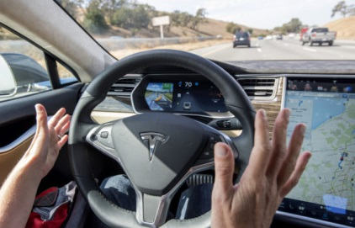


Laissez-Faire
Democratic
Autocratic
Healthy freedom and trust – directed engagement
Total freedom and trust for subordinates
Less freedom and trust – highly directive
Collaborative and plurality of voices heard
Expectation that individuals are autonomous
Machine metaphor – cogs as parts of machine. Tightly defined roles
Possibility of multiple vision and values – can be created bottom-up
Individual vision and values
Vision and values dictated from the top

Slide 6
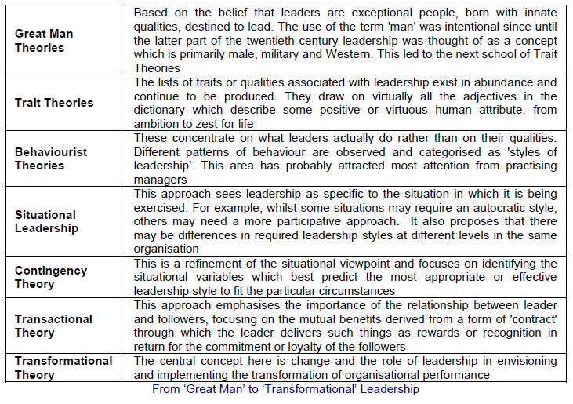
(Bolden et al, 2003)

Slide 7
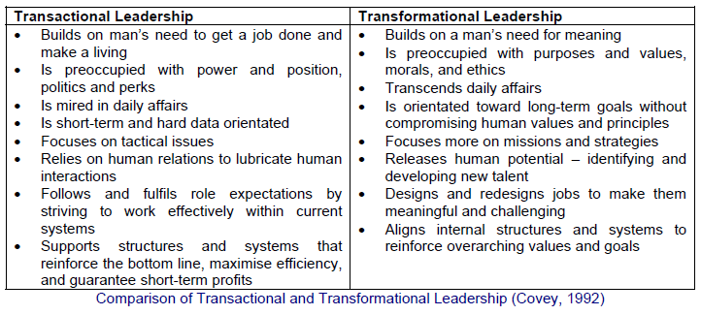
(in Bolden et al, 2003)
Transformational leadership more likely to be enacted through what Bolden calls ‘dispersed leadership’… moving towards distributed…

Slide 8
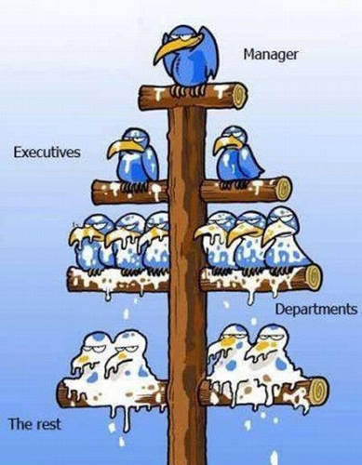
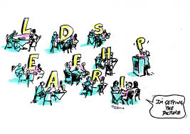
Exec Principal / Director
SLT

Slide 9
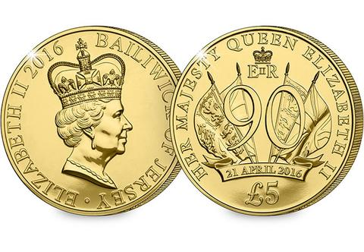
Collegial….
‘Collegial models assume that organizations determine policy and make
decisions through a process of discussion leading to consensus’ (Bush, 2003)
“challenges the view of leadership as a solely
vertical process in which an individual leader is seen as the main source of influence” (van Ameijde et al, 2009)
“a shift away from hierarchical leadership to flatter
leadership structures that maximize leadership talent of the many,
rather than the few” (Harris in Bowen & Bateson, 2008)
…Distributed

Slide 10

2 key principles
“Leadership is a shared influence process to which several individuals contribute”
“Leadership arises from the interactions of diverse individuals which together form a group or network in which essential expertise is a dispersed quality”
(van Ameijde et al, 2009, p. 766)

Slide 11

Formal Leadership Positions Still Needed
‘The paradox is that without stable, consistent leadership in schools distributed leadership will be incredibly vulnerable and ultimately fragile’
(Harris, 2007, p. 322)

Slide 12


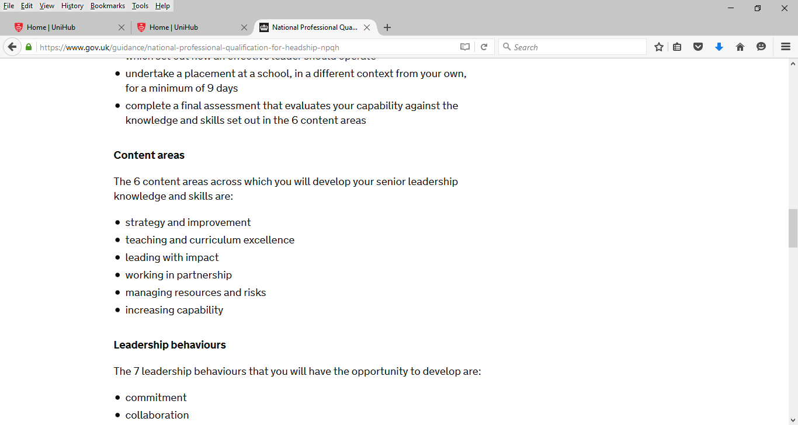
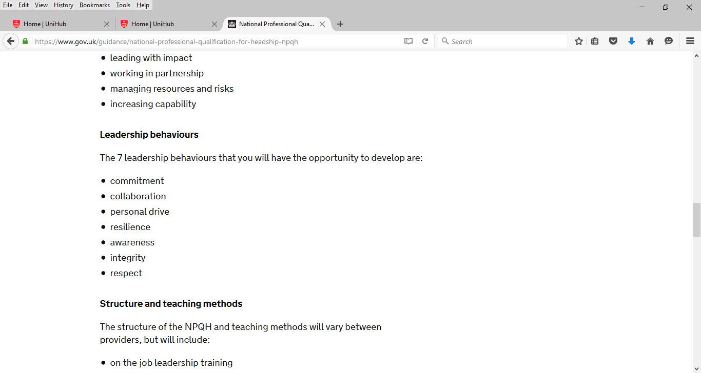
National Professional Qualification for Headship (NPQH)
National Professional Qualification for Senior Leadership (NPQSL)
National Professional Qualification for Middle Leadership (NPQML)
UCL IoE deliver abroad in association with local contacts
Also consider MDX MA Edu L&M

Slide 13

Argument for more leadership training, coaching and mentoring…
For all those in leadership positions and aspiring…
Including middle leadership – perhaps especially?
Not just promoting good teachers of a subject…
Preparing and developing leaders before they take on leadership roles…
Continuing to develop them while in those roles.
Thank you – any questions?
Twitter: @DrCWebbBAPhD

