Slide 1


Slide 2
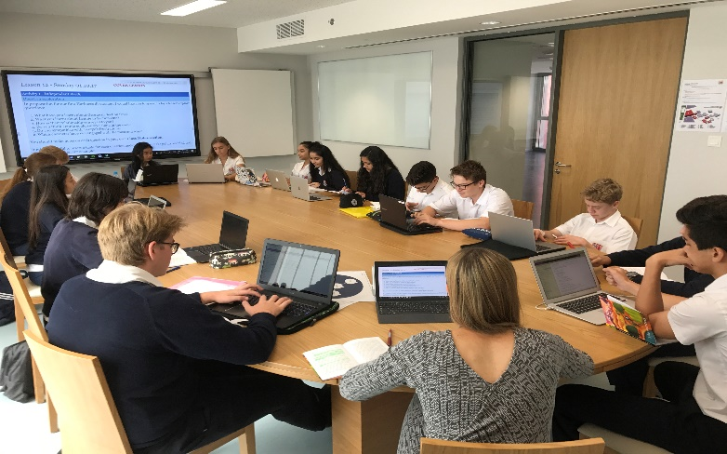
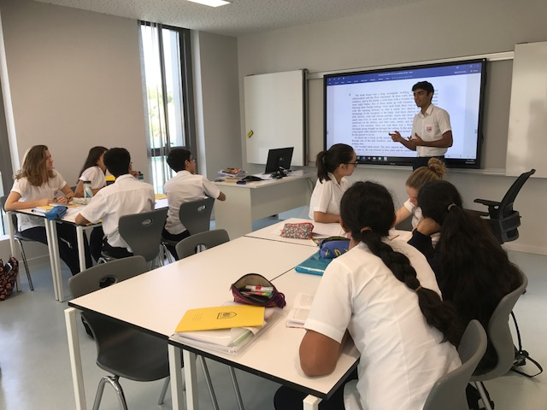
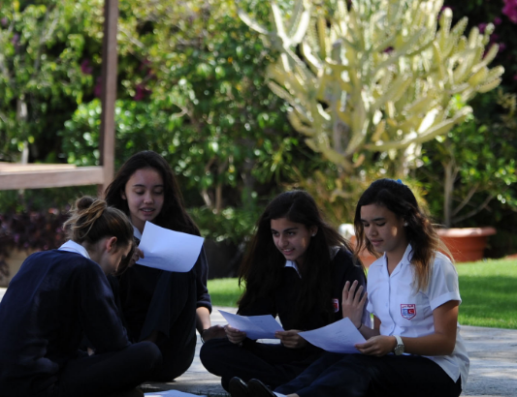

Building a research culture to become a Centre of Innovation in Learning and Teaching
Deputy Head at Dubai College
Learning and Teaching, Research, CPD and Professional Development
DUBAI COLLEGE
A tradition of quality of education
Notes:
Good evening and welcome to Meet the Headmaster. I am Mike Lambert, Headmaster Designate of Dubai College and whilst I can’t quite get the film Meet The Parents out of my head I hope this evening will be a smooth and informative opportunity for you to hear a little about me and how we are beginning to set the strategic direction for the school as we draw to a close of this academic year and look increasingly to September.

Slide 3
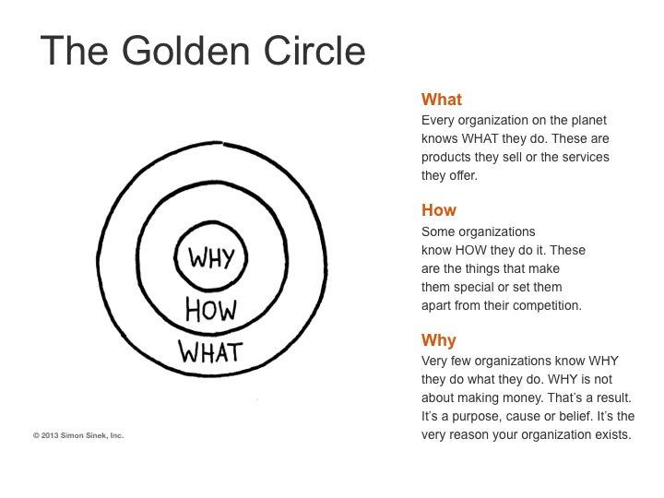
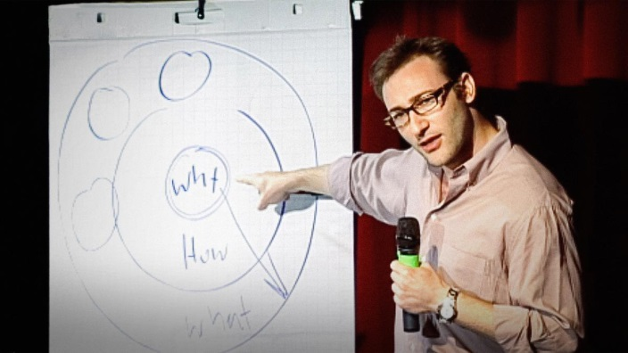
Be informed
Be inspired
Be connected
Be recognised
Be an agent of change
How?
Why?
What?
What is your what?
How can being research engaged support you in developing your what?
DUBAI COLLEGE
A tradition of quality of education
Notes:
Good evening and welcome to Meet the Headmaster. I am Mike Lambert, Headmaster Designate of Dubai College and whilst I can’t quite get the film Meet The Parents out of my head I hope this evening will be a smooth and informative opportunity for you to hear a little about me and how we are beginning to set the strategic direction for the school as we draw to a close of this academic year and look increasingly to September.

Slide 4

What is our what?
Learning and Teaching
Pastoral Care and Wellbeing
Innovation
To be the best British School Overseas in the world, unpinned by four pillars of sporting, creative, philanthropic and academic endeavour

Slide 5
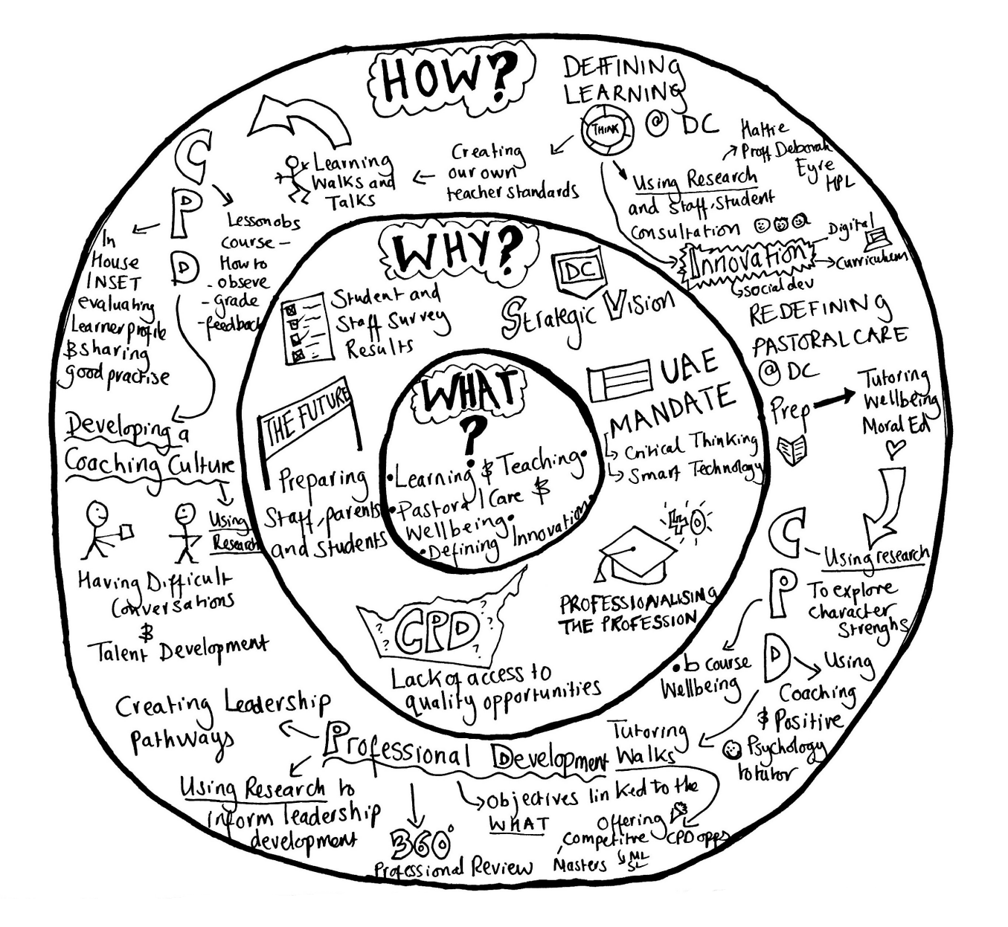

Slide 6
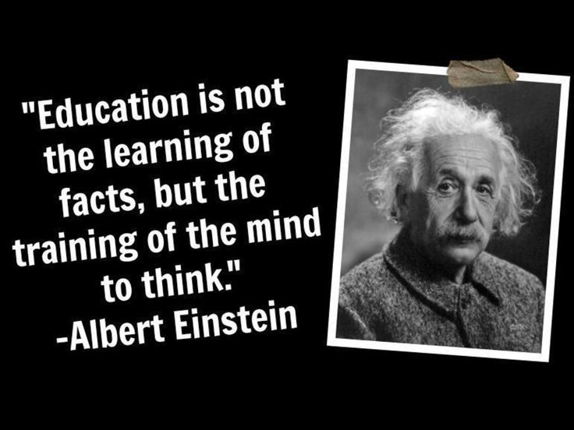

Slide 7
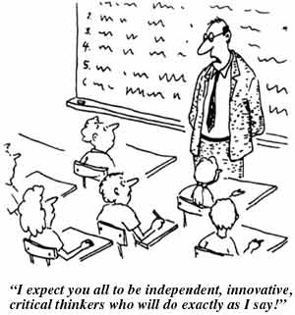
Passive Learning

Slide 8
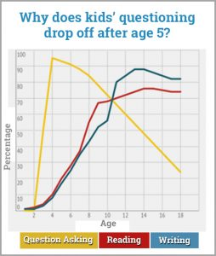
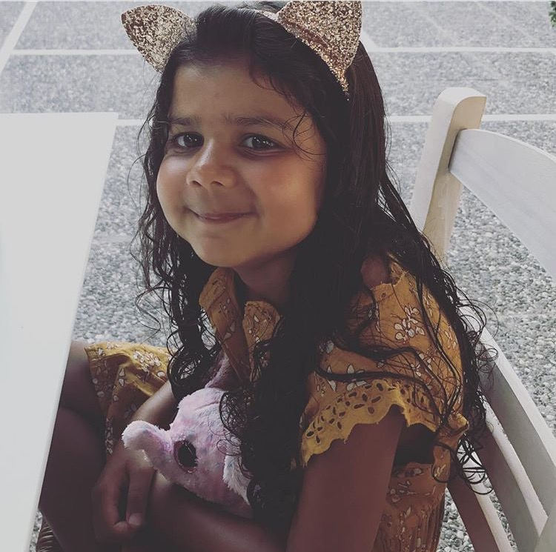
What is killing curiosity?
Apparently the average 4 year old asks 400 questions a day….
She managed 112….When are you going to die? Why do I have two eyes if I only see one thing? Why do you always have to work?

Slide 9
How have we used research to inform our vision?
Learning and Teaching
Pastoral Care and Wellbeing
Innovation

Slide 10
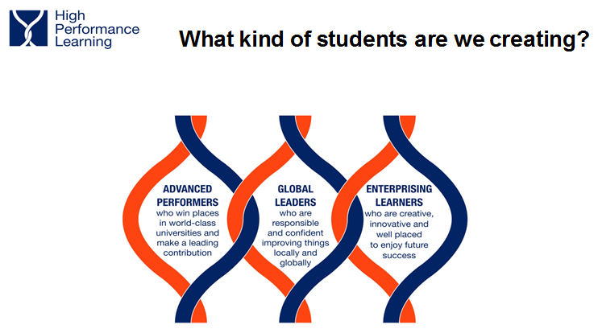

Innovation at the forefront…

Slide 11
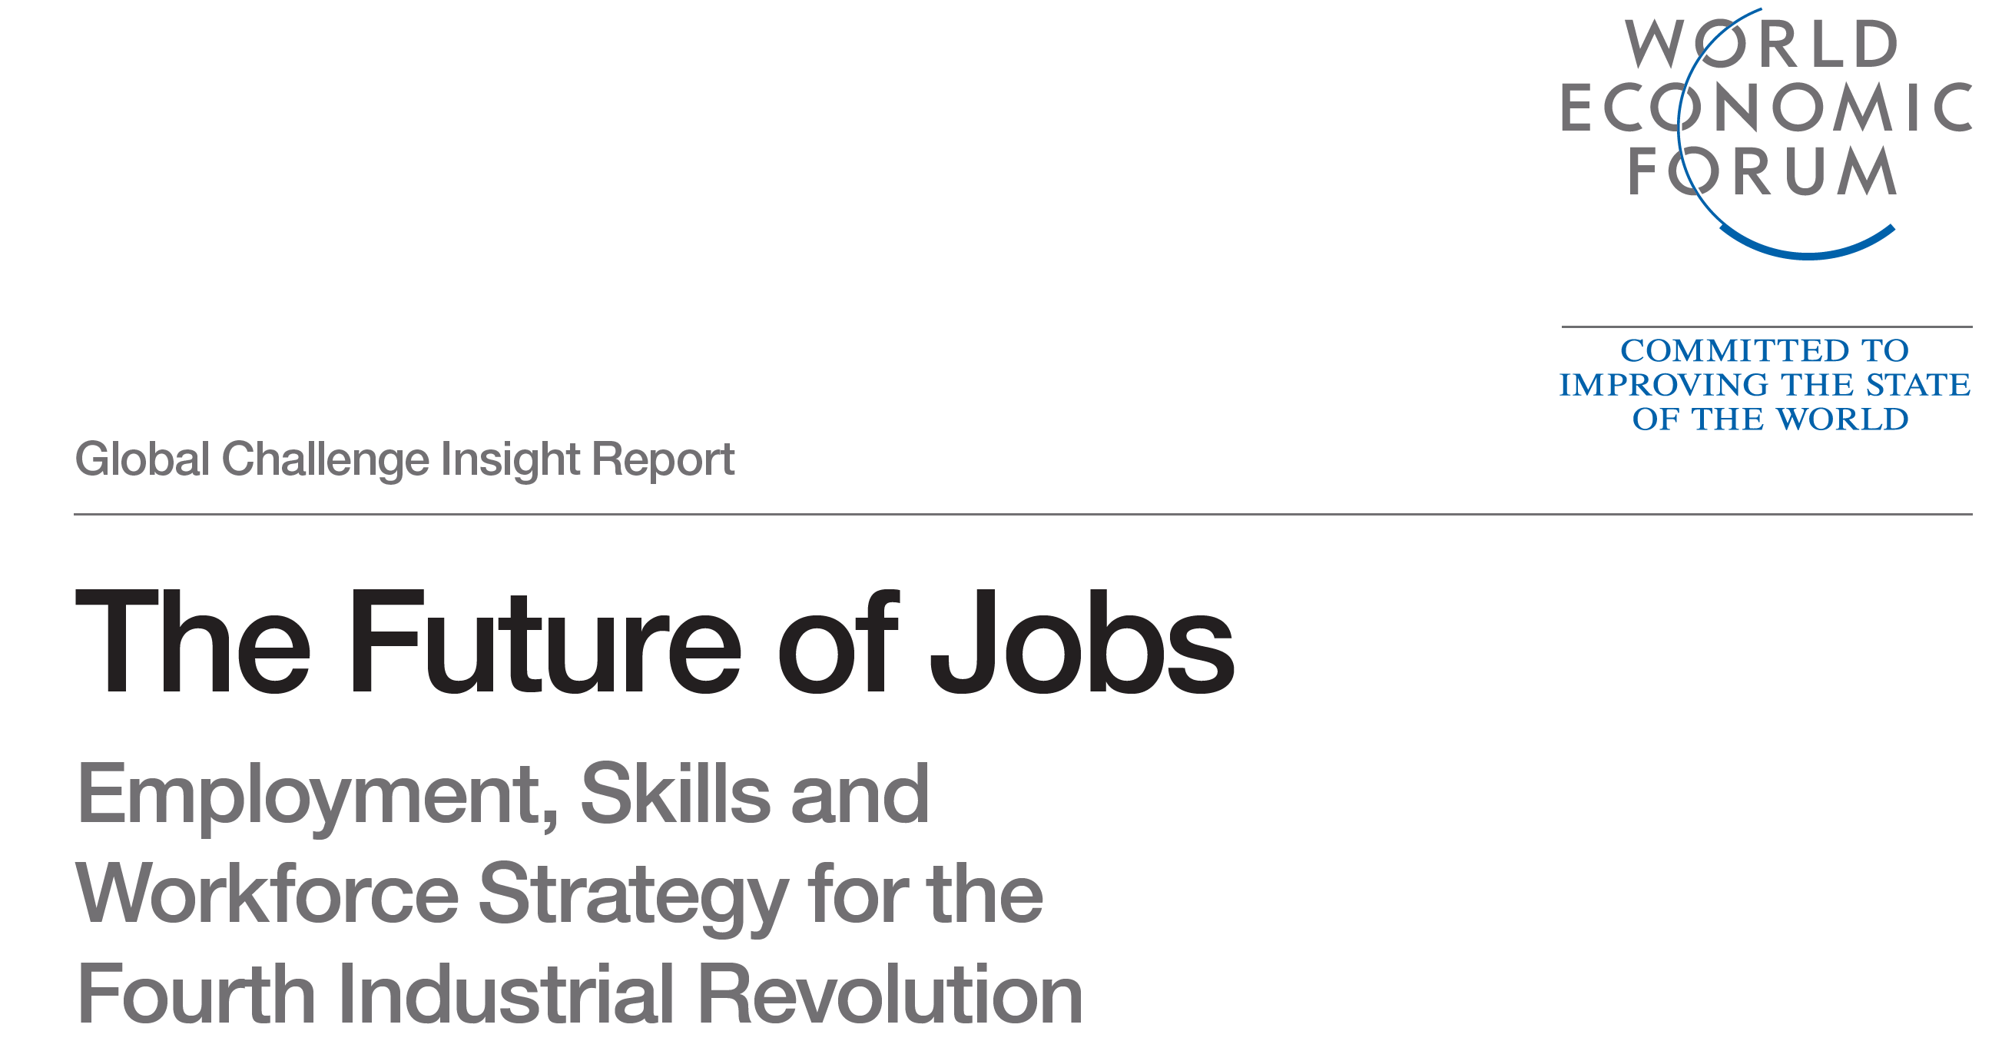

Slide 12
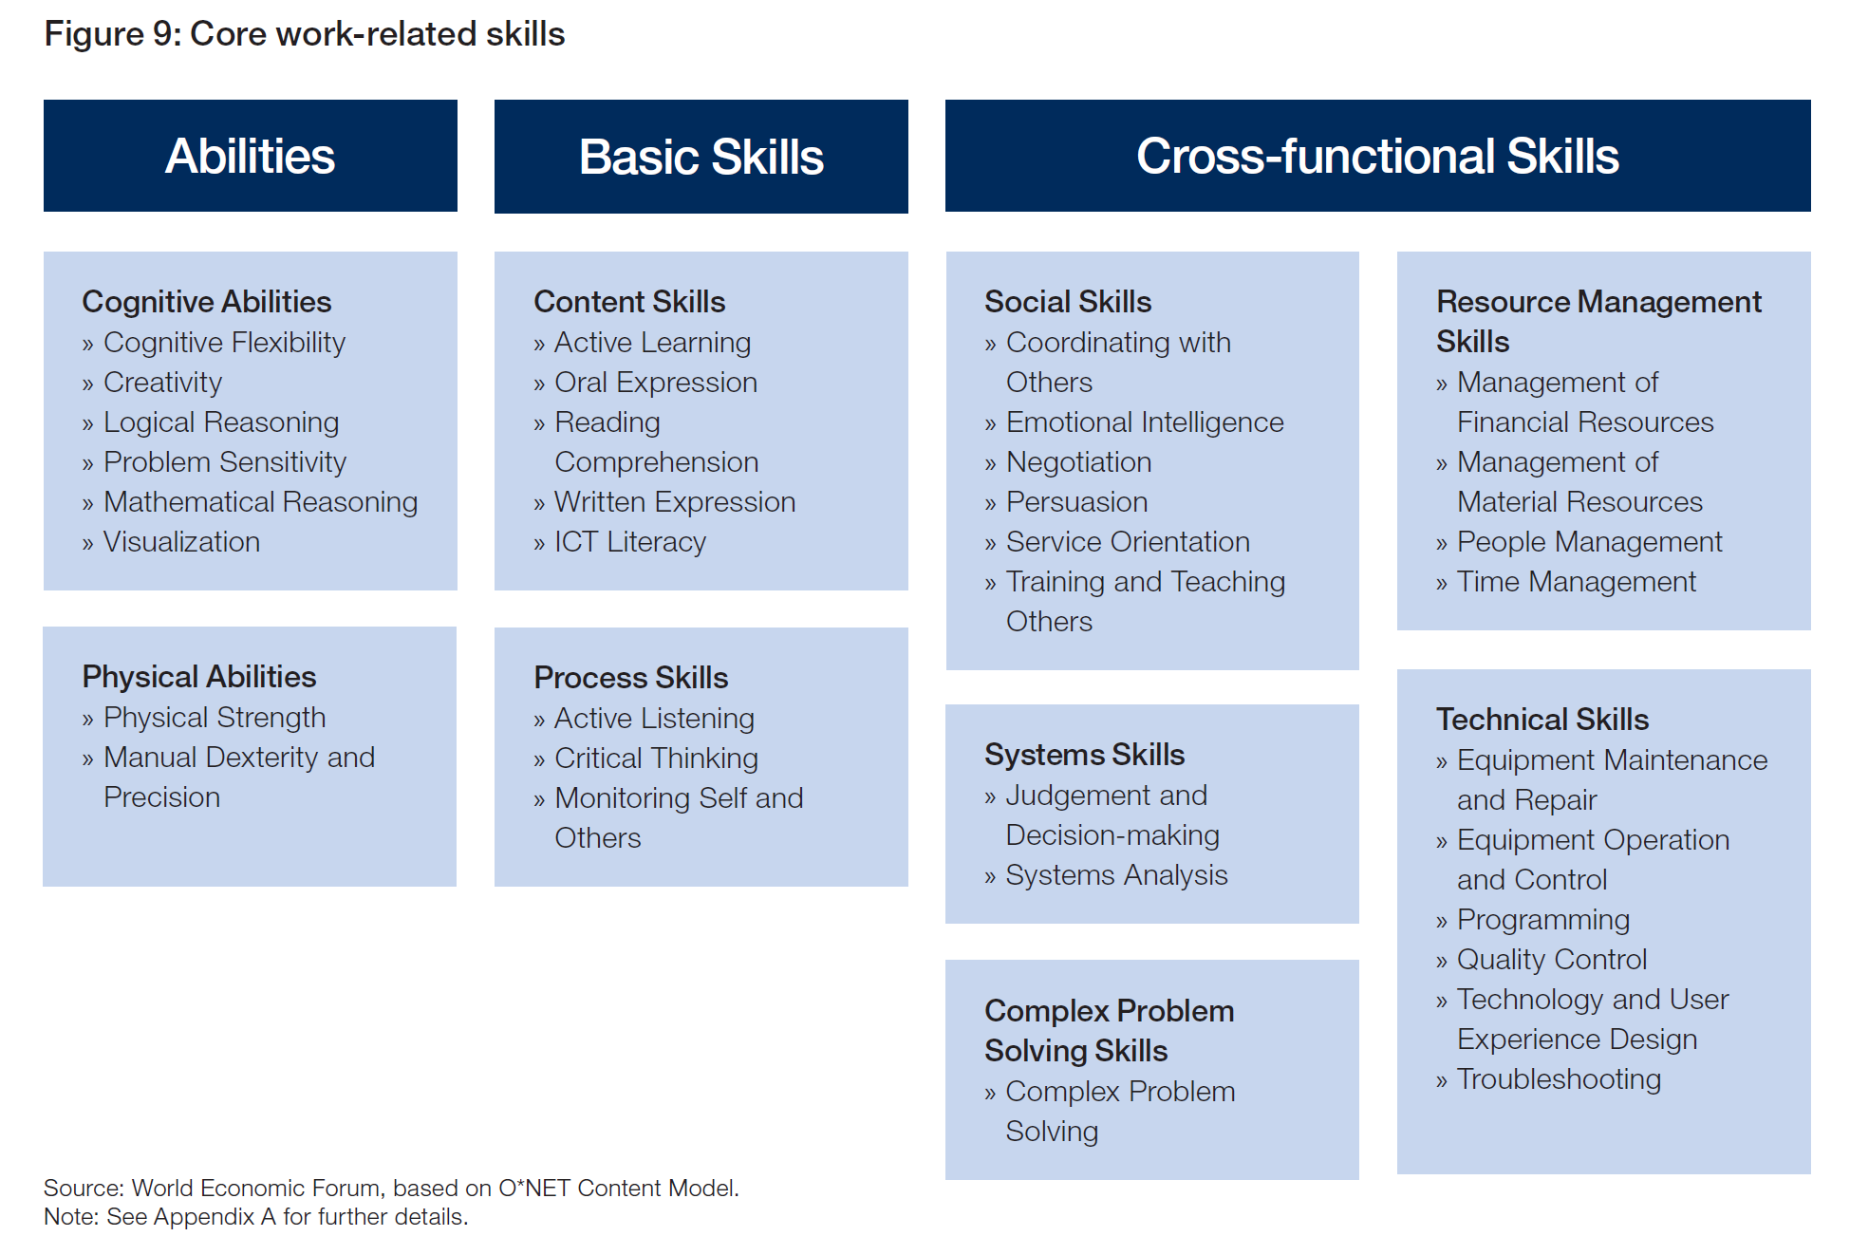

Slide 13

Triangulation of our approach
Students
Teachers
Parents

Slide 14
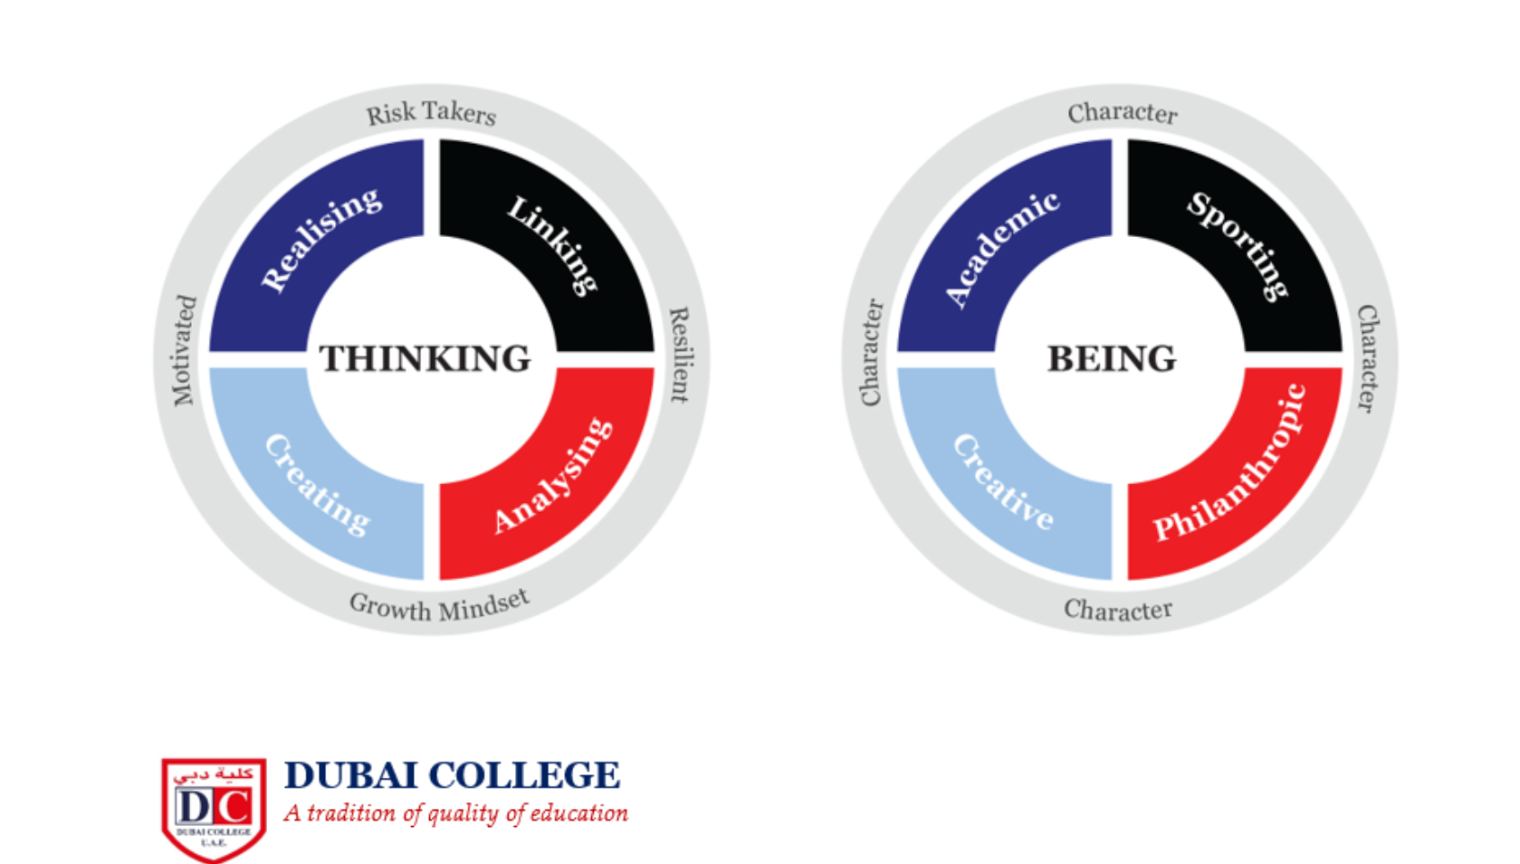

The DC Learner Profile
DUBAI COLLEGE
A tradition of quality of education

Slide 15
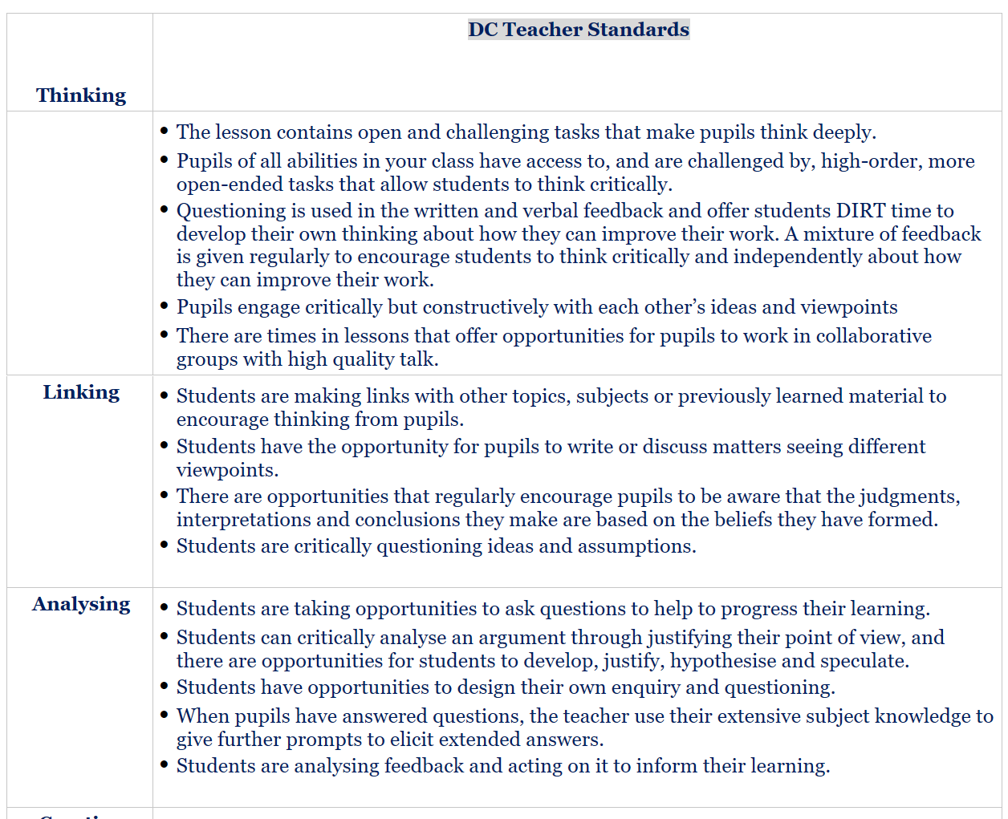

Slide 16
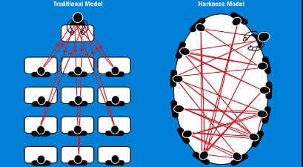
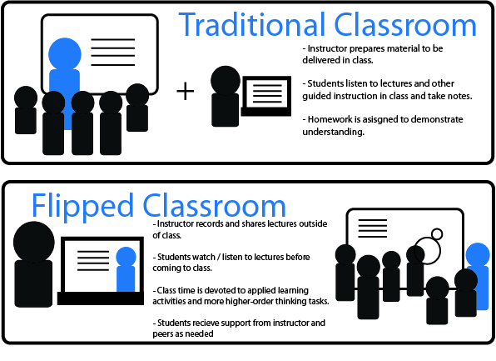
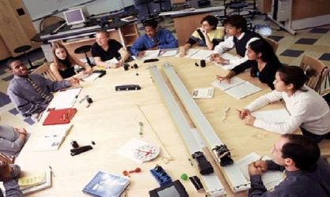
Innovation in Education

Slide 17
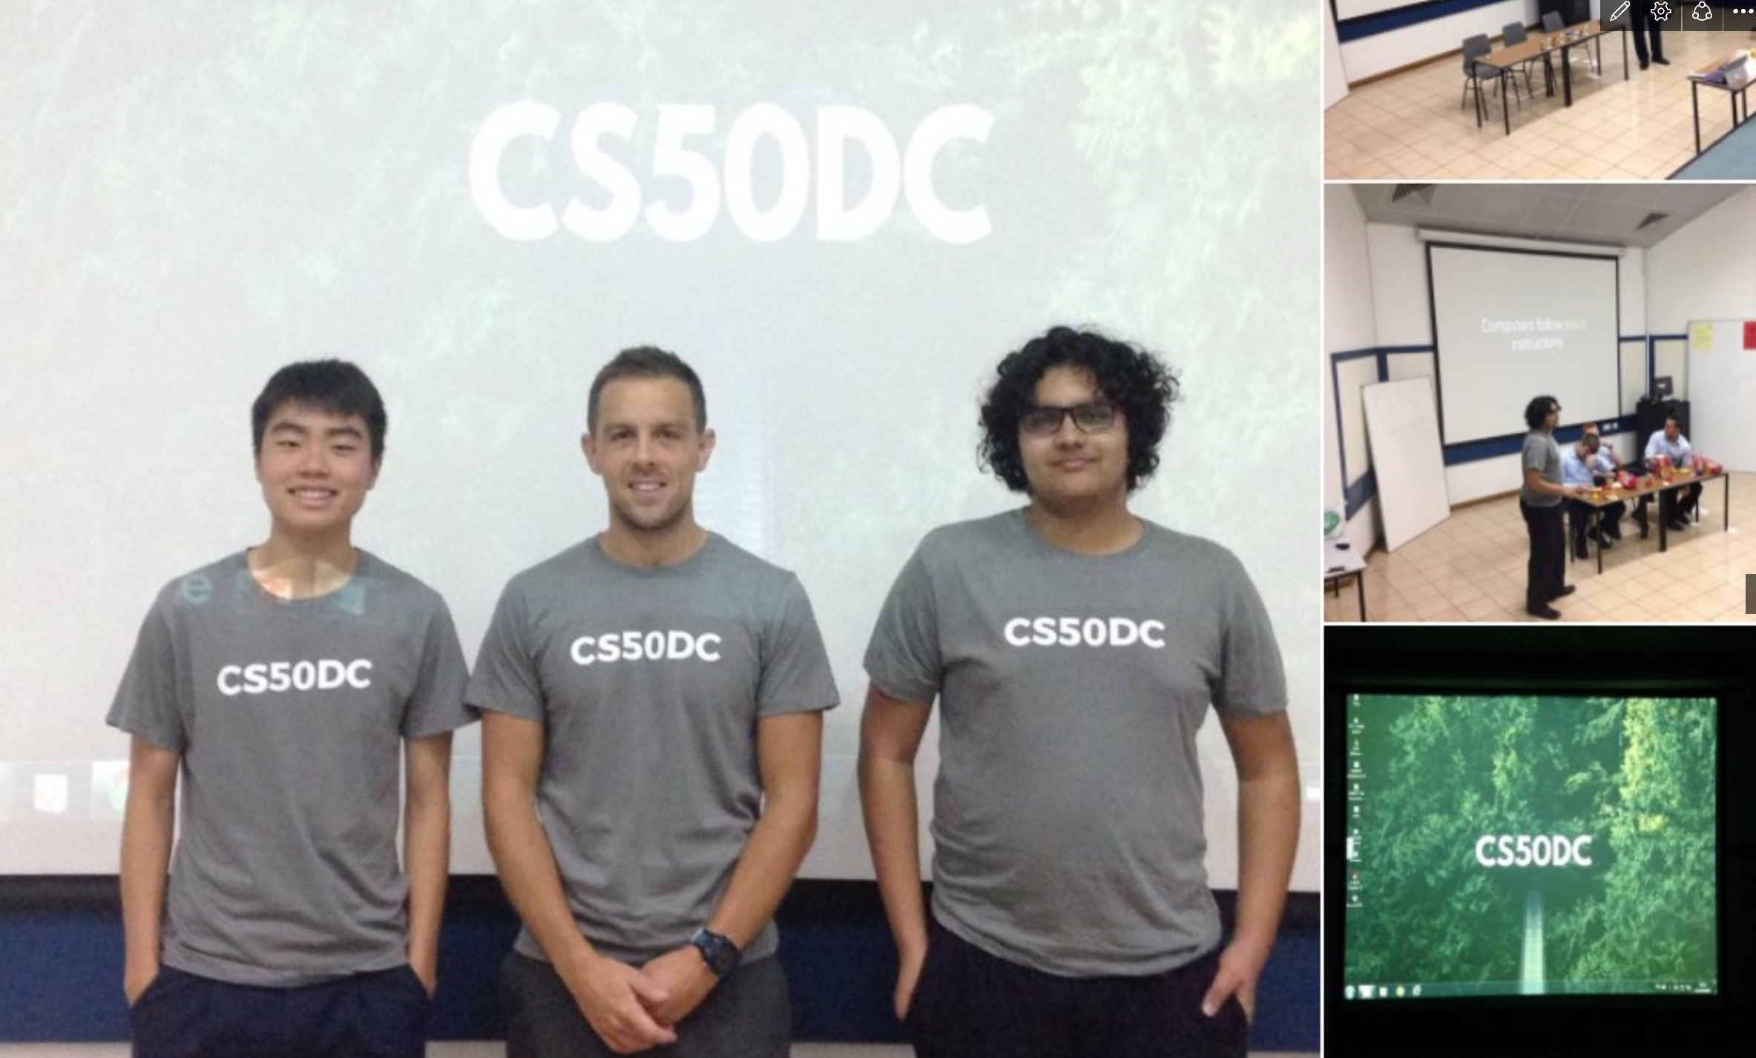

Slide 18
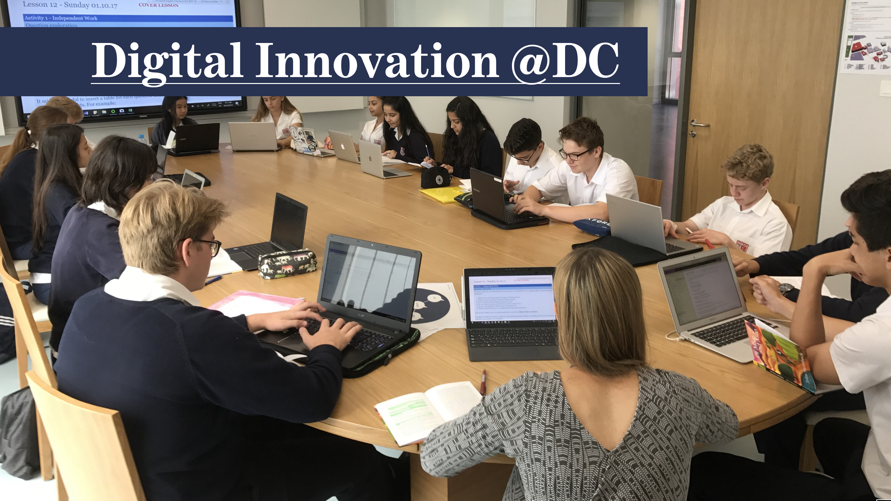
Informed by the DC Learner Profile

Slide 19
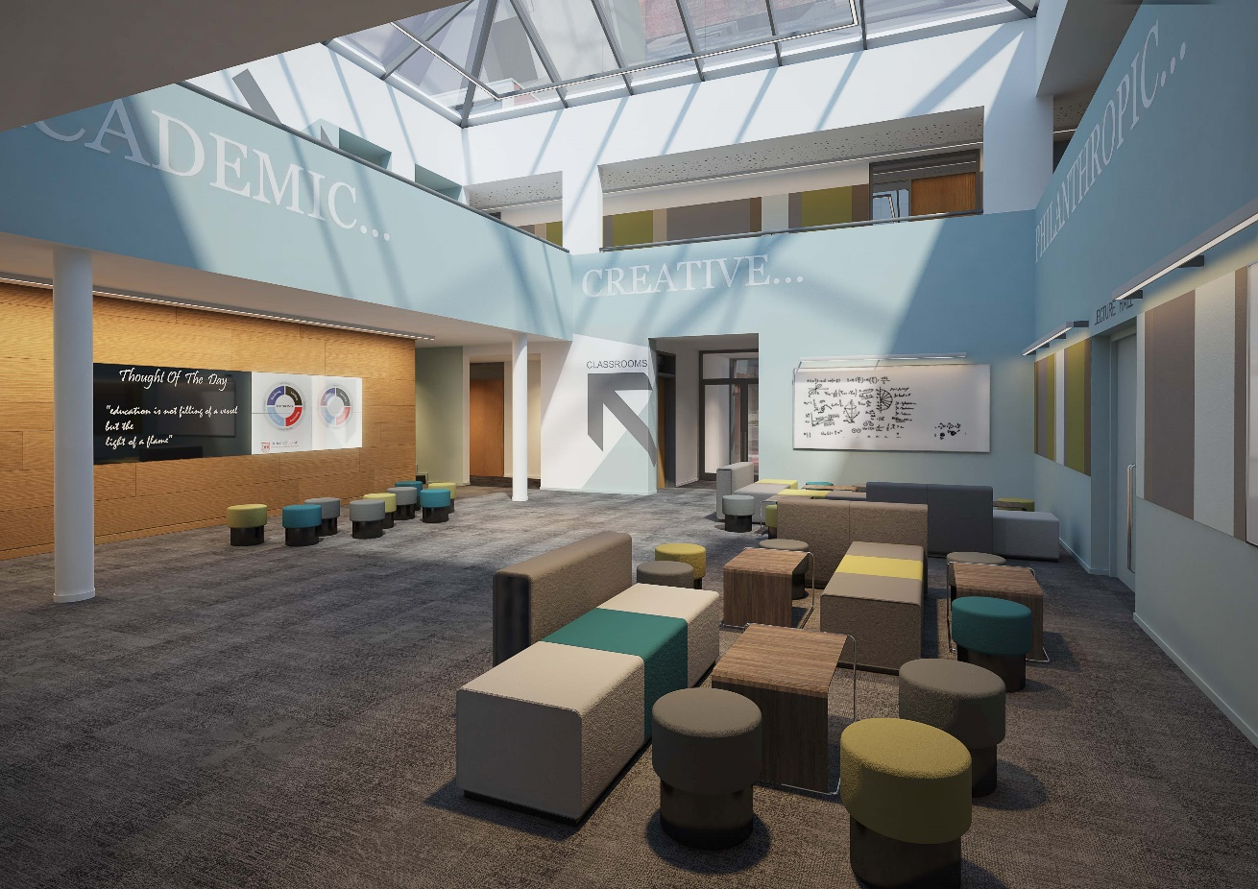

Slide 20
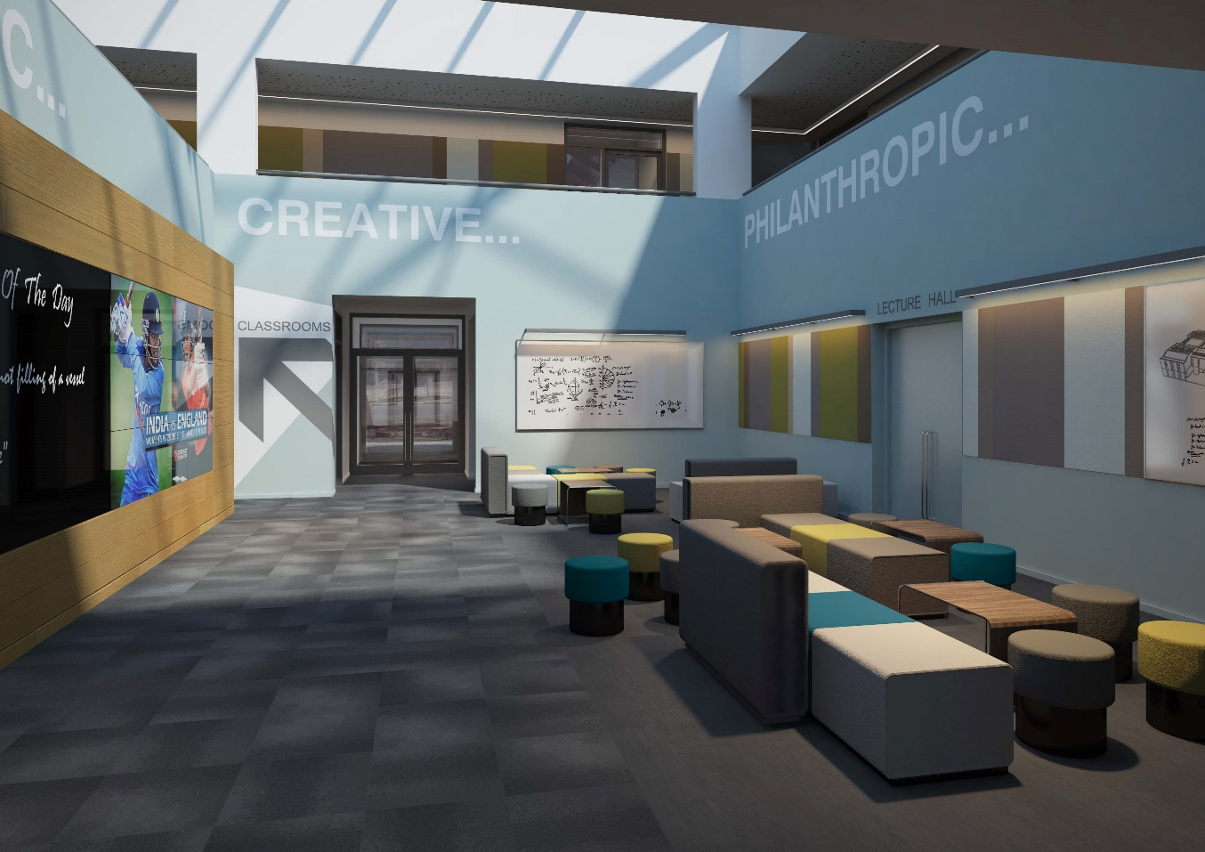

Slide 21
Everything is Underpinned by CPD support
Research
Digital Skills Training
Masters
Curriculum training
Mental Health
Learner profile in action
Networking
Peer learning
Microsoft OneNote
Learn by doing
Tutoring
Leadership Development
DUBAI COLLEGE
A tradition of quality of education
Notes:
Good evening and welcome to Meet the Headmaster. I am Mike Lambert, Headmaster Designate of Dubai College and whilst I can’t quite get the film Meet The Parents out of my head I hope this evening will be a smooth and informative opportunity for you to hear a little about me and how we are beginning to set the strategic direction for the school as we draw to a close of this academic year and look increasingly to September.

Slide 22
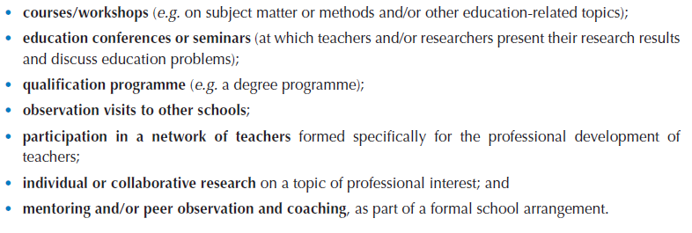
Which of these professional development opportunities is most effective?

Slide 23
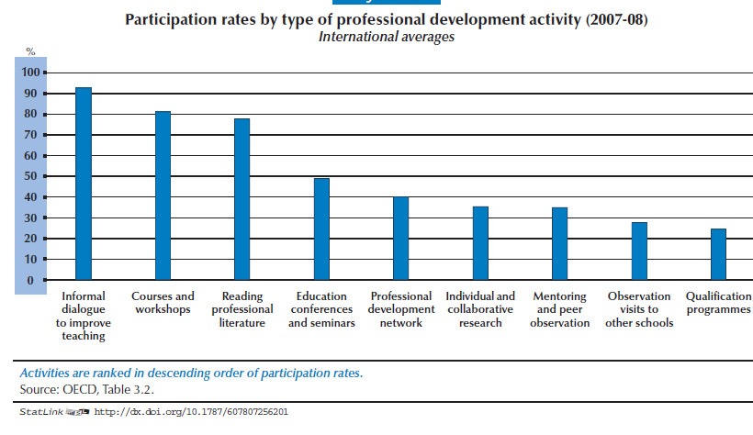

Slide 24
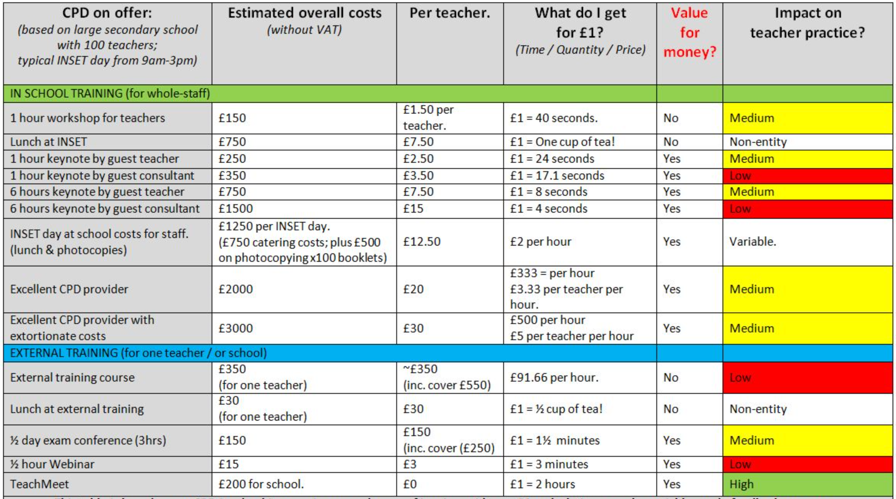
DUBAI COLLEGE
A tradition of quality of education

Slide 25
ACTION RESEARCH
Cultivating a researcherly disposition
‘Every learner is entitled to teaching that is informed by the latest relevant research. Every teacher is entitled to work in a research-rich environment that supports the development of their research literacy’ (BERA-RSA, 2014:7)

Slide 26
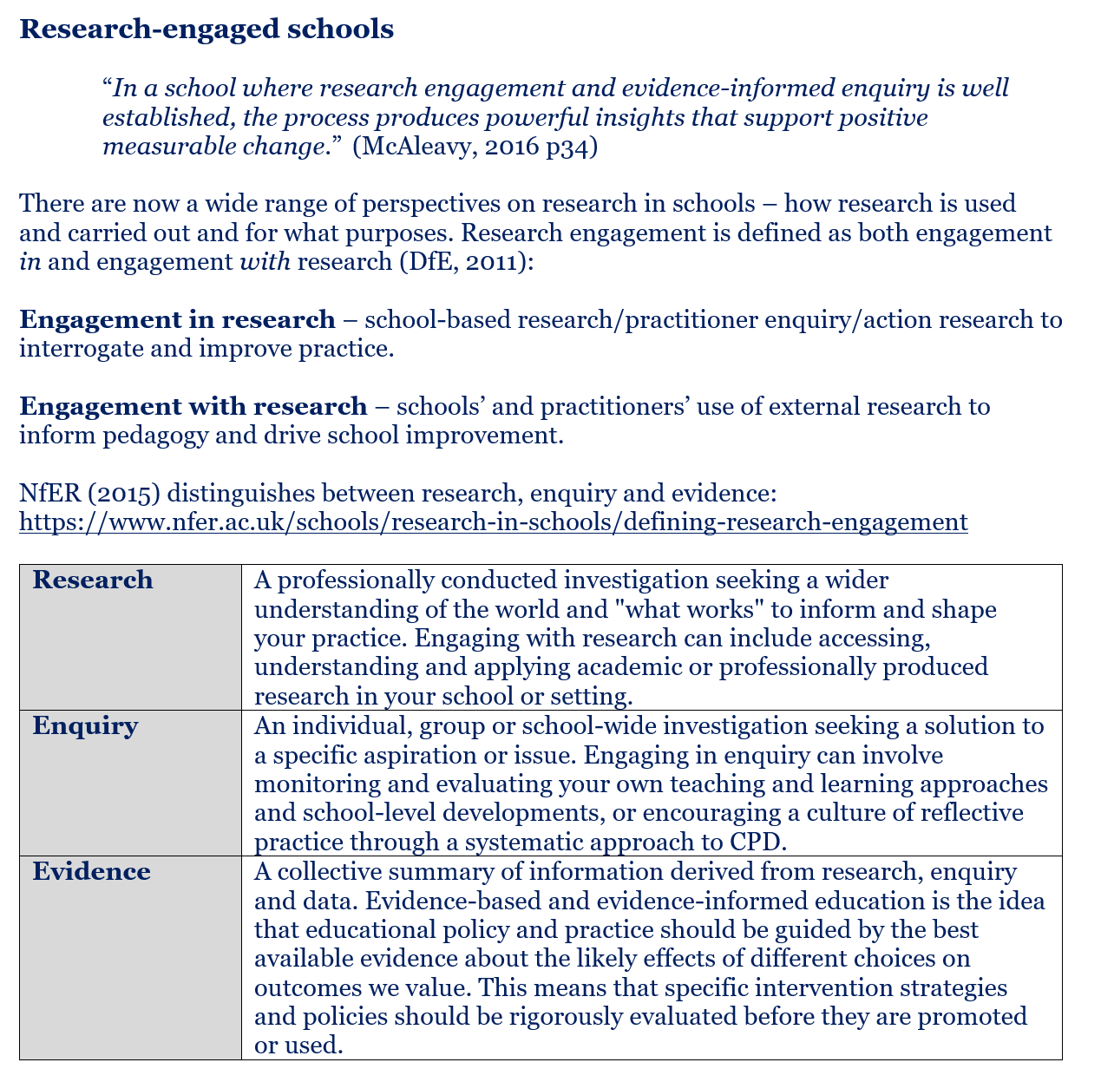

Slide 27
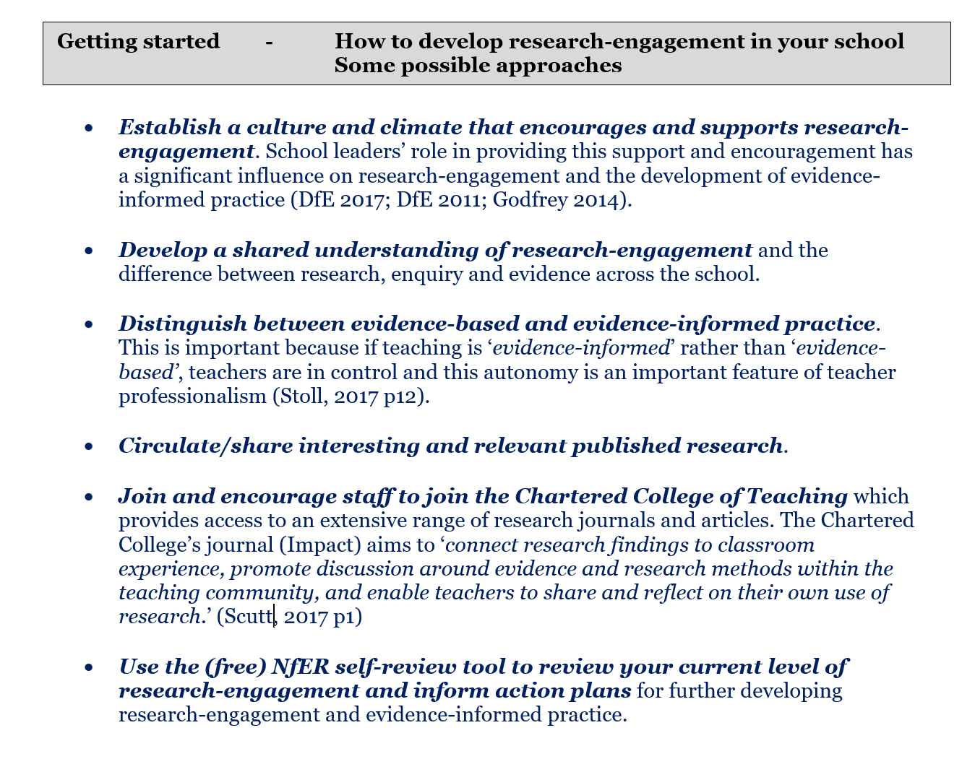
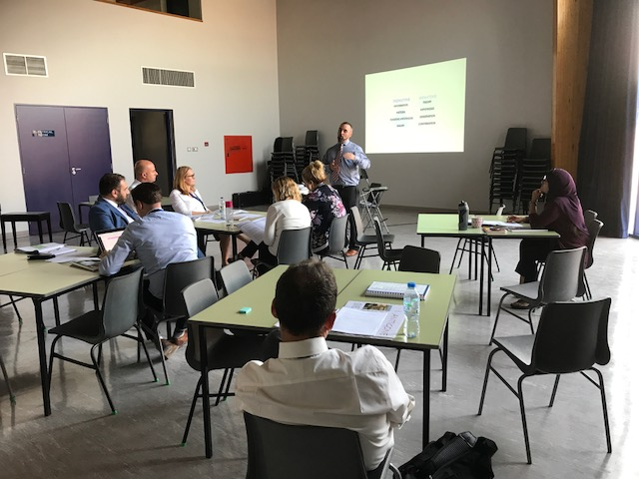
25 Staff have embarked on action research at Dubai College.
Some were incentivised by the part funded Masters offer.
DUBAI COLLEGE
A tradition of quality of education

Slide 28
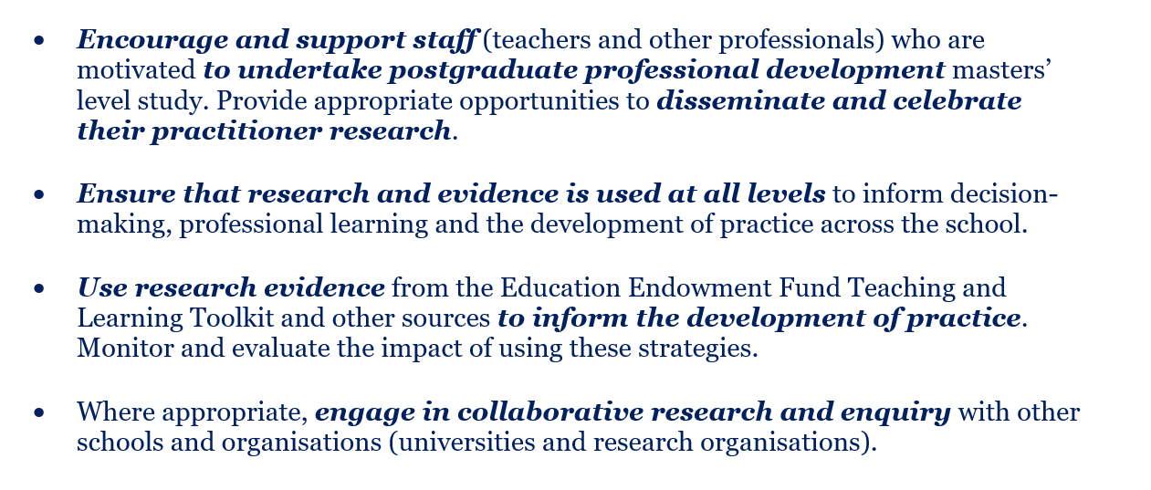
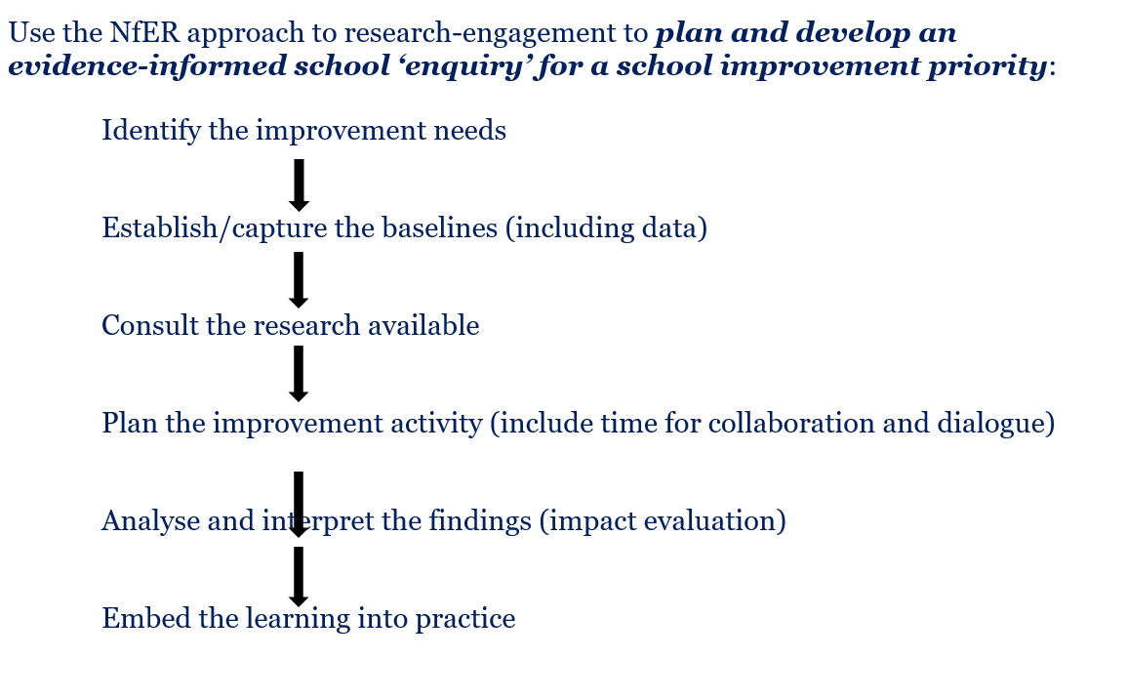

Slide 29
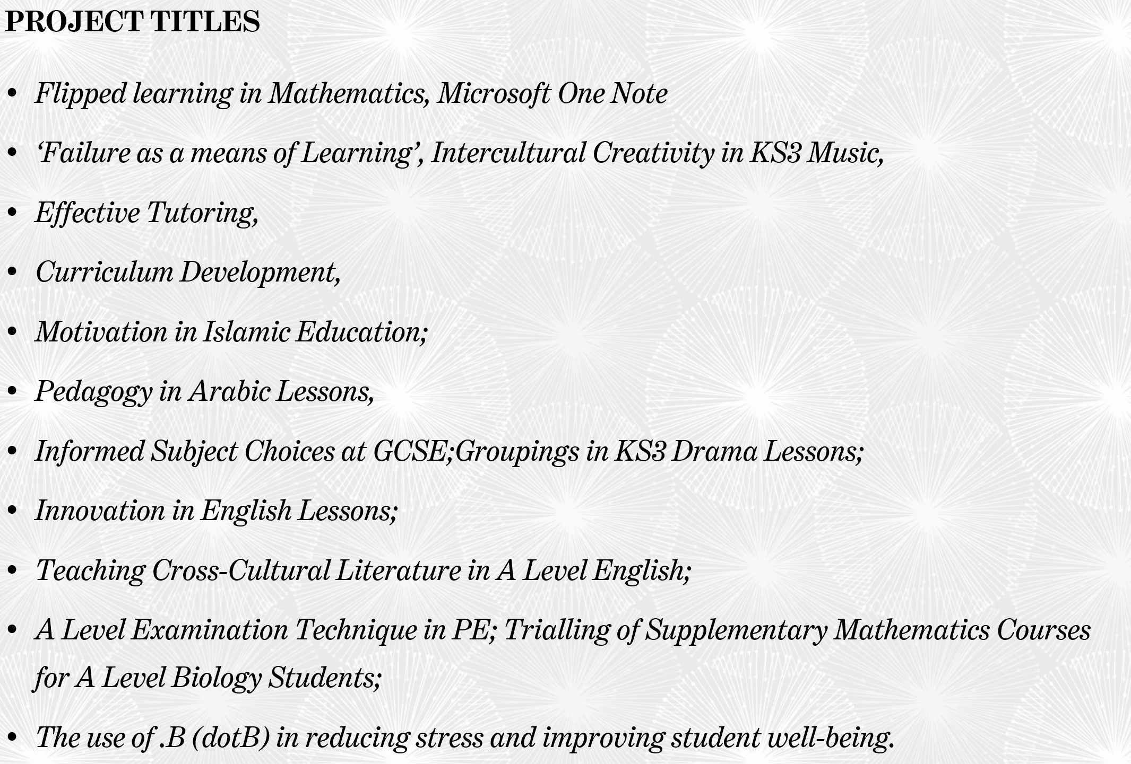

Slide 30







The Future :Research Schools
Evidence-informed practice is now regarded as instrumental to school reform efforts both in England and elsewhere (Greany, 2016). This is especially important given the focus on school self-improvement coupled with a drive for high-quality teaching within a devolved, and increasingly autonomous, education system.
DUBAI COLLEGE
A tradition of quality of education
Notes:
Good evening and welcome to Meet the Headmaster. I am Mike Lambert, Headmaster Designate of Dubai College and whilst I can’t quite get the film Meet The Parents out of my head I hope this evening will be a smooth and informative opportunity for you to hear a little about me and how we are beginning to set the strategic direction for the school as we draw to a close of this academic year and look increasingly to September.

Slide 31
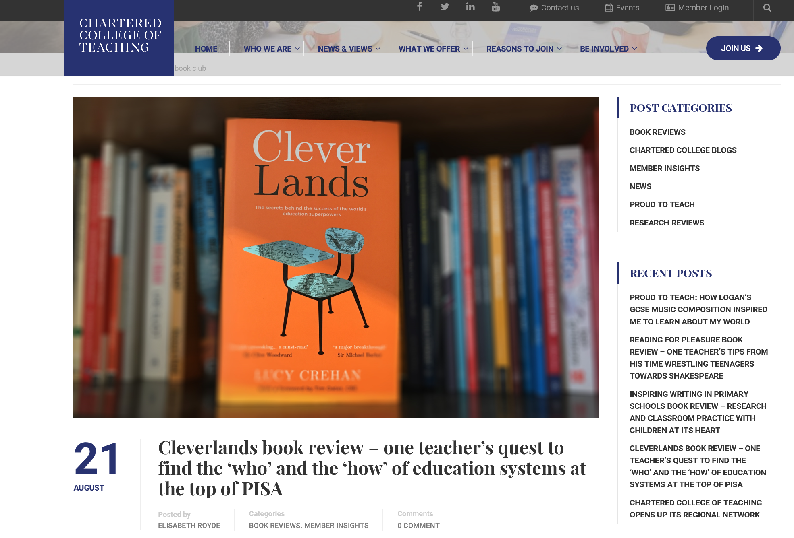
Publishing journals and Book Club
The book clubs will be held on the second Thursday of every month.
You can join in on Twitter using #CCTbookclub, Facebook or via the website where we will publish an article a week before the date.
The first book is Lucy Crehan’s book Cleverlands on Thursday 14th September.

Slide 32

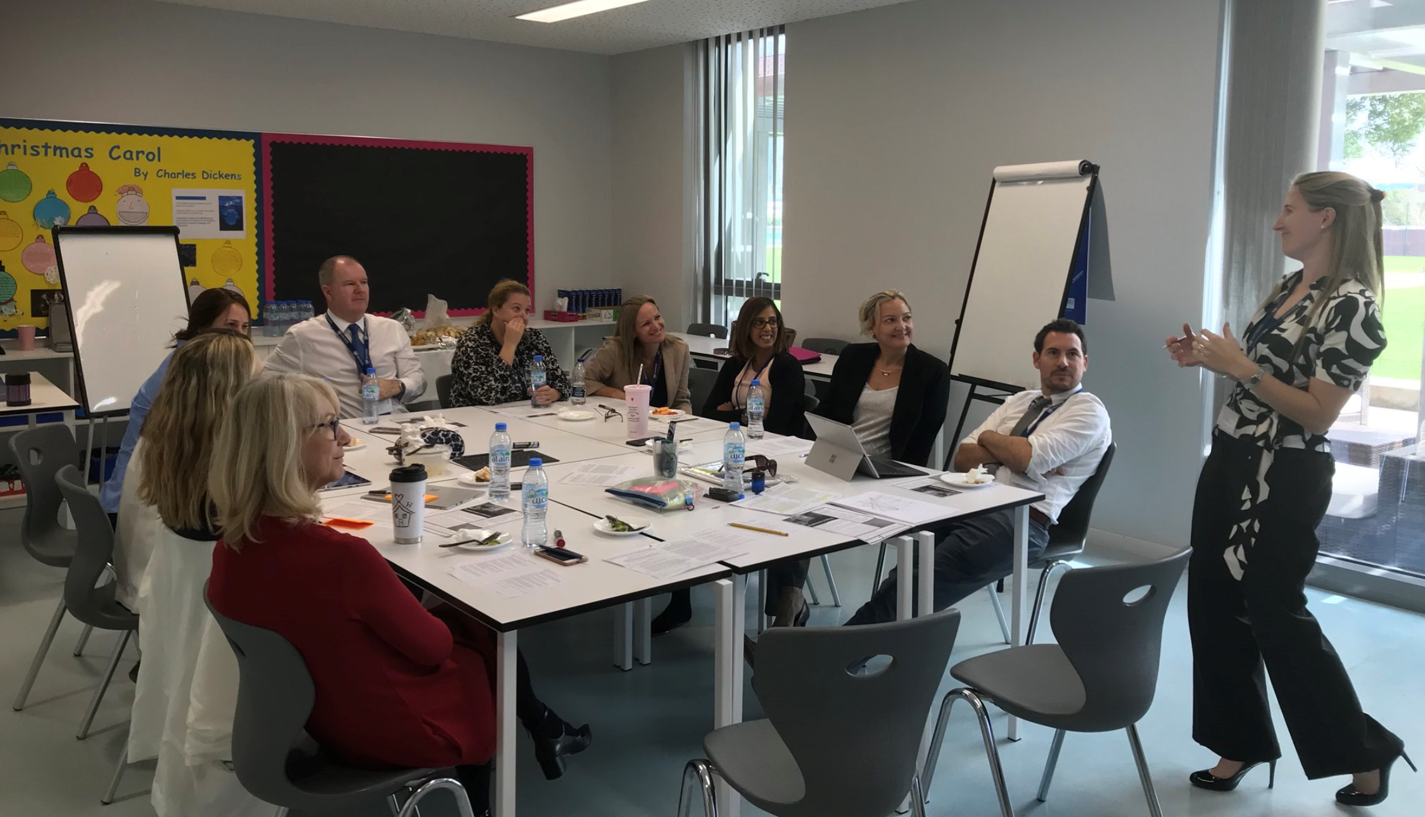
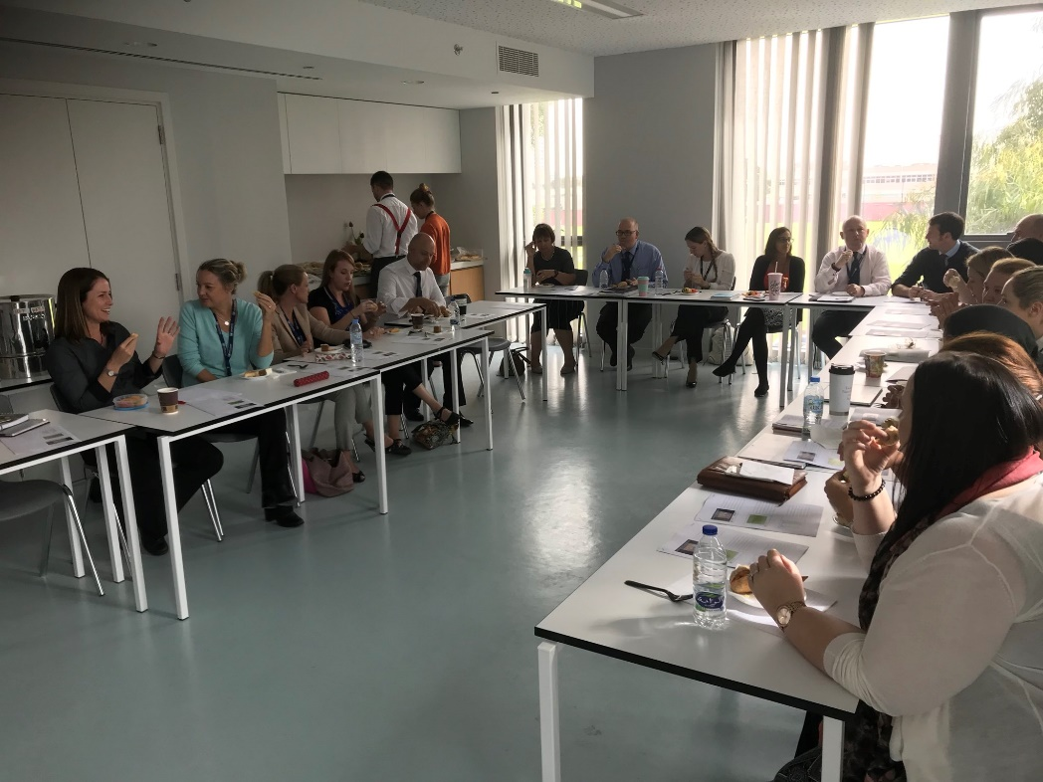
Lunch time
Pedagoo Sessions
SPARK events
Informal internal training by our best teachers
Internal best practice sharing on a regular basis.
All of which are related to the vision.

Slide 33
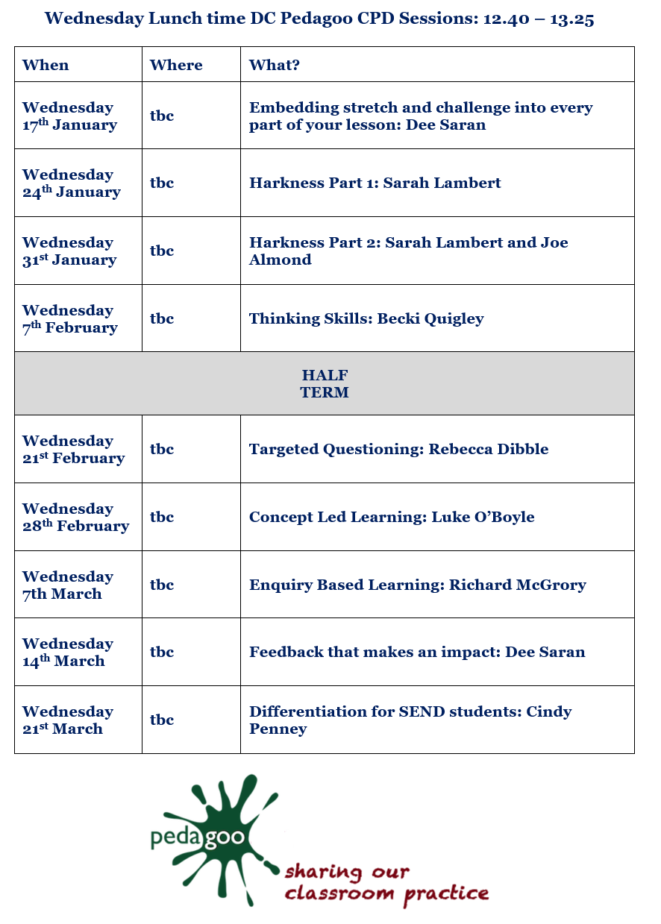

Slide 34
Be informed
Be inspired
Be connected
Be recognised
Be an agent of change
DUBAI COLLEGE
A tradition of quality of education
Notes:
Good evening and welcome to Meet the Headmaster. I am Mike Lambert, Headmaster Designate of Dubai College and whilst I can’t quite get the film Meet The Parents out of my head I hope this evening will be a smooth and informative opportunity for you to hear a little about me and how we are beginning to set the strategic direction for the school as we draw to a close of this academic year and look increasingly to September.

Slide 35
Developing Leadership Pathways
Emerging
Developing
Expert

Slide 36
New Roles: Specialist Leaders in Education
Embedding Digital Skills
Evaluating Impact through Action Research
Engaging through Dubai Online
Experimenting with Innovative Pedagogies

Slide 37
Vision
Choice
Support &Trust
Accountability
Opportunity
Futureproofing

Slide 38
Professional Review and CPD
There are four objectives that professional review will focus on:
Learning and Teaching
Department and Pastoral SIPs
Wider Professional Duties
Innovation
Learning Walks: Regular, real time, reflective feedback.
Term One: A 25 minute graded observation (SLT and HOD), with written feedback.
Term Two: Will be a 10 minute ungraded observation (HOD/Key stage leader), with written feedback.

Slide 39
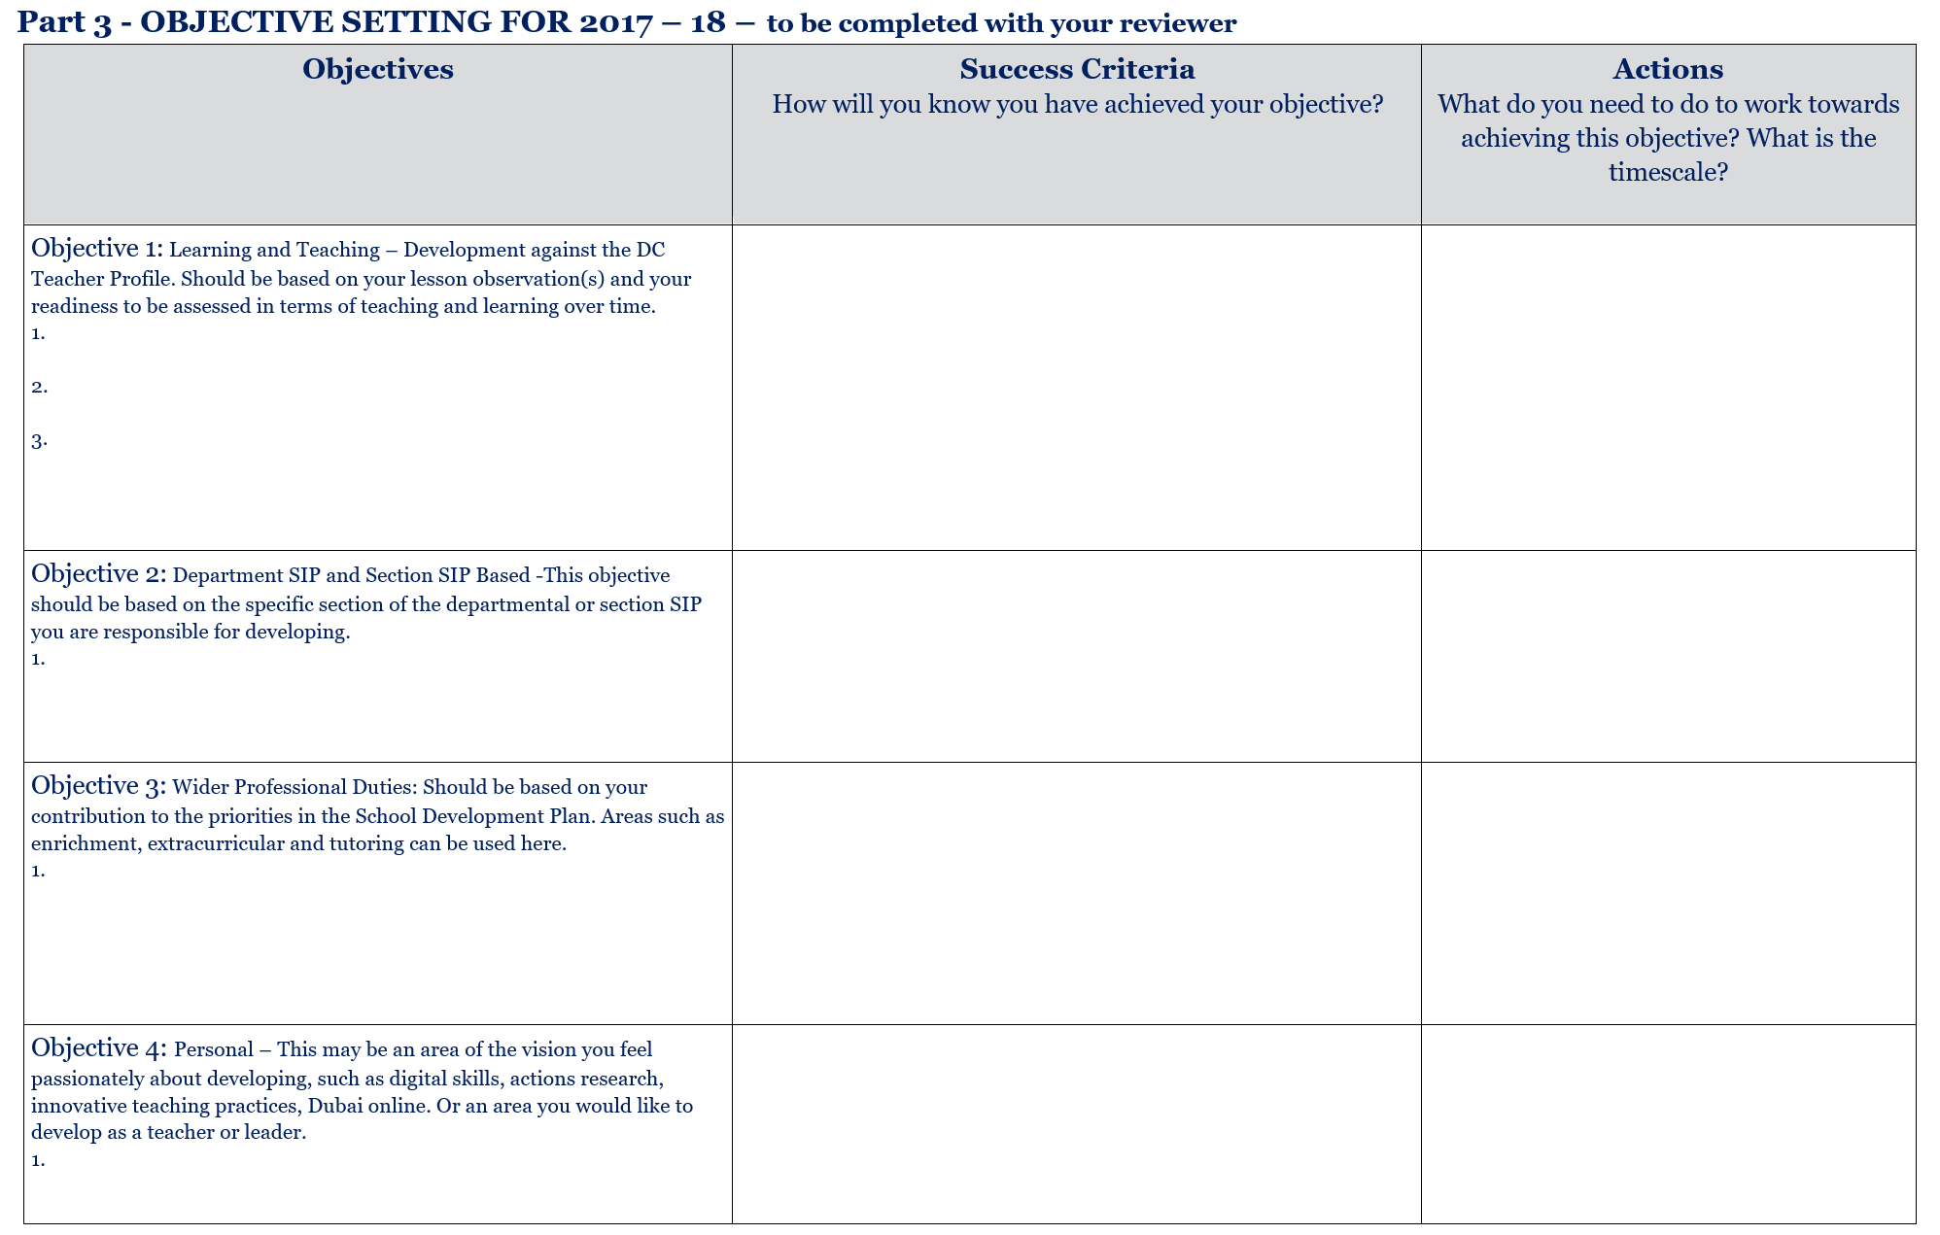

Slide 40
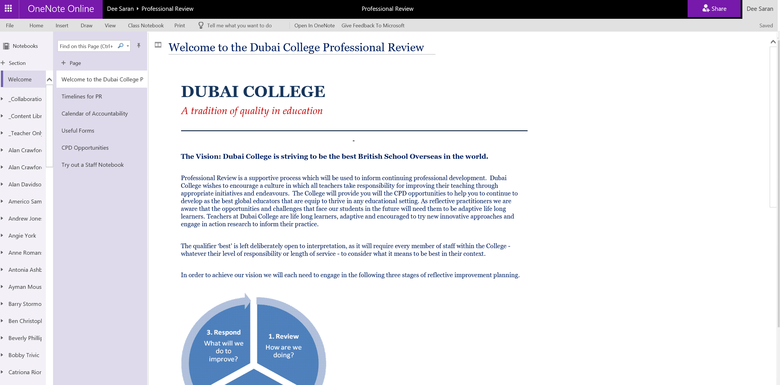
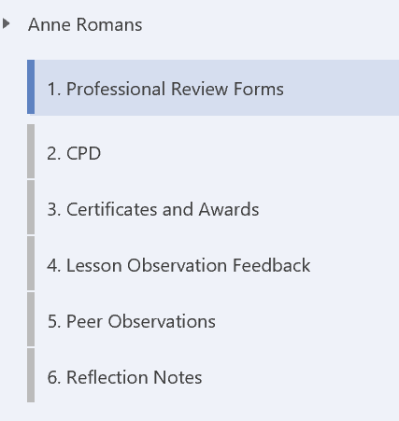
Professional Review on OneNote

Slide 41
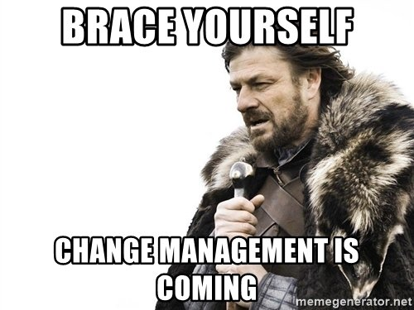
What does it mean practically for everyone?
#Lifelonglearning
DUBAI COLLEGE
A tradition of quality of education
Notes:
Good evening and welcome to Meet the Headmaster. I am Mike Lambert, Headmaster Designate of Dubai College and whilst I can’t quite get the film Meet The Parents out of my head I hope this evening will be a smooth and informative opportunity for you to hear a little about me and how we are beginning to set the strategic direction for the school as we draw to a close of this academic year and look increasingly to September.

Slide 42
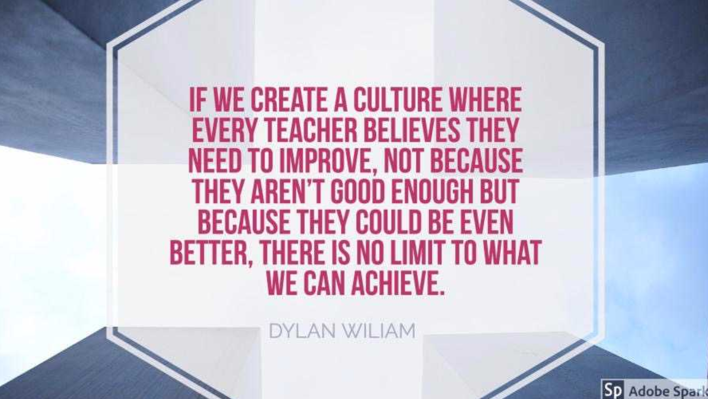

Slide 43
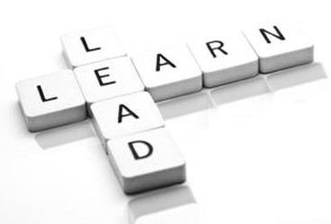
Thank you!
DUBAI COLLEGE
A tradition of quality of education
Notes:
Good evening and welcome to Meet the Headmaster. I am Mike Lambert, Headmaster Designate of Dubai College and whilst I can’t quite get the film Meet The Parents out of my head I hope this evening will be a smooth and informative opportunity for you to hear a little about me and how we are beginning to set the strategic direction for the school as we draw to a close of this academic year and look increasingly to September.

