Slide 1
Kate Jones - Lessons learned from Leaders
Head of History at Brighton College Al Ain
Lead Practitioner
Author - Love To Teach: Sharing Teaching and Learning Ideas For Every Classroom
Governor Manor Hall International School, Al Ain
Creator of #TeachUAEchat
@87history
Lovetoteach87
Lovetoteach87.com

Slide 2
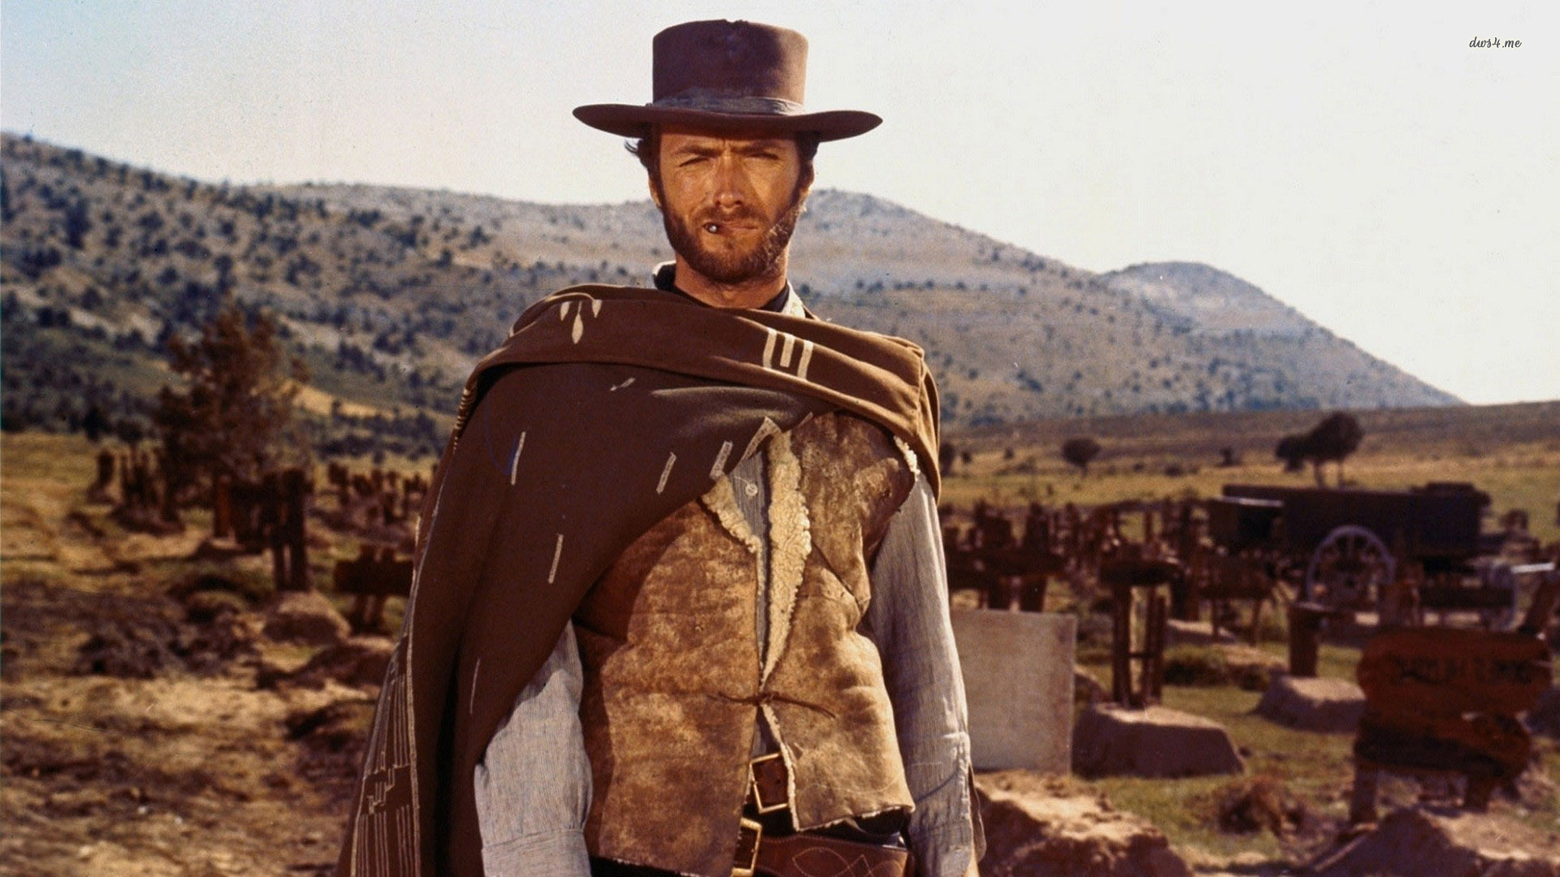
We can learn something from all leaders…

Slide 3
Why would anyone want be led by you?
Or…
What is it like to be led by you?
Dr Jill Berry:
Author: Making the leap. Moving from Deputy to Head - @jillberry102

Slide 4
Senior Leaders should teach in the classroom
Lead by example by being in the classroom.
Teachers shouldn’t aspire to leadership to get out of the classroom!
Being in the classroom working with children is the best job in the world!

Slide 5
“I think you have to teach, no matter how demanding the role of Headteacher has become. And I don’t mean cherry-picking the small Year 13 class, I mean teach the tough classes, team teach, teach out of your subject if necessary. Whilst I am gut-wrenchingly worried about the school’s headline figures on results days, I always sneak a look at my own students’ results first!”
John Tomsett:
Headteacher, Huntington School, York. Author @johntomsett
Notes:
and this is now often called the generation effect (Slamecka & Graf, 1978). In particular, one hour students spend writing test questions on what they have been studying results in more learning for them than one hour spent working with a study guide, answering practice tests, or leaving the students to their own devices (Foos, Mora, & Tkacz, 1994).

Slide 6
Difficult conversations …
can it wait until the end
of the school day?
Notes:
and this is now often called the generation effect (Slamecka & Graf, 1978). In particular, one hour students spend writing test questions on what they have been studying results in more learning for them than one hour spent working with a study guide, answering practice tests, or leaving the students to their own devices (Foos, Mora, & Tkacz, 1994).

Slide 7





Be a research informed leader and teacher …

Slide 8
Finally …
@87history
Lovetoteach87
Lovetoteach87.com

