Slide 1

Getting Beyond the Green
Growth of Innovation/Robotics at VISS
Stephanie Bernier - Director of Digital Learning
Victoria International School of Sharjah

Slide 2
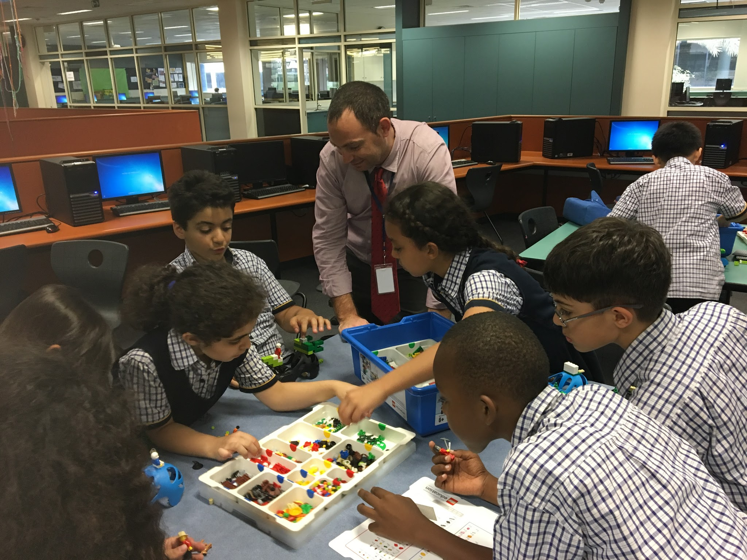
The Innovation Club - iPads, Collaboration, & STEM
iPad 1:1 Program
The Design Process
Collaborating with other students to build solutions
Innovating
Imagination in Action
Problem solving
Hands on Practical Experiences

Slide 3
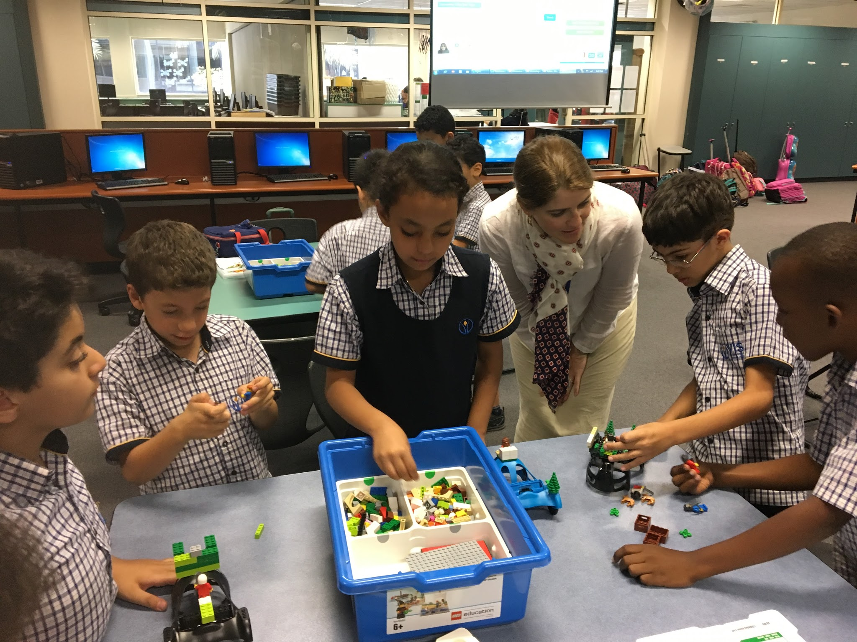
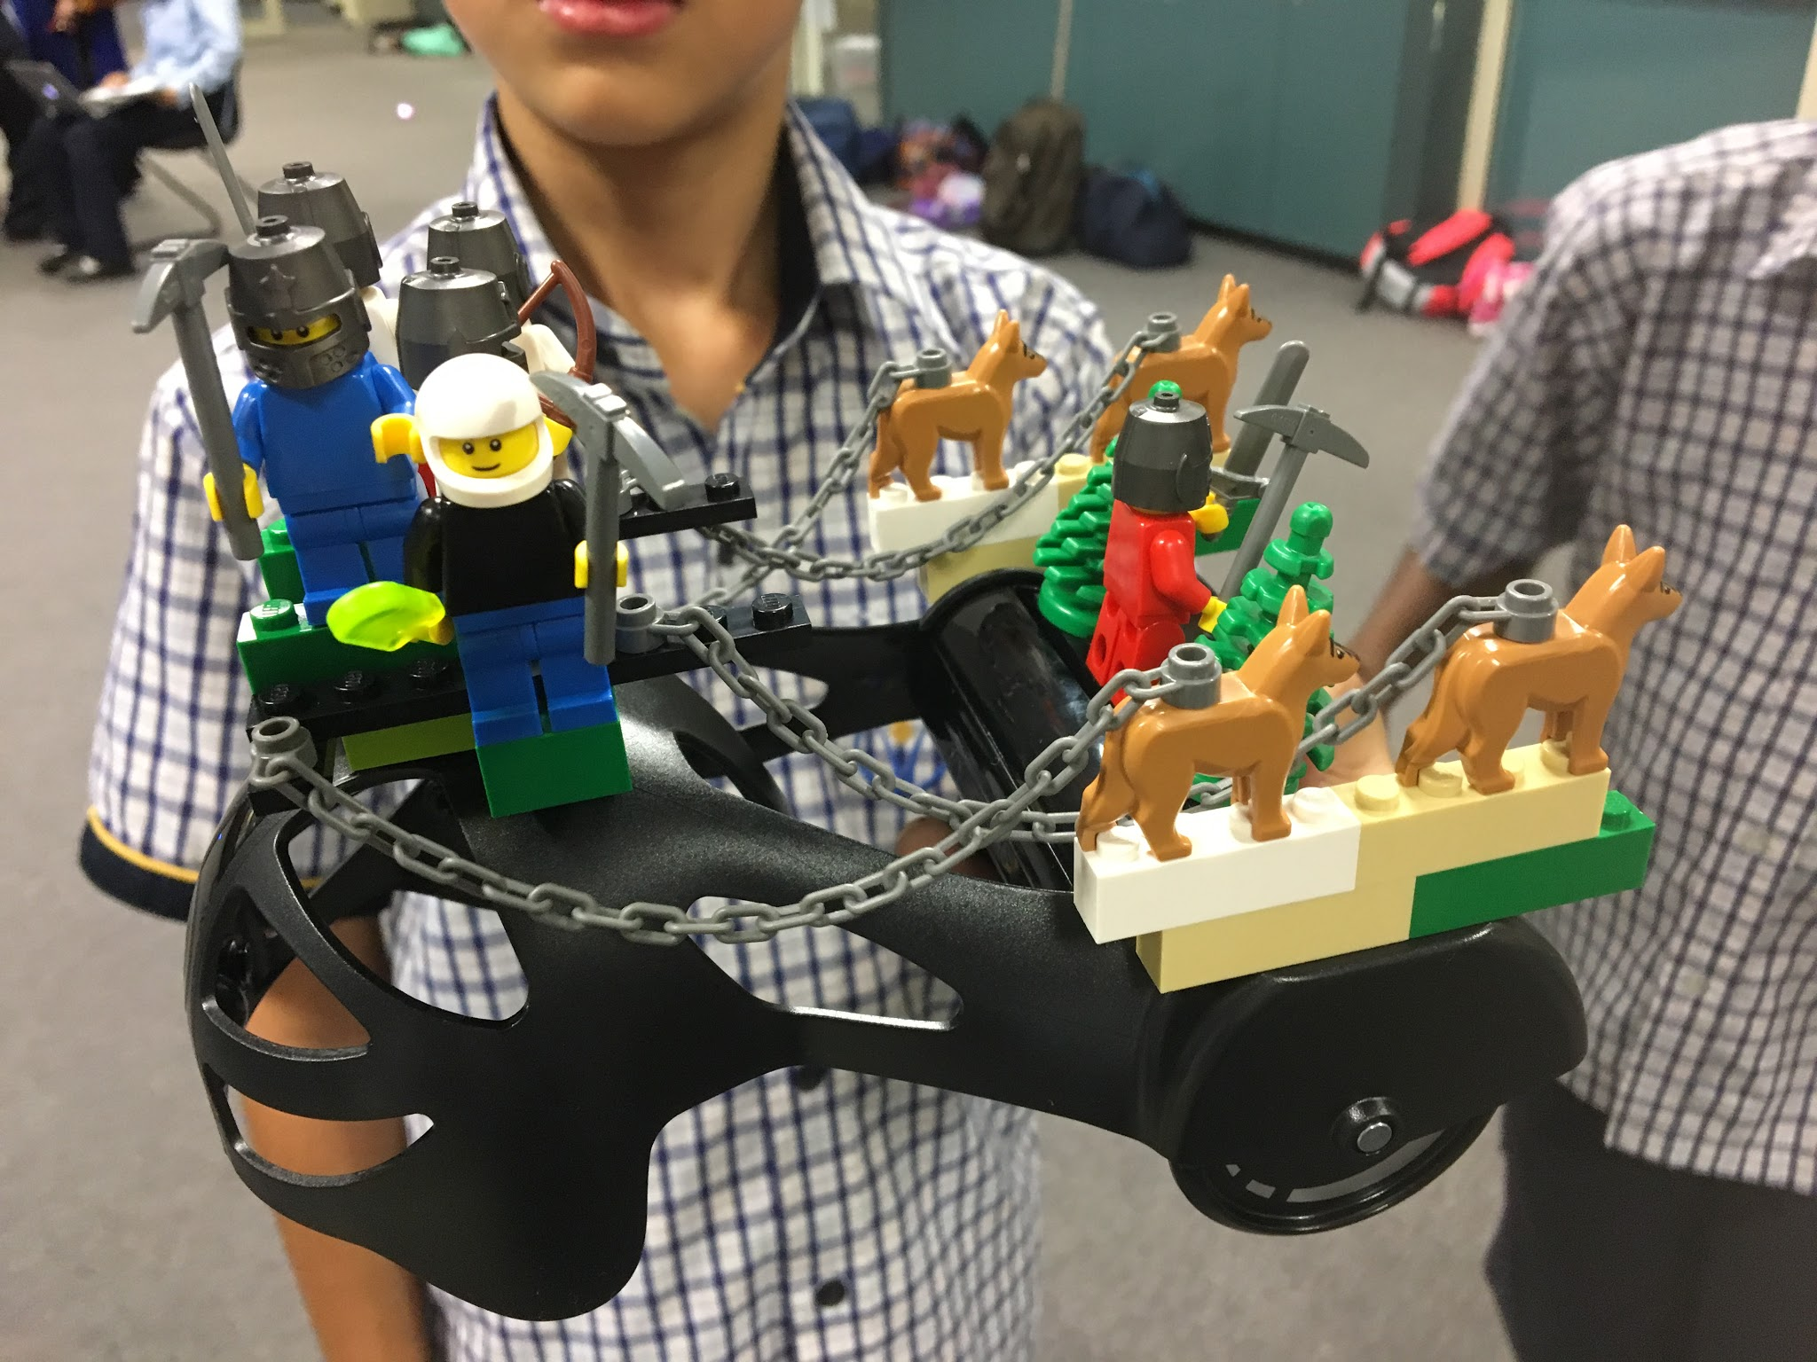
Collaborating with other students

Slide 4
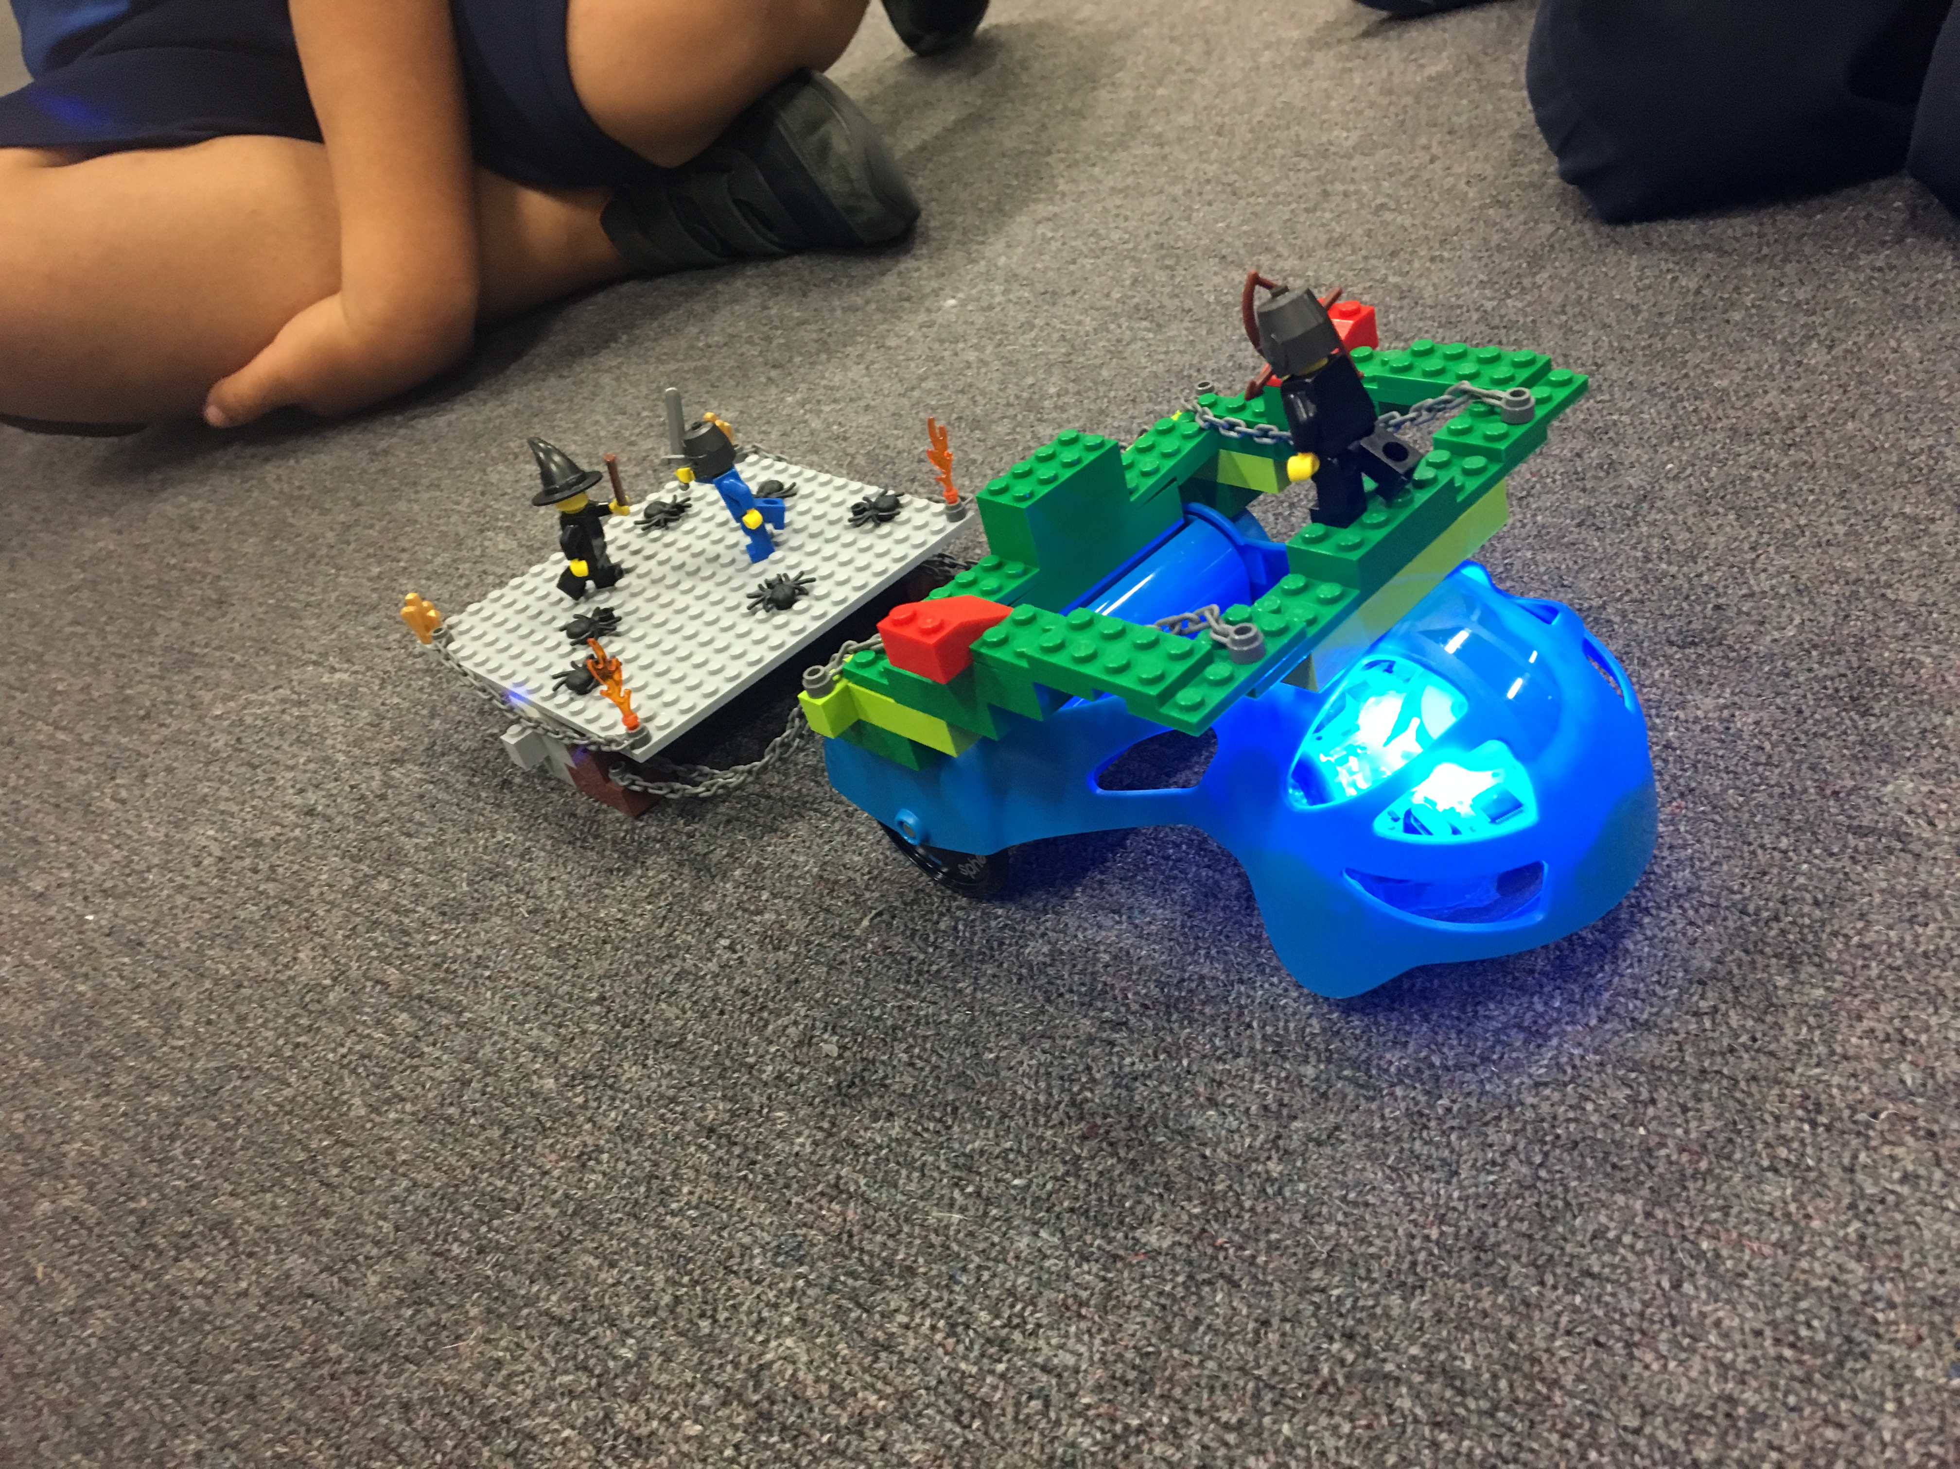
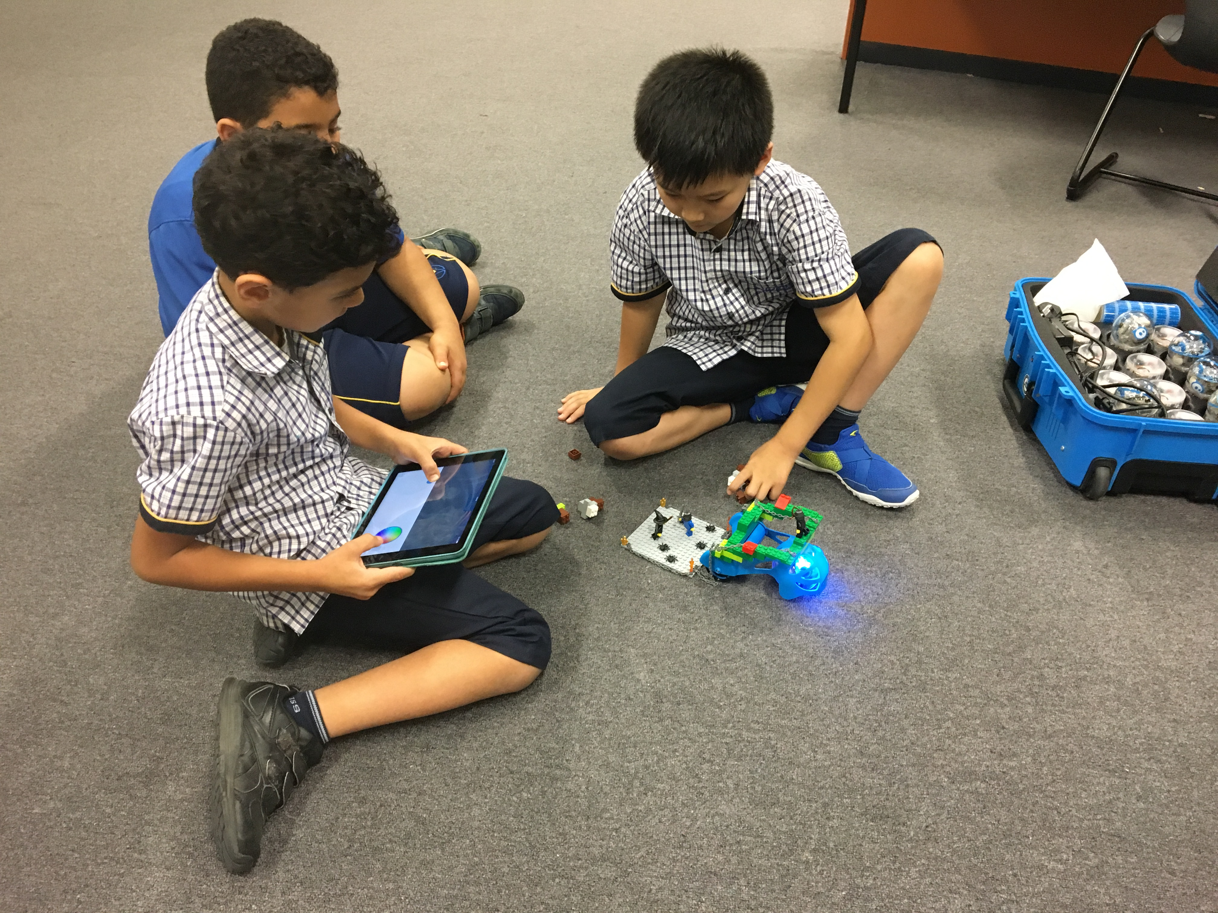
Modifications to build – Heavy load

Slide 5
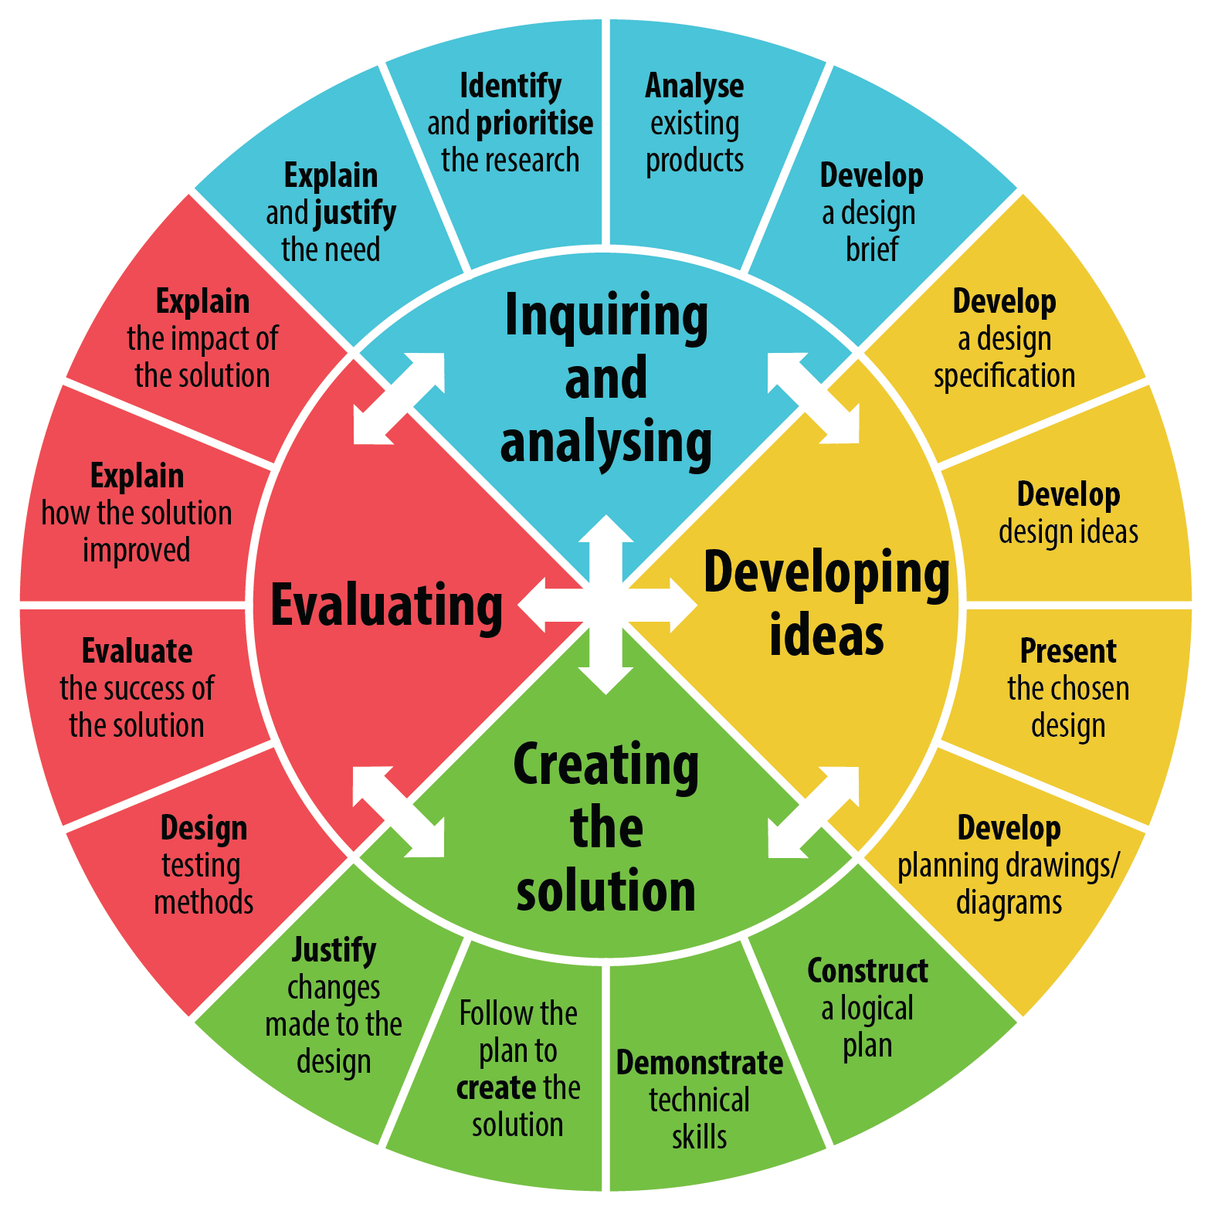
Design Life Cycle

Slide 6
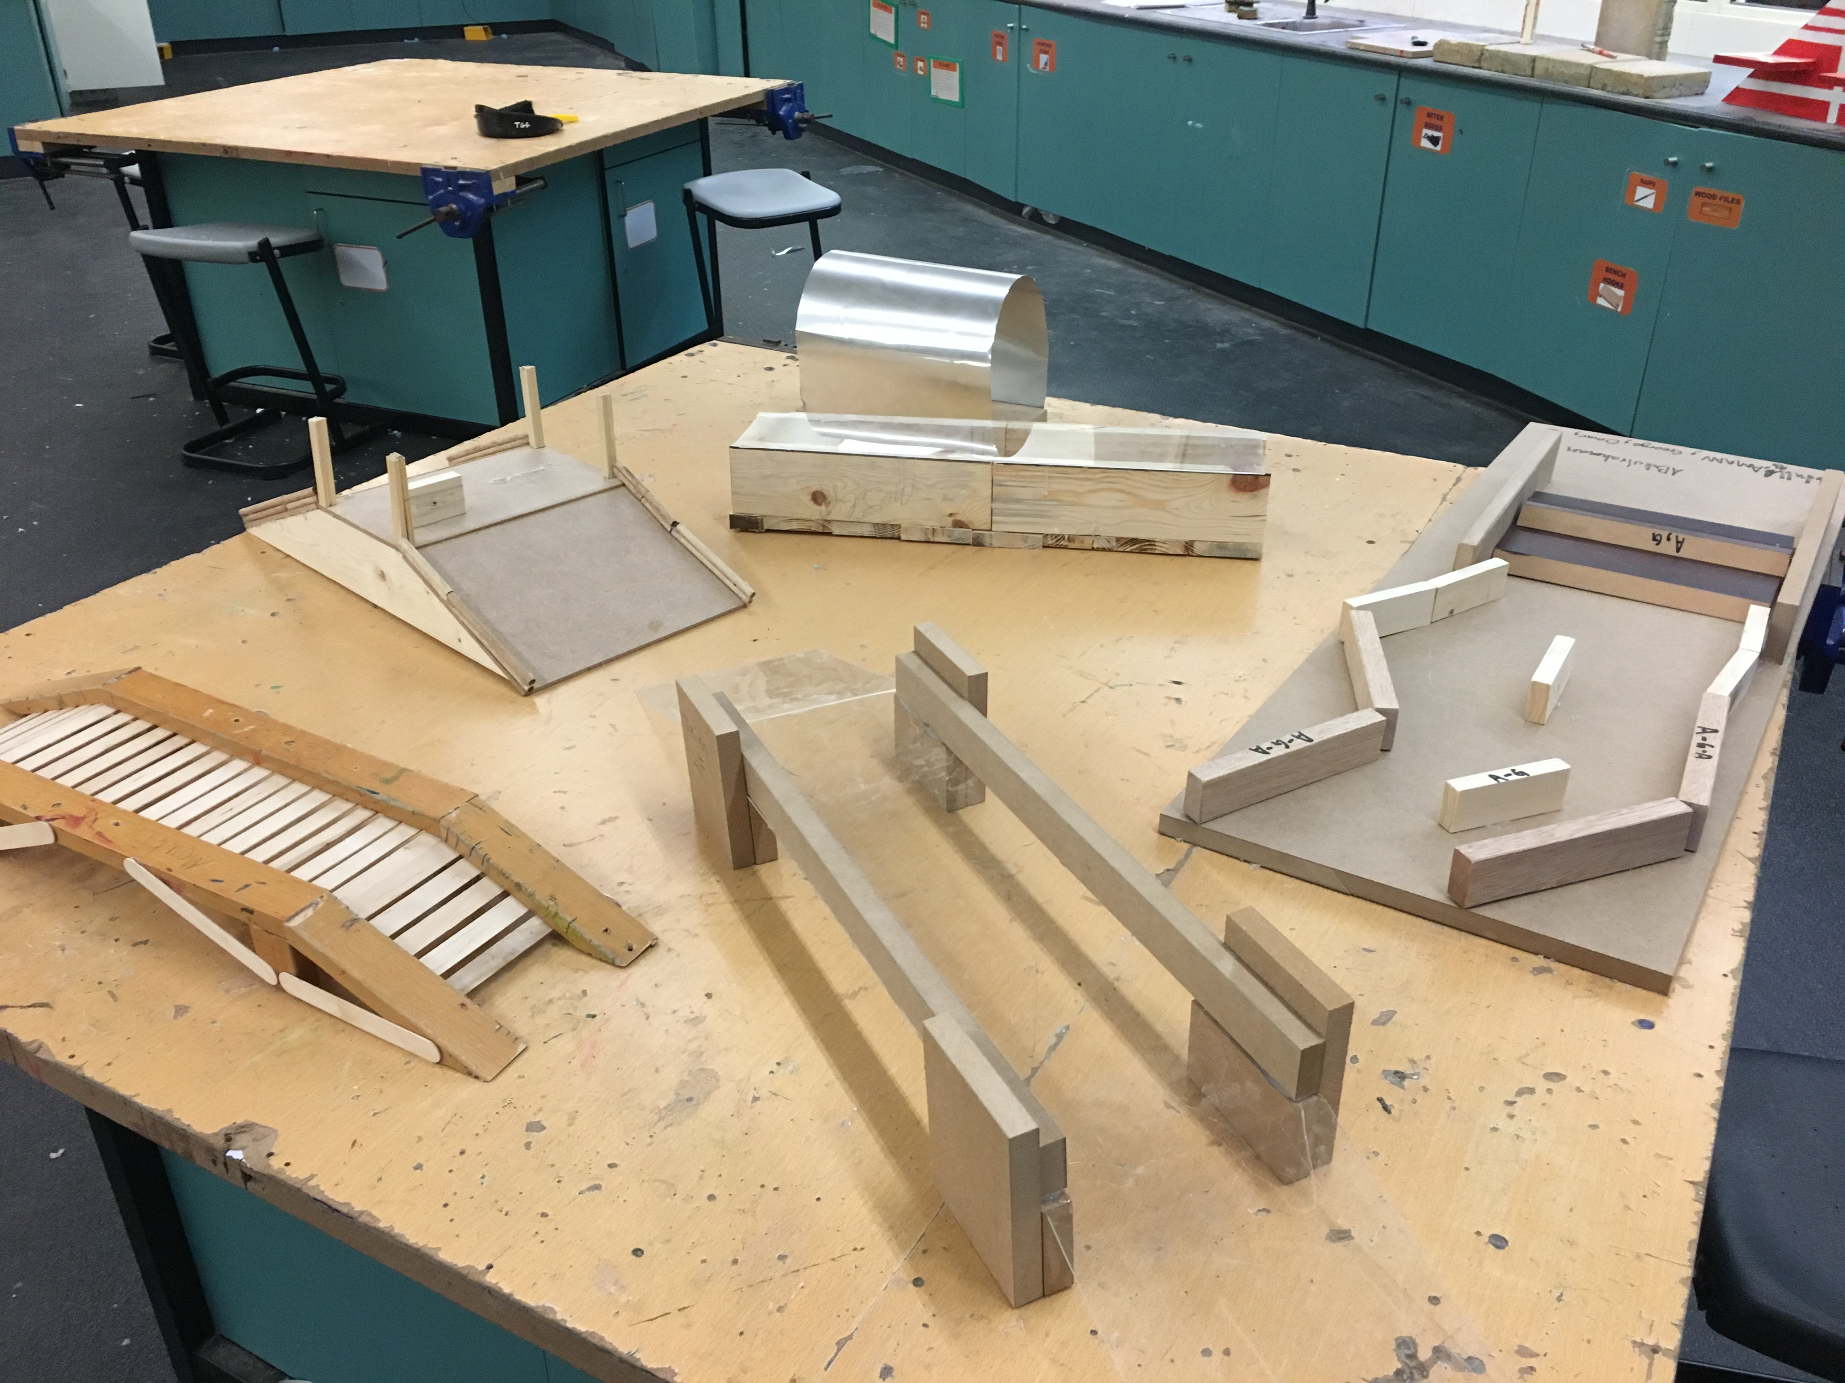
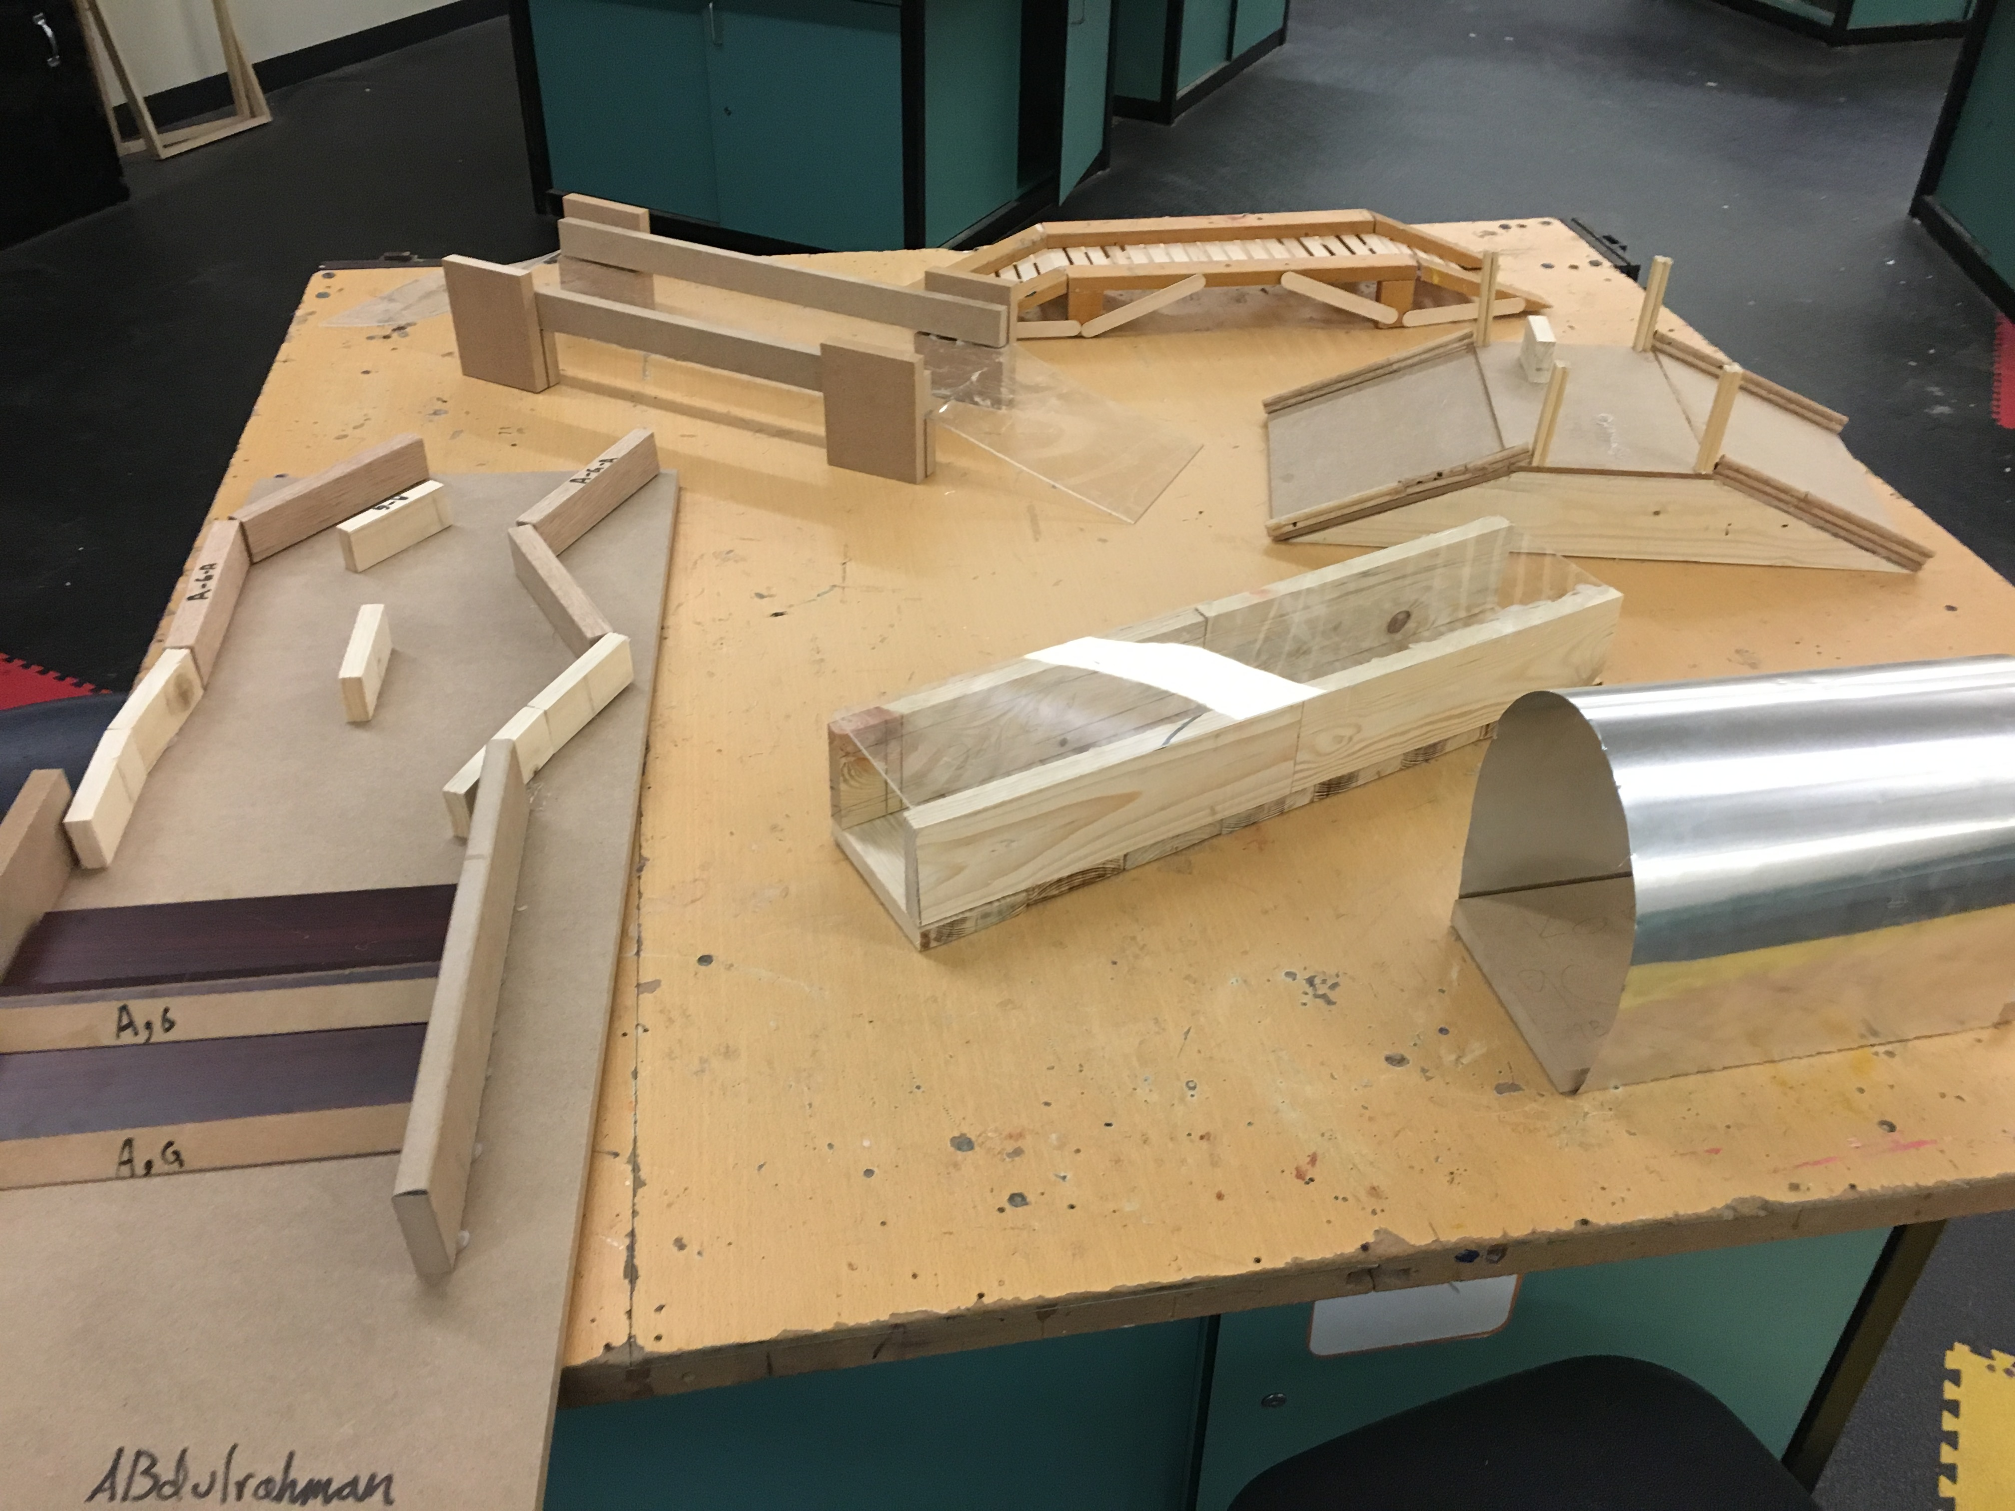
STEM – Making the Obstacles in the DT Lab

Slide 7
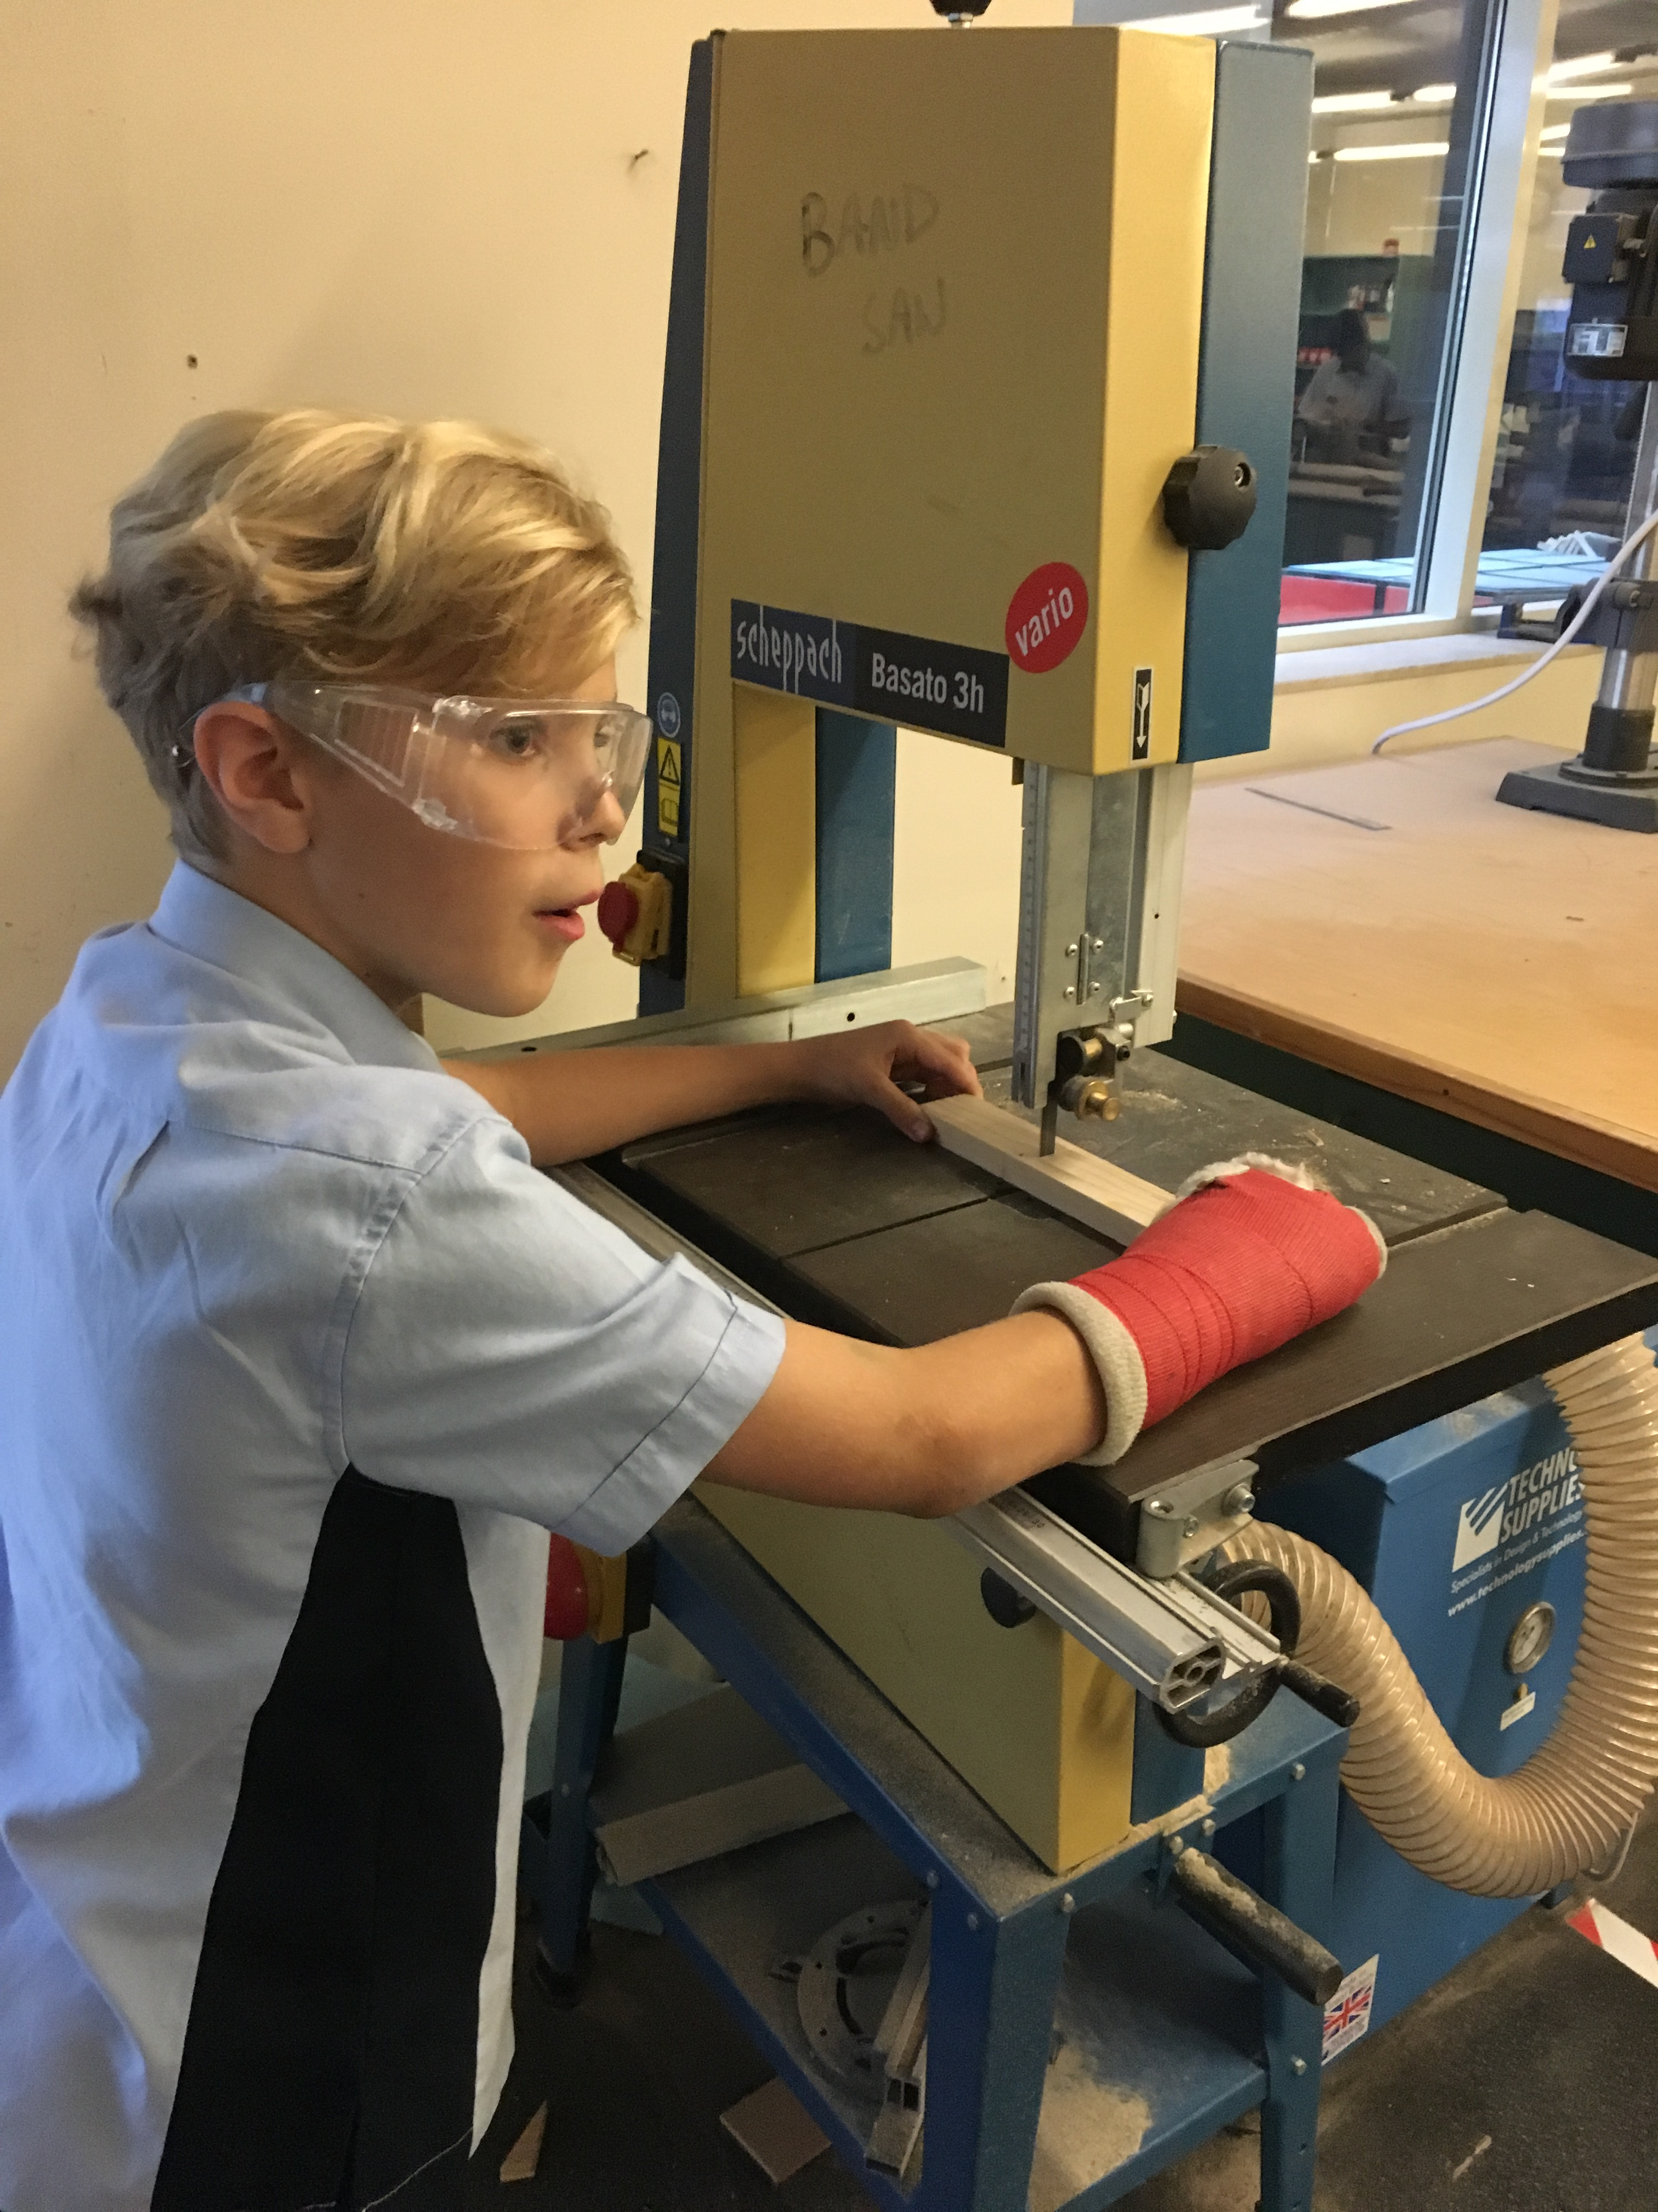
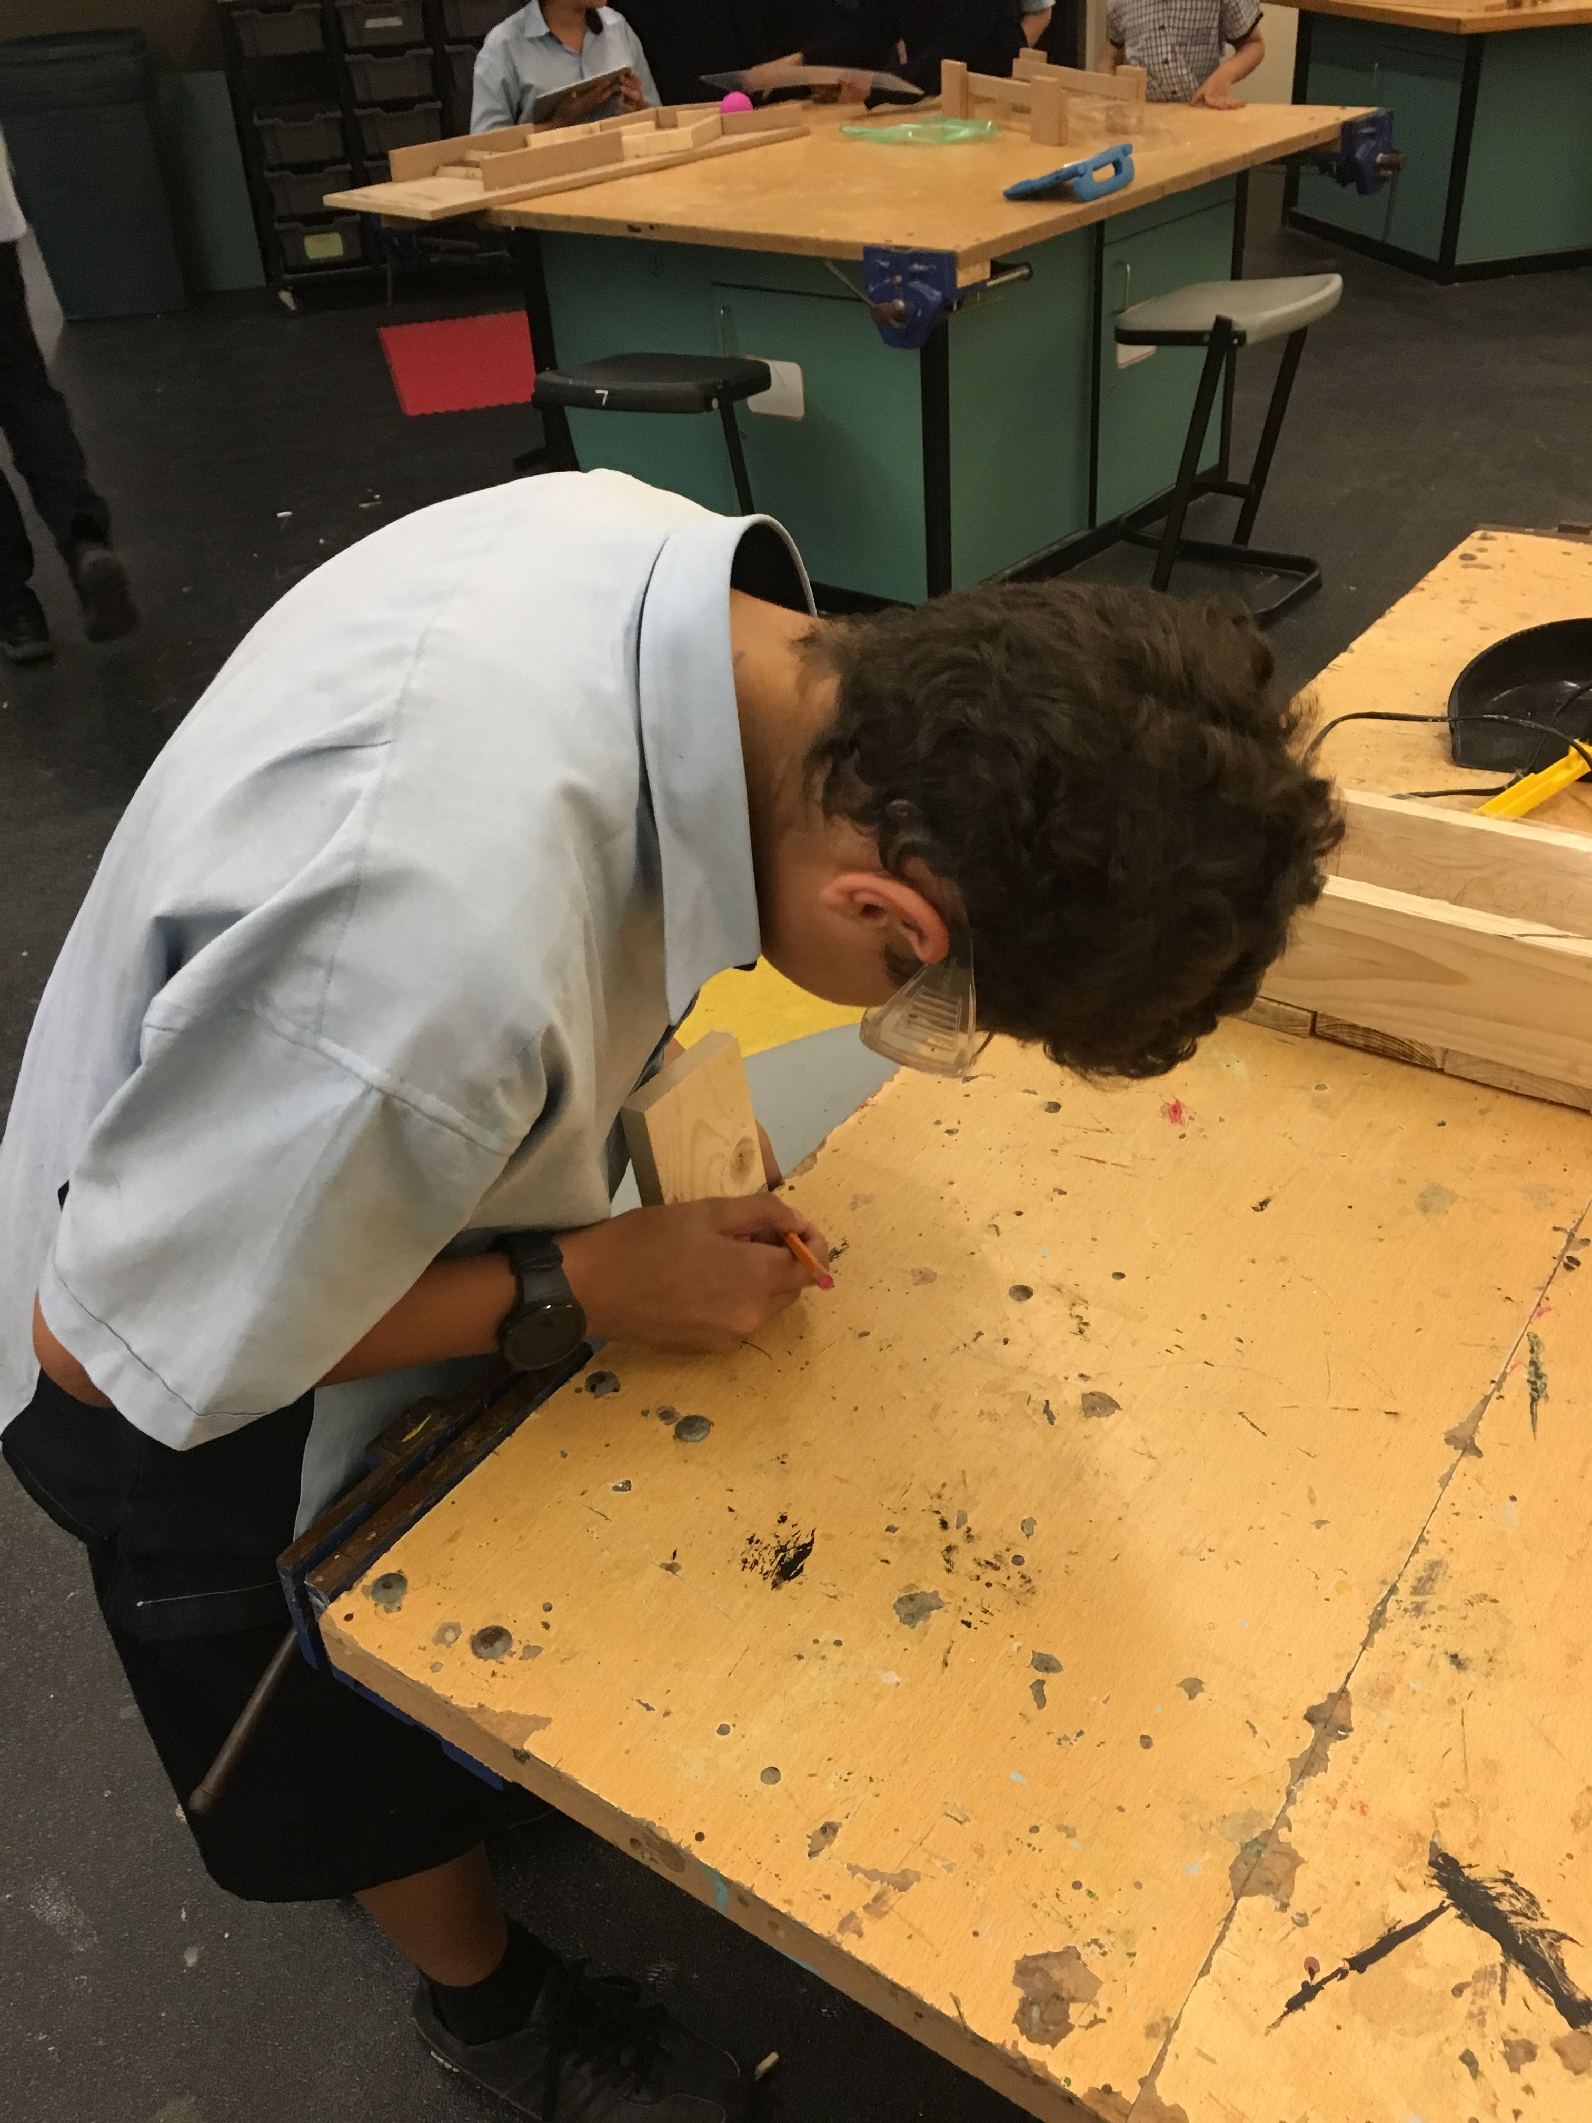
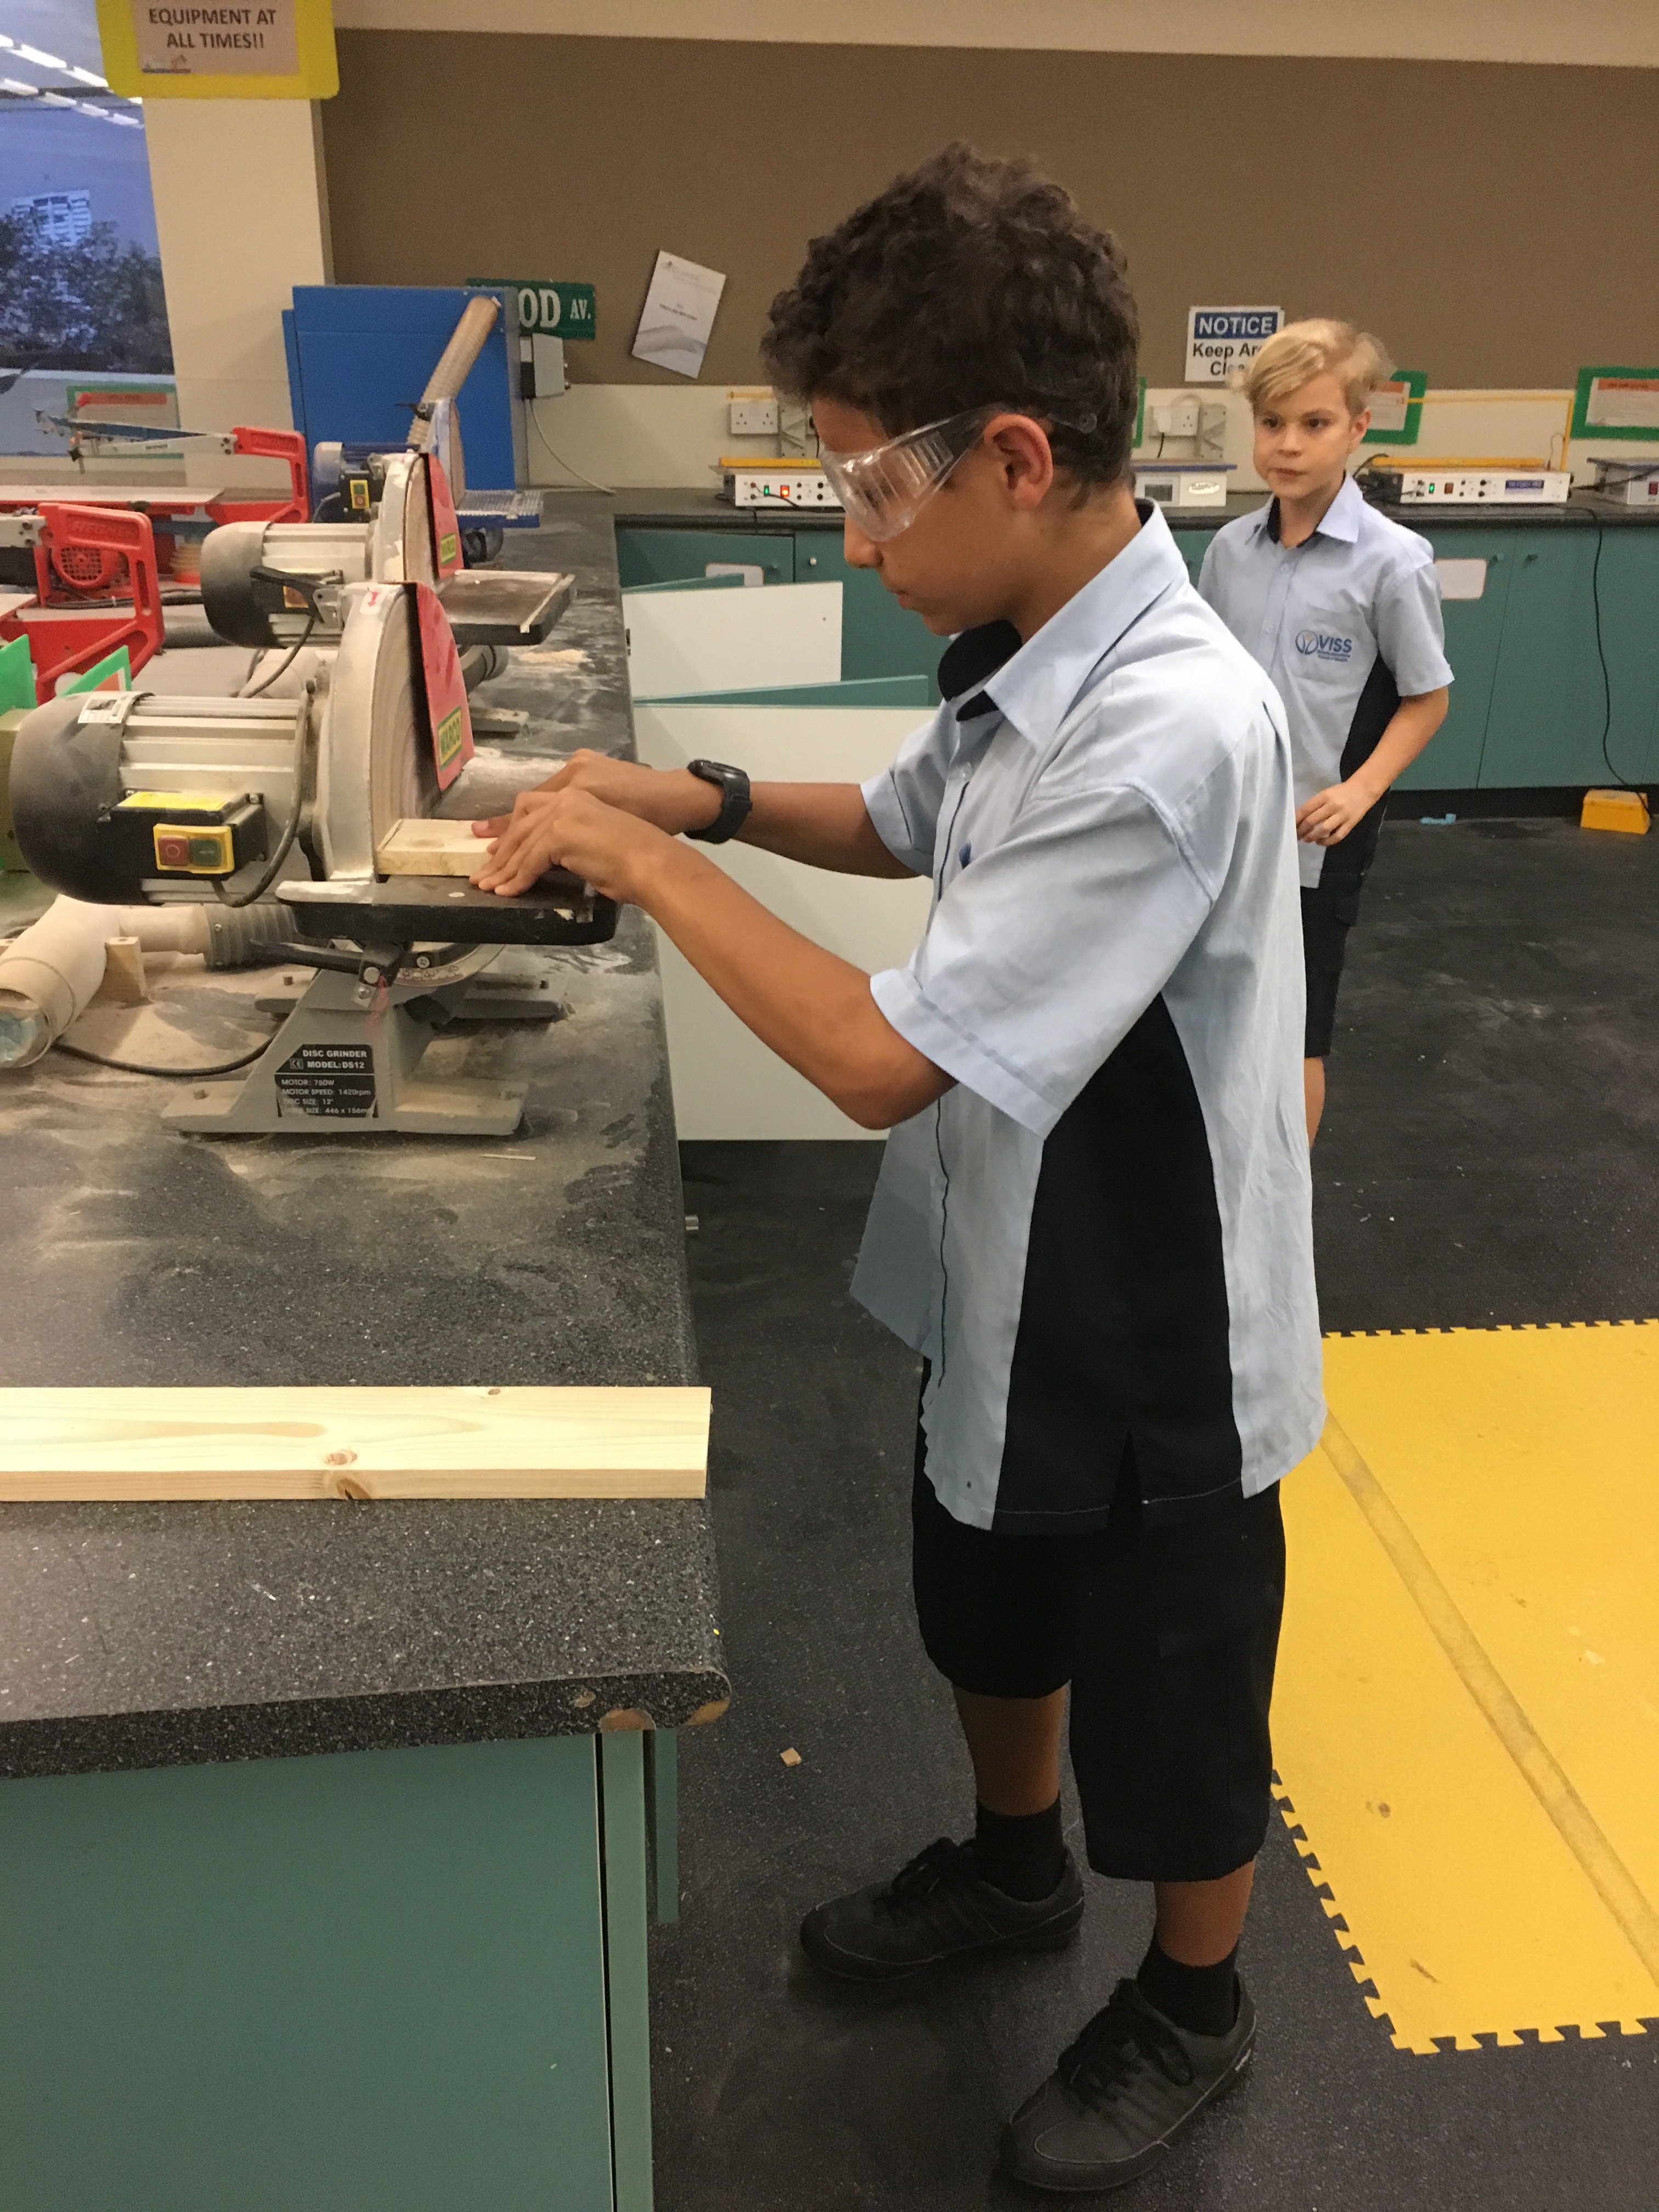
Grade 6 – Designing to Building

Slide 8
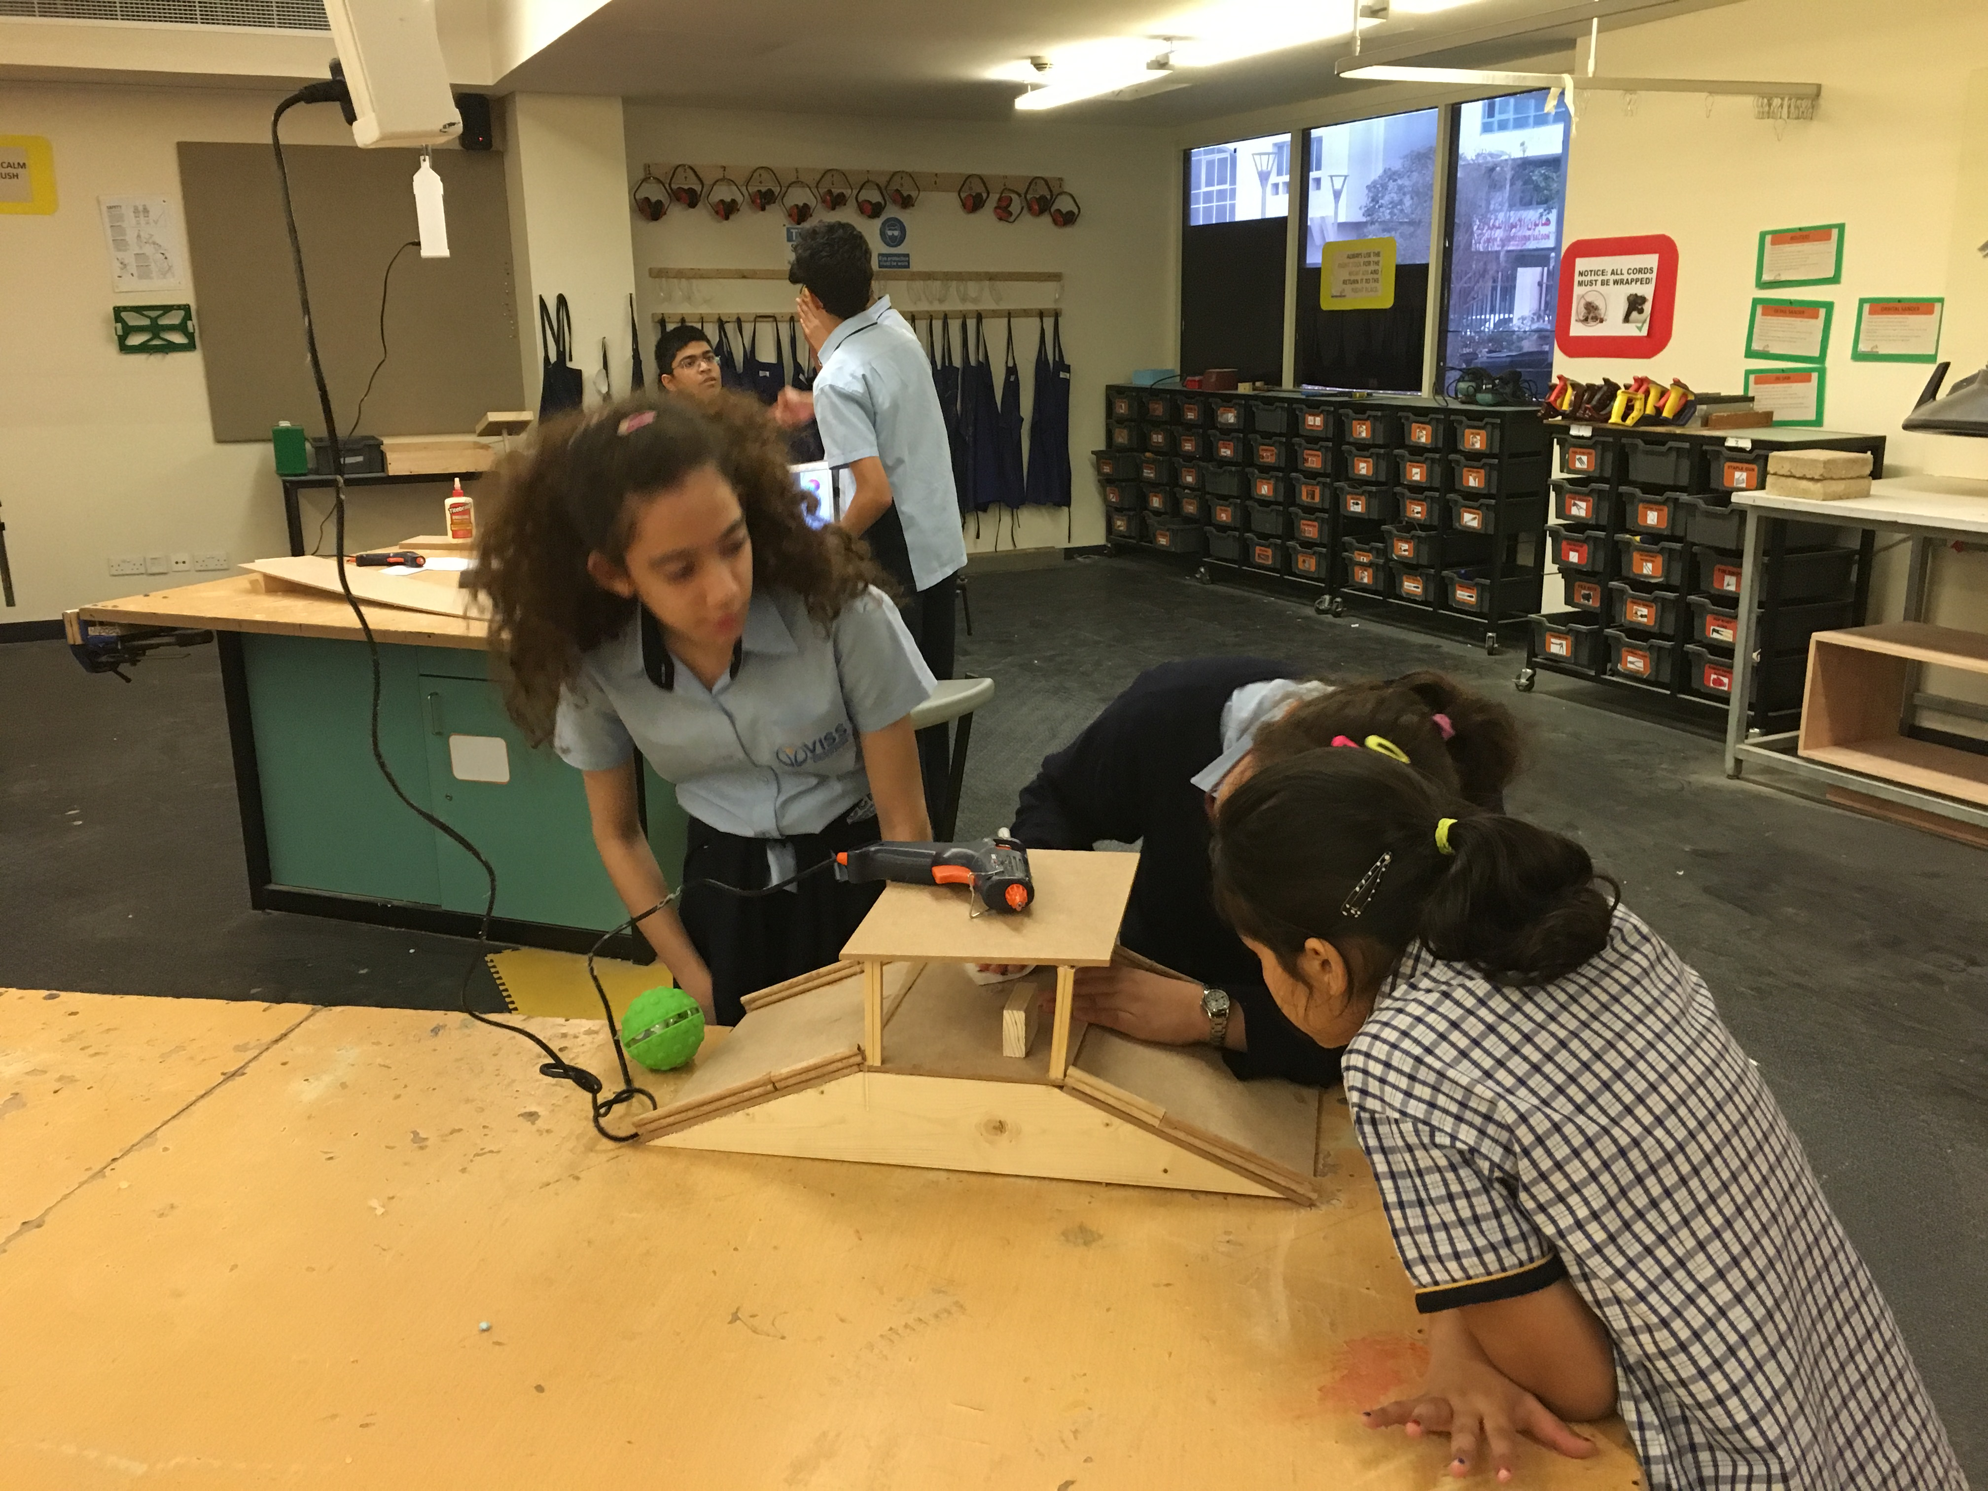
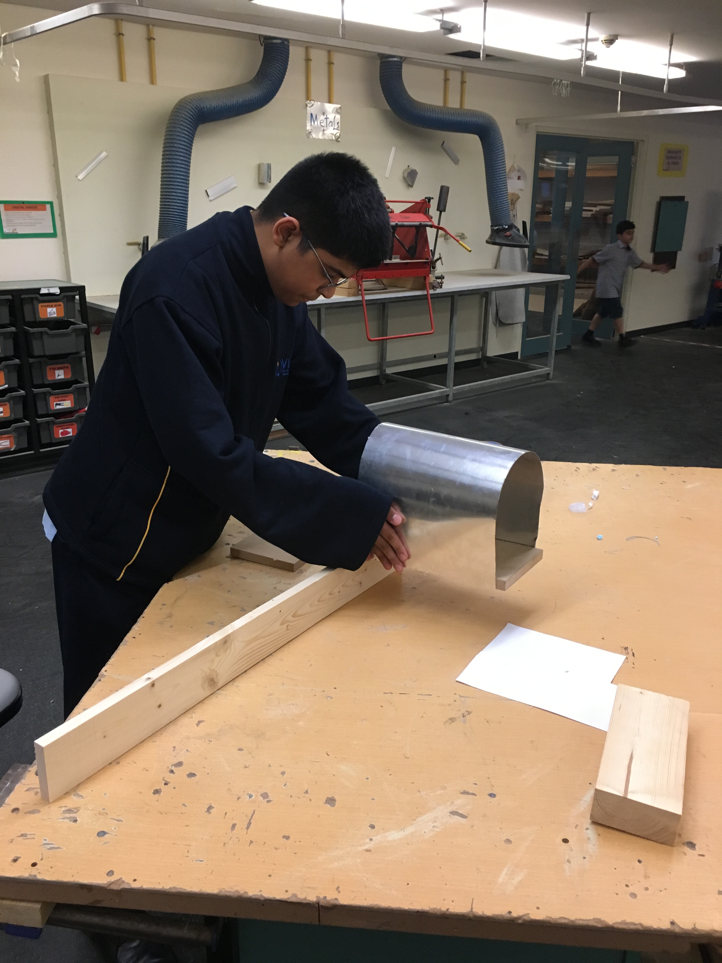
Implementation of Designs

Slide 9
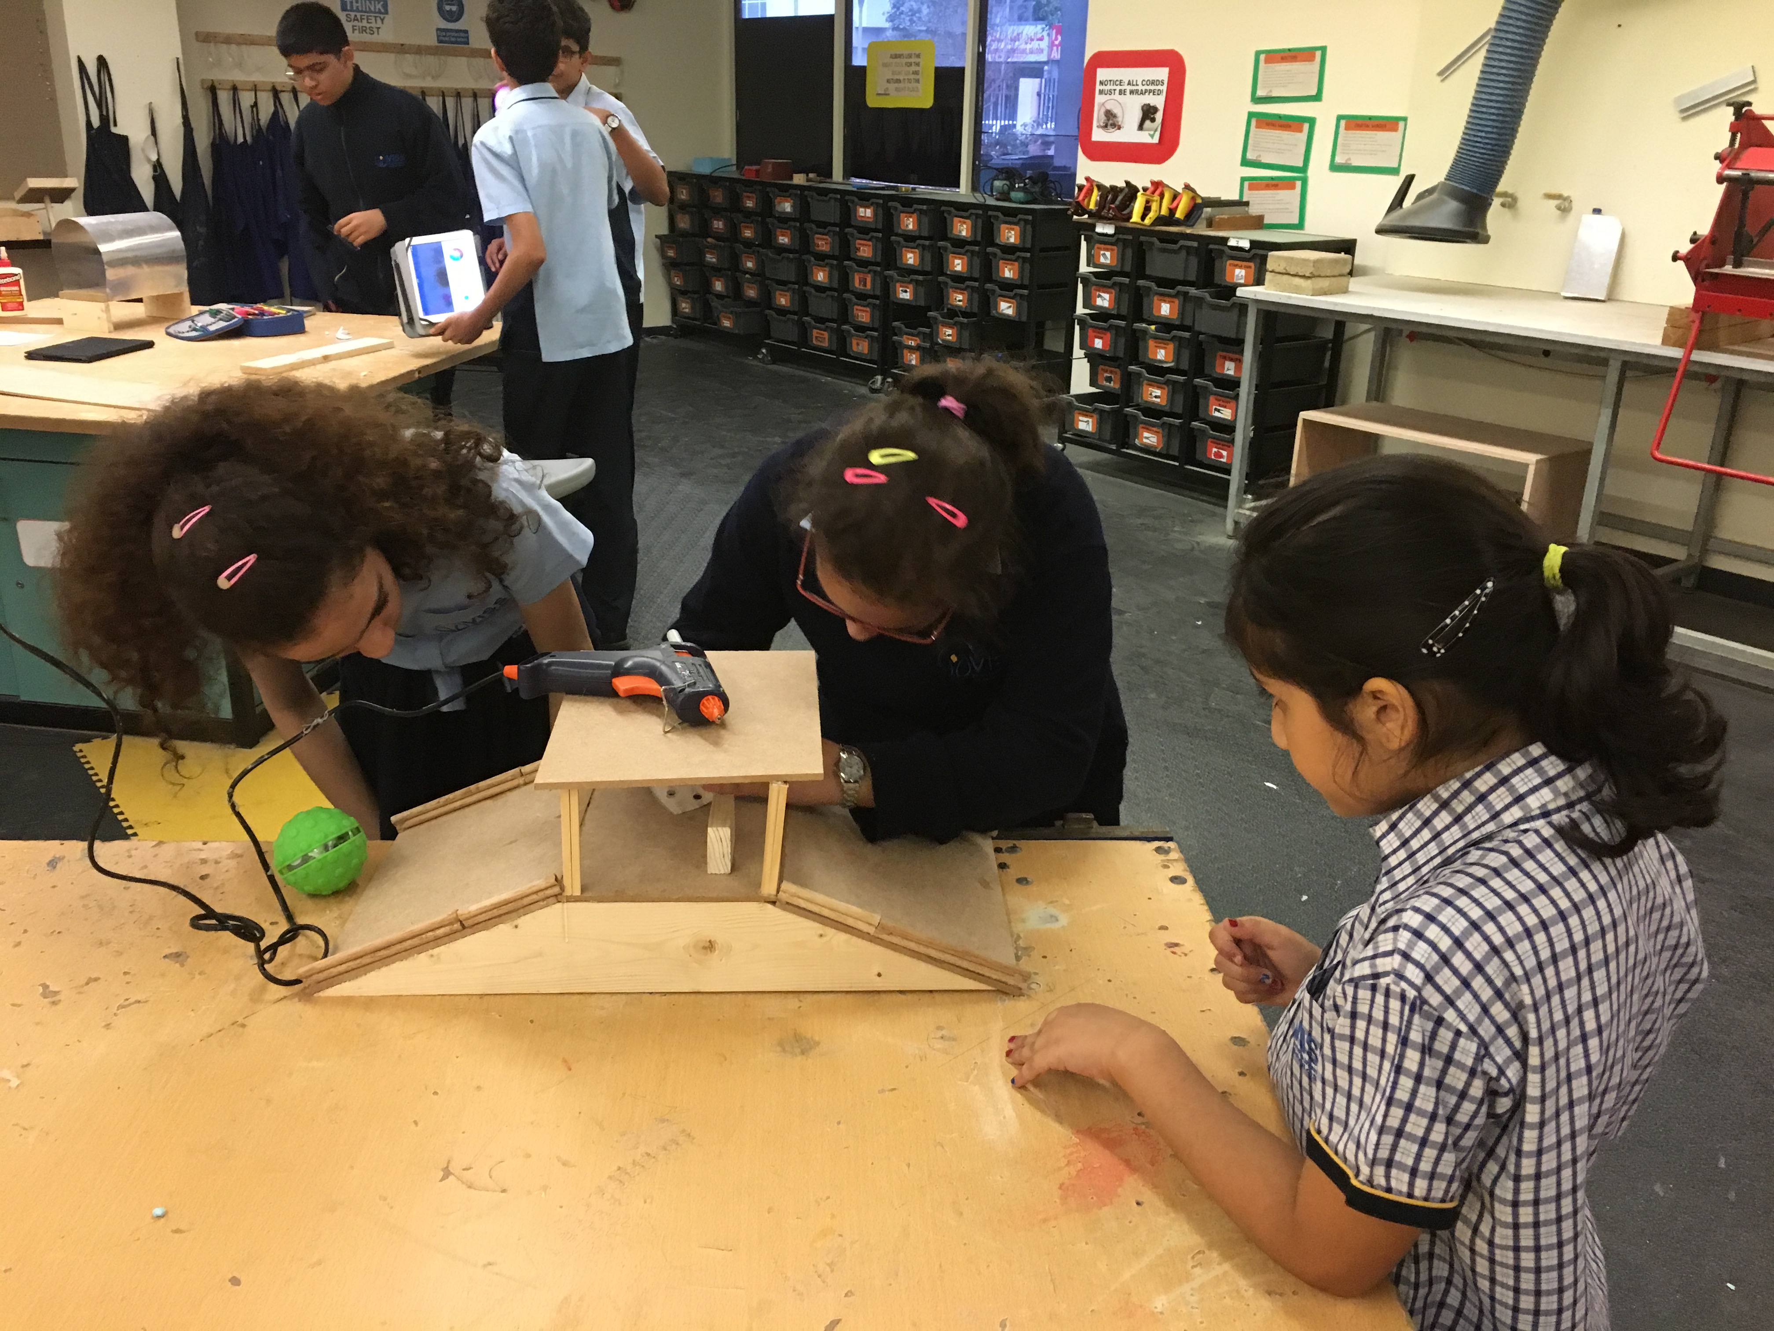
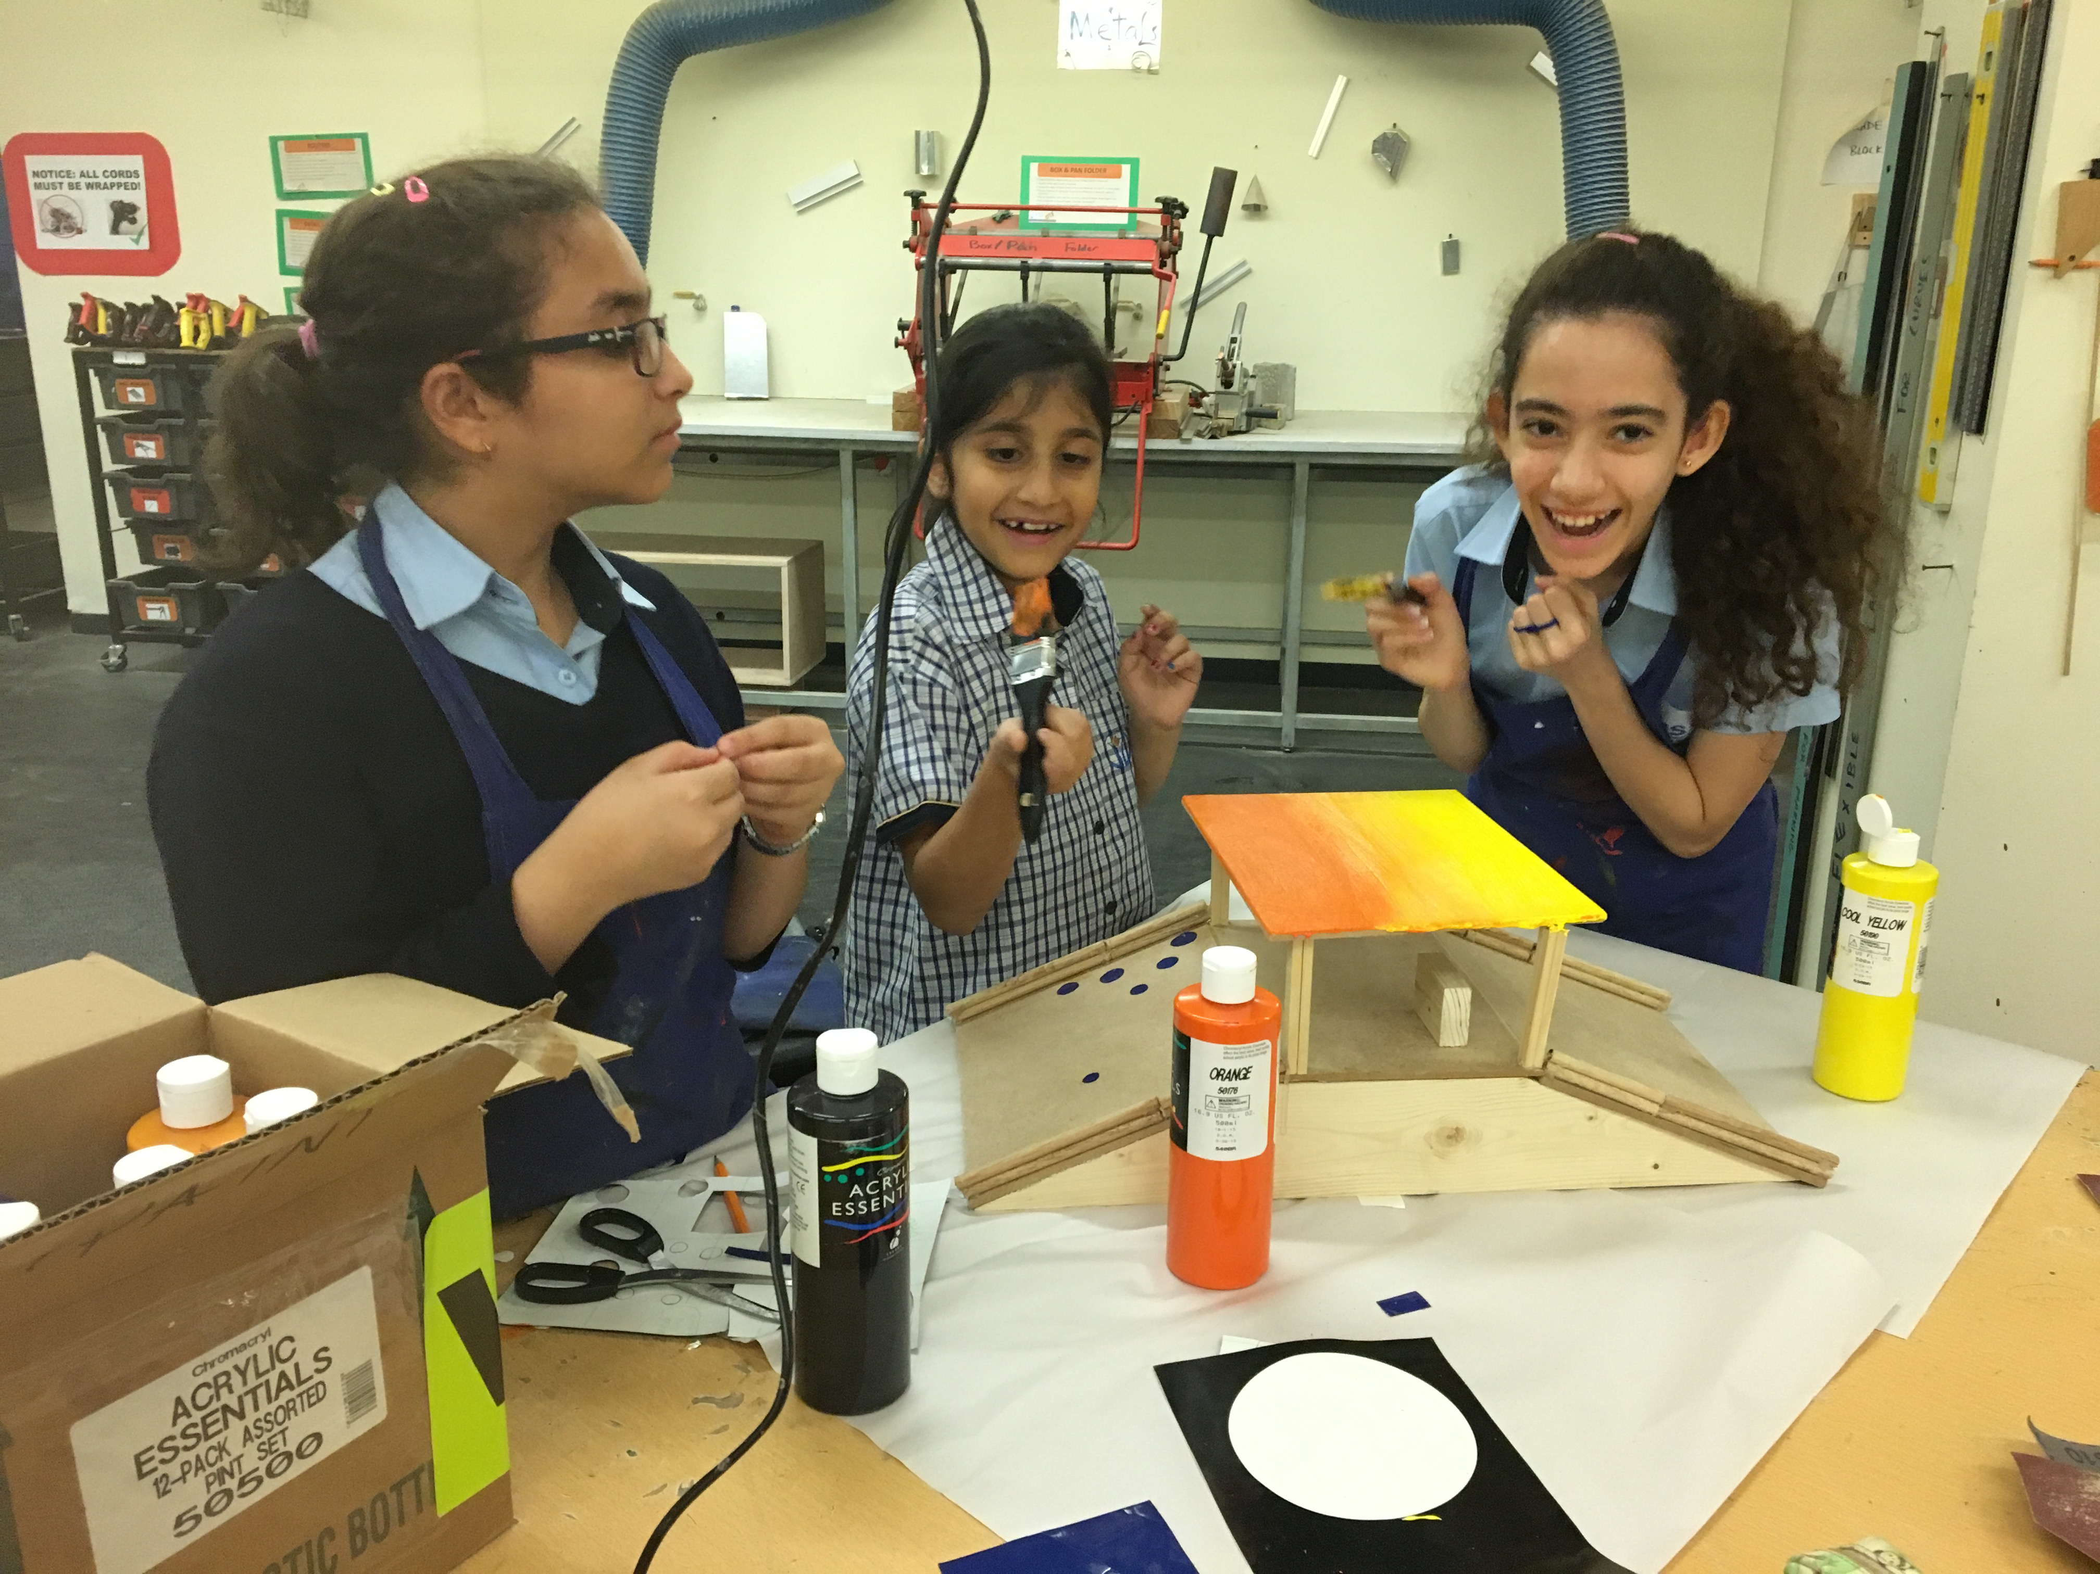
Girls in STEAM

Slide 10
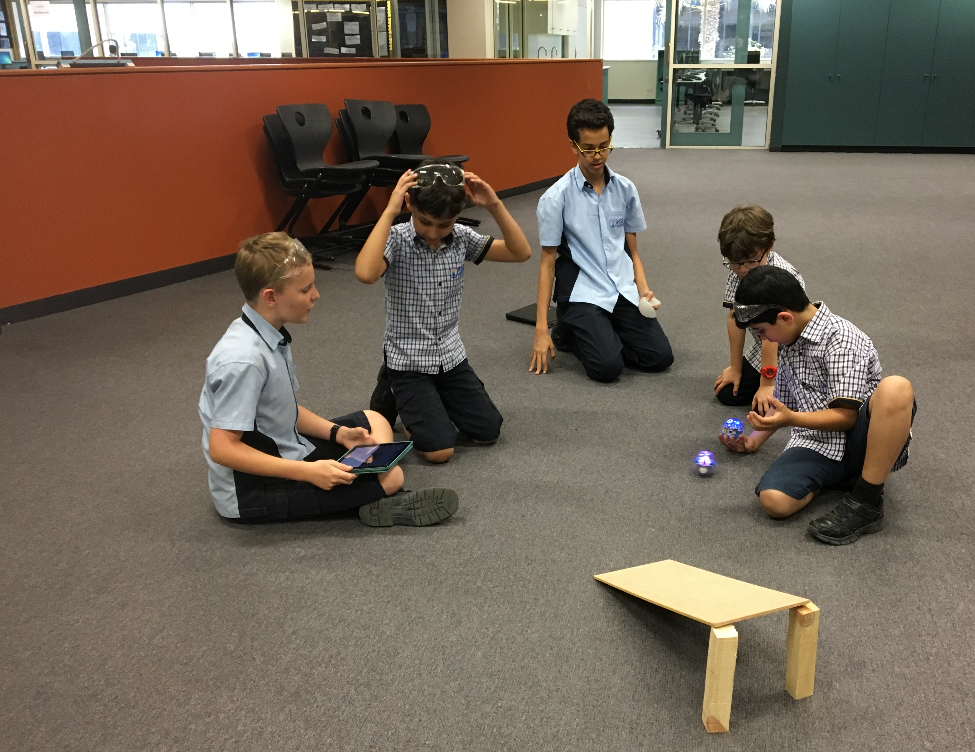
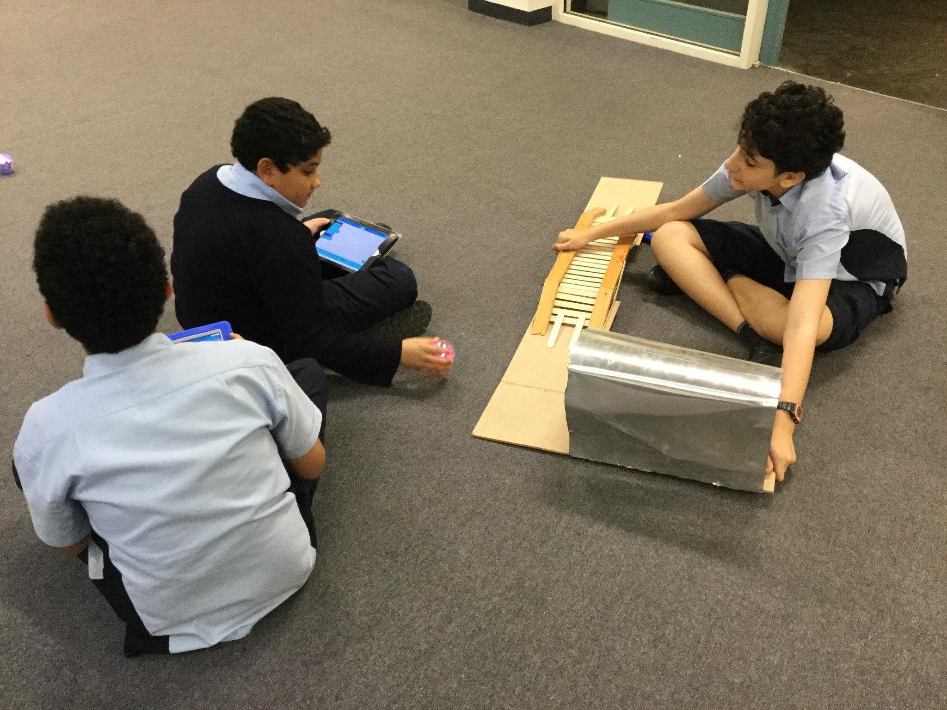
Controlling to Programming

Slide 11
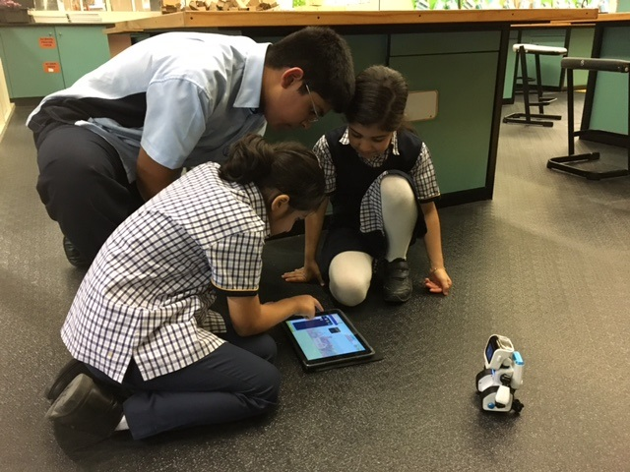
What did we learn from the Innovation Club?
You don’t have to start out with loads of kit but certainly be willing to add to it.
Encourage other staff members to help. ie Design Technology Specialists
Cross School Clubs can be effective
Allow for mistakes, learn from them
Be creative!
Have fun!

Slide 12
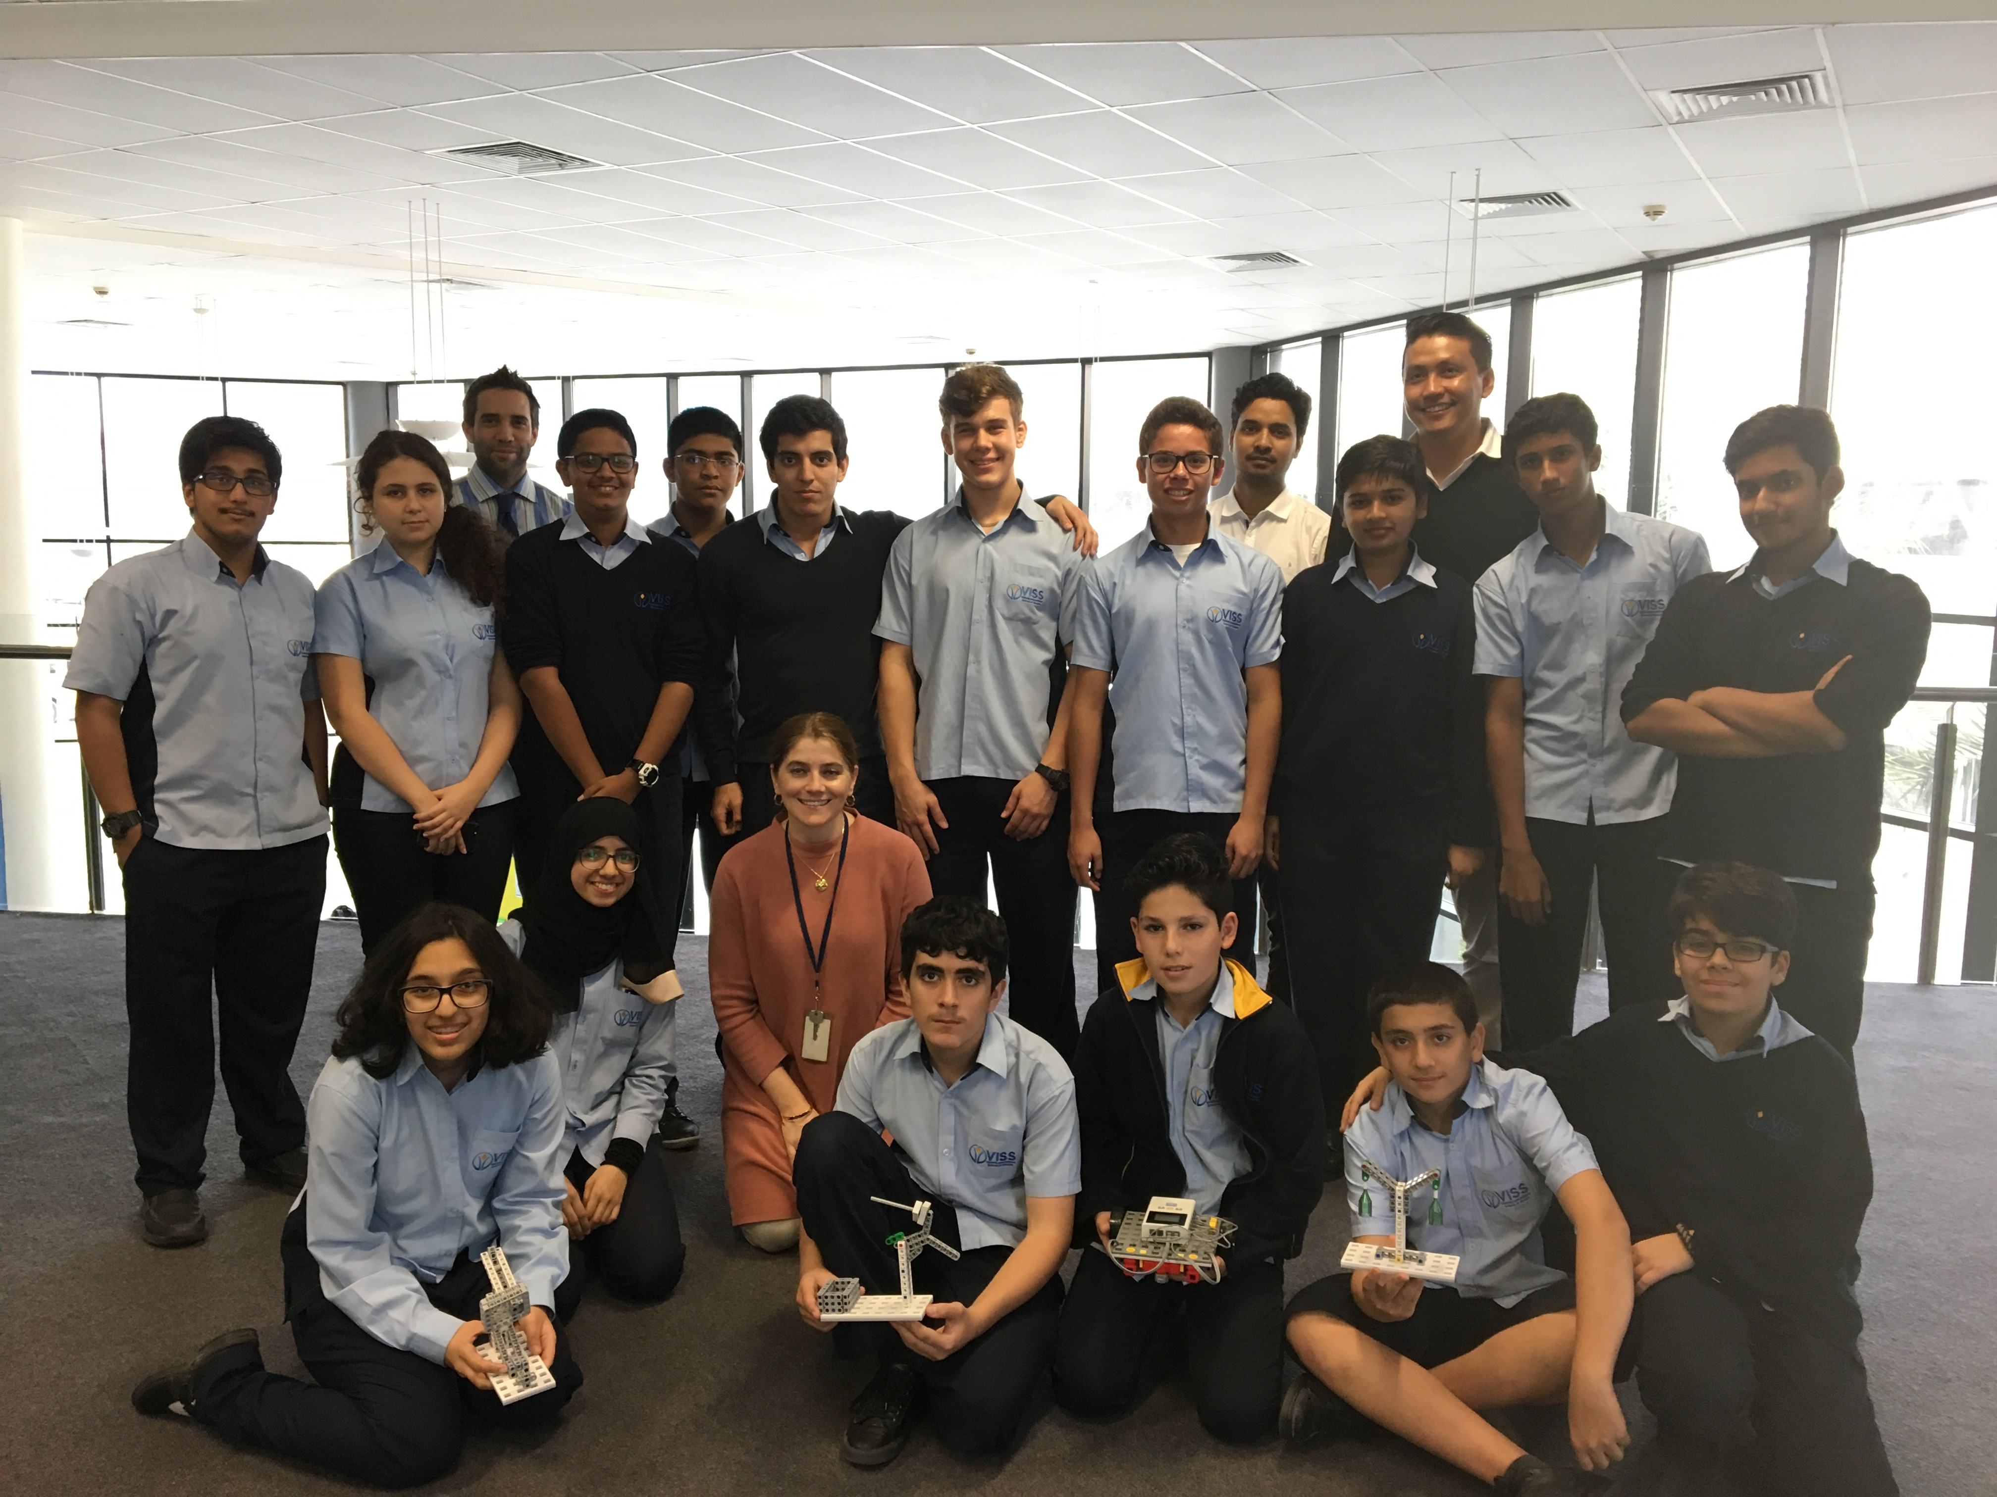
Robotics Team – World Educational Robot Contest

Slide 13
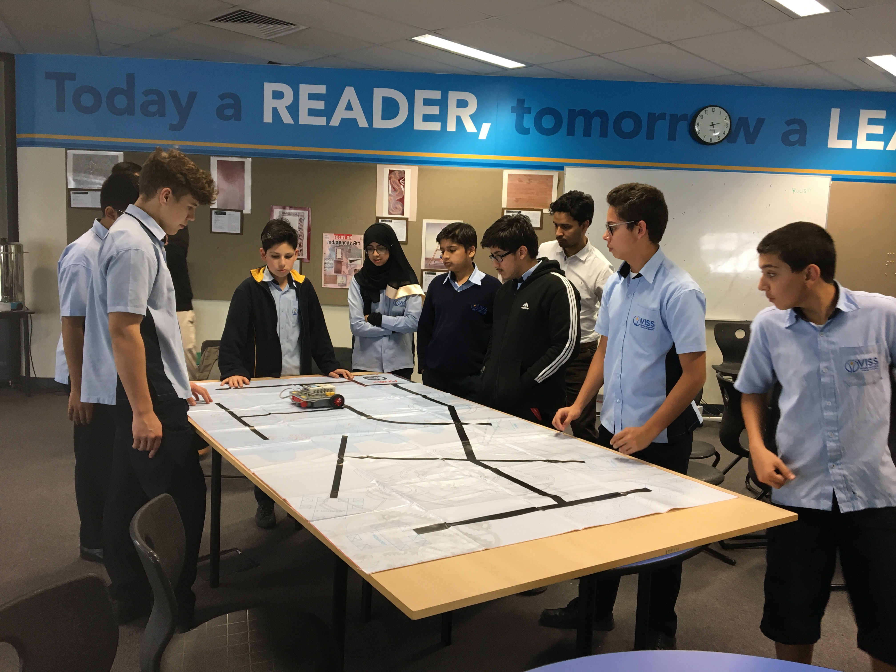
The Secret Formula
Gifted and Talented
Students academic standing in Science, Technology subjects (ICT and Design Tech) and Maths were taken into consideration
Behavior and Academic rewards
Collaboration and critical thinking
Strong coders, designers and all rounders

Slide 14
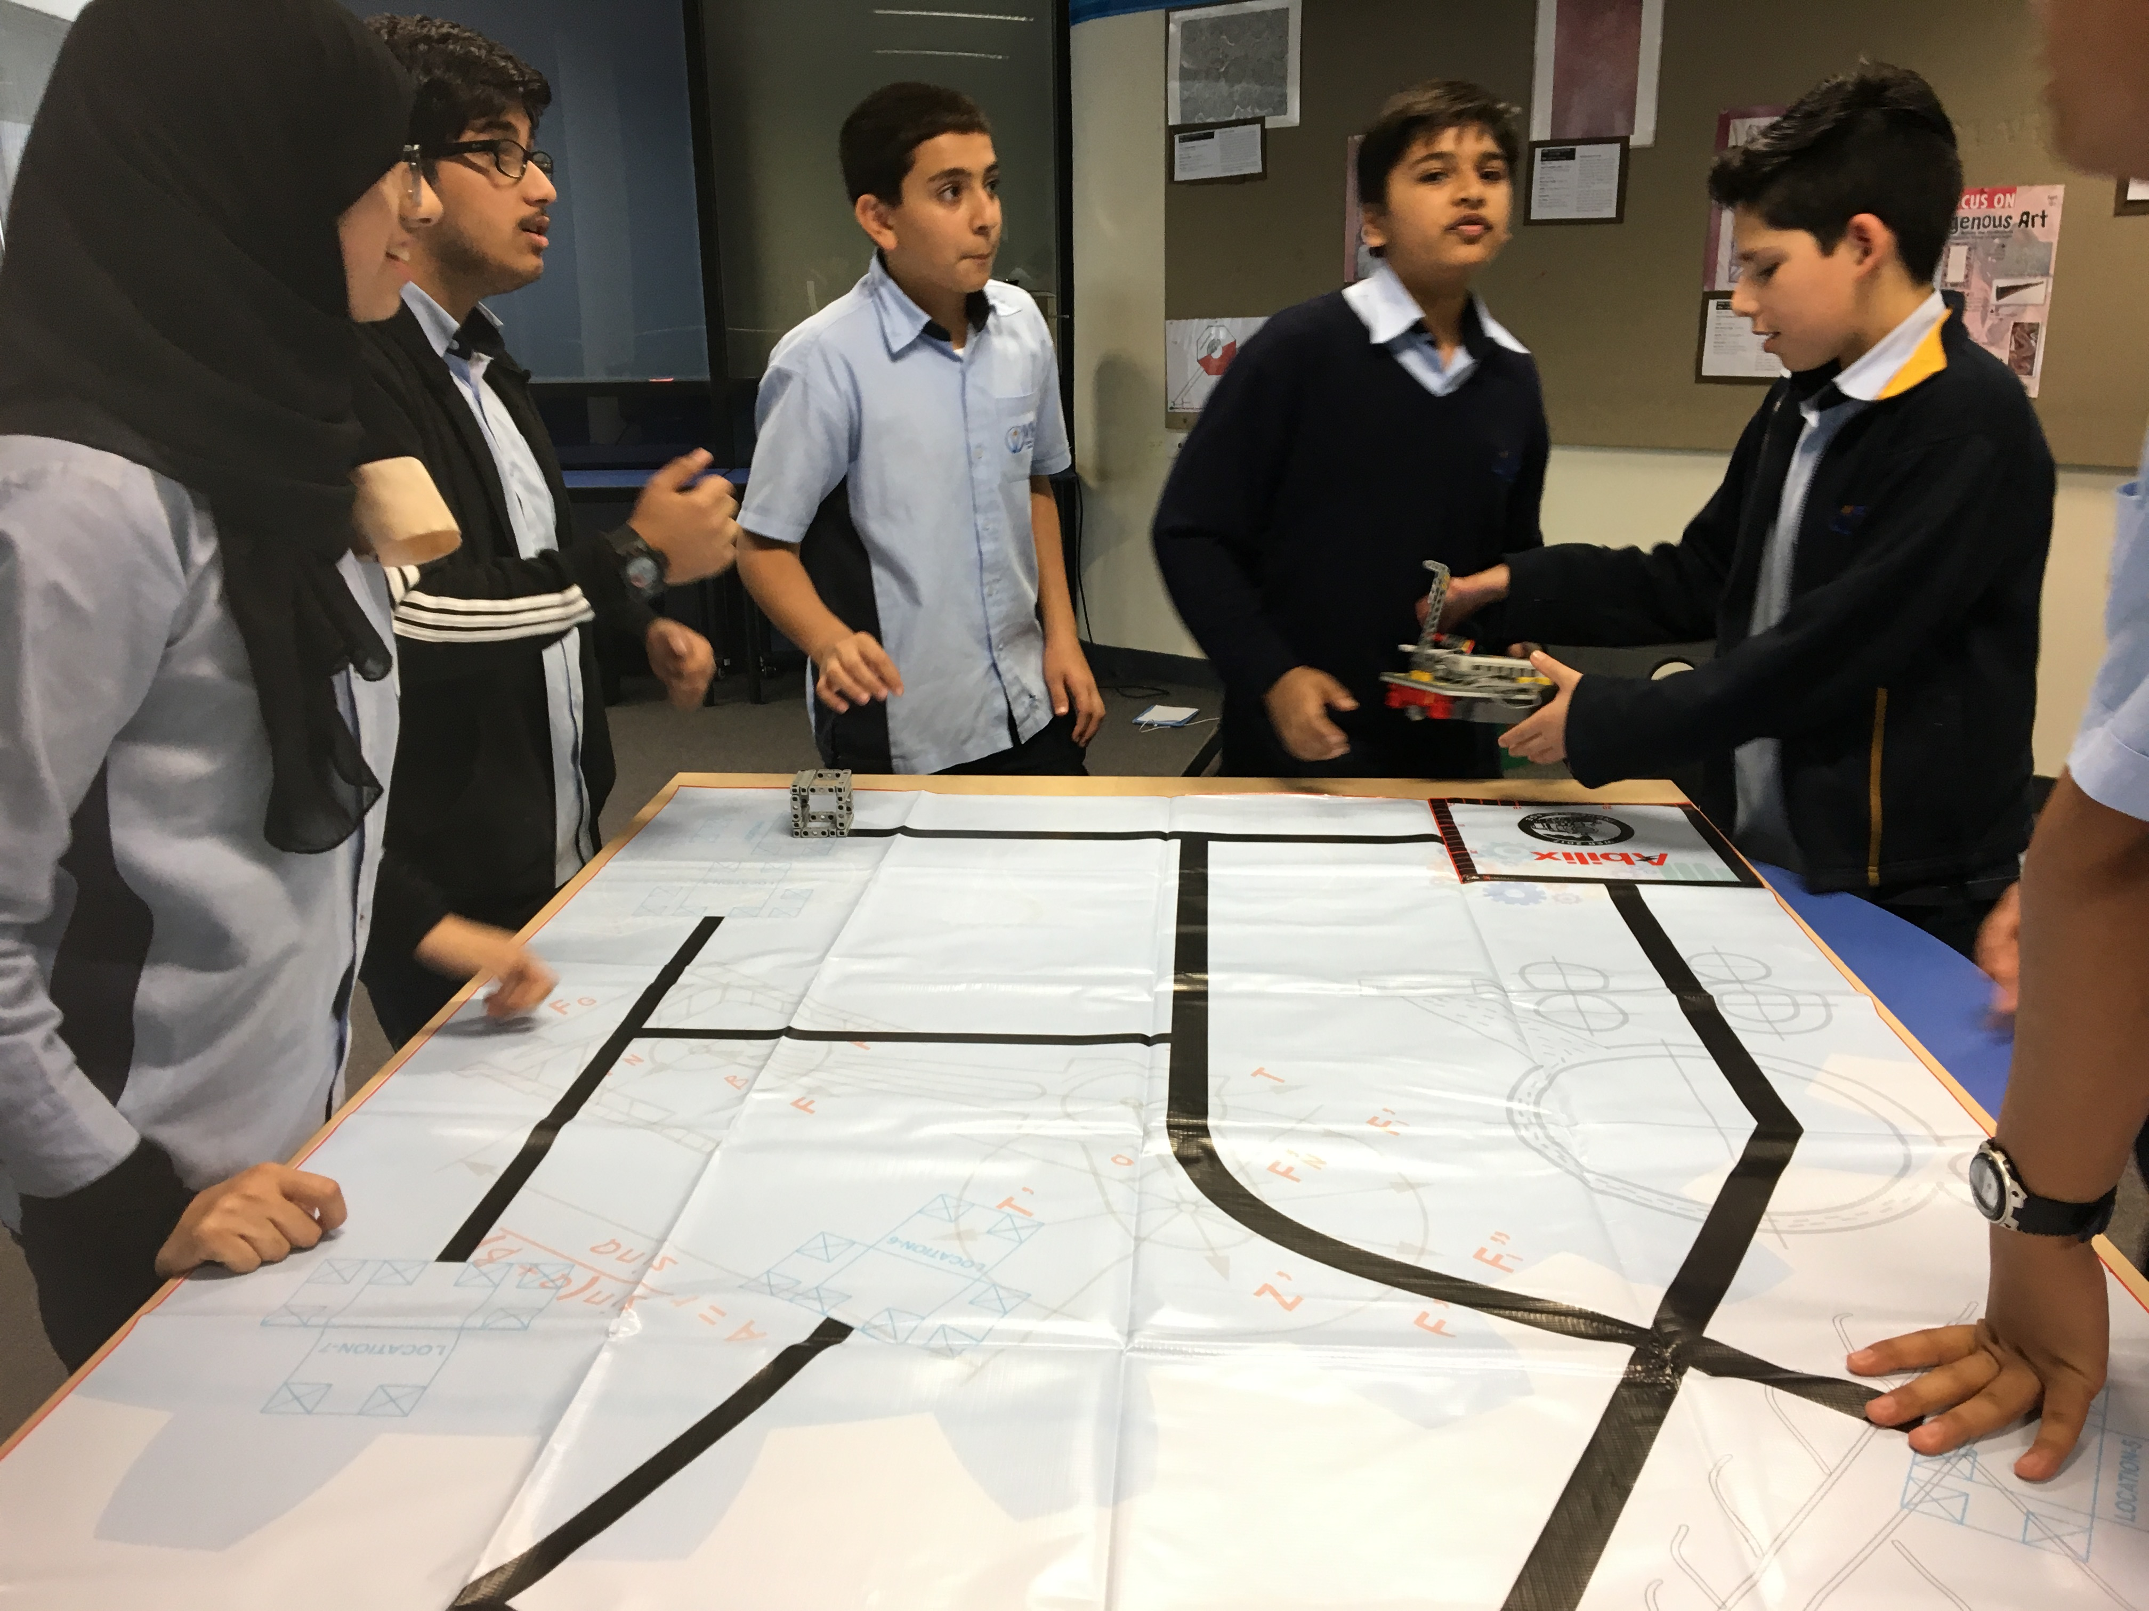
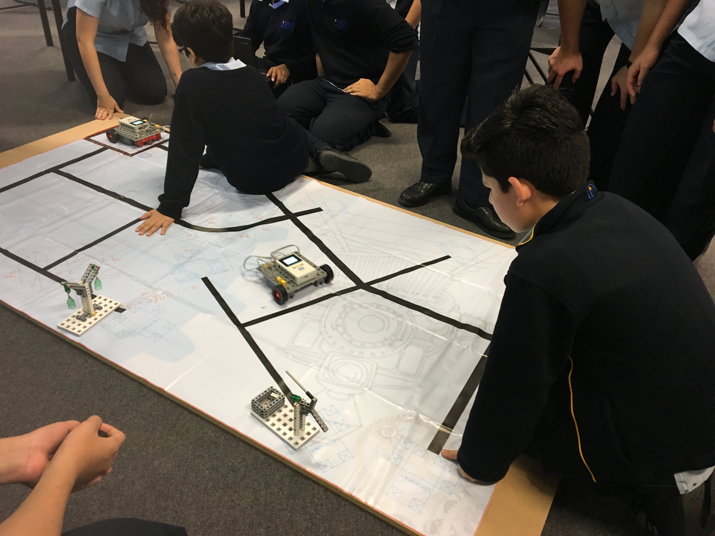
Communication/Collaboration

Slide 15
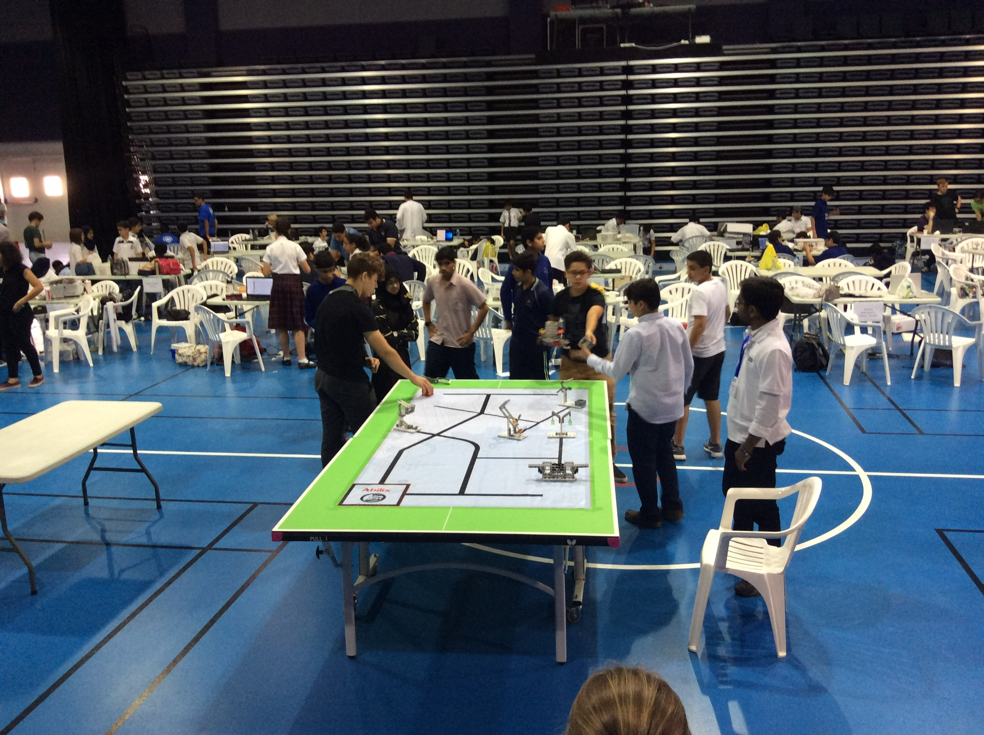
Competition Day

Slide 16
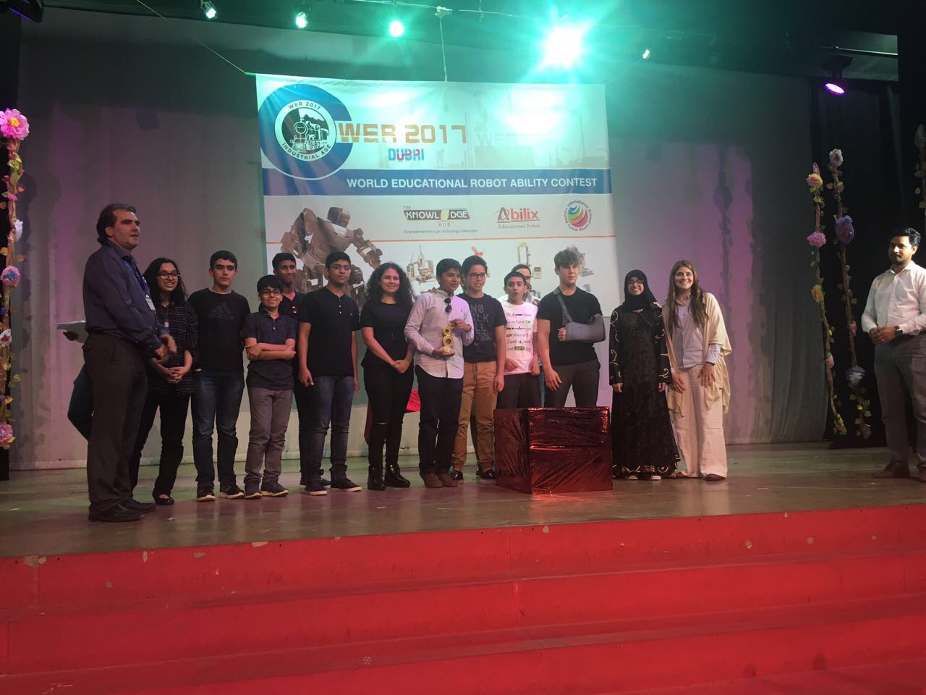
Dubai WER Champions 2017!

Slide 17
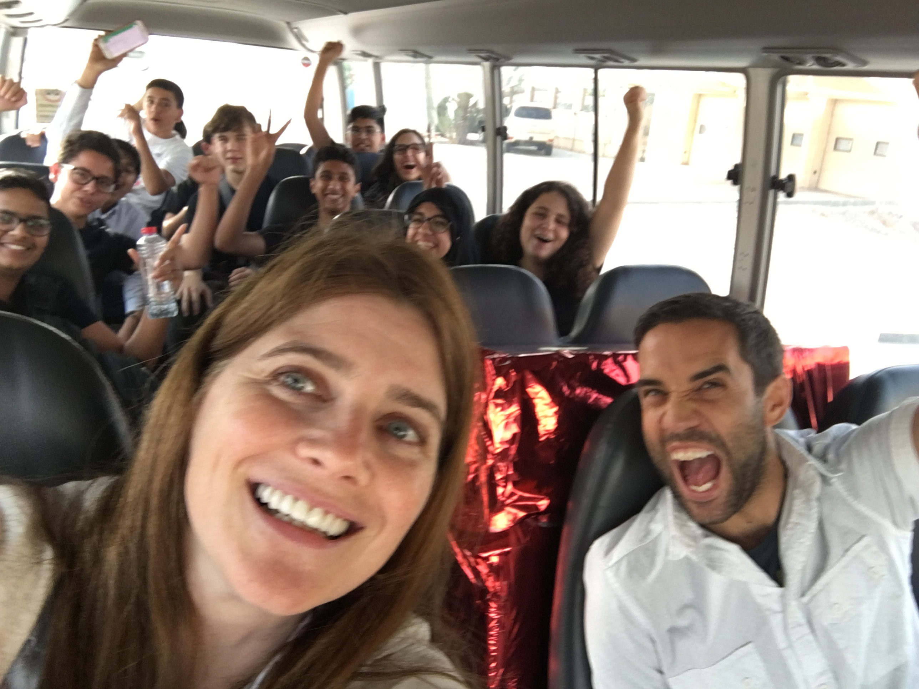
Triumphant on the way home.

Slide 18
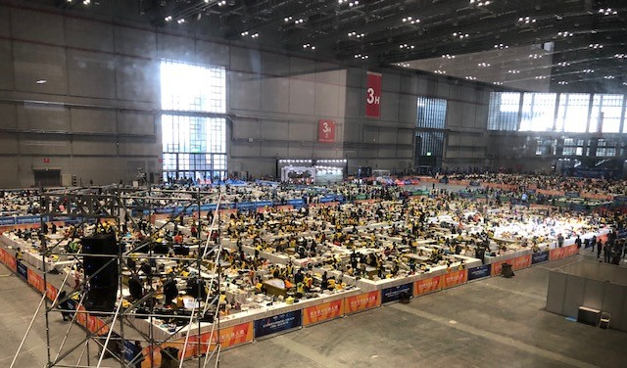
Shanghai, China WER 2017
5000 Students

Slide 19
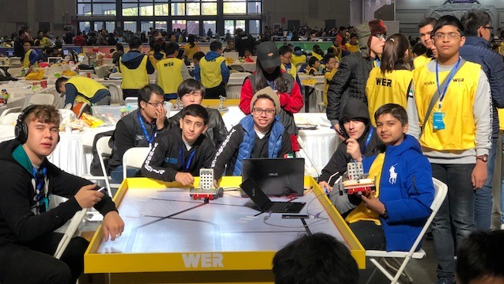
Determined

Slide 20
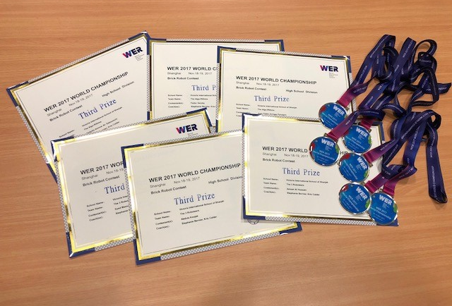
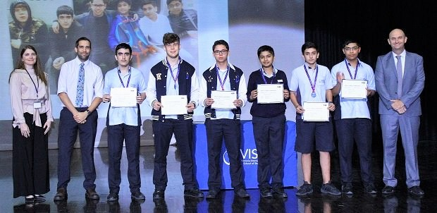
3rd Prize in Shanghai, China

Slide 21
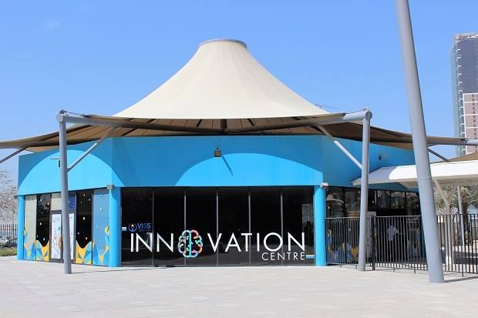

Slide 22
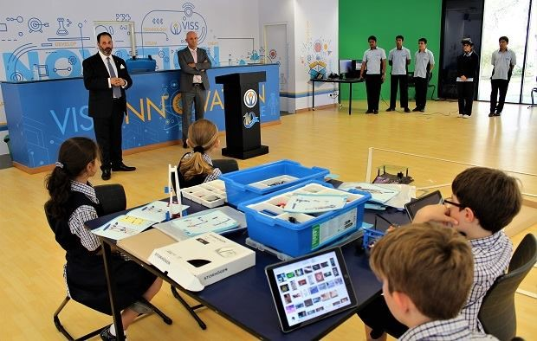
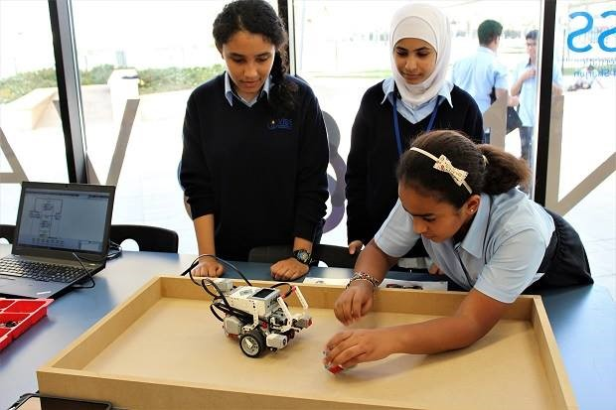
Robotics, Drones

Slide 23
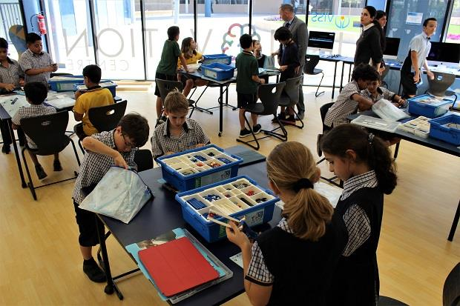
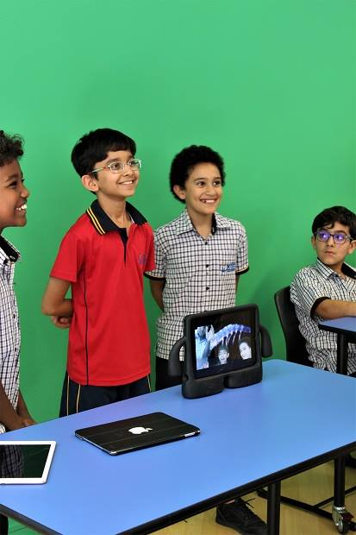
Green Screen, Lego

Slide 24
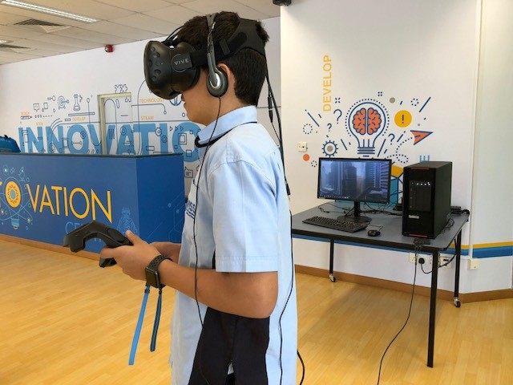
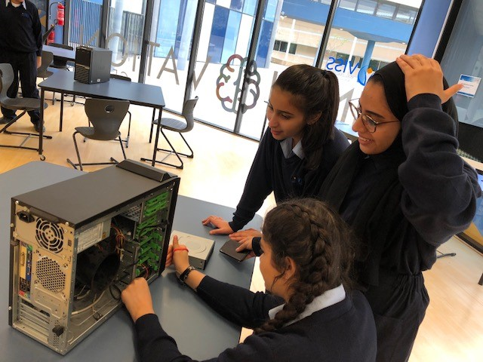
Virtual Reality and more…

Slide 25
Get Beyond the Green
Trust your staff
Make modest investments at first, see what works
Encourage collaboration
Be flexible with space allocation
FAIL – First Attempt In Learning
Go for it!! Develop perseverance, determination and grit!

Slide 26
Thank–you!
Stephanie Bernier - bernier.stephanie@viss.ae
Twitter Handle: @steph_bernier01

